Slide 1
Europe Code Week
#codeEU

Slide 2
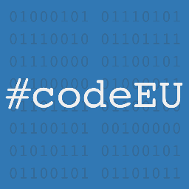
We want to connect individuals, groups and organizations who are able to help more people experience the joy of coding with people willing to learn.
Do you want to join?

Slide 3
Why coding?
Why
What
When
Who
Me? You!
Coding is becoming a key skill for professionals in every field
ICT professionals, researchers, designers…
Basic ICT skills enable the creation of small business
Today there is already a shortage of ICT professionals in Europe
By 2015, we will be missing 900.000 ICT professionals
These positions could be filled by Europeans currently unemployed
The future economy of Europe passes by a strong focus on technology and startups

Slide 4
What do we plan?
Why
What
When
Who
Me? You!
Dedicate 1 week to raise awareness and generate attention at European level
European Parliament
Facebook, Twitter
Media in countries member
Organize coding-related events and workshops in the different member countries
Whenever possible sharing a common objective
Collaborate among different existing initiatives and groups, and share best practices
Website, Facebook page
Open to other suggestions

Slide 5
When we plan to do it?
Why
What
When
Who
Me? You!
This year we will run the first edition of what we expect becomes a new tradition
It will take place across all EU countries, from November 25th to 30th

Slide 6
Who is behind this?
Why
What
When
Who
Me? You!
The initiative has been launched by Neelie Kroes' Young Advisors with the support of DG Connect at the European Commission
… but it is people like you who really make it work with your support!

Slide 7
And what can I do?
We need your support to organize the events of the week!
As we rely on already existing organizations, we would like to ask you to:
Organize your event during Europe Code Week. Even if it in not purely coding-related we will be happy to talk about it!
Contact your local ambassador and register your event in our map
Share your best practices on our Facebook page
Bring your own ideas!
Why
What
When
Who
Me? You!

Slide 8
Contact
For more information or collaboration, you can find us in:
Europecodes@gmail.com
http://codeweek.eu/
https://twitter.com/CodeWeekEU
https://www.facebook.com/pages/Europe-Code-Week/377506999042215
You can find your local ambassador in http://codeweek.eu/learn/

