Slide 1
Employee Data Analysis using Excel
STUDENT NAME: STEVEN OSCAR DICKSON
REGISTER NO: 312207130
DEPARTMENT: B.COM
COLLEGE: A M JAIN COLLEGE

Slide 2
PROJECT TITLE
Employee Performance Analysis using Excel

Slide 3


AGENDA
Problem Statement
Project Overview
End Users
Our Solution and Proposition
Dataset Description
Modelling Approach
Results and Discussion
Conclusion
3/21/2024 Annual Review

Slide 4

PROBLEM STATEMENT
To perform an analysis of the employee performance by using excel for data analysis and visualisation

Slide 5

PROJECT OVERVIEW
Define objectives: Understand what we want to achieve with the data analysis.
Prepare the data
Clean and filter data : Collect, clean and organise the data by removing duplicates and null values
Analyse the data : Using various excel formulas
Visualise the data : Using charts and pivot tables

Slide 6

WHO ARE THE END USERS?
Employee performance analysis serves a variety of end users within an organization. Human Resources (HR) utilizes this data to manage talent, develop training programs, and make decisions on promotions and compensations. Managers and supervisors rely on performance analysis to evaluate their team’s effectiveness, provide feedback, and support employee development. Executives and senior leadership use aggregated performance data to assess organizational effectiveness and guide strategic decisions. Employees review their own performance to understand their strengths, identify areas for improvement, and set personal development goals. Training and development teams design targeted programs based on performance insights, while compensation and benefits teams use the data to make informed decisions about salary adjustments and bonuses. Organizational development consultants analyze performance to recommend improvements in structures, processes, or culture. Lastly, recruitment and talent acquisition teams apply performance insights to refine recruitment strategies and enhance candidate selection. Each user leverages performance analysis to meet specific needs and contribute to the organization's overall success.

Slide 7

OUR SOLUTION AND ITS VALUE PROPOSITION
Performs a comprehensive Employee performance evaluation by taking into account a number of parameters and therefore is helpful as it leverages performance analysis to meet specific needs and contribute to the organization's overall success.

Slide 8
Dataset Description
This dataset was obtained from Kaggle under the title of Employee Dataset(All in one)
It is a Synthetic Employee Records Dataset simulated and created to explore various data analysis and machine learning techniques in the context of human resources and employee management. This synthetic dataset mirrors the structure and characteristics of real employee data, while all the information contained within is entirely fictional and generated for illustrative purposes.

Slide 9

THE "WOW" IN OUR SOLUTION
Usage of the excel formula IFS() to calculate the performance and DATEDIF() to determine the employee age
Formulae used:
=IFS(Z8>=5,"VERY HIGH",Z8>=4,"HIGH",Z8>=3,"MED",TRUE,"LOW")
=DATEDIF(R8,TODAY(),"y")
3/21/2024 Annual Review
9

Slide 10
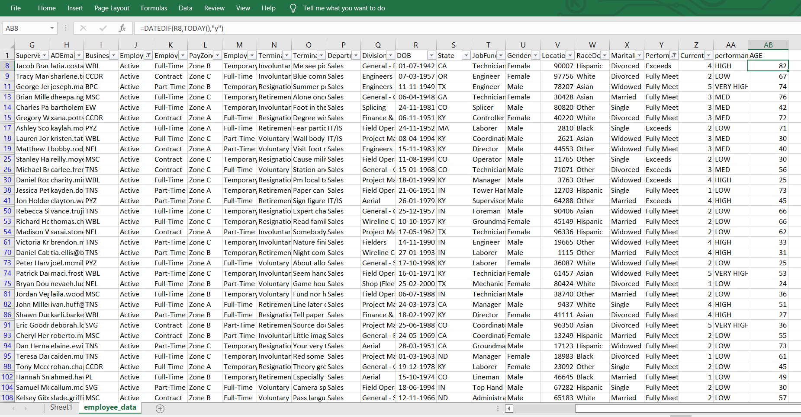
MODELLING
First, we removed all the rows containing null values from or dataset as this cannot be used in the analysis. We did this by using the filter and sort function in excel
10

Slide 11
Secondly, We determined which columns would be beneficial to our analysis. We also computed the performance evaluation and age columns by using =IFS(Z8>=5,"VERY HIGH",Z8>=4,"HIGH",Z8>=3,"MED",TRUE,"LOW")
and =DATEDIF(R8,TODAY(),"y") respectively. We also cleaned the data by selecting only the employees whose status was “Active”
We then used a pivot table to determine the employees with a “High” performance evaluation and whose performance score was “exceeds” and visualised this using a graph

Slide 12
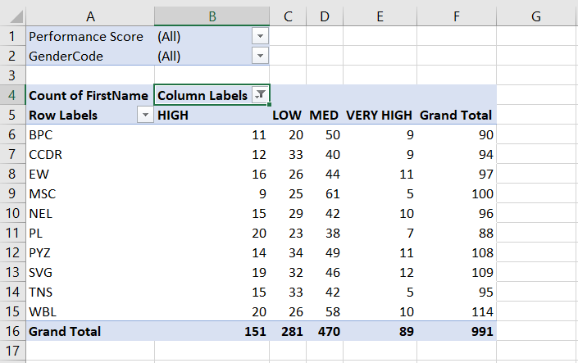
RESULTS
12

Slide 13
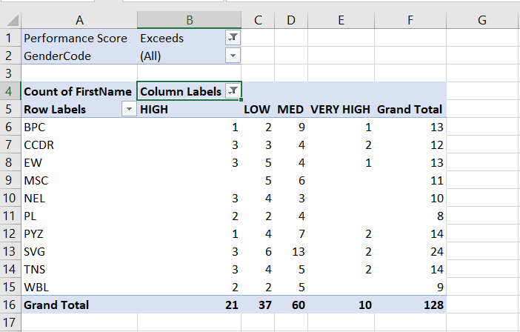
RESULTS
13

Slide 14
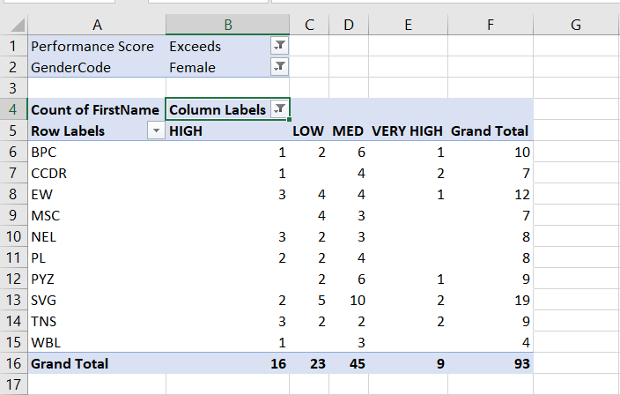
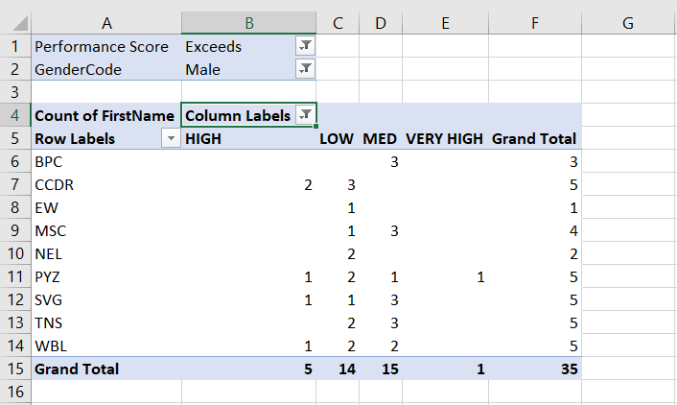
RESULTS
14

Slide 15
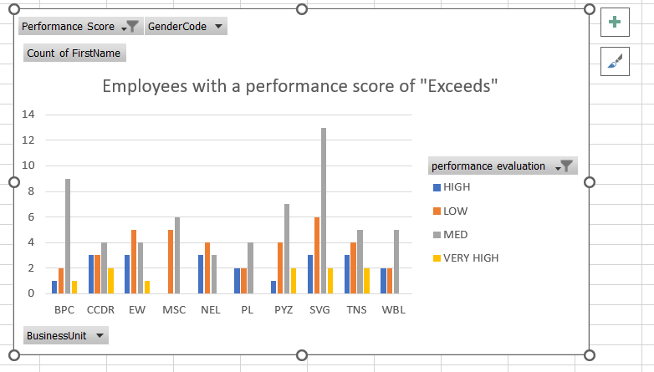
Data visualised

Slide 16
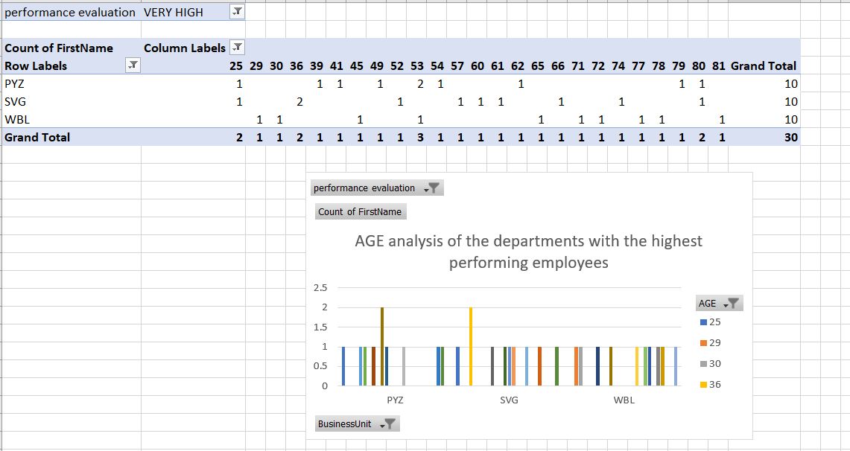
Performance evaluation by age and department

Slide 17
conclusion
Thus, we were able to perform an analysis of the performance of employees by age, gender and department. We were also able to visualise this using various charts

