Slide 1
Reddit Sentiment Analysis and Financial Market Correlations
Exploring NLP-driven signals for financial prediction
Presenters: Group 6
Janhi Ong, Shailyshreyee Tagore, Sukriti Dhungel,
Steven Nguyen, Vincent So
Notes:
Vincent:
"Hello everyone, we will be presenting our work on Reddit Sentiment Analysis and Financial Market Correlations. This project explores how NLP-derived signals can be leveraged for financial prediction, testing whether textual sentiment can anticipate or explain movements in the market."

Slide 2


Content Map
1. Introduction & Motivation
2. Data Collection & Processing
3. Sentiment Analysis Pipeline
4. Machine Learning Models
5. Results & Discussion
6. Conclusions & Future Work
Notes:
Vincent:
"Here, we lay out the roadmap of our project. We start with the motivation behind our work of using Reddit sentiment for financial prediction. Then explaining how we collected and processed the various collected data. After that, we go through our sentiment analysis pipeline and the machine learning models we applied. We will then share our results and discuss our key findings, to then wrap up with our conclusion and future direction."

Slide 3
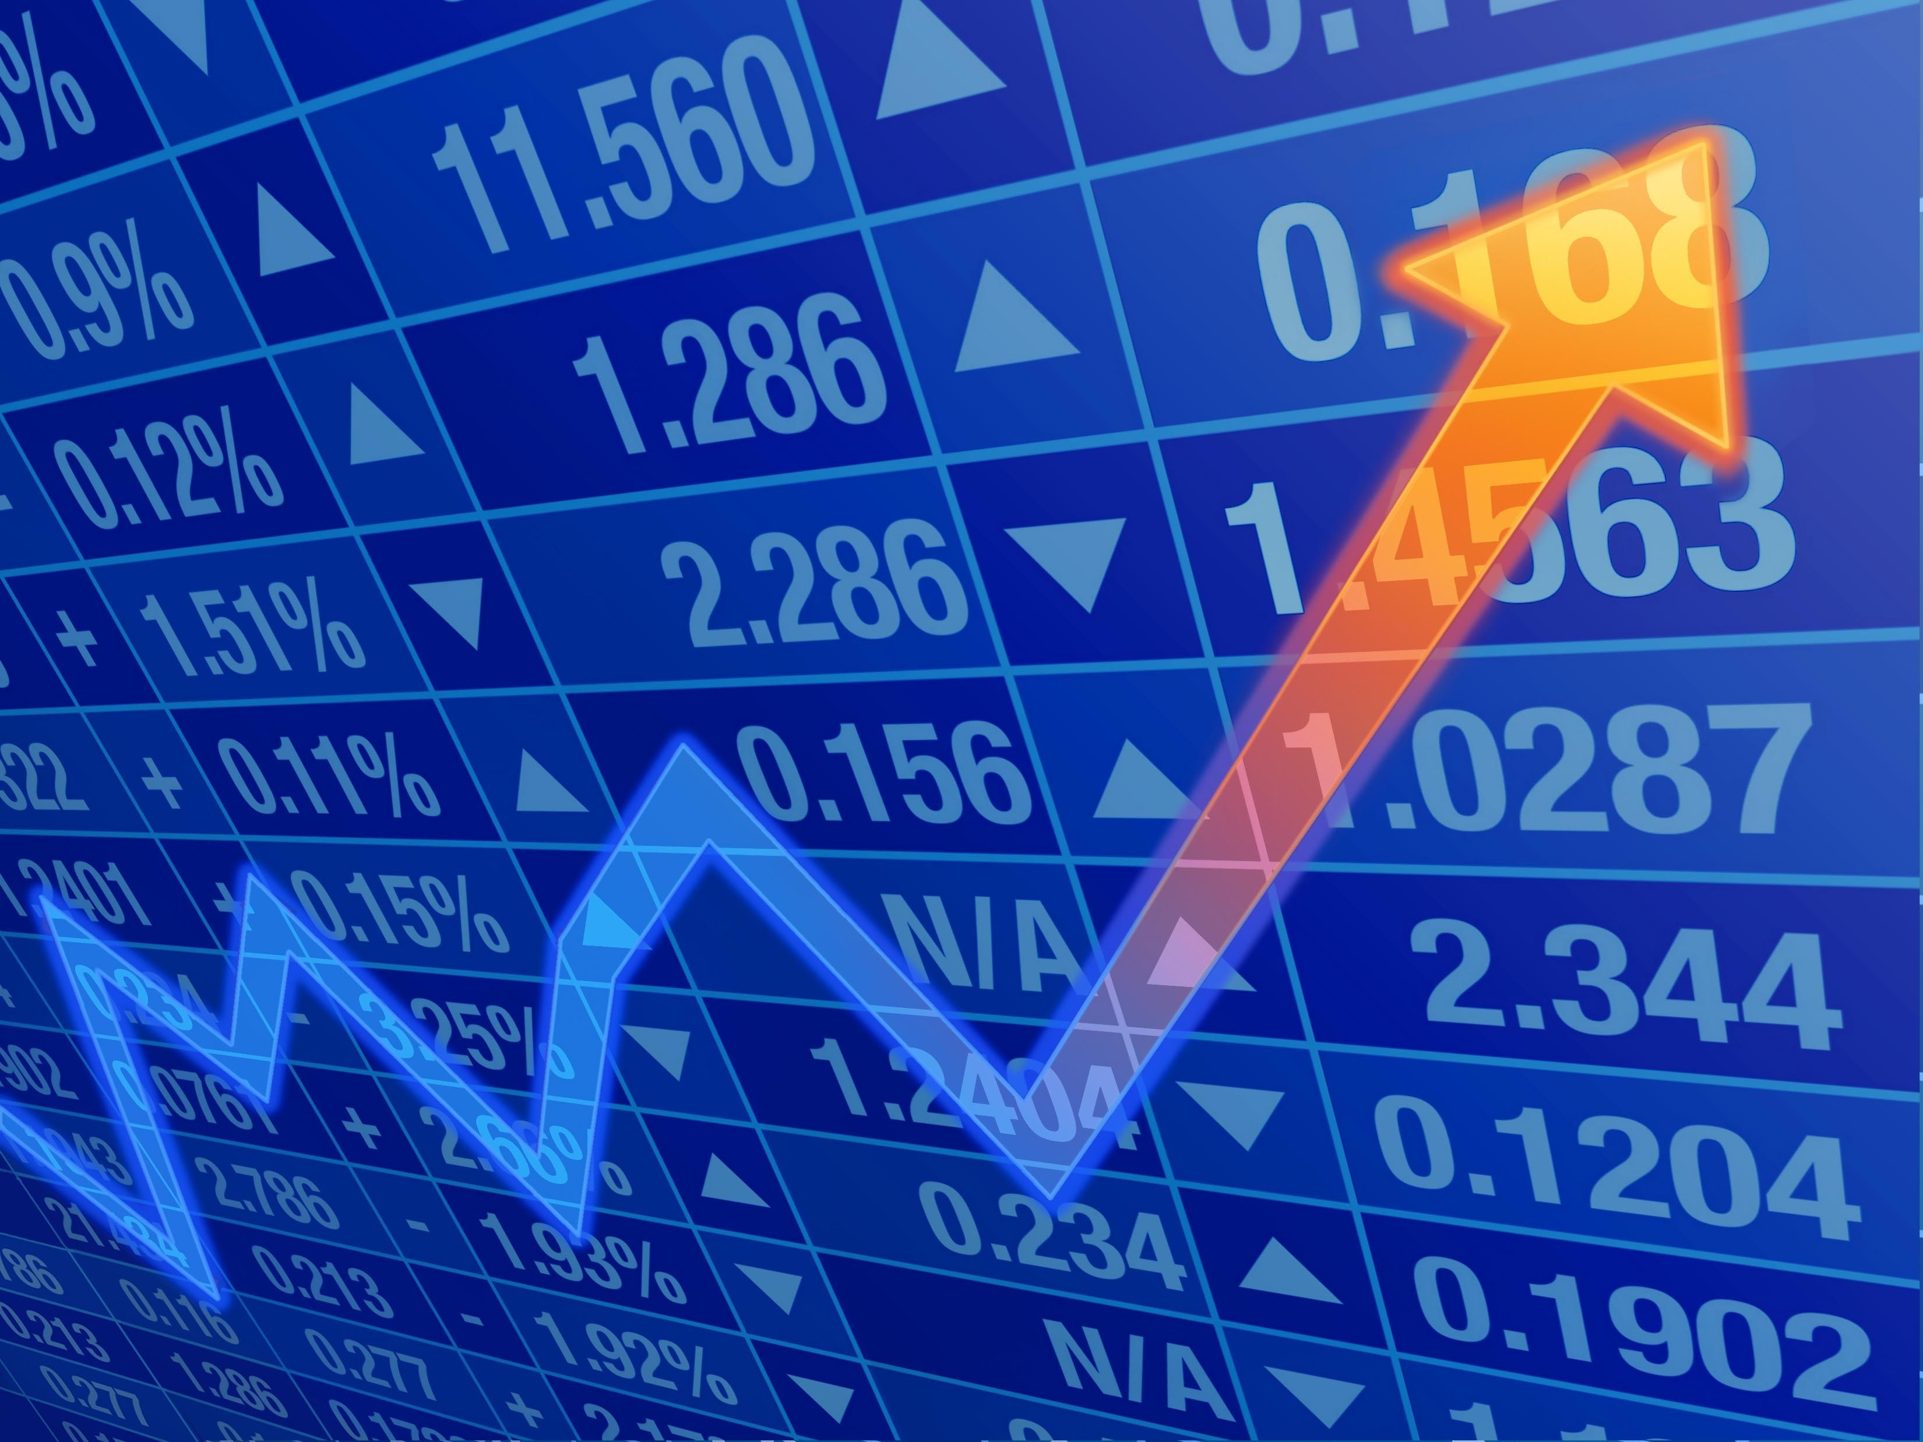
Introduction and Motivation
Core Problem
Our aim was to quantitatively analyze the relationship between Reddit discourse and subsequent market behavior. By leveraging NLP on post data and ML models, we attempted to determine if shifts in online sentiment and discussion themes correlate with, or even predict, changes in stock price and trading volume.
Real-World Impact:
Traders can identify potential early signals for momentum or volatility trades.
Regulators are offered a framework to monitor forums for signs of coordinated manipulation or systemic risk.

Slide 4
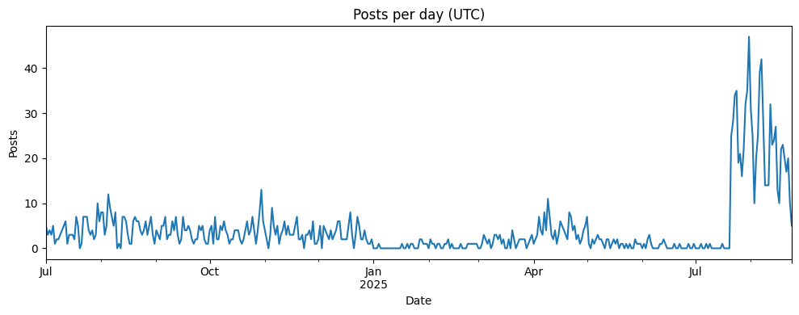
Reddit Post Data Collection
Collected real-time stock posts from 4 subreddits (July 2024-current)
  r/stocks, r/wallstreetbets, r/superstonk, & r/investing
Recent, yearly top, and all-time top posts
Limitations:
  Skew toward recent posts, fewer older ones
  Data does not automatically update with recent posts/changes unless rerun notebook
Notes:
Data Collection (Steven)
We collected real-time discussion posts from 4 stock-related subreddits covering the period between July 1, 2024 to the present. These subreddits include stocks, Wall Street Bets, Superstonk, and investing.
For each post, we captured basic info, such as the title, body text, scores, number of comments, creation time, and source of where it's retrieved.
We build the data collection process by first defining each subreddit and the time window, then collected posts under 3 conditions: recent posts with high engagement, older posts that are historically popular, and newest posts that are up to date
After collecting the data, we cleaned the data by removing duplicates, sorting by date, and labeling each post by the source they came from, whether it came from the most recent feed, the top posts of the year, or all-time top posts.
However, there are some limitations of this data collection approach.
Because Reddit is built to surface what’s new and popular right now, it is designed to be naturally biased toward recent posts, therefore, retrieving older posts is more difficult, leading to a skewed distribution toward newer posts.
Additionally, the data is static, meaning new posts or edits to existing posts are not automatically reflected unless the data collection script reruns.

Slide 5
Financial Data Collection
Built a daily date x ticker panel to compare subreddit mentions with market performance
Utilized yfinance package to download Adjusted Close prices for all tickers mentioned
Compute daily return, cumulative growth of $1, and excess return vs. SPY
Exports three files:
To be rejoined with Reddit data table
Adj_close_*.csv
(wide daily prices)
Features_long_*.csv (date, ticker,
and features)
Summary_*.csv
(period return and outperformance vs. SPY)
Notes:
Data Collection (Vincent):
"With that, we then built the market data pipeline to later merge with the Reddit dataset, which helps us to answer 'When Reddit talked abt a ticker, did that ticker outperform the market on those days'. We created a daily data x ticker panel using yfinance to fetch prices from Yahoo Finance and pandas and NumPy to clean and compute features.
We pulled Adjusted Close for every valid ticker mentioned on the subreddit from July 1st of 2024 to July 31st of this year. We use Adjusted Close specifically as it accounts for splits and dividends, so our performance reflects a more total-return view. We aligned averything to US business days and forward-filled so all tickers share the same calendar, then we dropped symbols with no data or delisted names.
From these prices, we computed three simple metrics: 1) Daily return, or how much each stock mobed each day which lines up directly with daily Reddit activity; 2) cumulartive growth of $1, or how the value evolved over the whole window; and 3) excess return vs. SPY, which is the stock's daily return minues the S&P 500 ETF's return
The SPY ETF is designed to track the S&P 500 index by holding a portfolio comprising all 500 companies on the index.
We exported three files: 1) a wide Adjusted Close table for quick price lookups; 2) a long "features" table incorpoprating the three simple metrics; 3) and a summary table showing each ticker's total period return and its outperformance versus SPY. All lining up with the Reddit posts by company and date.
We merged this clean market panel with the Reddit dataset by company and date. The row count then dropped from 6,400 rows to 1,700 as only a portion of the Reddit data contained valid stock tickers.”

Slide 6
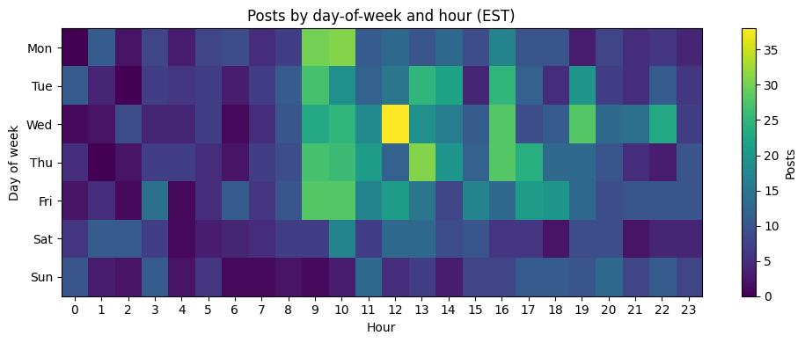
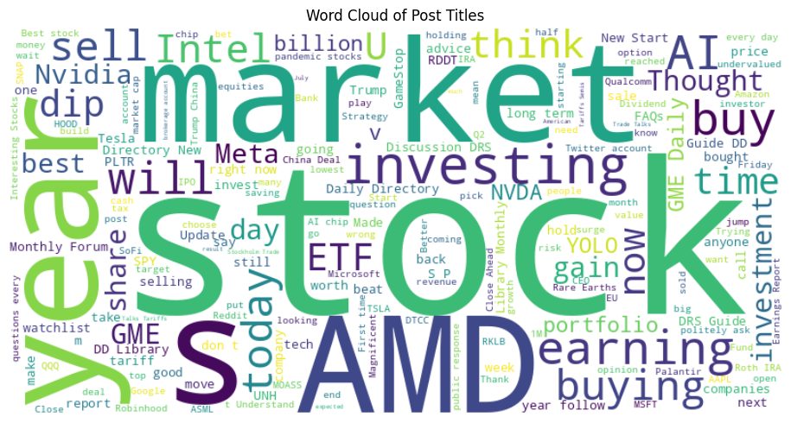
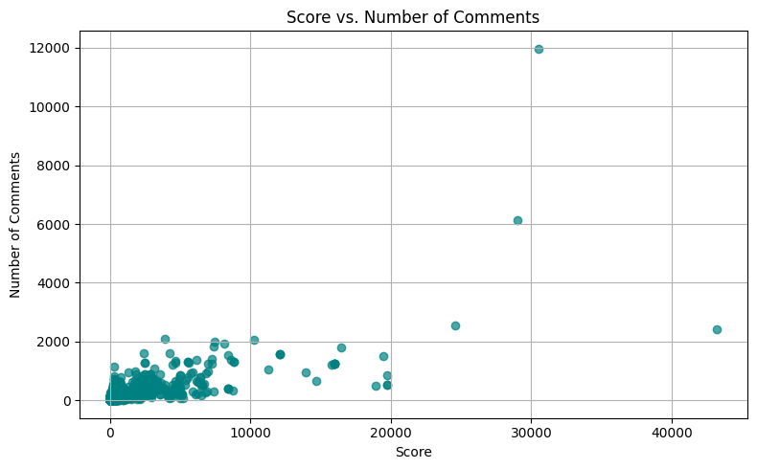
Exploratory Data Analysis
# of Reddit DataFrame Rows: 6452
# of DataFrame After Reddit & YFinance Merge Rows: 1,752
Notes:
Steven
After merging the Reddit and Yahoo Finance data, we did exploratory data analysis on the merged data where all records are aligned with stock market and trading discussions, and we found some significant findings.
Firstly, in the heatmap, it shows that most stock-related posts created are concentrated on weekdays roughly between 9am to 7pm, peaking around late morning and early afternoon.
This roughly overlaps with U.S. market hours, which are specific times of the day that stock exchanges are open for trading.
One notable hotspot happens on Wednesdays at noon where number of posts are at its highest, suggesting mid-week market news and activity drive higher posting volume.
Secondly, in the word cloud, some frequent terms in these posts include "market,” “stock,” “year,” "AMD", “investing,” “earnings,” and “buy", which is expected for stock-related posts.
One term that stands out is "AMD" which represents a stock from a US-based semiconductor company called Advanced Micro Devices, Inc., which designs and sell CPUs and graphics cards (GPUs) used in PCs and gaming consoles.
Its frequent appearance highlights AMD as one of the most actively discussed tickers in the dataset.
Lastly, we see most posts cluster below 10,000 scores and 1,000 comments. There are a few outliers that go beyond 40,000 scores and 12,000 comments, showing there are a few viral posts for certain topics Reddit users find the most engagement in.
But overall, this trend shows how typically active these stock-related discussions are.

Slide 7
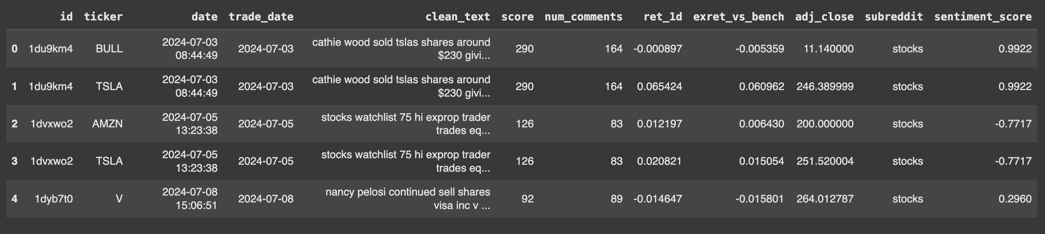
Experimental Results
Model 1: Vader Sentiment Analysis:
Analyzed cleaned post text, generating sentiment scores
Calculated daily average sentiment score for each stock
Notes:
“Using this data, we wanna test whether subreddit posts related to stocks helps predict short-term stock returns. So our initial hypothesis is that when the post says the price can go up, the next-day returns increase, otherwise when the post said it goes down, they fall. So for our datasets, we have some features from Reddit like id, tickers, clean_text, etc, and features for our Market: ret_1d (daily return). I compare three sentiment engines: VADER (great for social/emoji), ProsusAI/FinBERT, and FinBERT-tone (both finance-tuned transformers).
“Our dataset combines Reddit and market fields. From Reddit: id, ticker, clean_text, score, num_comments, subreddit, and timestamps. From the market side: ret_1d (daily return), adj_close, and exret_vs_bench.
Pipeline: 1) clean text and extract tickers, 2) score each post with a sentiment model, 3) aggregate to (ticker, date) to get a daily signal per stock, 4) align to next-day returns for evaluation.”

Slide 8
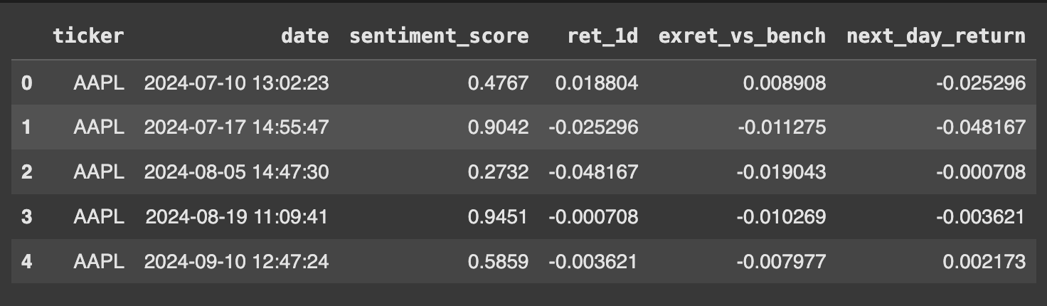
Experimental Results
Group by ticker and date
Notes:
“VADER is fast and good at social/emoji language. “VADER gives a compound score from −1 to +1 per post. We average those at the (ticker, date) get one sentiment per stock per day. The table shows examples—cleaned text in the middle and the per-post VADER score on the right. Then I roll those up to daily sentiment per stock.”

Slide 9
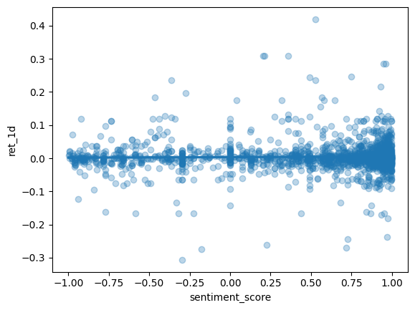
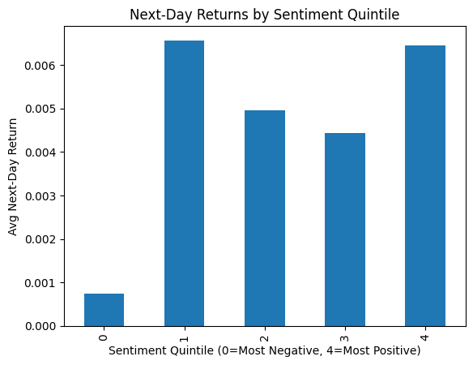
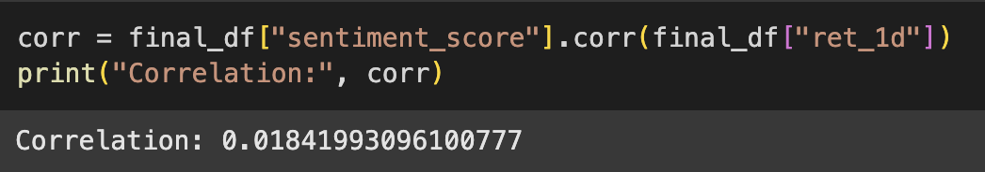
Experimental Results
Notes:
“Here are VADER’s outcomes.
• The scatter of sentiment vs. next-day return looks almost flat—Pearson correlation is about 0.018 (very weak linear link).
• I then binned sentiment into quintiles. There isn’t a strong monotonic pattern; some buckets show small positive averages. Overall: no strong linear effect from VADER.

Slide 10
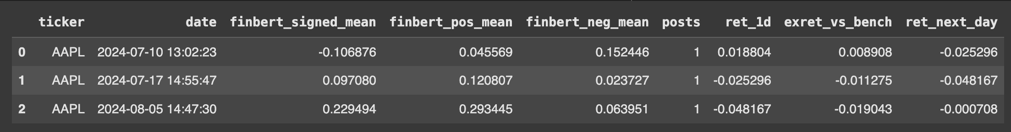
Experimented Results
Model 2: ProsusAI/FinBERT:
Analyzed cleaned post text, generating sentiment probabilities
Calculated daily average "Signed Sentiment" score for each stock
Computed correlation between daily sentiment and the following day stock
Correlation: 0.0615 (Very weak positive linear relation)
Notes:
“FinBERT is trained on financial text, so it understands phrases like ‘missed guidance’ or ‘EPS beat’. It returns probabilities for positive/neutral/negative. I convert those to a single signed score = P(pos) − P(neg) and average by (ticker, date).
When I correlate that daily score with next-day returns, I get about 0.0615—still weak, but slightly stronger than VADER.”

Slide 11
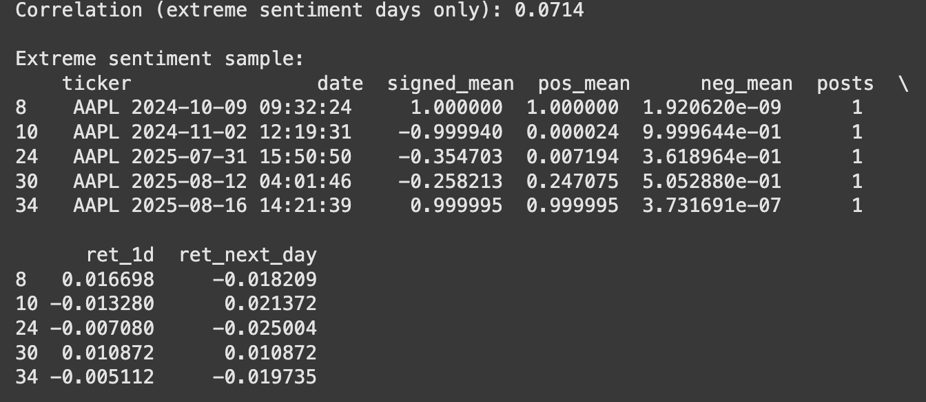
Experimented Results
Model 3: FinBERT-tone with extreme sentiment only
Computed daily average sentiment for each stock
Calculated correlation between this extreme sentiment and the next day's stock return
Correlation: 0.0714
Notes:
“I also tried FinBERT-tone and focused on extreme sentiment days—where the model is very confident. The idea is: if sentiment matters, it should matter most when it’s extreme. On that filtered subset, correlation with next-day returns rises to about 0.0714—still small, but it’s the strongest of the three.”
These r values—~0.02 to ~0.07—mean the linear relation between sentiment and next-day returns is weak. That’s normal in short-horizon finance.

Slide 12
Methodology (Cont.)
Test 1: Logistic Regression (Next-Day Prediction)
Goal: Baseline test - can sentiment alone predict if stock goes up/down tomorrow?
Features: Sentiment score + sentiment quintiles
Why: Simple, interpretable starting point
Test 2: Random Forest (3-Day Smoothed Returns)
Goal: Reduce daily noise by predicting smoothed 3-day forward returns
Features: Added market data (current return, excess return, engagement metrics)
Why: Daily returns are noisy - maybe sentiment works over longer periods
Test 3: XGBoost (5-Day Cumulative Returns)
Goal: Full feature engineering + hyperparameter optimization
Features: Lagged returns, rolling averages, volatility measures + sentiment
Why: Test if sophisticated ML can extract predictive signal
Notes:
For Test 1, we started simple with logistic regression to predict next-day direction using just sentiment scores and quintiles. This gave us a baseline — easy to interpret and see if sentiment alone has any predictive power.
In Test 2, we moved to a random forest predicting 3-day smoothed returns. The idea was to reduce daily noise, and we added market features like current and excess returns and engagement metrics. This helped capture sentiment effects that unfold over a slightly longer horizon.
Finally, Test 3 used XGBoost with 5-day cumulative returns. Here we incorporated full feature engineering: lagged returns, rolling averages, volatility measures, and sentiment, plus hyperparameter tuning. This tested whether a more sophisticated ML approach could extract a meaningful predictive signal from the combined data.
Across these tests, we could see how performance improved as we expanded the features and horizon, showing that both feature engineering and longer-term trends are important for capturing any predictive power in sentiment.

Slide 13
Experimental Results (Cont.)
Model | F1-score (class 0) | F1-score (class 1) | Macro F1 | Weighted F1
Logistic Regression | 0.50 | 0.48 | 0.49 | 0.49
Random Forest | 0.58 | 0.54 | 0.56 | 0.56
XGBoost | 0.56 | 0.70 | 0.63 | 0.64
Model | Accuracy | ROC-AUC | Target
Logistic Regression | ~50% | ~0.52 | Next-day
Random Forest | ~58% | ~0.61 | 3-day smoothed
XGBoost | 64.3% | 0.665 | 5-day cumulative
F1 improvement shows real predictive power: from ~0.49 (Logistic Regression) → 0.63 (XGBoost)
Longer horizons help: 5-day cumulative predictions outperform next-day forecasts
Feature engineering matters: volatility, lagged returns, and rolling metrics drive performance beyond sentiment
Accuracy (~64%) supports the signal but is secondary to F1
Market-aligned drivers: Reddit sentiment often lags, technicals dominate short-term moves
Notes:
To measure the models, I focus on F1 scores because they balance precision and recall, which is crucial for predicting stock movements from Reddit sentiment. Precision helps avoid false signals that could mislead trading decisions, while recall ensures we capture real price moves even when sentiment is noisy or delayed. Together, F1 provides a single metric that reflects both, making it more informative than accuracy in this context. Macro F1 rises from ~0.49 for Logistic Regression to 0.63 for XGBoost, showing that the models are getting better at correctly identifying both upward and downward price moves influenced by retail sentiment.
Accuracy supports this trend. XGBoost achieves ~64%--but it’s secondary to F1. In stock prediction, overall accuracy can be misleading if one class, like down-moves, dominates; F1 gives a clearer picture of predictive balance.
Longer horizons, like 5-day cumulative returns, improve predictive performance over next-day forecasts. Feature engineering—especially volatility, lagged returns, and rolling metrics—adds more predictive power than sentiment alone.
The top drivers make sense in the context of the market: Reddit posts often react after price moves, so sentiment lags short-term returns, while technical patterns dominate immediate market behavior.

Slide 14
Challenges
Market complexity & noise: Reddit sentiment competes with meme-driven hype, macro shocks, and overlapping news, making its true price impact hard to isolate.
Ambiguity in sentiment labeling: Slang, irony, and implicit cues (“diamond hands,” “paper hands”) complicate consistent labeling compared to formal news.
Overfitting risks: FinBERT and other transformers may learn spurious correlations from small, noisy Reddit datasets.
Data volatility: Discussion volume and tone swing sharply around events (earnings, scandals, short squeezes), weakening signal stability.
Notes:
Reddit is incredibly noisy. In this project, it was hard to separate genuine sentiment from meme-driven hype or overlapping news. That’s one reason sentiment alone didn’t end up being the strongest predictor.
Labeling was another hurdle. Slang and irony make automated sentiment scores unreliable, which likely explains why engineered features outperformed raw sentiment inputs in my models.
Overfitting was a real concern too. With relatively small Reddit datasets, FinBERT and other transformers tended to latch onto spurious correlations, so simpler models with feature engineering gave more stable results.
And finally, sentiment on Reddit is very event-driven — volumes spike around earnings or scandals. That volatility made the signal unstable, which is why longer-horizon forecasts performed better than daily ones.

Slide 15
Takeaways
Reddit sentiment explains market dynamics: Posts and comments capture retail investor psychology, meme-driven hype, and short-term price movements that fundamentals alone miss.
Advanced NLP adds value: Transformers like FinBERT or fine-tuned financial models interpret slang, irony, and context in Reddit discussions better than simple lexicon approaches.
Filtering enhances reliability: Focusing on extreme sentiment days or key events (e.g., earnings, short squeezes) uncovers stronger, more consistent correlations with stock returns.
Correlation has limits: Simple correlations between Reddit sentiment and returns understate the nuanced impact of social media-driven market behavior.
Notes:
Steven
Overall, the takeaway is that Reddit sentiment provides a unique view into market dynamics.
Posts and comments do not just reflect news, but they also capture investment decision-making based on an investor's well-being, meme-driven hype, and short-term price movements that traditional fundamentals often miss.
To analyze this effectively, advanced NLP models such as FinBERT, or other fine-tuned financial transformers, add real value.
They’re better at interpreting slang, irony, and context in Reddit discussions than simple word lists or lexicon-based methods.
At the same time, filtering the data improves reliability.
By focusing on extreme sentiment days or major events like earnings or short squeezes, we uncover stronger and more consistent correlations with stock returns.
And finally, it’s important to note that correlation alone has limits.
While Reddit sentiment can move markets, the relationship is more complex and nuanced than a single number suggests.
It’s about capturing shifts in attention, mood, and the widespread sharing of a piece of content, idea, and trend.

Slide 16
Future Directions
Broaden dataset scope: Incorporate longer time periods, multiple tickers, and cross-market data to test generalizability of Reddit-driven sentiment signals.
Causal and event-focused analysis: Use event-study methods or Granger causality to isolate sentiment effects around earnings, short squeezes, or viral posts.
Hybrid signal integration: Combine Reddit sentiment with market microstructure data (volatility, trading volume, order flow) to improve predictive power.
Enhance NLP models: Fine-tune context-aware models to handle informal, meme-heavy language and domain-specific slang typical of Reddit discussions.
Notes:
1. On Broadening the Dataset:
"While our initial findings are revealing, the next crucial step is to test how generalizable this signal really is. We plan to do this by expanding our dataset significantly—incorporating a longer time period, many more tickers, and even data from other markets. This will help us answer a key question: Is what we're seeing a persistent market phenomenon, or was it just a unique feature of our specific sample?"
2. On Isolating the Signal with Causal Analysis:
"To move from correlation to causation, we need to isolate the signal from the noise. We propose using more precise methods, like event studies. This means zeroing in on specific, high-impact events—like earnings reports or a post going viral—and analyzing the sentiment and market activity in a tight window around them. This helps us see if Reddit sentiment is actually driving the move, or just reacting to it."
3. On Building a Hybrid Model:
"Our results show that sentiment alone is a weak predictor. The real power likely comes from combining it with other data. Our next phase is to build a hybrid model that integrates Reddit sentiment with traditional market data—like trading volume, volatility, and order flow. The goal is to see if social sentiment can add predictive power to these established technical indicators."
4. On Improving Our Language Tools:
"Finally, we must acknowledge that Reddit has its own unique language—full of memes, slang, and sarcasm. General-purpose sentiment models often miss these nuances. A major initiative for us is to enhance our NLP models, potentially by fine-tuning them on Reddit-specific data. This will allow us to more accurately capture the true sentiment behind posts that might otherwise be misclassified."

Slide 17
Thank You!
Questions?

