Slide 1
Cross section
Components (laminate/fill)
Base points and lines
Materials and layups
Global configurations
Included files
Transformation and meshing
Analysis

Slide 2





l
B
A
$$\left(x_{2}^{B}, x_{3}^{B}\right)$$
$$x_{2}^{M}$$
M
$$\left(x_{2}^{A}, x_{3}^{A}\right)$$
$x_{3}$
$$x_{2}$$

Slide 3
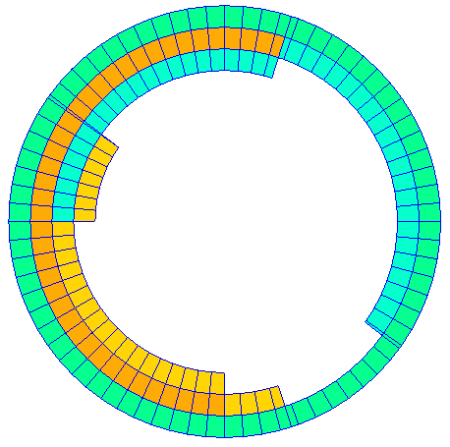
layup 1
0.2
l
layup 2
layup 3
-0.6
layup 4
-1/0/1
0.5
-0.1
-0.2
0.75

Slide 4
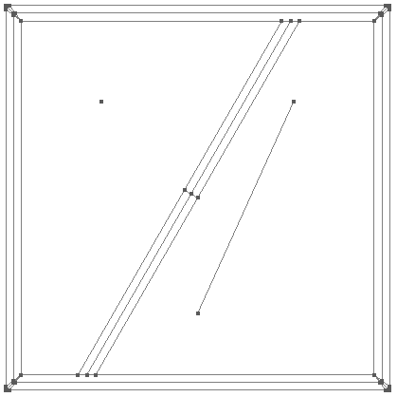
filling 1
A
B
C
filling 2

