Slide 1


Jack-Tar Deckhand: Conference-Quality Presentations, Engineered by AI
Steve Jones
metamirror.io
Notes:
- Everyone builds presentations -- nobody engineers them - This talk: what happens when you apply real architecture to the most common deliverable - 14 skills, 3 AI agents, one pipeline, and the deck you're looking at is the proof

Slide 2

Presentations: The Most Common Deliverable Nobody Engineers
Every professional makes presentations -- most dread it
The tooling hasn't meaningfully evolved since 2005
We still start from blank slides or bloated templates
Design, content, and narrative are treated as afterthoughts
Notes:
- How many times have you stared at a blank slide the night before a talk? - Tooling hasn't evolved -- we're still dragging rectangles - Design, content, narrative -- all afterthoughts - The industry treats presentations as disposable. What if they're not?

Slide 3
What If You Could Engineer a Presentation?
Notes:
- Let the question hang - Engineering: repeatable, testable, collaborative - Not automation -- orchestration

Slide 4
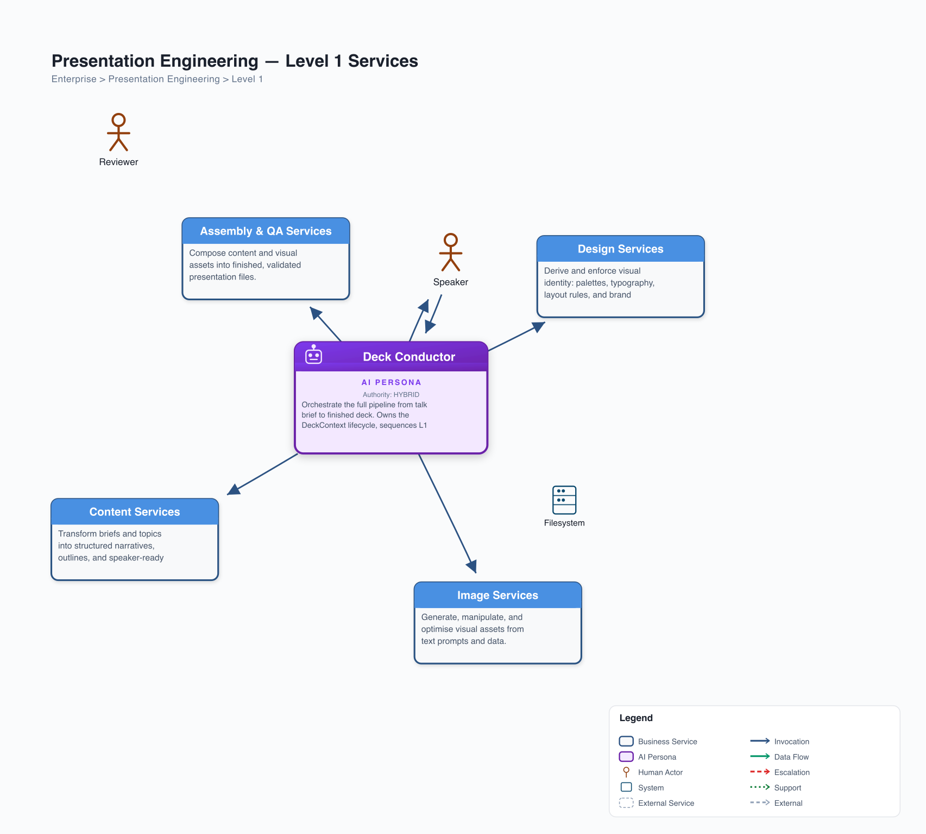
14 Skills, 3 Agents, 4 Services -- One Pipeline
Content Service: narrative arcs, speaker notes, timing
Design Service: brand profiles, style guides, palettes
Image Service: local Ollama draft, cloud production, routing
Assembly & QA: .pptx generation, 25 anti-pattern checks
Notes:
- Four services, each standalone and reusable - Content: arcs, outlines, timed notes - Design: brand extraction, style guides, palettes - Image: local draft with Ollama, cloud production, intelligent routing - Assembly & QA: .pptx generation, 25 anti-pattern checks - Deck Conductor sequences everything -- the pipeline is the product

Slide 5
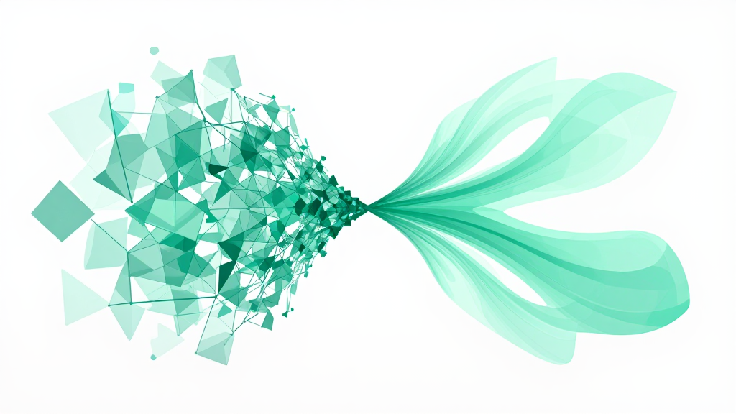
Skills Propose, the Speaker Decides
Brand manager extracts your identity from guidelines
Slide stylist proposes palette, fonts, image mood -- you choose
Narrative architect offers arc structures -- you pick the story
Every creative decision stays with the human
Notes:
- Every creative decision stays with the human - Brand manager extracts -- you validate - Stylist proposes three palette options -- you choose - Narrative architect offers arc structures -- you pick your story - What does 'AI-assisted' actually mean if the AI makes all the decisions?

Slide 6
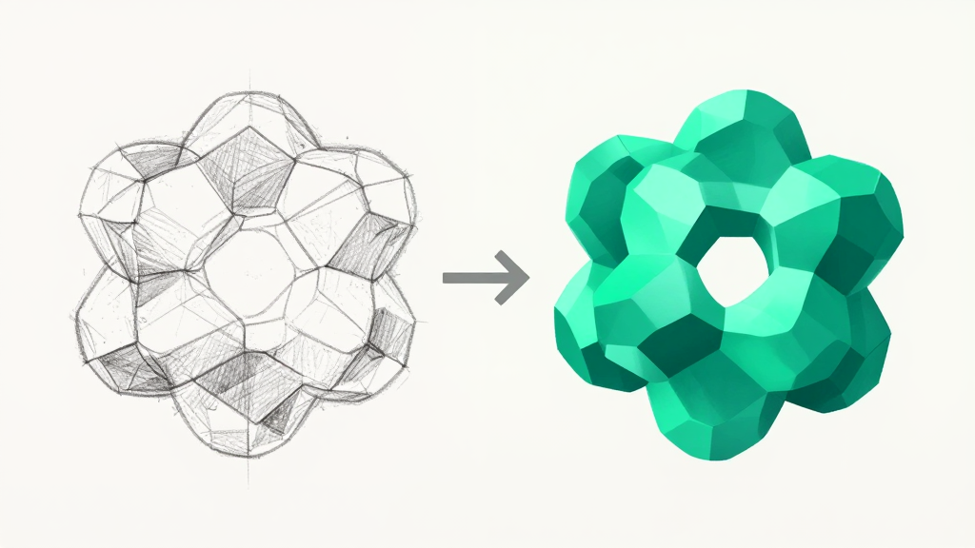
Draft Fast, Produce Once
Draft phase: Ollama renders locally -- zero cost, fast iteration
Review cycle: QA checks catch 25 anti-patterns automatically
Production phase: cloud APIs render at full quality
Budget tracker ensures you never overspend
Notes:
- Draft phase: Ollama renders locally, zero cost, fast iteration - Iterate on structure and content before spending a penny - Production phase: cloud APIs render at full quality - Budget tracker with hard caps -- no surprises - Why would you render at production quality while you're still changing headlines?

Slide 7

385 Tests and Zero Trust in Vibes
Every contract validated: schemas, timing arithmetic, layout references
25 QA anti-patterns: font drift, colour escape, orphan slides, timing gaps
Image routing with budget advisory -- not just generation
Pipeline state tracked end-to-end: repeatable, auditable
Notes:
- 385 tests -- not vibes, not 'it looks right' - Schema validation on every contract between skills - QA catches font drift, colour escape, orphan slides, timing gaps - Image routing with cost advisory -- not just generation - Pipeline state tracked end-to-end: repeatable and auditable - This is engineering discipline applied to creative output

Slide 8
This Deck Was Made by the Pipeline
Notes:
- Let the reveal land - This deck. This one. Made by the pipeline. - Not a mockup. Not a demo. The real thing.

Slide 9
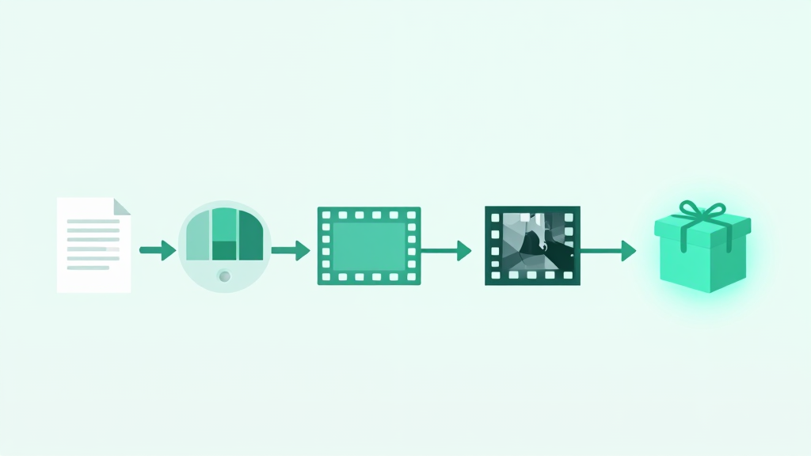
From Brief to .pptx in One Pipeline Run
TalkBrief written, brand extracted from metamirror.io guidelines
Style guide collaboratively derived -- palette, fonts, image mood
Arc selected, 10 slides outlined, notes timed to 11 minutes
Images generated, deck assembled, QA passed, reviewed
What you're looking at is the output
Notes:
- TalkBrief written, brand extracted from metamirror.io guidelines - Style guide derived collaboratively: palette, fonts, image mood - Problem-Demo-Impact arc selected from three options - 10 slides outlined, notes timed to 11 minutes - Images generated, deck assembled, QA passed, reviewed - What you're seeing right now is the output of that single pipeline run

Slide 10
Stop Cobbling. Start Engineering.
github.com/SteveGJones/jack-tar-deckhand
metamirror.io
Steve Jones -- @SteveGJones
Notes:
- Stop cobbling. Start engineering. - The repo is live -- go break it, extend it, build your own pipeline - Presentations deserve the same engineering discipline as everything else we build - Thank you

