Slide 1

Predictive Sales Model
Based on advertising channels

Slide 2
Table of contents
Data Exploration
Model and Insights
Suggestions

Slide 3
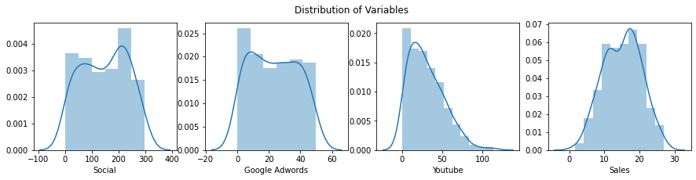
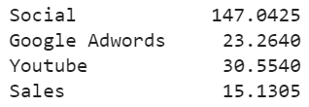
Dataset exploration and variable selection
Data Exploration
We see that the most money is spent on Social media.
Spendings are evenly distributed for Social and Google adwords, but follow a highly skewed distribution for Youtube, with low spendings being more common
None of the variable contain significant outliers
Average daily spending per Channel in Dollars

Slide 4
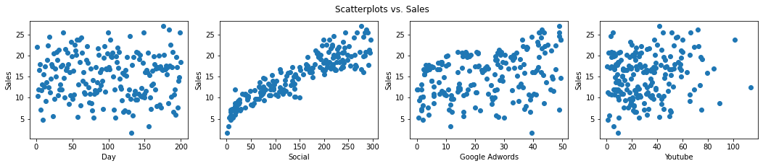
Trends when comparing Variables
Data Set
Social Media seems to follow a clear linear trend with Sales
Days, Google Adwars and Youtube do not show any noticable trends with Sales

Slide 5
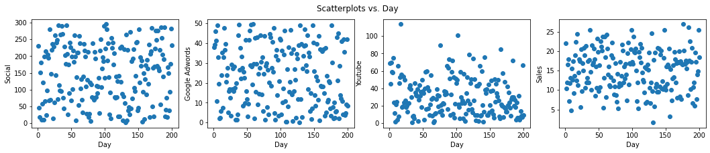
Seasonal Trends
Data Set
There seems to be no meaningful seasonal trend within the data. All variables show no significant trend vs. Day.

Slide 6
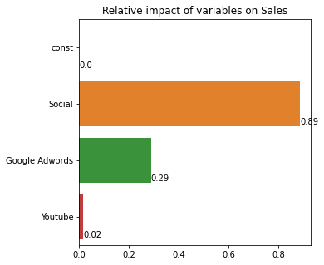
Model and Insights
Sales = 0.05∗(Social Media Spendings) + 0.10∗(Google Adwords Spendings) + 4.79
For every dollar spent on
Social Media, there is a 5 cents increase in Sales
Google Adwords, there is a 10 cents increase in Sales.
Youtube, there is half a cent increase in Sales. (Not statistically significant, p>0.05)
Without any Channels 1000ml would still make 4.79$ in Sales per day.
We removed Days and Youtube from our model, since they carry no statistical significance.
Channel impact: Social Media has about 3 times the impact of Google Adwords

Slide 7
Suggestions
Summary
Average daily Channel Spending: Social 147, Google Adwords 23, Youtube 30
Social Media has a higher impact on Sales because of the higher amount spent on it, however Google Adwords is twice as effective generating twice the amount of Sales per Dollar spent
Youtube carries no statistical significance in its impact on Sales
Suggestions
Increase Google Adwords,, keep Social Media and reduce Youtube spending
Other possible features:
Channel reach (clicks, views etc.)
user demographic (through user profiles)

