Slide 1
Predictive Sales Model
Presentation for
Director of Data Analytics

Slide 2
Table of contents
Data Set
Linear Regression
Final Model

Slide 3
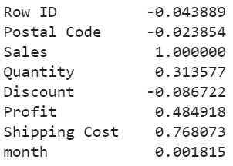
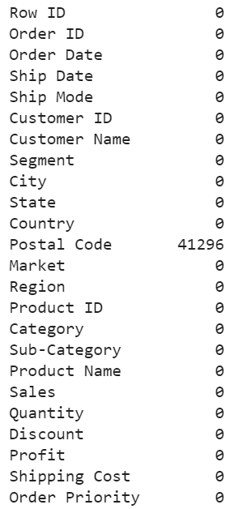
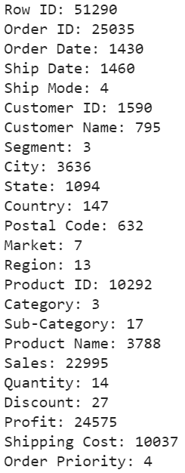
Dataset exploration and variable selection
Data Set
Correlation with Sales
The provided data set is clean
We can eliminate numeric variables with a correlation < 0.2, and categorical variables with 17 or less unique entries
This leaves us with the following variables:
Ship Mode, Segment, Market, Region, Category, Sub-Category, Quantity, Discount and Order Priority
Null Values per Variable
Unique Values per Variable

Slide 4
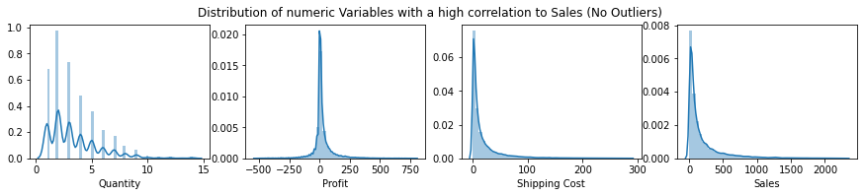
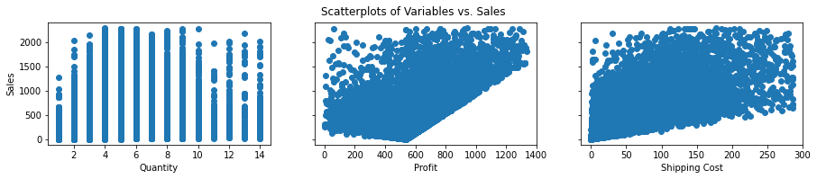
Numeric Variables
Data Set
Shipping Cost and Sales are both one sided distributions, so we removed the top 1% of data points. For Profit we remove the top and bottom 0.5%.
The scatter plots already follow a fairly wide but noticable linear relationship.
Log transformations did not yield better results.

Slide 5
First steps in the modelling process
Linear Regression
OLS with numerical Variables
We start with a simple OLS model to predict sales based only on the numerical variables with a correlation higher than 0.2.
Variables: Shipping Cost, Quantity and Profit
Train score: 0.713
Test score: 0.699
Train root mse: 165.045
Test root mse: 165.913
OLS with numerical and categorical Variables
Numerical variables with a correlation higher than 0.2 and the categorical with less than 18 unique entries.
Variables: Shipping Cost, Quantity and Profit, Category, Sub-Category, Segment, Market, Region and Order Priority,
Train score: 0.759
Test score: 0.748
Train root mse: 151.447
Test root mse: 152.016

Slide 6
Arriving at the scaled model
Final Model
Scaled OLS with numerical and categorical Variables
umerical variables with a correlation higher than 0.2 and the categorical with less than 18 unique entries, all scaled
Variables: Shipping Cost, Quantity and Profit, Category and Order Priority
Train score: 0.759
Test score: 0.748
Train root mse: 0.491
Test root mse: 0.502
We see an increase in R2 and decrease in MSE compared to the Regression without the categorical values.
We keep the categorical variables 'Category', 'Subcategory' and 'Order Priority', because the other variables and their dummies have p values above 0.05.
For modelling purposes we also drop 'Sub-Category', as this and 'Category' are most likely collinear and 'Category' has less dummies
We see a slight decrease in R2 and increase in MSE. However the vastly reduced amount of variables justifies this drop in accuracy. The metrics are still better than the simple OLS model from the beginning.

Slide 7
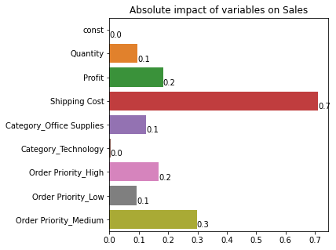
Coefficients and Formula
Final Model
Due to scaling we can now see the impact of each variable on sales. Shipping cost has by far the highest impact, which makes sense because the correlation between the two was above 0.7.
This is the final formula of our model. However all variables are scaled and the resulting predictions need to be rescaled as well.
The formula can be used to predict future sales based on the given variables, as an ongoing score of the costumer base
Sales = 0.095∗(Quantity) + 0.182∗(Profit) + 0.711∗(ShippingCost)
− 0.126∗(Category OfficeSupplies) − 0.003∗(Category Technology)
+ 0.167∗(Order Priority High) + 0.093∗(Order Priority Low)
+ 0.297∗(Order Priority Medium)

