Slide 1
tec-memR: Memristor Research Project
Advanced Memristor Computing & Neural Networks
Lissajous Phase-Based Hardware Implementation
DIY Construction & Z80 Integration
Presented by: Steve
Date: December 2025

Slide 2
What is a Memristor?
• Passive two-terminal electronic component
• Resistance changes based on voltage/current history
• Acts as non-volatile memory element
• Ideal for neuromorphic computing
• Enables in-memory processing
Key Property: 'Remembers' its last state without power

Slide 3
Project Components
1. DIY Memristor Construction
- Copper-sulfide method
- Simple fabrication process
2. Lissajous Phase Neural Networks
- Novel computing architecture
- Wave-based computation
3. Hardware Integration
- Z80 microprocessor interface
- Crossbar array implementation

Slide 4
DIY Memristor: Copper-Sulfide Method
Materials (Under $20):
• Copper PCB or sheet
• Sulfur powder
• Isopropyl alcohol
Process:
1. Clean copper surface
2. Apply sulfur slurry (12-24 hours)
3. Form black copper sulfide layer
4. Attach electrodes
5. Test with pinched hysteresis loop

Slide 5
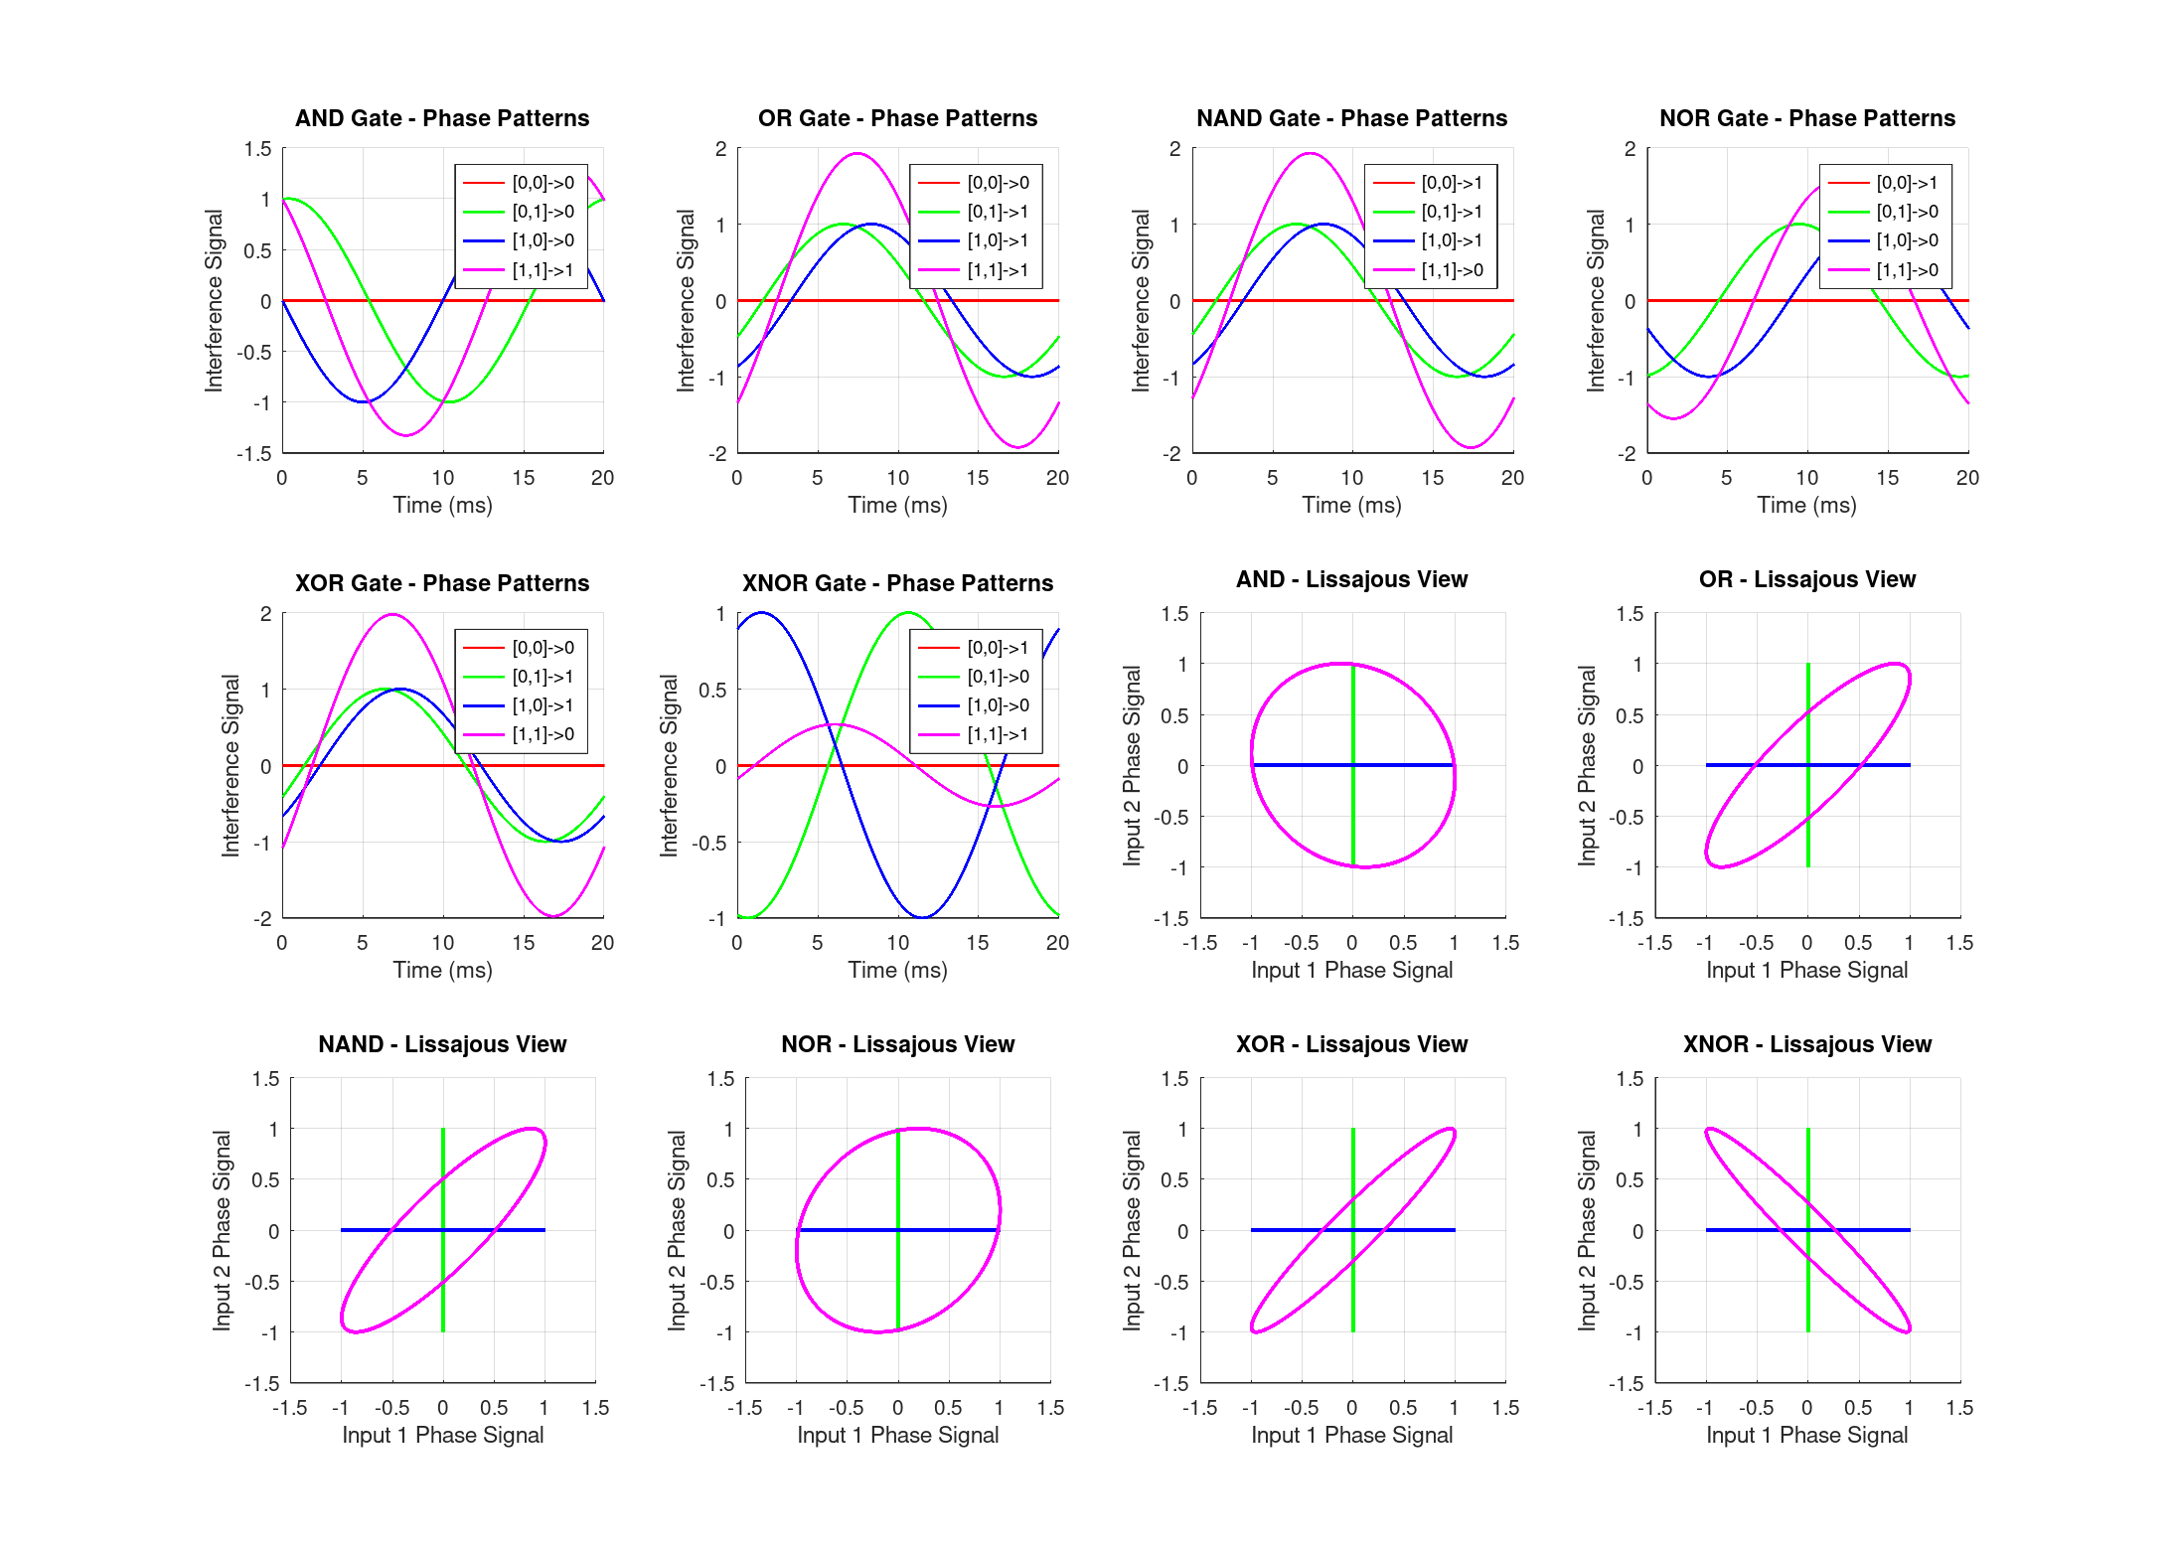
Lissajous Phase Neural Network
Revolutionary Approach:
• Uses phase relationships for computation
• Frequency-division multiplexing (FDM)
• Massive parallelism via wave superposition
Key Advantage:
Each wire can carry MANY parallel computations
simultaneously at different frequencies
Implemented logic gates: AND, OR, XOR, NAND

Slide 6
Scaling Analysis: Frequency Multiplexing
Technology | Bandwidth | Neurons Possible
--------------------------------------------
Analog (audio) | 100 kHz | 1,000
RF (wireless) | 10 GHz | 100,000,000
Optical (fiber)| 100 THz | 1,000,000,000,000
MASSIVE parallelism through wave superposition!
Current implementation: 4 neurons @ 1-4 kHz

Slide 7
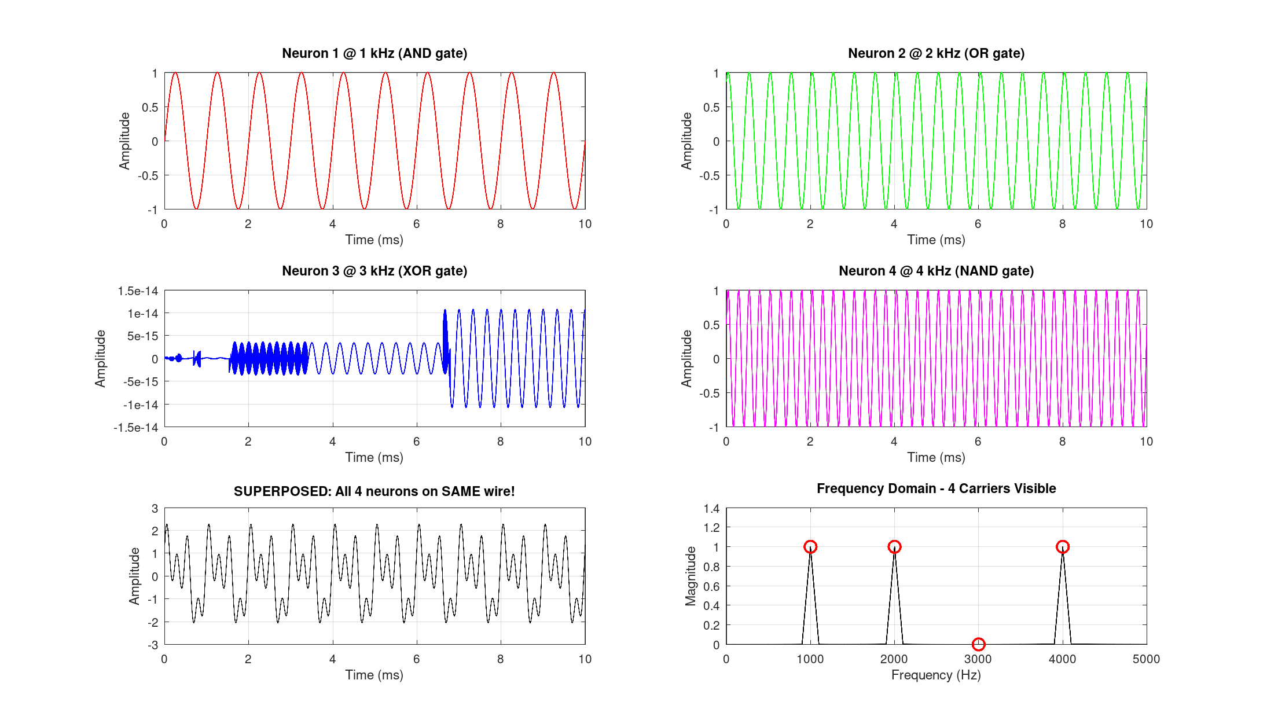
Hardware Implementation Options
1. FPGA (Fastest to prototype)
- ~1000 neurons @ 100 MHz
- Cost: ~$100 dev board
2. Analog ASIC (Ultimate efficiency)
- 10,000 neurons in 5mm × 5mm chip
- 10 TOPS, only 10mW power
3. Memristor Crossbar (Current focus!)
- Physical wave computation
4. Photonic (Future work)
- Speed of light computation

Slide 8
Memristor Crossbar Architecture
KEY INSIGHT: Memristor state = Phase shift
Architecture:
• N×M crossbar array
• AC voltage on rows (inputs)
• Current summing on columns (outputs)
• Each junction: learnable phase element
Advantages:
✓ Natural phase computation
✓ No external phase shifters needed
✓ Non-volatile (retains state)
✓ Training via simple voltage pulses

Slide 9
Z80 Microprocessor Integration
Hybrid Analog-Digital System:
Z80 Role:
• Controls DC programming pulses
• Sets memristor states
• Reads ADC outputs
• Orchestrates computation
Memristor Array:
• Performs analog computation
• Physical wave interference
• Natural parallel processing

Slide 10
Current Achievements
✓ Software simulation in Octave/MATLAB
✓ Logic gates implementation (AND, OR, XOR, NAND)
✓ Frequency multiplexing demonstration
✓ Lissajous curve visualization
✓ Hardware design documentation
✓ Z80 assembly interface code
Generated Visualizations:
• Logic gate phase patterns
• Frequency multiplexing spectrum
• Hardware design diagrams

Slide 11
Implementation Roadmap
Phase 1: Software Validation ✓
- Logic gates working in Octave
Phase 2: Arduino Prototype
- Build 4-input neuron
Phase 3: Memristor Integration
- 2×2 crossbar array
- Z80 interface
Phase 4: FPGA Accelerator
- 100+ neuron scaling
Phase 5: Publication & Open Source

Slide 12
Technical Innovations
Novel Contributions:
1. Phase-coded memristor computing
- Using AC impedance for computation
2. Frequency-division neural multiplexing
- Massive parallelism in single wire
3. DIY memristor fabrication
- Accessible, low-cost method
4. Retro-computing integration
- Z80 + modern memristor tech

Slide 13
Applications
Neuromorphic Computing:
• Pattern recognition
• Analog neural networks
• In-memory computation
Research & Education:
• Physics demonstrations
• DIY electronics projects
• Academic publications
Future Possibilities:
• Edge AI acceleration
• Ultra-low-power computing

Slide 14
Next Steps
Immediate Goals:
1. Build Arduino prototype (4-neuron demo)
2. Fabricate 2×2 memristor crossbar
3. Implement Z80 control interface
4. Demonstrate XOR learning
5. Document results for publication

Slide 15
Questions & Discussion
Thank you!
Project: tec-memR
Memristor Research & Neural Computing
Open for questions and collaboration

