Slide 1
Cognitive Model for Categorization
Name: Stephen Kohlmann
Student Number: 14204243
Module Code: COMP40720
Lecturer: Fintan Costello
Date:28/3/2016

Slide 2
Theory of Model

Slide 3


Using = COUNT IF
e.g Category C Long Term Memory
E.g Test item C Y B for Category C

Slide 4
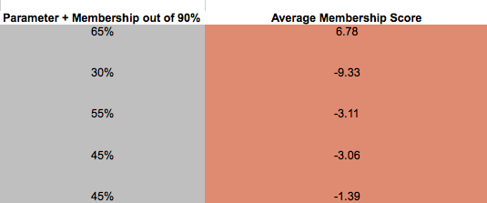
Comparison
Compare average membership score with proposed model… Where does the % come from?

Slide 5

Parameter
For each test item >0 the value of 10 was assigned.
e.g. Test Set C
C = 10, Y = 10, B = 10… CYB = 30%
Y = 0, A = 10, C = 10… YAC = 20%

Slide 6


Parameter cont.
The idea behind the parameter is that a participant will choose that the test item belongs to the category if more dimensions are populated.
e.g. Results for Category C

Slide 7
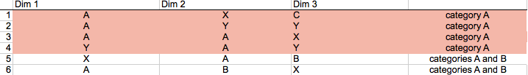
Degree of Membership
For Category A, B, C.
Category A – Using A, A&B items 1-6

Slide 8


Degree of Membership cont.
Category B – Using B, A&B items 5-10
Category C – Using items 11-16

Slide 9
Degree of Membership calculation 1
A,B,C have 6 items with 3 dimensions per category
Total of 18 possible items per category. (6x3=18)
Each item has a value associated with it for computation purposes
For ease of calculation 90% is the max figure in my model. Take 90% as max.

Slide 10
Degree of Membership calculation 2
Each item is given a value of 5%
Each dimension has 6 possible points for A,B,C
Dim 1 30 = 6 x 5
Dim 2 30 = 6 x 5
Dim 3 30 = 6 x 5
Total 90 = Dim 1 + Dim 2 + Dim 3

Slide 11
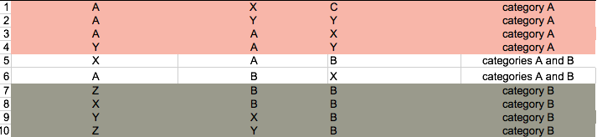
Degree of Membership conjunctive A & B
For Category A&B Conjunctive – Using A, A&B, B items 1-10. Calculation will be the same as B & C conjunctive explained on slide 13.

Slide 12
Degree of Membership A & C conjunctive
For Category A & C there is the option to choose from A, A&B and C creating 12 possibilities per dimension
The value assigned each item is 2.5% instead of 5%
Dim 1 30 = 12 x 2.5
Dim 2 30 = 12 x 2.5
Dim 3 30 = 12 x 2.5
Total 90 = Dim 1 + Dim 2 + Dim 3

Slide 13
Degree of Membership B & C conjunctive
For Category B & C there is the option to choose from B (4 items) and C (6 items) creating 10 possibilities per dimension. The below is also used for the A&B calculation.
Dim 1 30 = 10 x 3
Dim 2 30 = 10 x 3
Dim 3 30 = 10 x 3
Total 90 = Dim 1 + Dim 2 + Dim 3

Slide 14
Degree of membership Summary
Category A, B, C –item value 5
6 per dimension – 3 dimensions – 18 x 5 = 90
Category A&C –item value 2.5
12 per dimension – 3 dimensions – 36 x 2.5 = 90
Category A&B and B&C –item value 3
10 per dimension – 3 dimensions – 30 x 3 = 90

Slide 15
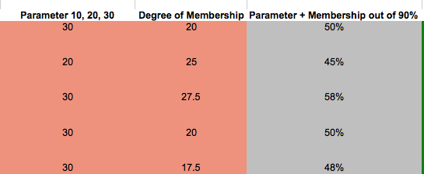
Parameter + Degree of Membership
The parameter is added to the degree of membership to get a total percentage out of 90%(Max)

Slide 16
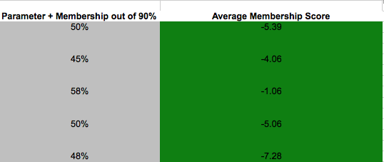
Comparison to Long Term Model
The parameter + degree of membership result is compared with the average membership of the long term model.

Slide 17
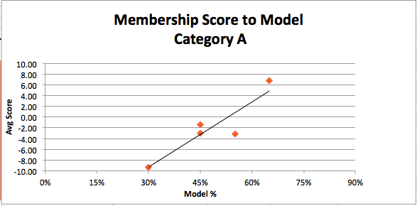
Results Scatter Plot Category A

Slide 18
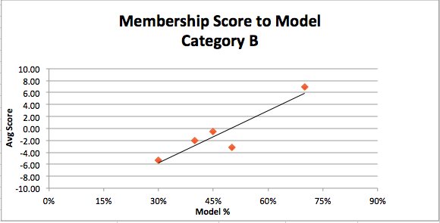
Results Scatter Plot Category B

Slide 19
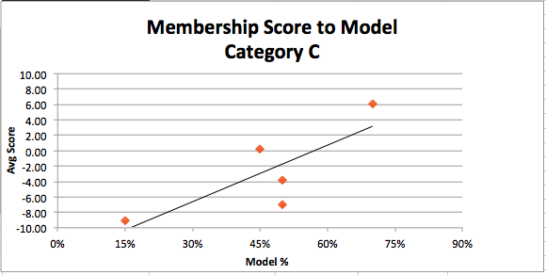
Results Scatter Plot Category C

Slide 20
Does the Model Fit Single Categories?
A – Yes
B – Yes
C- Not Really – Why?
Not enough of a difference between YAC and XXB – Both coming in at 50% on the model
YAC is 024, XXB is 121

Slide 21
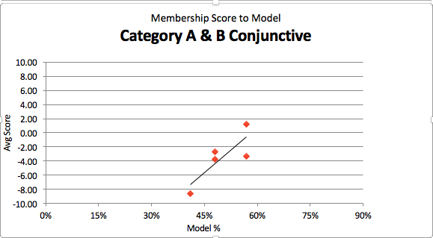
Results Category A & B

Slide 22
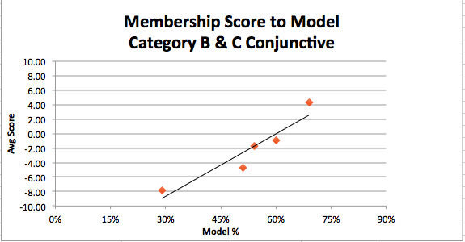
Results Category B & C

Slide 23
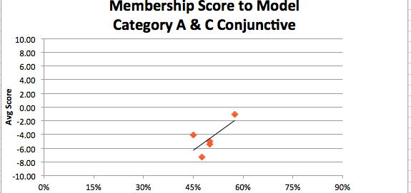
Results Category A & C

Slide 24
Does the Model Fit Conjunctive Categories?
A&B – CYB & XXB do not seem to fit
B&C – Yes
A&C – XXB does not fit
Why?
Parameter & Weight for each time a symptom not matching results

Slide 25
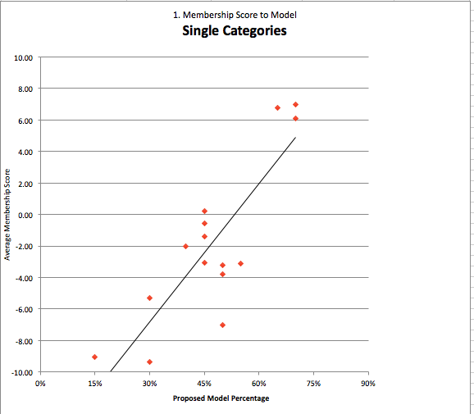
Single Categories Combined

Slide 26
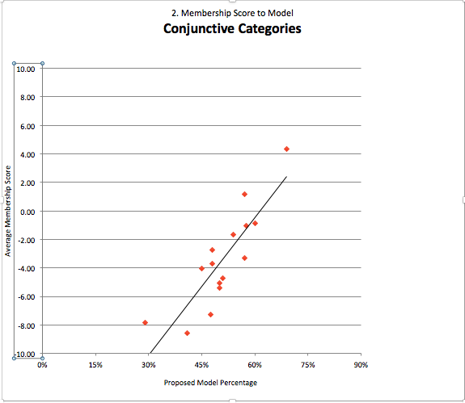
Conjunctive Categories Combined

Slide 27
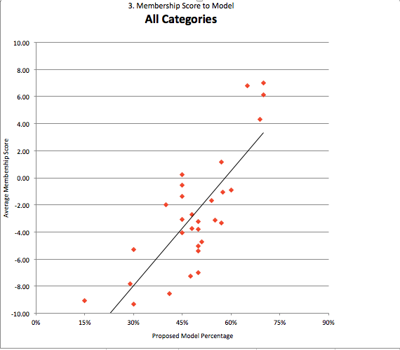
All Categories Combined

Slide 28
Summary
Does the model match?
Is there a positive correlation?
How can the model be improved?

Slide 29


