Slide 1

CCTI Microsoft Store Readiness
Release-review framing and status
DRAFT INPUTS
EVIDENCE CONTROLS
STORE CERTIFICATION
READY
READY
BLOCKED
CCTI INTERNAL
01
Notes:
Today’s output is a Store-listing readiness package for Claude Code Tools Installer. It includes reviewed draft copy, a screenshot capture system, and an operator sequence. It does not claim that CCTI is in the Store, certified, signed for Store distribution, or ready for submission. First, here is the product story we can truthfully tell today.

Slide 2

The Truthful Product Story
SUPPORTED USER VALUE
EXPLICIT BOUNDARIES
Review-before-change desktop setup helper.
Not a guarantee about third-party tools, commands, or services.
Keeps shared developer-tool choices separate from project-level choices.
Does not silently delete credentials or unreviewed folders.
Surfaces curated extras and shows a visible plan before approval.
Discovery is read-only by default (pending final code verification).
Backup-first cleanup for eligible local skill folders.
No affiliation or endorsement by Anthropic, Claude, or GitHub.
CCTI INTERNAL
02
Notes:
CCTI helps people work through developer-tool setup in clear steps. It keeps shared choices separate from project-level choices, surfaces curated extras, and shows a plan before a proposed change. The copy also states the boundary: CCTI is a setup helper, not a guarantee about third-party tools or services. That product story is useful, but only if the wording remains accurate and policy-safe.

Slide 3
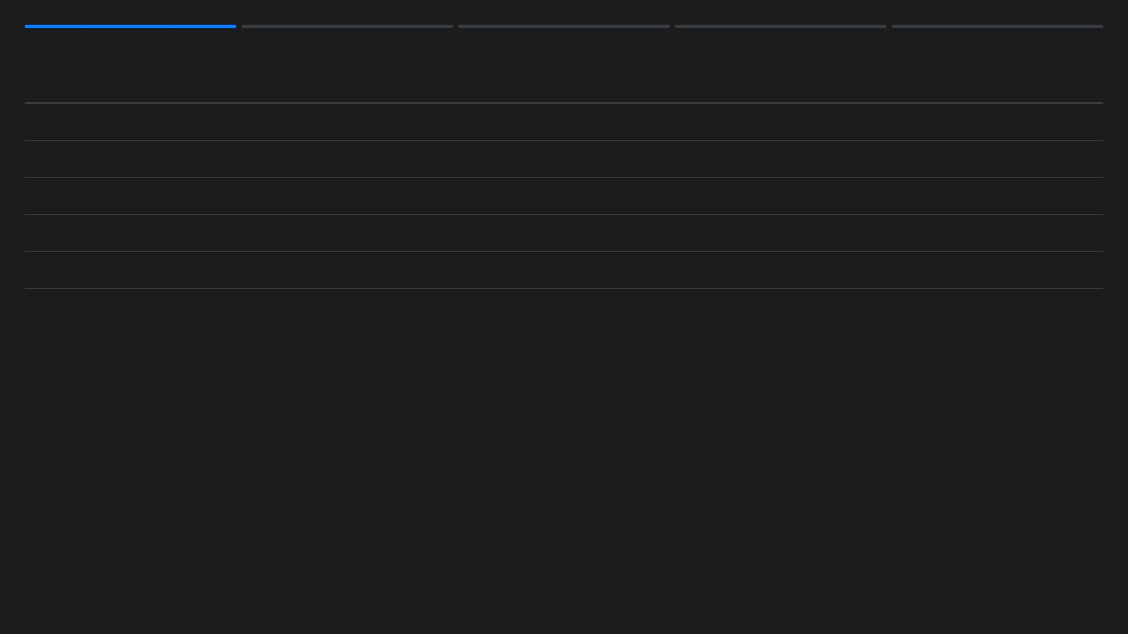
Listing Copy: Conditional Draft Approval
CLAIM CATEGORY
STATUS
CONDITION / RATIONALE
Setup steps & curated choices
SAFELY CLAIMED
Supported by public user manual and documentation.
Review plan before approval
SAFELY CLAIMED
Supported by public terms and product disclaimer.
Microsoft-certified / Store-ready
EXCLUDED
No evidence exists; submission is blocked.
Windows EXE / Silent install
EXCLUDED
Current release is ZIP; silent install contradicts review workflow.
Discovery is read-only by default
CONDITIONAL
Requires revalidation against the final Electron build.
CCTI INTERNAL
03
Notes:
The short and long descriptions now avoid unsupported claims. They do not say that CCTI is Microsoft-certified, signed, Store-ready, a Windows EXE installer, or affiliated with Anthropic or Claude. We also removed the unverified claim that discovery is read-only by default from the final description. The product name itself requires confirmation against the reserved Partner Center name and approved trademark use. Every remaining feature claim must be checked again against the final Electron build. Search terms needed a concrete correction.

Slide 4

Keywords: All Limits Passed
TOTAL KEYWORDS (MAX 7)
7
VERIFIED KEYWORD SET
developer tools
TOTAL WORDS (MAX 21)
16
local development workflow
26
project setup helper
LONGEST KEYWORD (MAX 40 CHARS)
developer utility
PRICING TERMS
0
tool catalog
0
change preview
3RD-PARTY PRODUCT TITLES
setup review
CCTI INTERNAL
04
Notes:
The original draft had eight terms and included a third-party product title. Microsoft allows at most seven keywords, each with a 40-character maximum and no more than 21 total words. Store policy also prohibits pricing terms and other product titles unless the same publisher owns them. The corrected CCTI set passes: seven terms, 12 to 26 characters each, and 16 total words. The biggest integrity risk is not the text. It is the screenshots.

Slide 5

Screenshots Must Be Evidence
REQUIRED CAPTURE ORIGIN
PROHIBITED MOCK SOURCES
Native app window only.
Browser previews or web pages.
Captured from the exact installed MSIX candidate.
Renderer running outside the installed MSIX.
Tested on a clean Windows device.
Fixture data or mocked IPC bridges.
PNG format, ≥1366×768, ≤50 MB.
Forced status or button states.
Captions belong in Partner Center, not burned into pixels.
Composited or AI-generated mockups.
macOS or Linux sessions.
CCTI INTERNAL
05
Notes:
A Store screenshot is proof of the product experience. A browser preview, a renderer outside the package, mocked IPC, injected chat output, an AI mockup, a composite, or an image from an old build can look convincing but is not valid Store evidence. The only acceptable source is the normal native app window from the exact installed, clean-Windows-tested MSIX candidate. The manifest converts that principle into a release control.

Slide 6
Capture Manifest Creates Traceability
SOURCE
CANDIDATE
TEST RECORD
PER-PNG
→
Bundle & Manifest Hashes
→
→
Origin, Time, & File Hash
Canonical commit
Clean-Windows Proof
CCTI INTERNAL
06
Notes:
The template is explicitly marked not for upload. When we reach the capture step, we replace placeholders with observed evidence: the canonical source commit, bundle SHA-256, package identity, full package name, unpacked manifest hash, and clean-Windows test record. Each PNG then records its native window title, UTC capture time, origin, dimensions, byte size, and SHA-256. This lets a reviewer reject a screenshot that came from the wrong build or a mock environment. We plan four strong customer views, even though the formal minimum is lower.

Slide 7

What the Current Evidence Proves
VERIFIED EXISTS
STILL REQUIRED FOR STORE
Canonical Electron desktop source.
Protected Partner Center identity configuration.
MSIX build scripts and AppX assets.
Independently verified unsigned MSIX bundle.
Actual unsigned x64/ARM64 candidate built at f62ef8b….
Matching clean-Windows test record.
Genuine native screenshots from that candidate.
Current direct-download Windows ZIP.
CCTI INTERNAL
07
Notes:
The canonical Electron source is available, and the latest successful Store workflow produced an unsigned bundle at commit f62ef8b55e9aaabadb336f8677c588c0fbc5b2e4. The release owner confirms that the policies, public policy URLs, matching screenshots, and required metadata already exist. The remaining work is limited to protected identity configuration, independent verification of the final bundle, and a clean-Windows test record tied to that exact bundle.

Slide 8

Five Sequential Release Gates
01
Source & Identity
Canonical desktop source + protected Partner Center identity values.
02
Windows Candidate
Build x64/ARM64 packages on Windows; verify unsigned bundle SHA-256.
03
Clean-Device Test
Test install, launch, real workflows, and uninstall on clean Windows.
04
Native Captures
Capture native screenshots; complete manifest and asset audit.
05
Owner Approval
Publish URLs, complete IARC, review exact payload, and approve submission.
CCTI INTERNAL
08
Notes:
There are only three final-candidate controls. First, keep the exact Partner Center identity values in protected build inputs, never in workflow-dispatch inputs which expose them in run history. Second, independently verify the final unsigned bundle, including its checksum and manifests. Third, run the clean-Windows test on that exact bundle SHA-256 and confirm the temporary test certificate is removed. Existing policies and screenshots are not missing; they need to be bound to the final candidate in the evidence record.

Slide 9
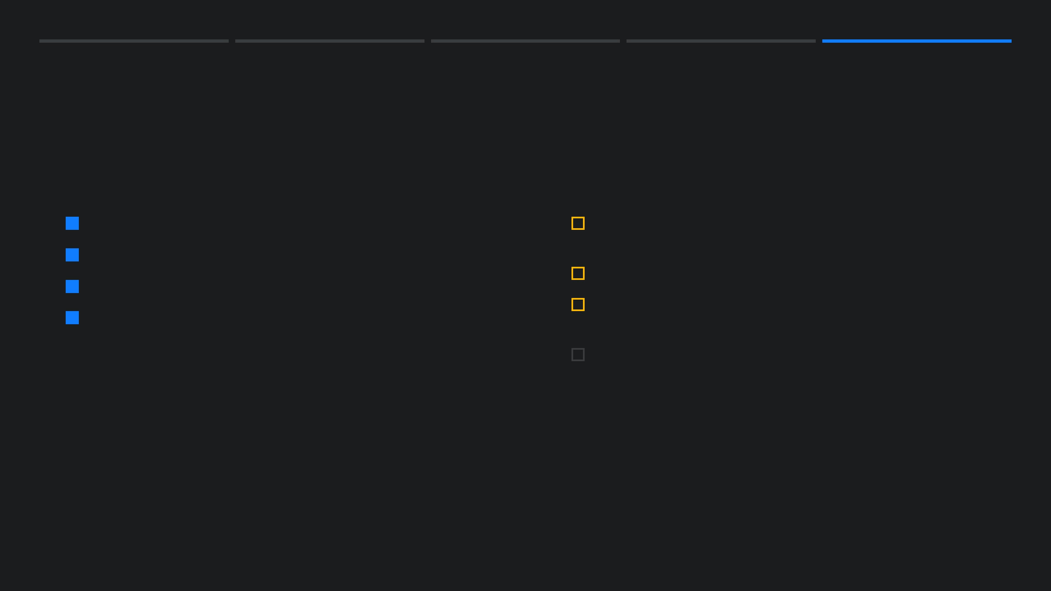
Only Three Final-Candidate Controls Remain
OWNER-CONFIRMED AVAILABLE
THREE REMAINING CONTROLS
Explicit policies and public policy URLs.
Place exact Partner Center identity values in protected build inputs.
Matching Store screenshot set.
Independently verify the resulting final unsigned bundle.
Listing metadata, copy, Keywords, and commercial selections.
Run clean-Windows install, launch, workflow, and uninstall test.
Policy and screenshot assets retain their original provenance.
Bind existing screenshots and URLs to final manifest; recapture only if UI changes.
CCTI INTERNAL
09
Notes:
The left column is available by owner confirmation: explicit policies, policy URLs, a matching screenshot set, and the required listing metadata. The three controls on the right are the full evidence-production scope. Configure the protected identity, independently verify the resulting final unsigned bundle and its companion checksum, then produce a clean-Windows record tied to that exact bundle SHA-256. Keep the existing screenshots; re-capture only if the final identity build changes their visible UI.

Slide 10

Decision: Bind, Verify, Test
1. Bind
2. Verify & Test
Select the exact candidate commit and apply protected Partner Center identity values.
Independently verify the final unsigned bundle, then run the matching clean-Windows test.
CCTI INTERNAL
10
Notes:
The order is bind, verify, then test. Apply the protected Partner Center identity to the selected commit. Verify the checksum and package manifests for that resulting final unsigned bundle, not merely the earlier pre-final workflow artifact. Then run installation, launch, real workflow, and uninstall checks on clean Windows against the same bundle SHA-256. Finally record the existing policy URLs and screenshot provenance in the final manifest. No separate asset-production phase is needed unless the UI changes.

