Slide 1

FinQwen Research Company

Slide 2
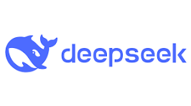


Who We are
We are the research lab partnering with or embedded inside a major financial institution (e.g., J.P. Morgan). We fine-tune open-source LLMs into a financial vertical LLM for: stock screening, buy/sell signal generation, automated financial-report analysis, industry & market sentiment analysis, and research workflow automation.

Slide 3



What We Do
Combine state-of-the-art LLM capabilities with finance-grade governance to deliver auditable, backtestable, and controllable investment intelligence that boosts analyst productivity and reduces operational risk.

Slide 4



Who We’re Looking For
AI researcher New fine-tuning methods, RLHF/FT, explainability, time-series + LLM research; drive publication-level work
Algorithm / ML Engineer Implement fine-tuning pipelines, distributed training, model compression/ distillation, and productionize research
Data Engineer / Data Scientist Ingest, clean, align and enrich market data, filings, news and social feeds; prepare training and evaluation datasets

Slide 5
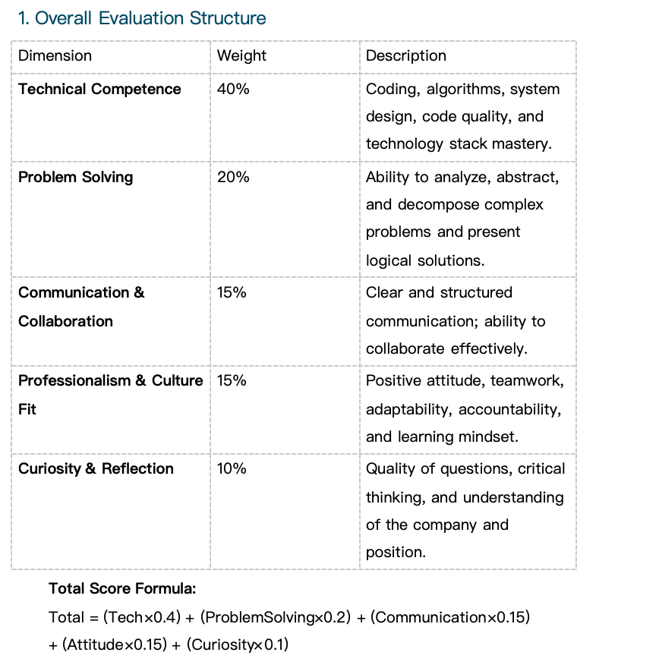
Scoring Framework

Slide 6
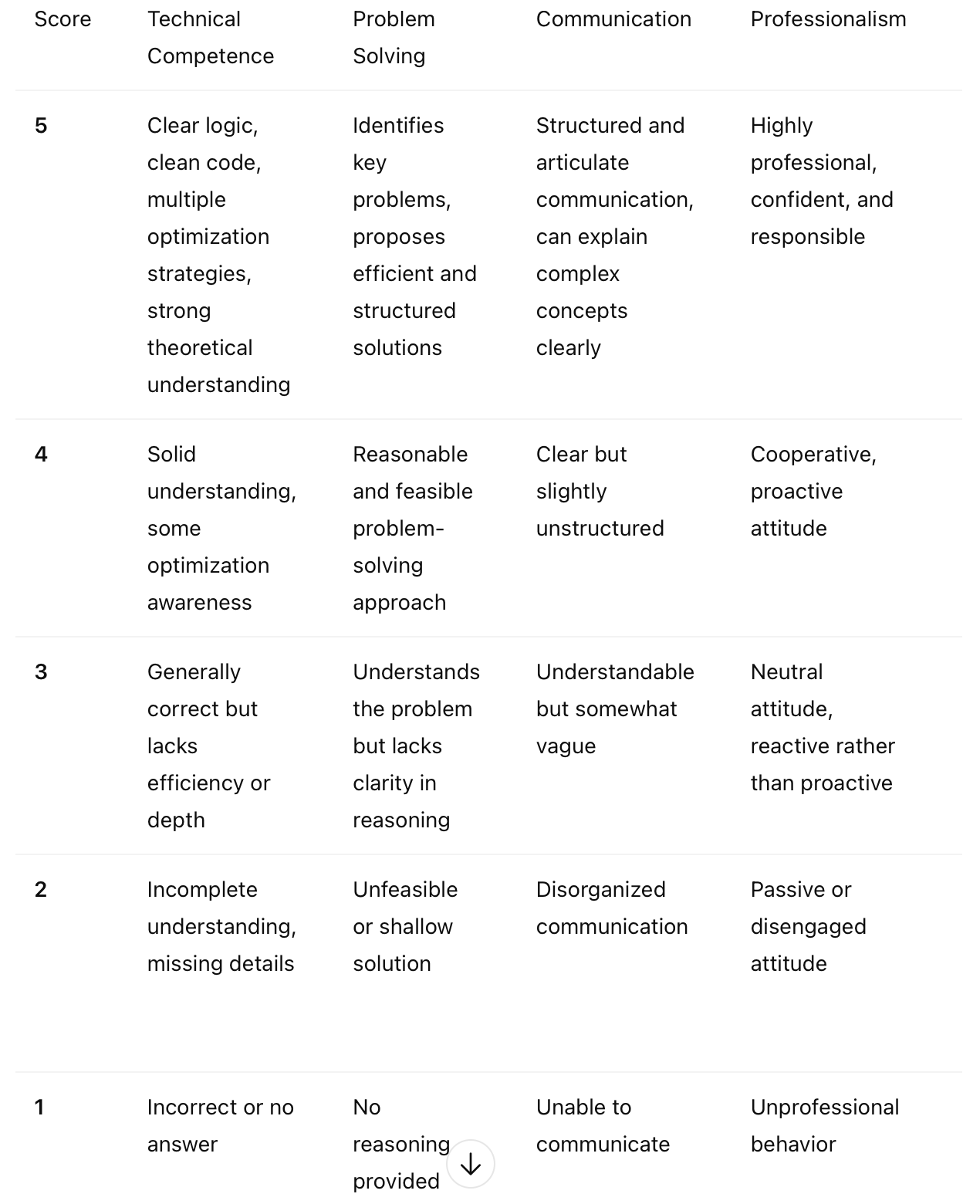
Rating Scale (1–5)

Slide 7
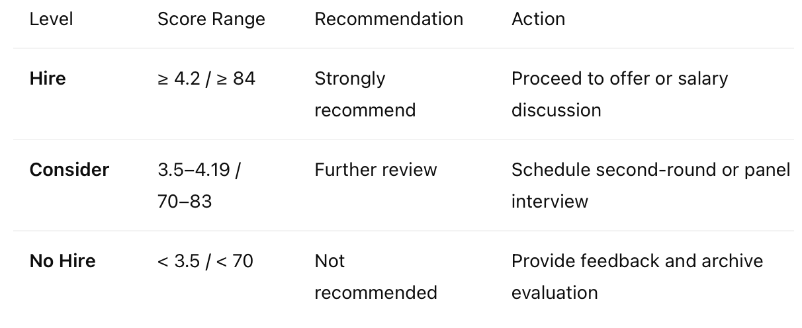
Decision Levels

