Slide 1
Docker Container Development Edit & Refresh, w/Docker Environment Variables
DEV212
Steve Lasker
Program Manager
Azure Developer Experiences

Slide 2
CI/CD Changes
CI/CD used to be about deploying code
You pushed your code to each environment
You hoped your new code didn’t conflict with the old code
Container Deployment
You push new OS Instances, with your code
Toss out your old instance - Immutable

Slide 3

Container Build System
SCC
Docker Registry
Public/Private
Docker Image
Docker Image
Docker Image
CI
Docker-compose.yml
TEST
Base Image
Dockerfile
Docker-compose
Build
envTEST.list
Push
Compiled Code
Write/Edit
Run
Debug
Docker Image^{(s)}
Docker Image^{(s)}
Staging
Docker-compose build
Docker-compose
envStag.list
Docker-compose up
Production
envInt.list
Docker-compose
Tests
envProd.list
Visual Studio Code

Slide 4
Configuration Files
App Configuration Behavioral Values
Owned By: Development
How errors are handled
Depth of logging
JavaScript optimizations
Docker Configuration Location Values
Owned By: Operations
Database Connection String
Storage Connection Strings
Telemetry Keys
Instance Count

Slide 5
Microsoft Docker Support
From the developer inner loop through production operations, Microsoft is committed to docker & containers
Docker Tools for Visual Studio
Docker Tools for Visual Studio Code
Dev Test Labs
Visual Studio Team Services
Windows Containers
Microsoft Operations Management
Azure Container Service

Slide 6
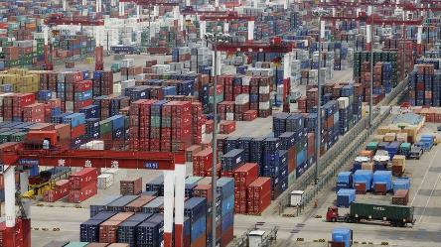
References:
Docker.com
aka.ms/DockerToolsForVS Docker Tools for VS
aka.ms/DockerToolsForVSCode Docker Tools for VS Code
aka.ms/YoDocker scaffolding of docker artifacts
aka.ms/DockerForDotNet Channel 9 Videos
aka.ms/WindowsContainers
Steve Lasker
@SteveLasker
blogs.msdn.com/SteveLasker
Steve.Lasker@Microsoft.com

