Slide 1

On The Shoulders of Giants, Building Apps That Consume Modern SaaS Endpoints with Visual Studio 2015
Steve Lasker
Program Manager
Microsoft
Level: Intermediate

Slide 2
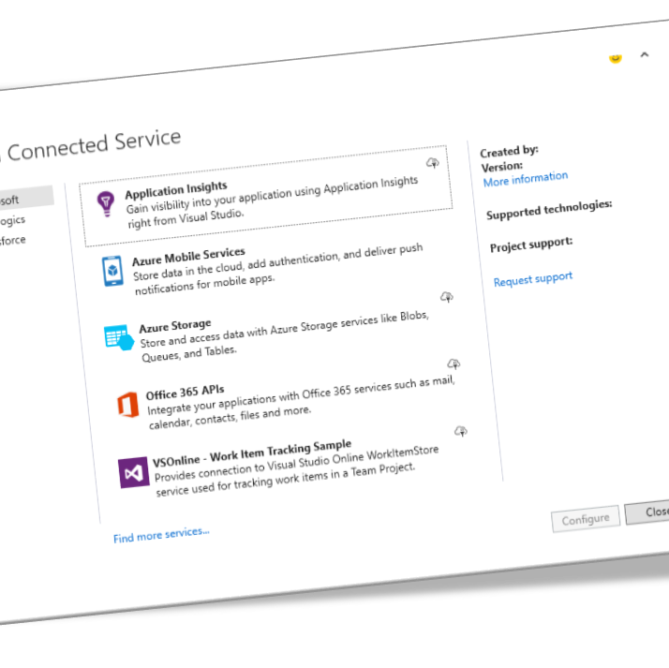
Agenda
What Are Modern Services
Demos – Consuming Services
Salesforce
Visual Studio Online
Azure Active Directory
Azure Storage
App Insights
Demo – Creating a Connected Service
Resources

Slide 3
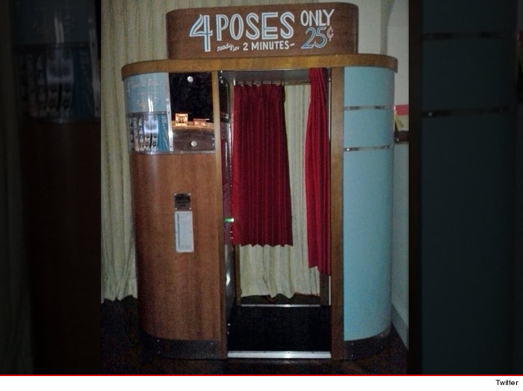
What are Connected Services?
Categories | Examples
Advertising | Bing, Google, MoPub (Twitter)
Analytics | App Insights, Flurry, New Relic
Authentication | Active Directory, Facebook, Twitter
Caching | Azure, Redis, Memcached
Content Delivery Network | Azure, Akamai, Limelight
Database | SQL Server, Mongo, MySQL
Social | Yammer, Facebook, Twitter
Productivity (Files, email) | Office 365, Evernote, Send Grid
Mapping | Bing, Google, OpenStreetMap
CRM | Dynamics, Salesforce, SAP
Payment | Dwolla, Google Wallet, Paypal
Storage / Queue | Azure, Amazon, Heroku
Push Notifications | Android, iOS, Windows
OData
OAuth
JSON
$metadata
REST
WebAPI
RAML
Swagger
SOAP
Notes:
So, what are connected services?
They’re simply the evolution of the same services we’ve been consuming for years. They provide technical services your development team may choose amongst, such as authentication, caching and data.
And they provide business services, such as Customer, Workforce and Resource Management, the business likely choses.
(Transition) The difference is the evolution of these services. The technologies they use are evolving at a rapid pace. While many are standardizing on variations of OData, REST and OAuth, there are varied differences between them.

Slide 4
Modern Service Consumption
A Multi Step Process
Provision and/or Configure the Service
Proxies for the Service
Consume the Service
Now What?
Notes:
Connecting to modern services requires varied steps, depending on the service. (Transition) Many services require service configuration for each app, just to consume the service, such as OAuth tokens and secrets.
(Transition) What’s the URI for the service? Which client libraries will you need?
(Transition) What code do I need, do I want, and any code added, should be MY code, not some generated code I can’t touch. I like to say we’re retiring MC Hammer with his Can’t Touch This style coding.
(Transition) And after you’ve consumed a service, if there was some magic configuration, what was done? What else do I need to do, or need to know? Am I left to the world wide web to find answers to the thing I just did?

Slide 5

Using Data to Inform Decisions
Systems Management
Security Management
IT Service Management
Asset Lifecycle Management
Enterprise Mobility Management
Salesforce Customer Data Prioritizes TFS Work Items

Slide 6
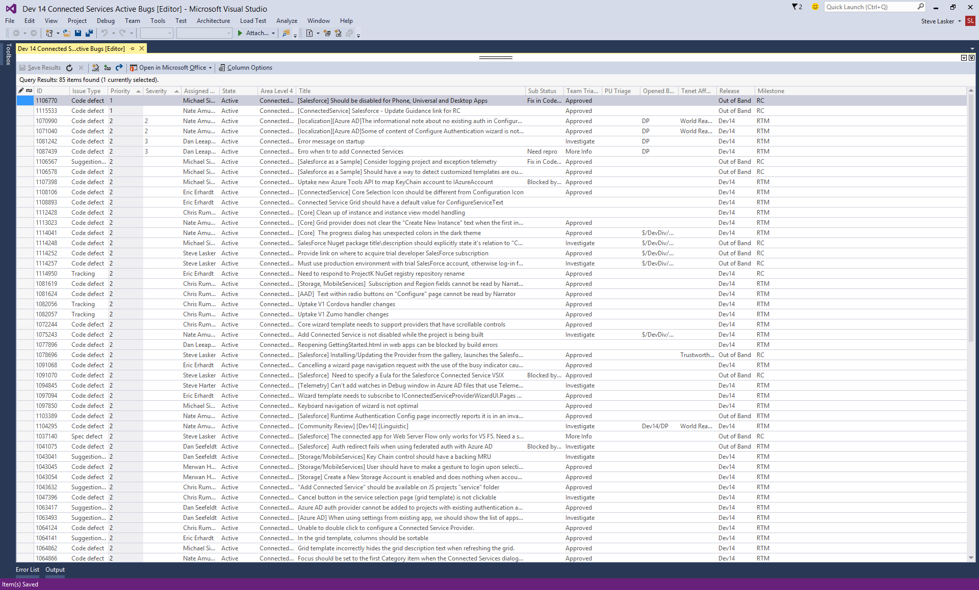


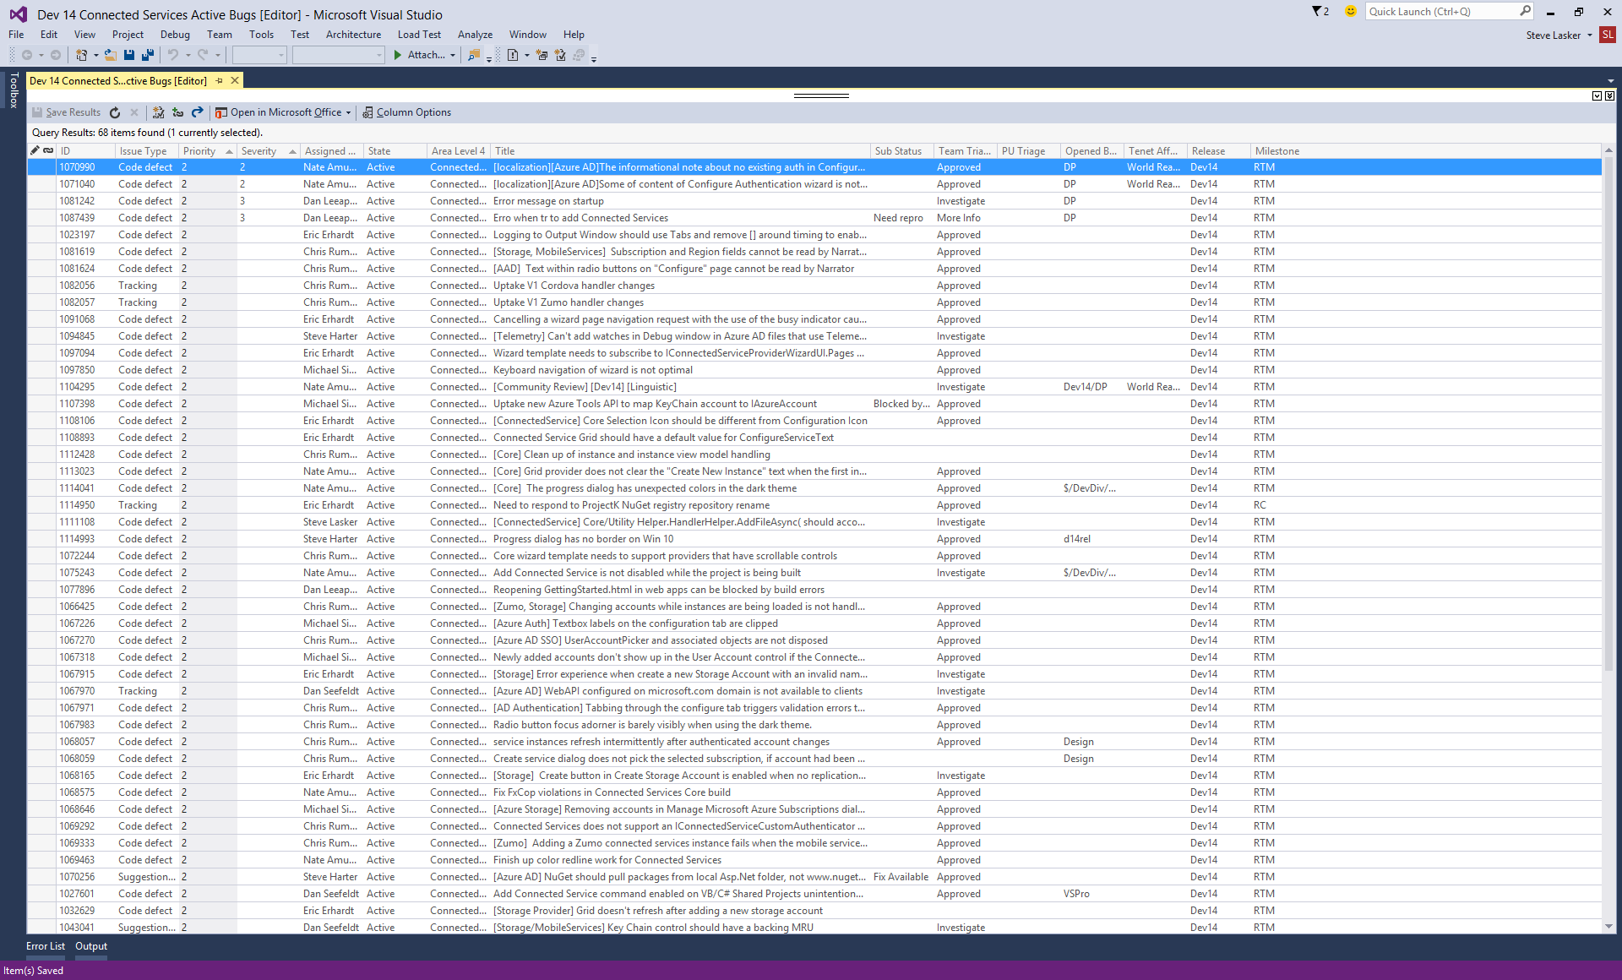

Size of customer
Customer Spend
Entitlement Points
Cases associated w/Bugs
Number of customers impacted

Slide 7
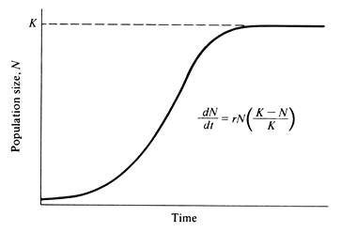

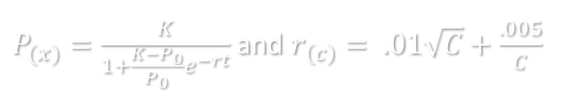
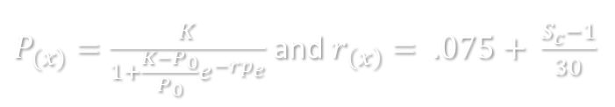
Using the Population Growth and Regulation formula to prioritize bugs
$P_{(x)}=\frac{K}{1+\frac{K−P_{0}}{P_{0}}e^{−rt}}$ and $r_{\left(c\right)}= .01\sqrt{C}+\frac{.005}{C}$
$P_{(x)}=\frac{K}{1+\frac{K−P_{0}}{P_{0}}e^{−rp_{e}}}$ and $r_{\left(x\right)}= .075+ \frac{S_{c}−1}{30}$
P_{(x)} = UMP Score 1
K = Max score = 5000
P₀ = The initial value
Sev 0 = 1000
Sev 1 = 500
Sev 2 = 100
Sev 3 = 10
Sev 4 = 1
r = growth rate
t = time in days since defect was filed
C = number of cases attached
P_{(x)} = UMP Score 2
K = Max score = 5000
P₀ = Initial value = 1
r = growth rate
p_{(e)} = sum of entitlement points of attached accounts / 25000
S_{c} = Average of case severity with highest thrown out.
Sev 1 = 4, Sev 2 = 3, Sev 3 = 2, Sev 4 = 1.
The final UMP* Score is the sum of the two formulas where the MAX will work out to be 10,000.
*Unified Metric Priority
Notes:
http://www.zo.utexas.edu/courses/Thoc/PopGrowth.html

Slide 8
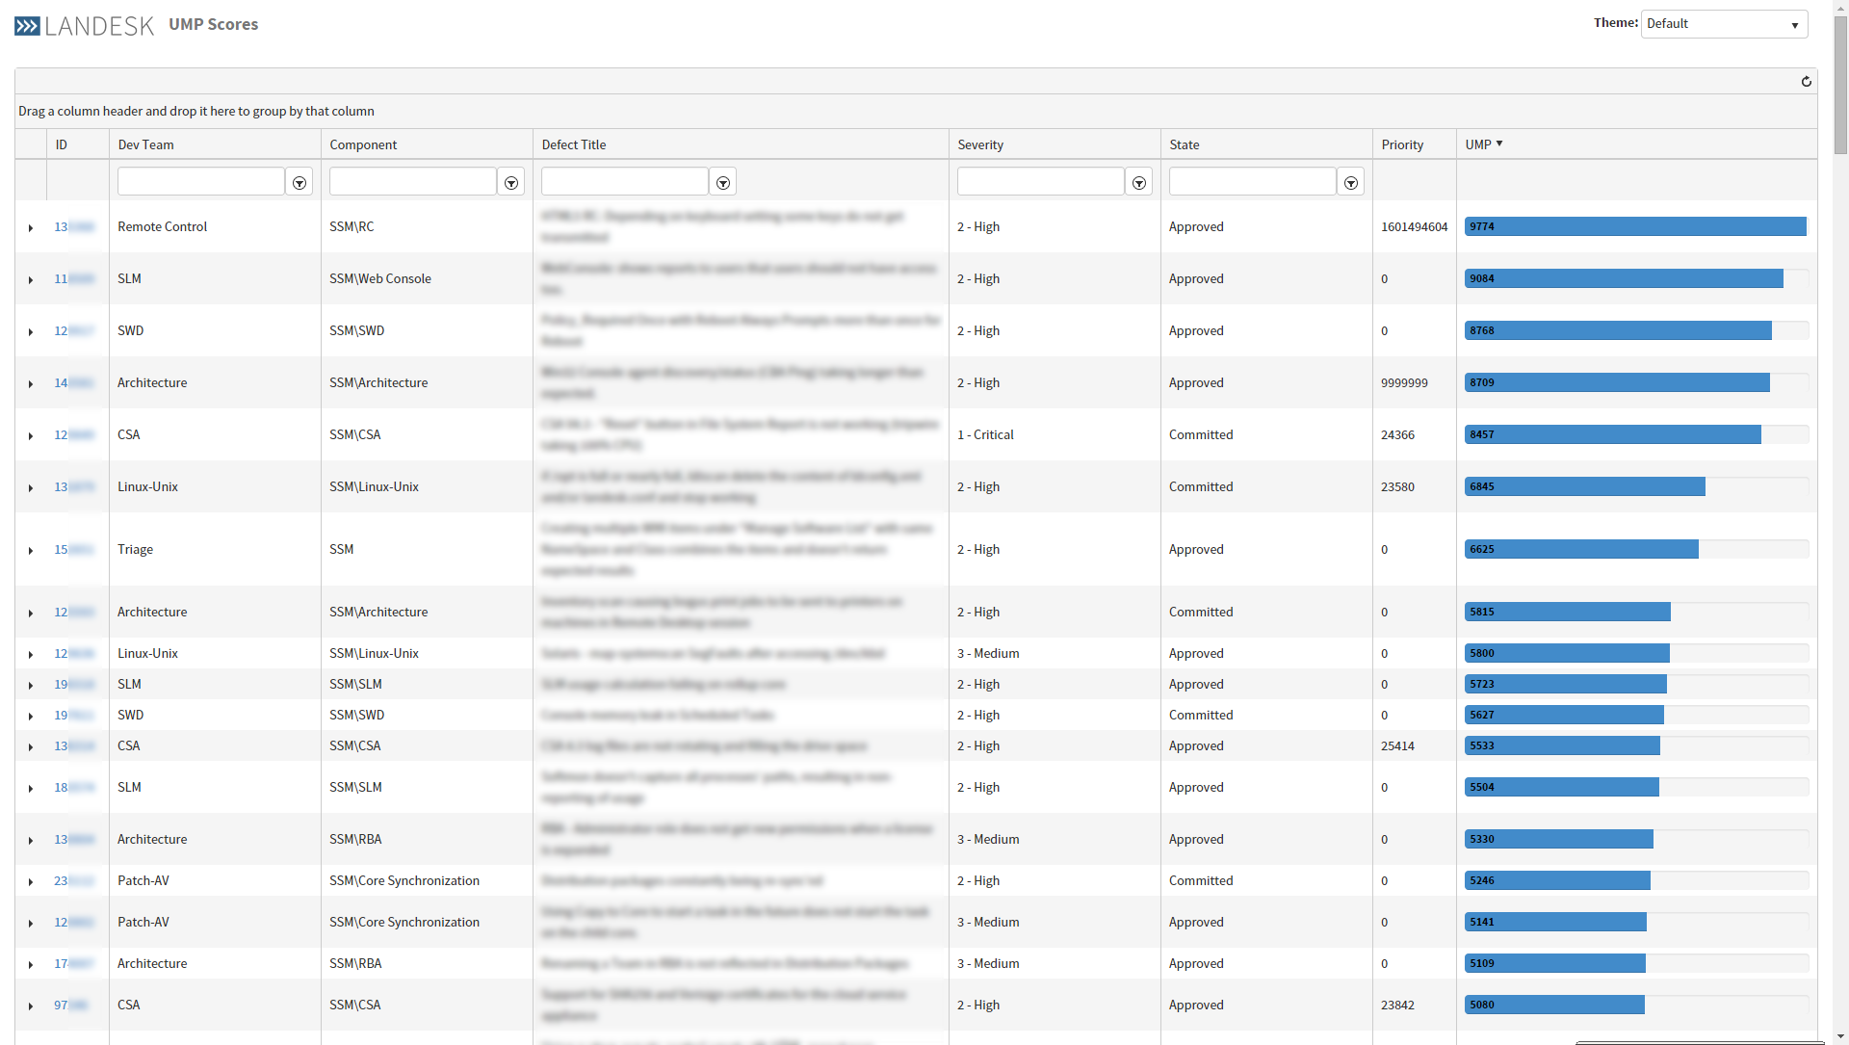
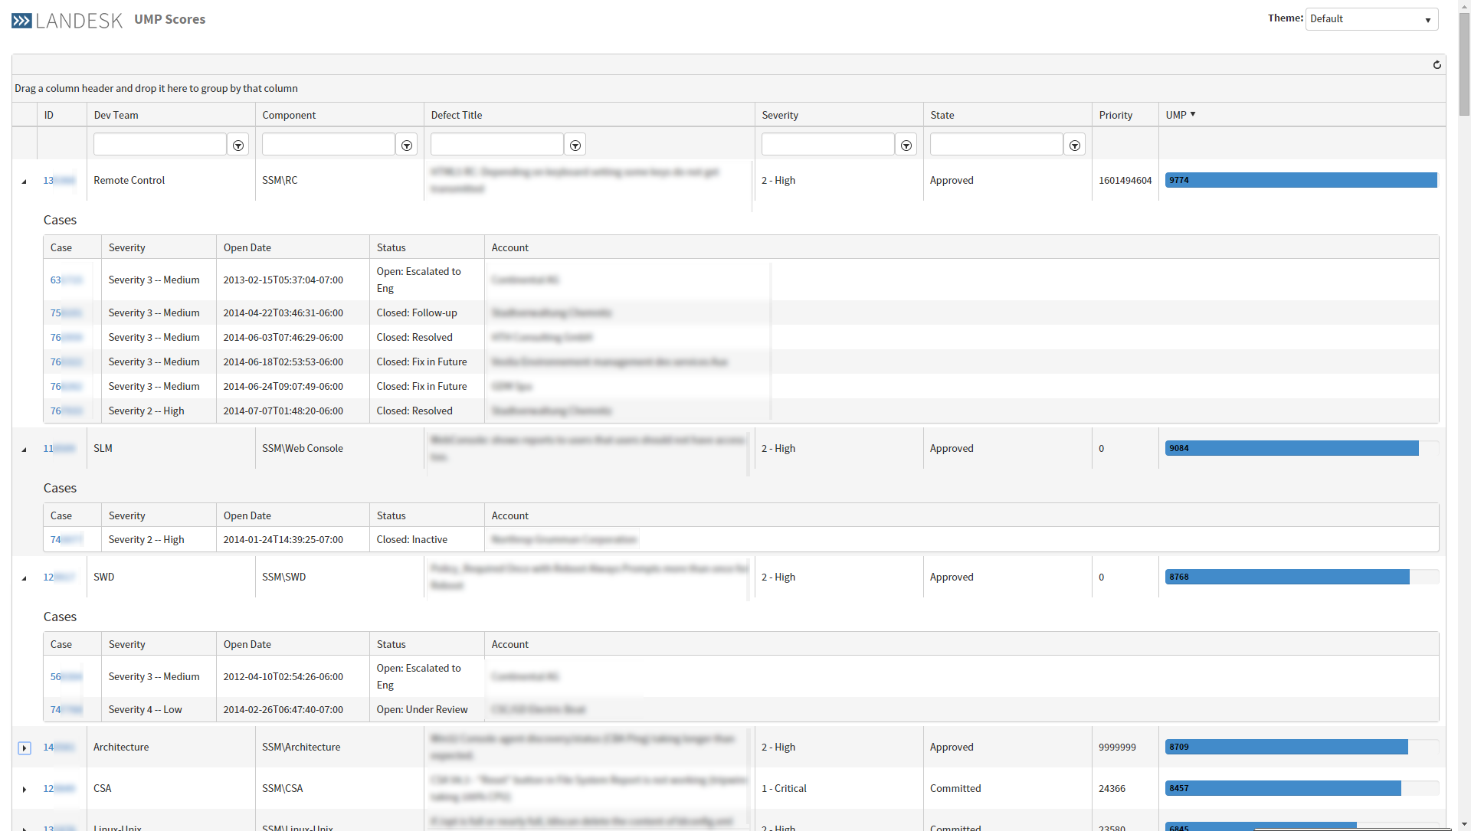


Slide 9
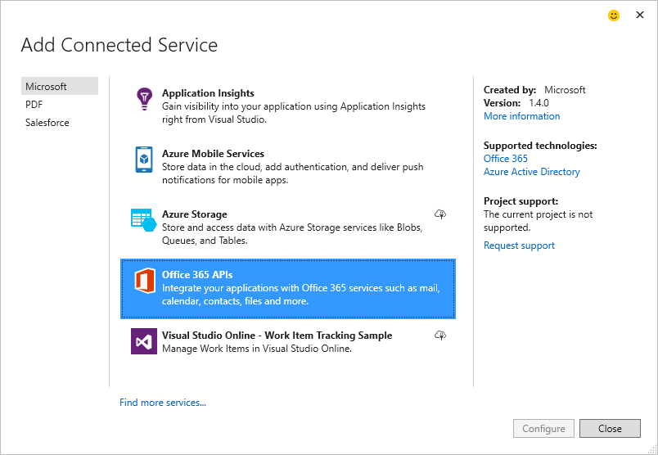
Adding Connected Services
Demo

Slide 10
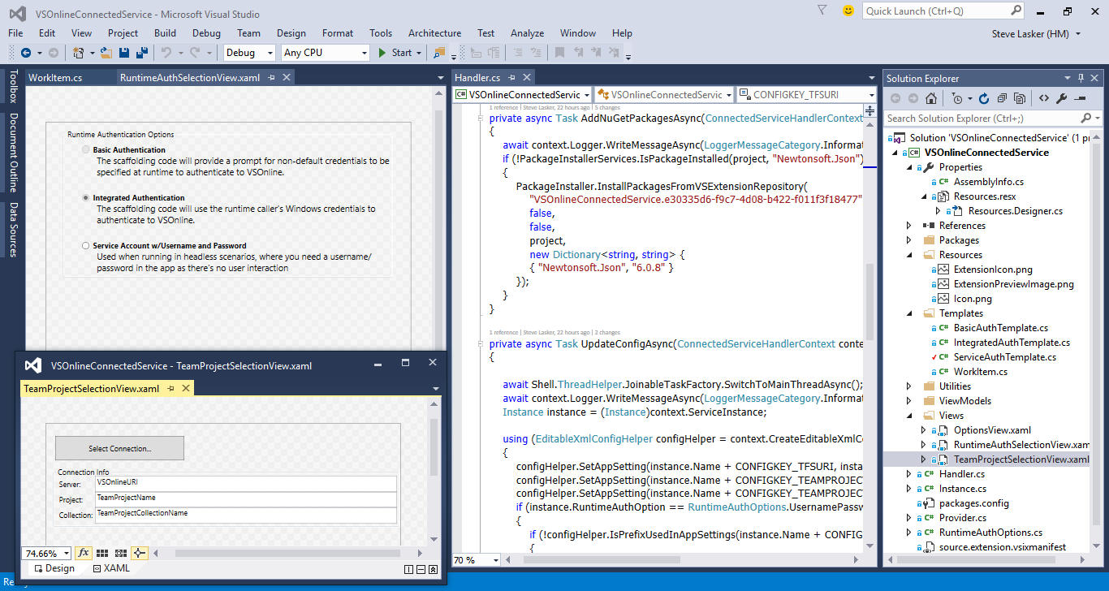
Authoring a Connected Services

Slide 11



Providers, Configurators & Handlers
Providers – Service Selection Information
Configurators – Gathers Configuration Info
Handlers – Does the Service & Project Configuration
Instance – the handoff between a provider and its handers
Provider/Configurator
Handlers
Provider
Salesforce
WinForms, WPF, Console
Cordova
Instance
ASP.net ^{Classic}
Phone, Store, Universal
Configurator
ASP.net 5

Slide 12
Building Connected Services
Demo

Slide 13
Authoring a Connected Service
Reference the Connected Services SDK ^{(NuGet)}
Implement a few classes for Connected Services
Add some WPF Controls ^{(Grid, SinglePage, Wizard)}
API calls to your service
Configure the project with VS SDK ^{(config & scaffolding)}
Support update with Roslyn ^{(model over code)}

Slide 14
Connected Services
…enables the breadth of services
…configures the service, your project
…guides you to next steps
…gives you ownership
…supports extensibility by 3rd parties
…downloadable from the Visual Studio Gallery

Slide 15
References:
aka.ms/ConnectedServices
aka.ms/ConnectedServicesSDK
aka.ms/SalesforceConnectedService
go off and Consume More Services…
Steve Lasker
@SteveLasker
blogs.msdn.com/SteveLasker
Steve.Lasker@Microsoft.com
Speshal thanks to:
Tanner Lindsay
www.TannerLindsay.com
LANDESK.com

