Slide 1




Artifact Registries
Extending Artifacts to support Supply Chain Reference Types
Steve Lasker
Program Manager / Architect
Azure Container Registries
Steve.Lasker@Microsoft.com
@SteveLasker
SteveLasker.blog
github.com/SteveLasker
github.com/SteveLasker/presentations
.blog

Slide 2
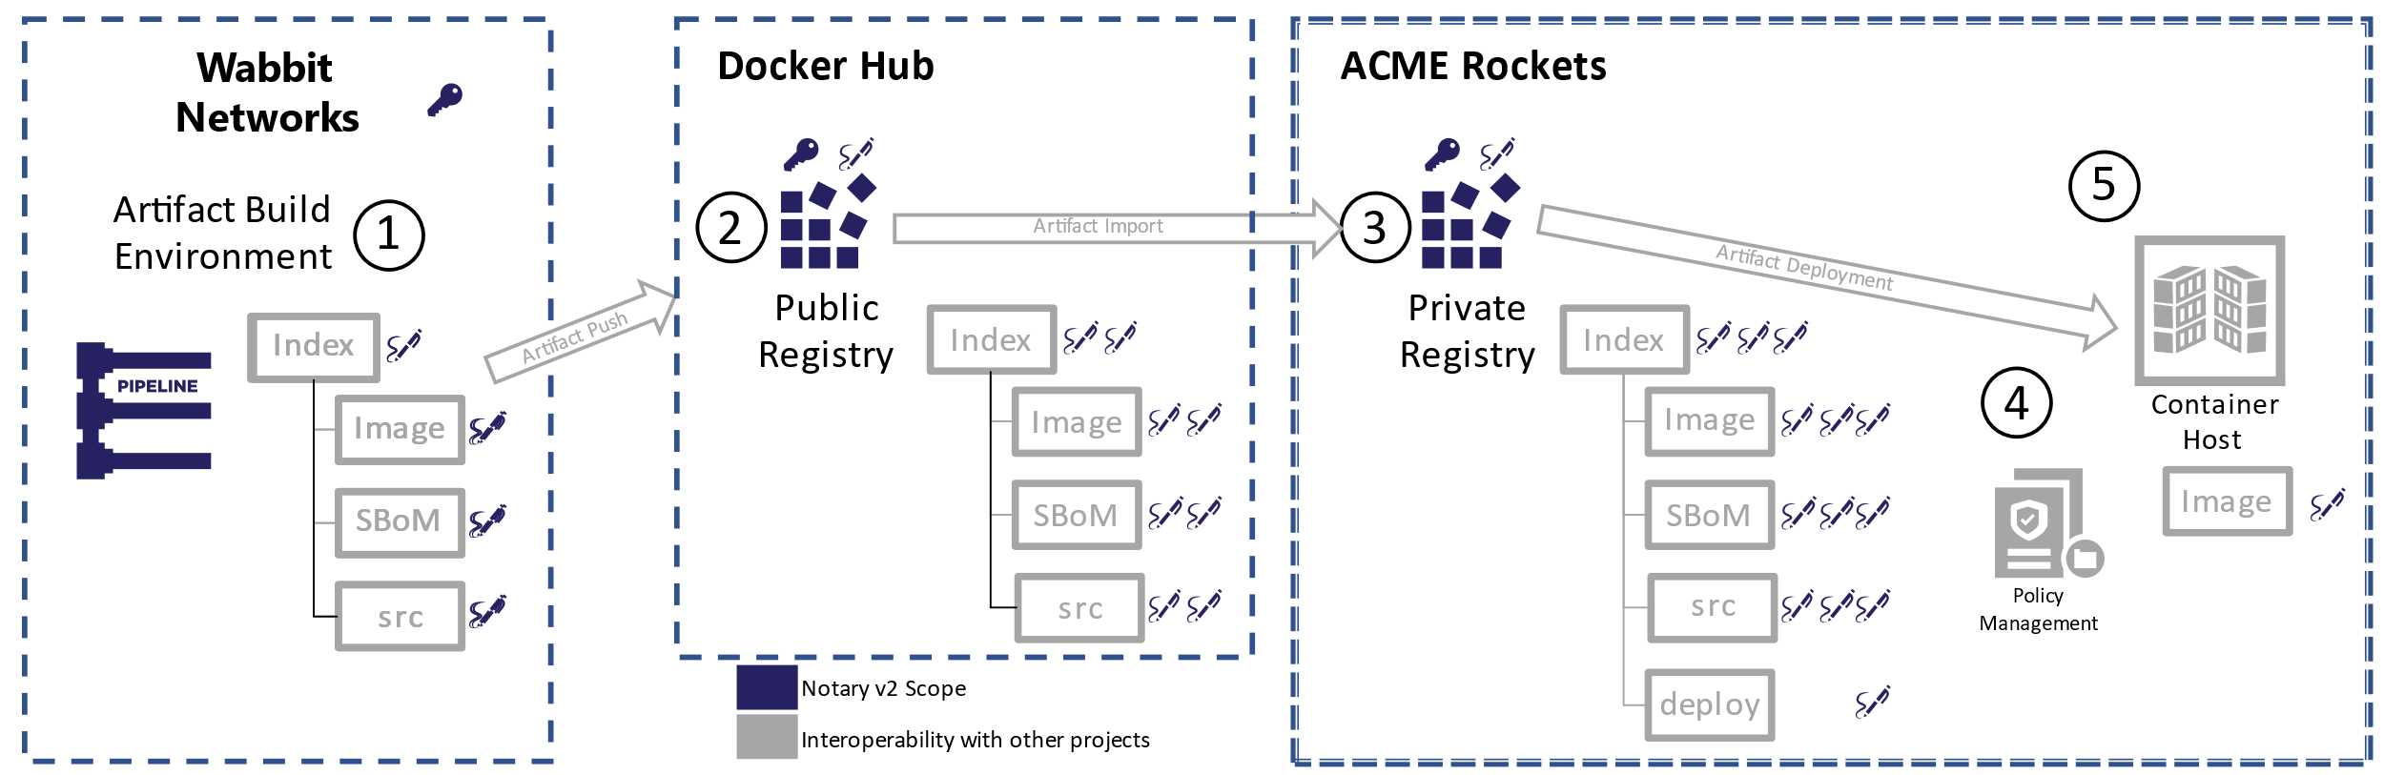
Enabling the Supply Chain
Content Promotion to Secured, Trusted Environments

Slide 3
What are the Supply Chain Artifact Types
Software Bill of Materials (SBoMs)
SPDX, CycloneDX, …
Security Scan Results, (list of vulnerabilities, at a point in time)
Formats starting to evolve (ossf/wg-vulnerability-disclosures)
More will exist
GPL Source, optionally including the source used to build the artifact
Signatures: proof of identity, by trusted providers, delivered end to end
Anything that can be represented as collections of one or more files
Can be multiple collections of files as well

Slide 4
Supply Chain Artifact Challenges
Artifacts are promoted across environments
Pubic → Shared Internal → Dev → Staging → Prod
Many of these destinations are within restricted networks (Vnets)
The supply chain artifacts should travel with the artifacts
Enabling evaluation and validation of the supply chain artifacts, where the content is consumed from

Slide 5

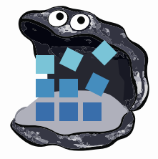












Container Registries
→ Artifact Registries
!
Y
Yet
Another
Storage
Solution
A
S
S

Slide 6




You have a thing. Where will you store your thing?
YASS?
cache
<-> REST
Thing
Notes:
You’re already building the thing, and all the experiences around the thing
What do you do for storage?
Build yet another storage solution (YASS)?
Leverage an existing solution?

Slide 7
Running A Storage Thing
VNET & Firewall Rules?
Documentation?
Authentication
What will you use?
Will it integrate with the rest of “the platform”
Security
How do you prevent hacks, DOS attacks, abuse?
Costs
Will you justify the costs to run the YASS?
Will you charge, offer for free- your YASS?
Multiple clouds?
Will other cloud vendors host this YASS for you?
Compliance
<-> REST
cache
Regional Replication?
Signing?

Slide 8
Registry Capabilities & Features
Capability | Feature
Security
Private Networking | Private Links
Sovereignty | Geo-replication
Limit public endpoints | Firewall Rules
Data exfiltration | Dedicated data endpoints
Double encryption at rest with Customer Managed Keys | Customer Manage Keys
Secure by default content | Quarantine
Policy management | Policy management
Integrated Security | Azure AD Objects
IoT/Device Security | Token Support
Repo Granularity | Repo Scoped Permissions
Public/Anonymous Access | Anonymous access
Locking a tag to a digest | Tag locking
Artifact Signing | Docker Content Trust & Notary v2
Automated content updating | Base Image Update Notifications
Capability | Feature
Reliability
Cross region redundancy | Geo-replication
In-region redundancy | Availability Zones
Performance
Locality | Geo-replication
In-network performance | Telport
Diagnostics & Troubleshooting
Diagnostics & Audit Logs | Diagnostics & Audit Logs
Health Check | Health Check CLI
Content Management
Auto-purging of aged out content | Auto Purge
Workflows
Asynchronous notifications | Regional Webhooks & Event Grid
Server-side content promotion | Import

Slide 9
What it takes to run a storage thing
~10 engineers - full time
Support
Compliance
Regional Rollouts
Feature Asks
Patching & Mediation of CVE Events
{ [] } Devs

Slide 10




Managed Versions Of YASS → YAPS
Notes:
Will each cloud run a managed instance of your YASS Thing?
YAPS – Yet Another Platform Service
What does it take to convince each vendor to host your YASS Thing?
Does a customer have to run your YASS Thing in their environment?

Slide 11
Registries & Reference Types
Registries are ubiquitous across all cloud providers
Cloud, On-Prem, IoT
Support performance, reliability, security capabilities from dev-prod
Users want fewer services to run, configure & maintain
Artifact authors want to focus on their thing
Does the SPDX or CycloneDX Community want to design, spec, build, service an SPDX or CycloneDX Service?

Slide 12
Artifact: Reference Type Principals
Multiple artifacts exist, and none should have to create YASS¹
Persisted alongside the subject artifact
Solves the discovery problem & network isolated/air-gapped environments
Reference Types artifacts can be copied with the target artifact
Associated with, but separable from the target artifact
Solves the trojan horse validation challenge
Target artifact must not change when adding new artifacts
docker pull mcr.microsoft.com/dotnet/runtime:5.0
docker pull mcr.microsoft.com/dotnet/runtime@sha256:ca9c27f79cfc669d74befcd93f
Helm chart references
Kubedeploy.yaml references
1- YASS- Yet Another Storage Service

Slide 13




Artifact: Reference Types
ACME Rockets Registry
Reference Types enable adding objects, which refer to a target artifact
net-monitor:v1
mediaType: oci.image.manifest
config (blob)
layer1 (blob)
layer2 (blob)
docker push net-monitor:v1
wabbit-networks signature
mediaType: cncf.oras.artifact.manifest.v1
artifactType : org.cncf.notary.v2
signature [blobs]
reference (subjectManifest)
notation sign net-monitor:v1 (notation cli incorporates push as a reference type)
SBoM Document
mediaType: cncf.oras.artifact.manifest.v1
artifactType: org.spdx.sbom.v3
sbom [blobs]
reference (subjectManifest)
spdx report net-monitor:v1
spdx push net-monitor:v1
(sbom cli could incorporate notation sign and oras-go push|discover|pull)
wabbit-networks signature
mediaType: cncf.oras.artifact.manifest.v1
artifactType: org.cncf.notary.v2
signature [blobs]
reference (subjectManifest)

Slide 14
net-monitor:v1
mediaType: oci.image.manifest
Demo Time
config (blob)
layer1 (blob)
layer2 (blob)
wabbit-networks signature
mediaType: cncf.oras.artifact.manifest.v1
artifactType: org.cncf.notary.v2
signature [blobs]
reference (subjectManifest)
SBoM Document
mediaType: cncf.oras.artifact.manifest.v1
artifactType: org.spdx.sbom.v3
Push, Discover, Pull Supply Chain Reference Types
sbom [blobs]
reference (subjectManifest)
wabbit-networks signature
mediaType: cncf.oras.artifact.manifest.v1
artifactType: org.cncf.notary.v2
signature [blobs]
reference (subjectManifest)

Slide 15

Artifact Copying
The reference graph enables deep, shallow of filtered copying
ACME Rockets
The reference graph enables deep, shallow of filtered copying
net-monitor:v1
net-monitor:v1
mediaType: oci.image.manifest
mediaType: oci.image.manifest
Artifact Copy
config (blob)
config (blob)
layer1 (blob)
layer1 (blob)
layer2 (blob)
layer2 (blob)

Slide 16

Artifact Copying
oci-reg copy \
--source docker.io/wabbitnetworks/net-monitor:v1 \
--target registry.acme-rockets.io/base-artifacts/net-monitor:v1
oci-reg copy \
--source docker.io/wabbitnetworks/net-monitor:v1 \
--target registry.acme-rockets.io/base-artifacts/net-monitor:v1 \
--include-references org.spdx.sbom.v3
oci-reg copy \
--source docker.io/wabbitnetworks/net-monitor \
--target registry.acme-rockets.io/base-artifacts/net-monitor:v1 \
--exclude-references org.scannerco.result.v1
ACME Rockets
net-monitor:v1
net-monitor:v1
mediaType: oci.image.manifest
mediaType: oci.image.manifest
config (blob)
config (blob)
layer1 (blob)
layer1 (blob)
layer2 (blob)
layer2 (blob)
wabbit-networks signature
wabbit-networks signature
mediaType: cncf.oras.artifact.manifest.v1
artifactType: cncf.notary.v2
mediaType: cncf.oras.artifact.manifest.v1
artifactType: cncf.notary.v2
signature [blobs]
signature [blobs]
reference (subjectManifest)
reference (subjectManifest)
Artifact Copy
SBoM Document
SBoM Document
mediaType: cncf.oras.artifact.manifest.v1
artifactType: org.spdx.sbom.v3
mediaType: cncf.oras.artifact.manifest.v1
artifactType: org.spdx.sbom.v3
sbom [blobs]
sbom [blobs]
reference (subjectManifest)
reference (subjectManifest)
wabbit-networks signature
wabbit-networks signature
mediaType: cncf.oras.artifact.manifest.v1
artifactType: cncf.notary.v2
mediaType: cncf.oras.artifact.manifest.v1
artifactType: cncf.notary.v2
signature [blobs]
signature [blobs]
reference (subjectManifest)
reference (subjectManifest)

Slide 17

Artifact Reference Types
OCI Artifacts: github.com/opencontainers/artifacts
ORAS Artifact Reference Types: github.com/oras-project/artifacts-spec
CNCF Distribution Reference Types: github.com/oras-project/distribution
Notary v2: github.com/notaryproject/notaryproject
Steve Lasker
Program Manager
Azure Container Registries
Steve.Lasker@Microsoft.com
@SteveLasker
SteveLasker.blog
github.com/SteveLasker
github.com/SteveLasker/presentations
Thank You

