Slide 1
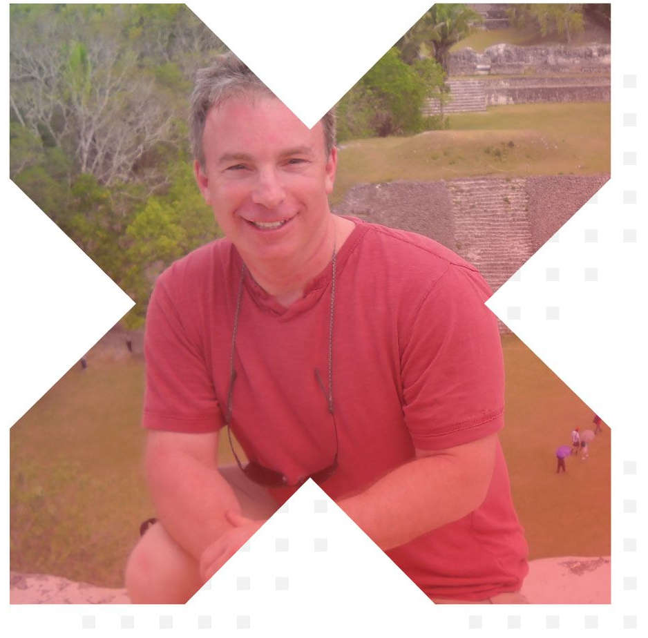


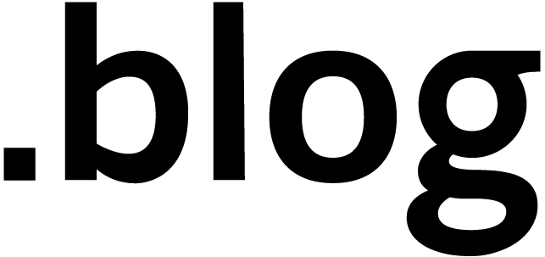

Leveraging Build Pipelines for Automating Container OS & Framework Patching
Steve Lasker
Program Manager
Azure Container Registries
Steve.Lasker@Microsoft.com
@SteveLasker
SteveLasker.blog
github.com/SteveLasker
github.com/SteveLasker/presentations
#REJEKTSNA2019

Slide 2




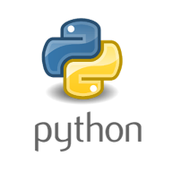







Containers: The App Packaging Format
Invocation
Response
contoso.azurecr.io/warranty/checkstatus:ab2q
<Code>
3.0preview
Version
9.341
2.1
9
1
Storage
Languages & runtimes
Secrets
Config

Slide 3
But, What About…
Where do the base artifacts come from?
Do you, should you, blindly trust upstream content?
How do you balance leveraging upstream content, while assuring stability?
Wrapping up a project, how do you patch containers?

Slide 4

How Do You Patch Containers?
Patch running containers, like VMs
Patch the container, at build time
Pull updated base images, rebuild, redeploy
Containers are a paradigm shift from VM workloads

Slide 5
Image Tagging
balancing servicing and stability

Slide 6

Deploy:
app:
web:1 x3
api:1 x3
cache:1 x4
HOST-A
3
Image Cache
web:1
digest: 91e
web:1
digest: 91e
app:
web:1 x3
api:1 x3
cache:1 x4
web:1
digest: 91e
api:1
digest: u82
api & cache are inconsistent states
1
cache:1
digest: 2re
cache:1
digest: 2re
docker build –t web:1
docker build –t api:1
docker build –t cache:1
docker images
REPOSITORY TAG DIGEST
web 1 91e
api 1 u82
cache 1 2re
docker push web:1
docker push api:1
docker push cache:1
HOST-B
Image Cache
api:1
digest: u82
api:1
digest: u82
9
8
api:1
digest: u82
5
cache:1
digest: 1n4
cache:1
digest: 2re
web:1
digest: 91e
cache:1
digest: 2re
api:1
digest: 3rp
api:1
digest: u82
cache:1
digest: 2re
cache:1
digest: 2re
Digests
91e
u82
2re
Image
web:1
api:1
cache:1
2
Digests
91e
u82
2re
3rp
1n4
web:1
digest: 91e
HOST-C
api:1
digest: u82
7
4
cache:1
digest: 2re
Image Cache
api:1
digest: 3rp
api:1
digest: 3rp
6
docker build –t api:1
docker build –t cache:1
docker images
REPOSITORY TAG DIGEST
api 1 3rp
cache 1 1n4
docker push api:1
docker push cache:1
cache:1
digest: 1n4
cache:1
digest: 1n4
api:1
digest: 3rp
cache:1
digest: 1n4
Notes:
Orchestrator icon from: http://cdn.marketplaceimages.windowsphone.com/v8/images/f58edb21-b20c-4315-b837-6cee21n442cd?imageType=ws_icon_large
https://git-scm.com/book/en/v2/Git-Branching-Basic-Branching-and-Merging

Slide 7
Tagging Techniques
Stable Tags
Tag
:latest
:1
:2
:3
:1.0
:1.1
:1.2
:2.0
:2.1
:3.0
Digest
91efj6
u82lq
2re7f
3rpn1
1n4ef
5wd1k
Build FROM
Serviced Stable Tags
Tag
:latest
:1
:2
:1.0
:1.1
:1.2
:2.0
Digest
91efj6
u82lq
e8s1f
1n4ef
2re7f
3rpn1
28efq
Deploy With
Unique Tagging
Tag
:12204
:12328
:12401
:33810
:35091
:4201
:50201
Digest
91efj6
u82lq
e8s1f
1n4ef
2re7f
3rpn1
28efq
Image Digest:
sha256:f875142531ccd91fbe8901c549fb453fee578f9a750b84d54e91f42fb95355b5
Notes:
[‎2/‎23/‎2018 3:18 PM] Sajay Antony:
https://git-scm.com/book/en/v2/Git-Branching-Basic-Branching-and-Merging
[‎2/‎23/‎2018 3:37 PM] Sajay Antony:
https://docs.docker.com/storage/storagedriver/
[‎2/‎23/‎2018 4:00 PM] Sajay Antony:
https://www.cockos.com/licecap/
[‎2/‎23/‎2018 5:10 PM] Sajay Antony:
https://docs.docker.com/datacenter/dtr/2.4/guides/user/create-promotion-policies/

Slide 8
Opportunity
What if:
You CI/CD pipeline was used for the life of the app
Your development unit and functional tests were used to validate base image updates?
The CI pipeline was triggered by base image updates, not just git commits

Slide 9

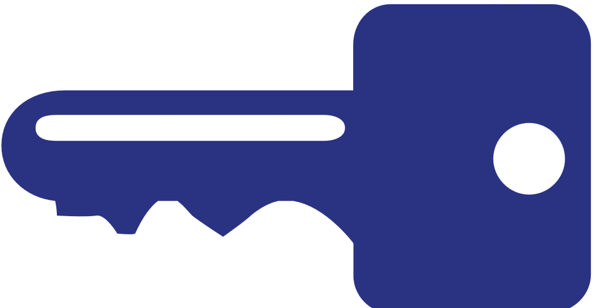

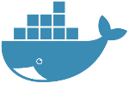



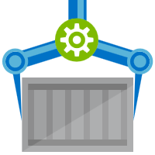







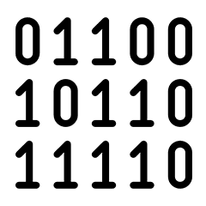
Are Your Base Artifacts Secure?
Images Secure?
Public Registries
Your Environment
aws, azure, google, on-prem, …
FROM demo42.azurecr.io/base-artifacts/dotnet/core/runtime:2.1.10 AS base
WORKDIR /app
FROM demo42.azurecr.io/base-artifacts/dotnet/core/sdk:2.1 AS build
WORKDIR /src
COPY src/Important/Important.csproj src/Important/
RUN dotnet restore src/Important/Important.csproj
COPY . .
WORKDIR /src/src/Important
RUN dotnet build Important.csproj -c Release -o /app
FROM build AS publish
RUN dotnet publish Important.csproj -c Release -o /app
FROM base AS final
WORKDIR /app
COPY --from=publish /app .
ENV VERSION=0.0.25
ENTRYPOINT ["dotnet", "Important.dll"]
FROM microsoft/dotnet/core/runtime:2.1.10 AS base
WORKDIR /app
FROM microsoft/dotnet/core/sdk:2.1 AS build
WORKDIR /src
COPY src/Important/Important.csproj src/Important/
RUN dotnet restore src/Important/Important.csproj
COPY . .
WORKDIR /src/src/Important
RUN dotnet build Important.csproj -c Release -o /app
FROM build AS publish
RUN dotnet publish Important.csproj -c Release -o /app
FROM base AS final
WORKDIR /app
COPY --from=publish /app .
ENV VERSION=0.0.25
ENTRYPOINT ["dotnet", "Important.dll"]
FROM mcr.microsoft.com/dotnet/core/runtime:2.1.10 AS base
Private Registry
acr, ecr, gcr, dtr, harbor, jfrog, …
.NET
demo42.azurecr.io
Docker Hub
FROM mcr.microsoft.com/dotnet/core/sdk:2.1 AS build
Public Internet
Task Image Validation
node
java
MCR
dotnet
ACR Tasks
wordpress
base-artifacts
node
Red Hat
java
dotnet
gcr
wordpress
dev
faclon-team
warriors-team
SCC
Source Code ControL
gpr

Slide 10
Are Your Base Artifacts Secure?
Images Secure?
Public Registries
Your Environment
aws, azure, google, on-prem, …
Private Registry
acr, ecr, gcr, dtr, harbor, jfrog, …
.NET
demo42.azurecr.io
Docker Hub
Public Internet
Task Image Validation
node
java
MCR
dotnet
ACR Tasks
wordpress
base-artifacts
node
Red Hat
java
dotnet
gcr
wordpress
dev
faclon-team
warriors-team
SCC
Source Code ControL
gpr

Slide 11
Demoing Base Artifact Updates
Public Registries
Your Environment
demo42.azurecr.io/hub
Private Registry
demo42.azurecr.io
Docker Hub
Public Internet
Task Image Validation
node
java
MCR
dotnet
ACR Tasks
wordpress
base-artifacts
node
java
dotnet
wordpress
dev
faclon-team
warriors-team
SCC
Source Code ControL

Slide 12
Demo
Event Driven Image Building…

Slide 13
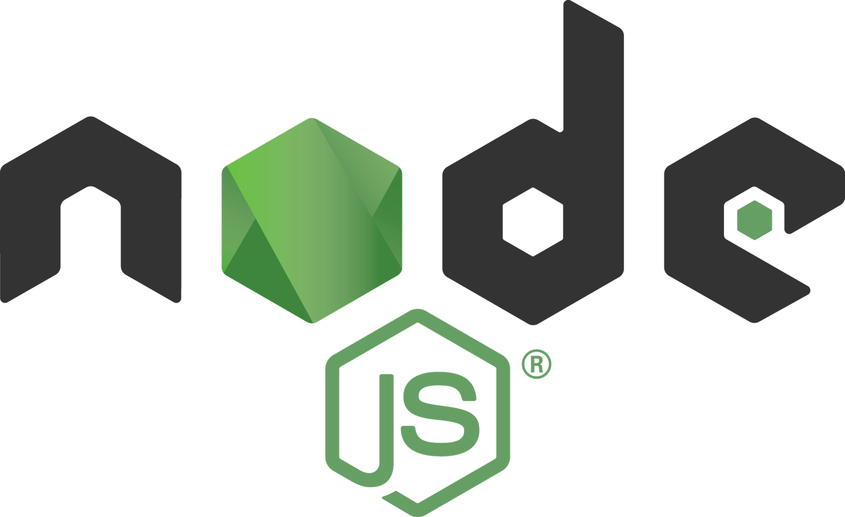
Automating Base Artifact Validation
Public Registries
Your Environment
aws, azure, google, on-prem, …
Private Registry
acr, ecr, gcr, dtr, harbor, jfrog, …
demo42.azurecr.io
Docker Hub
Public Internet
Task Image Validation
node
java
MCR
dotnet
ACR Tasks
wordpress
base-artifacts
node
Red Hat
java
dotnet
gcr
wordpress
dev
faclon-team
helloworld
digest: 91e
warriors-team
SCC
Source Code ControL
gpr

Slide 14
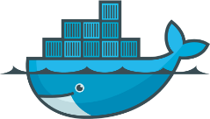
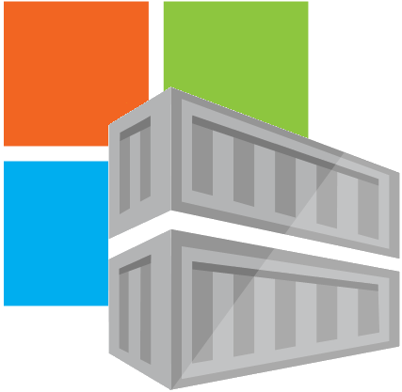
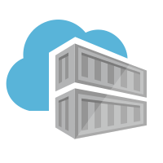
Container OS & Framework Patching
Triggers
Registries
Docker Hub
MCR
ACR
SCC Providers
ACR Tasks
Azure Container Registry
Timers
aka.ms/acr/tasks

Slide 15
Trust But Verify
Be protected and available,
when things outside your control aren’t secured or available, shouldn’t you still be secured and available?
Use OSS solutions
Buffer base artifacts in your secured environment
Validate each, and every download
Automate everything
Balance value with security
Follow best practices for tag locking
Build FROM stable tags
Deploy with Unique tags
Lock tags
Investments during development, will accrue to the life of the app

Slide 16



Thank You
ACR Tasks aka.ms/acr/tasks
ACR Import aka.ms/acr/import
ACR Tag Locking aka.ms/acr/tag-locking
Tagging Best Practices aka.ms/acr/tagging
Presentations aka.ms/acr/presentations
ACR Links aka.ms/acr/links
Steve Lasker
Program Manager
Azure Container Registries
Steve.Lasker@Microsoft.com
@SteveLasker
SteveLasker.blog
github.com/SteveLasker
github.com/SteveLasker/presentations

