Slide 1




Securing Container Workloads Build, Sign, Scan, Push, Deploy & VNets
Oh My
Steve Lasker
Program Manager
Azure Container Registries
Steve.Lasker@Microsoft.com
@SteveLasker
SteveLasker.blog
https://github.com/stevelasker

Slide 2
Where do you start? What are the components of securing workflows?

Slide 3
Multiple lines of defense
Authentication & Authorization
Container Workflows, w/Security

Slide 4


Security isn’t definitive it’s a matter of time, effort and how determined someone is.

Slide 5

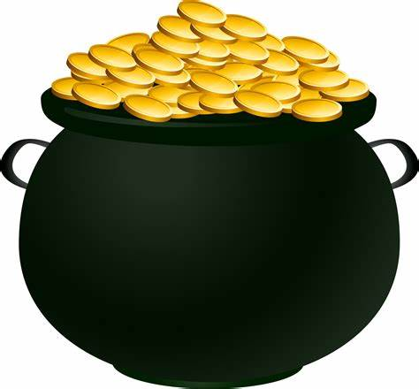
Multiple Lines Of Defense

Slide 6
Multiple Approaches
Authentication Boundaries
Active Scanning
Network Security
Content Verification

Slide 7
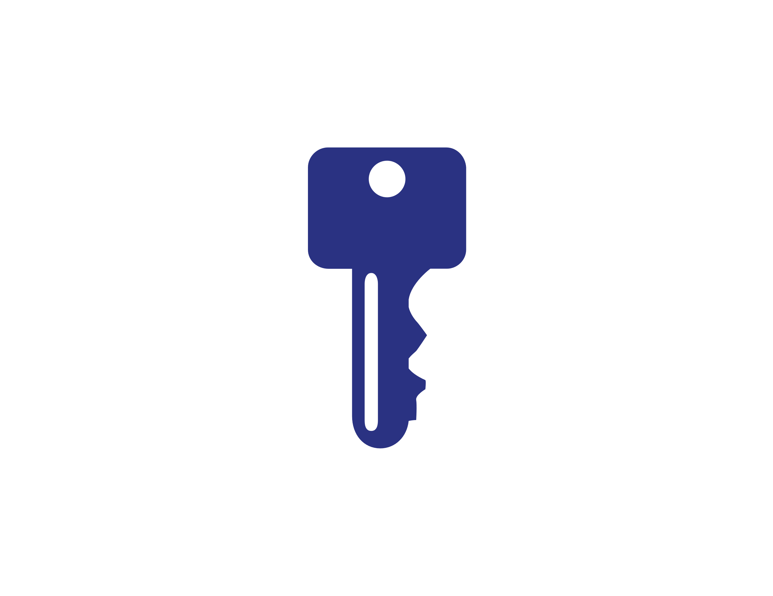

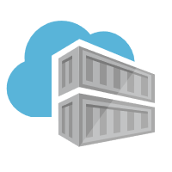


Authentication & Authorization
Require the most stringent authentication
Users – 2fa
Services – rotatable, revocable, time-based tokens
Provide the least permissions required to get the job done.
Runtime clusters should only be able pull images
CI Systems should be able to push
Who can sign images?
Authentication:
Username/Password?
2FA
Token
Certificate
Time based
Revocable?
Permissions:
Read – Pull
Write – Push
Sign – content trust
List – repos and tags
Delete
Update meta-data – expiration date
Users
Services

Slide 8

Container Workflows…

Slide 9
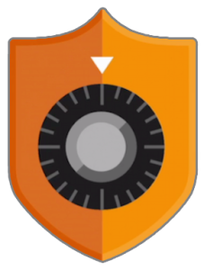
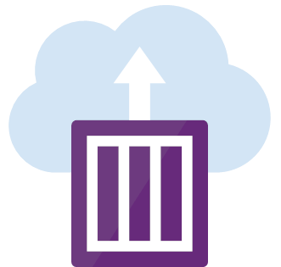
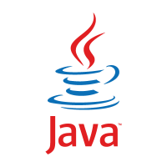



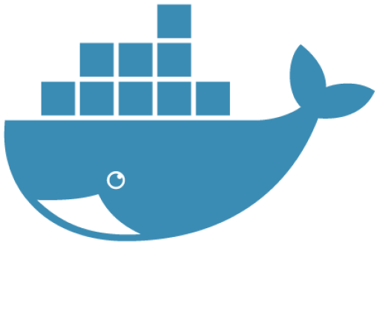


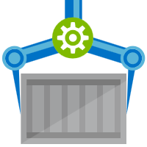



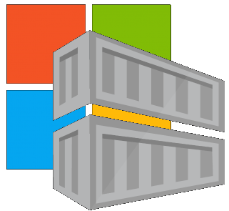



Container Lifecycle Primitives
Host agents monitor, protect and report running containers
3
Container Service
Container Instances
Source Code Control
(SCC)
Build/CI,
Integrate,
Test
CD, Deploy
7
App Services
Upon release, set released flag in ACR (ACR-Auto-purge policies)
Service Fabric
.NET
6
Base Image Index
4
8
1
2
Azure Functions
Docker Hub
ACR Tasks
Azure Container Registry
IoT
Azure Container Registry
Image Security Scanning
Secure by default
Microsoft Container Registry
Inner-Loop
Azure Batch
Run
5
Code
Validate
Debug
* Work in progress

