Slide 1






OCI Artifact Registries
Leveraging OCI Distribution for new Cloud Native Artifacts
The journey continues Adding support for Reference Types
Steve Lasker
Program Manager / Architect
Azure Container Registries
Steve.Lasker@Microsoft.com
@SteveLasker
SteveLasker.blog
github.com/SteveLasker
github.com/SteveLasker/presentations

Slide 2

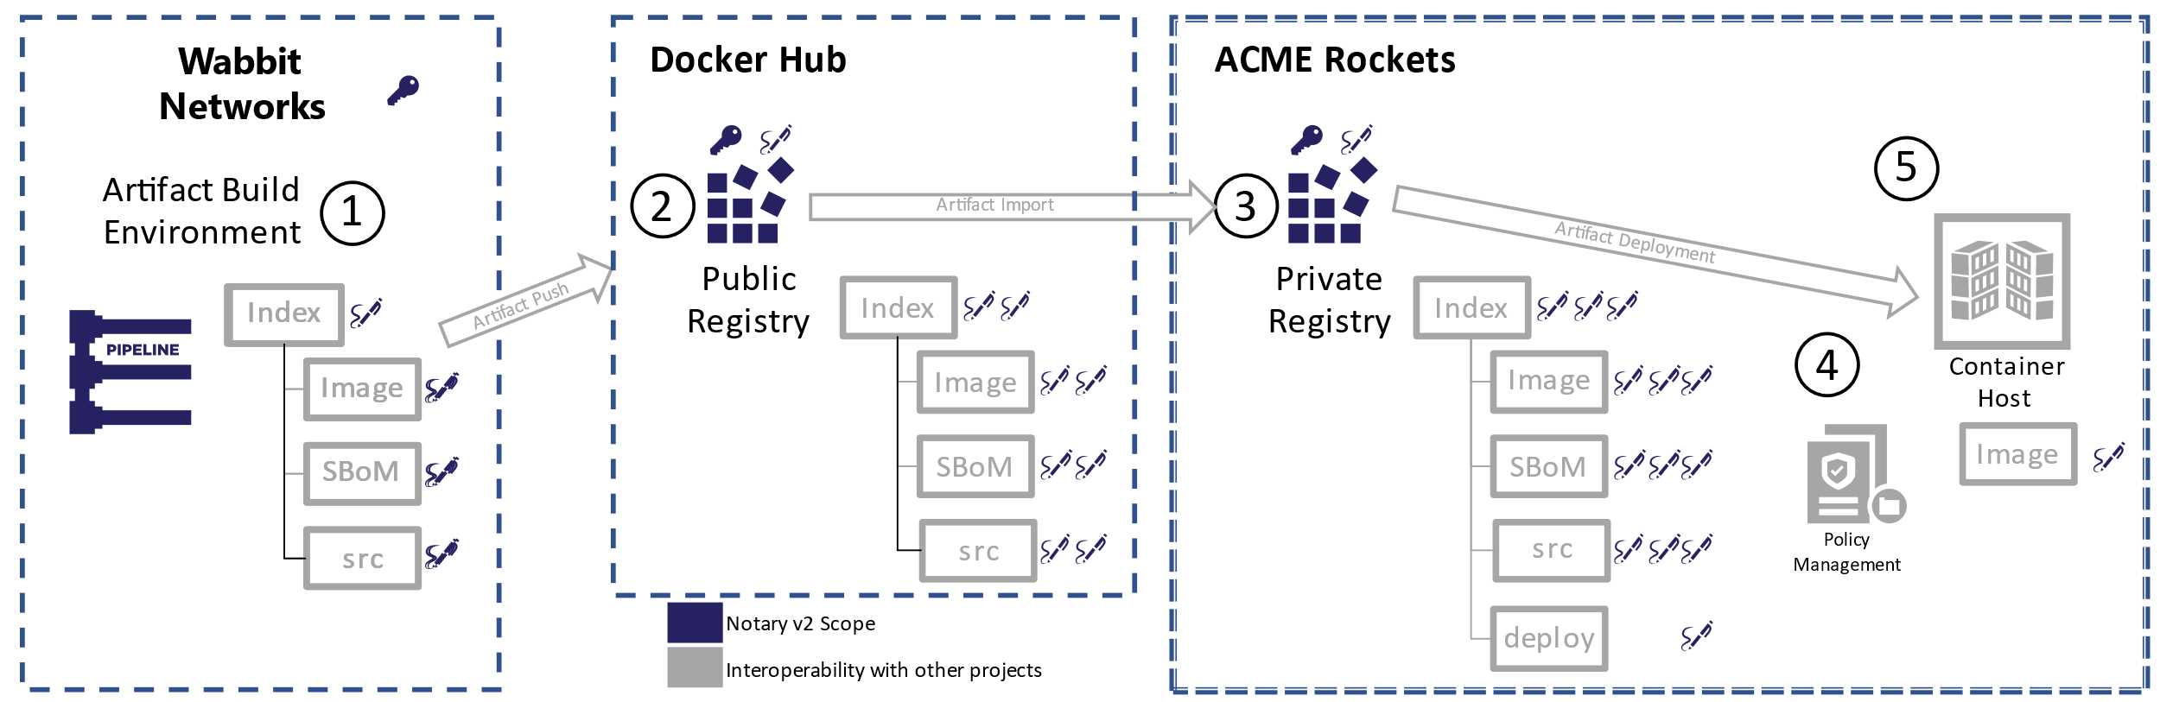
OCI Artifacts Enabling the Supply Chain

Slide 3
Secure Supply Chain Artifact Workflows

Slide 4
Container Registries
Production resources, fed through dev output
High availability – critical production asset
High performance – thousands of nodes and users concurrently interacting
Production security – Auth & RBAC, Firewalls, VNets, Policy, Scanning, Audit Logs, Content Management, Double Encryption at rest,
Ubiquitous – Every major cloud has one, on-prem, integrated into devops and production workflows

Slide 5
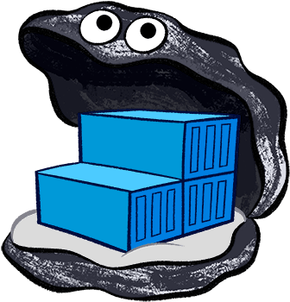
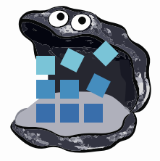












Container Registries
→ Artifact Registries
!
Y
Yet
Another
Storage
Solution
A
S
S

Slide 6
Supply Chain Artifacts
How OCI Artifacts supports Supply Chain Artifacts

Slide 7
What are the Supply Chain Artifact Types
Software Bill of Materials (SBoMs)
There are multiple formats
Security Scan Results, (list of vulnerabilities, at a point in time)
Formats starting to evolve (ossf/wg-vulnerability-disclosures)
More will exist
GPL Source, optionally including the source used to build the artifact
Anything that can be represented as collections of one or more files
Can be multiple collections of files as well

Slide 8




OCI Artifact: Reference Types
ACME Rockets Registry
Reference Types enable adding objects, which refer to a target artifact
net-monitor:v1
mediaType: oci.image.manifest
config (blob)
layer1 (blob)
layer2 (blob)
docker push net-monitor:v1
wabbit-networks signature
mediaType: oci.artifact.manifest.v1-rc1
referenceType: cncf.notary.v2
signature [blobs]
reference (subjectManifest)
nv2 sign net-monitor:v1 (nv2 cli incorporates push as a reference type)
SBoM Document
mediaType: oci.artifact.manifest.v1-rc1
referenceType: example.sbom.v0
sbom [blobs]
reference (subjectManifest)
sbom push net-monitor:v1
(sbom cli incorporates nv2 sign)
wabbit-networks signature
mediaType: oci.artifact.manifest.v1-rc1
referenceType: cncf.notary.v2
signature [blobs]
reference (subjectManifest)

Slide 9
OCI Artifact: Reference Type Principals
Multiple artifacts exist, and none should have to create YASS¹
Available alongside the target artifact
Solves the discovery problem & network isolated/air-gapped environments Reference Types artifacts can be copied with the target artifact
Associated with, but separable from the target artifact
Target artifact must not change when adding new artifacts
docker pull mcr.microsoft.com/dotnet/runtime:5.0
docker pull mcr.microsoft.com/dotnet/runtime@sha256:ca9c27f783381678c8a06d93944469c8cfc6669d7a244c26dd2cbbedfbcfd93f
Helm chart references
Kubedeploy.yaml references
1- YASS- Yet Another Storage Service

Slide 10

Demo Time
net-monitor:v1
mediaType: oci.image.manifest
config (blob)
layer1 (blob)
layer2 (blob)
wabbit-networks signature
mediaType: oci.artifact.manifest.v1-rc1
referenceType: cncf.notary.v2
signature [blobs]
reference (subjectManifest)
SBoM Document
mediaType: oci.artifact.manifest.v1-rc1
referenceType: example.sbom.v0
sbom [blobs]
reference (subjectManifest)
Push, Discover, Pull Supply Chain Reference Types
wabbit-networks signature
mediaType: oci.artifact.manifest.v1-rc1
referenceType: cncf.notary.v2
signature [blobs]
reference (subjectManifest)

Slide 11
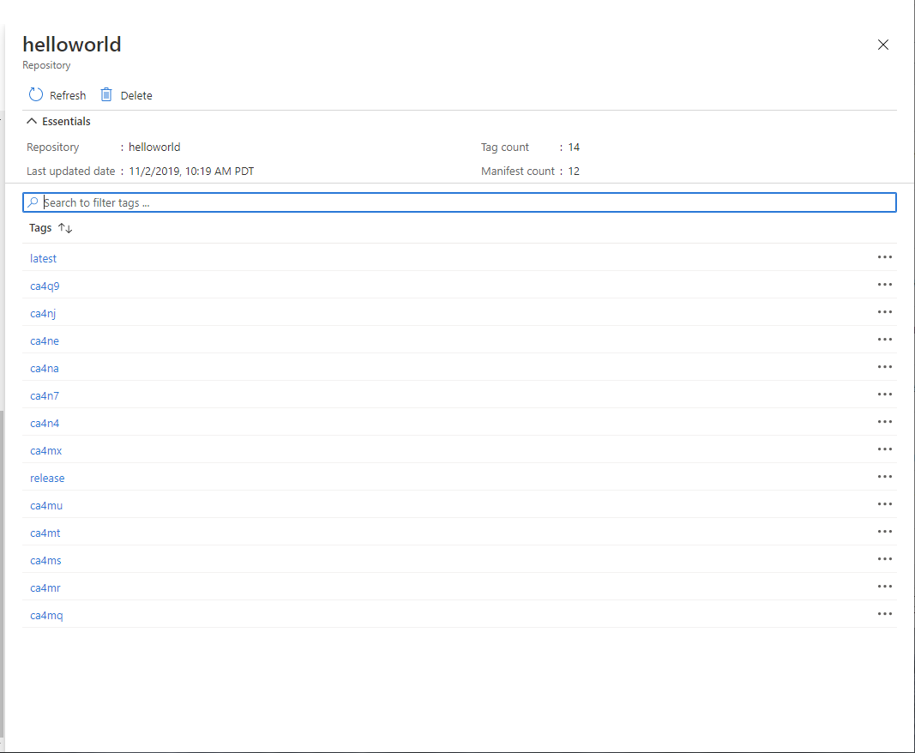
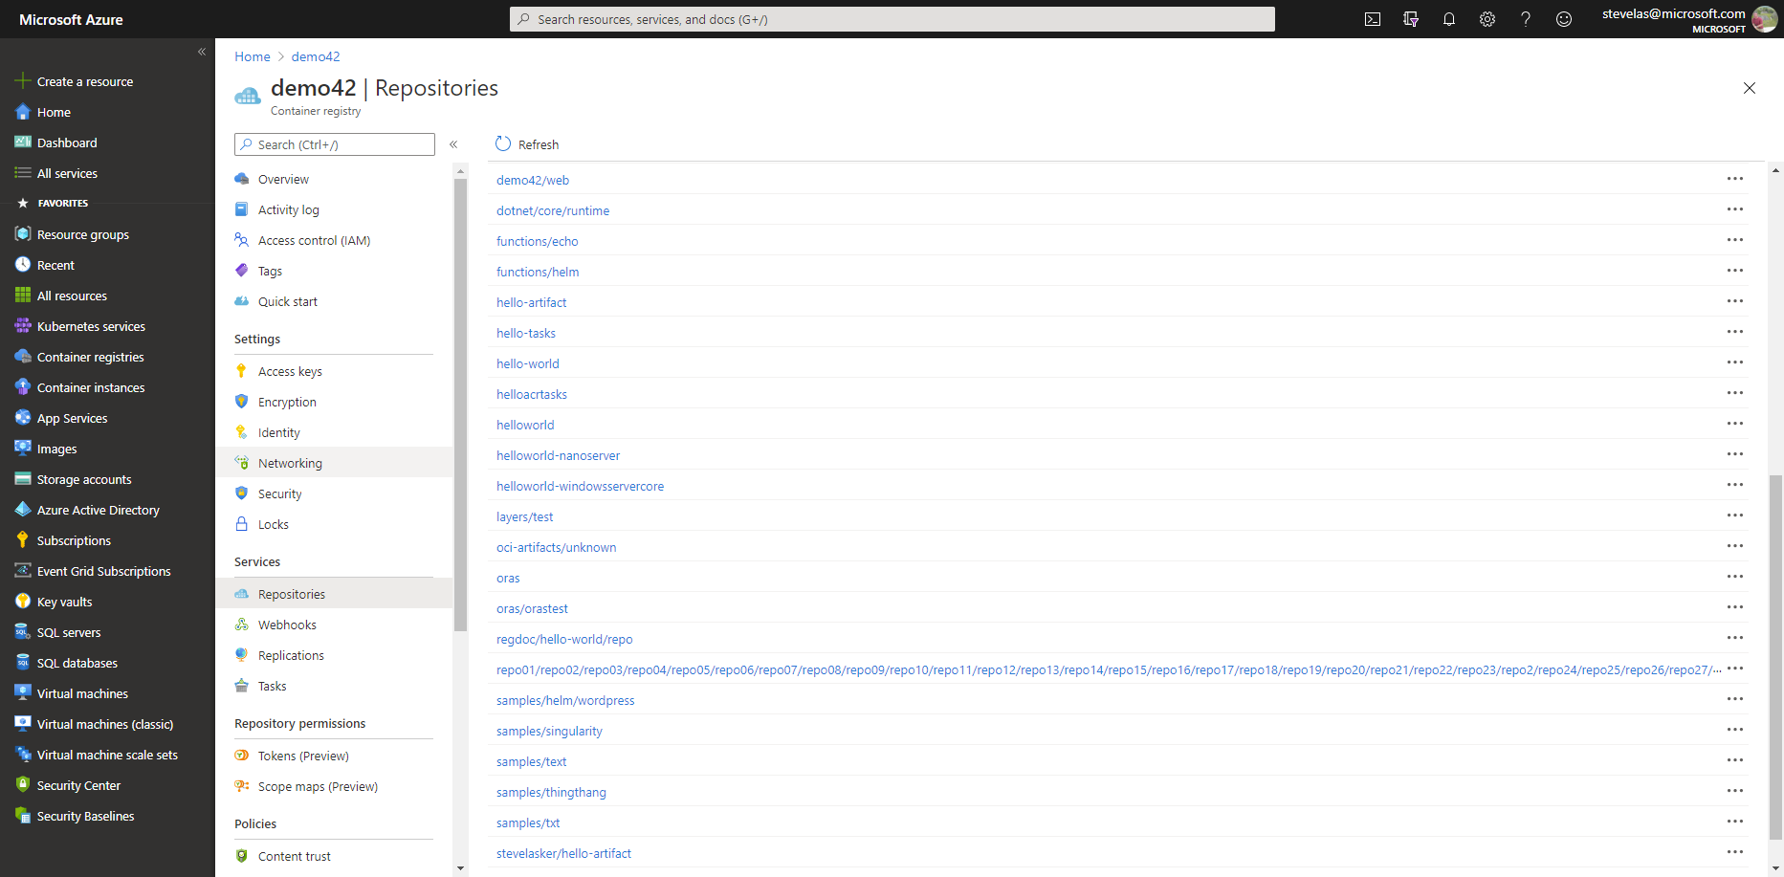


What should be seen?
latest
…
S
B
latest
o
M
ca4na
…
S
B
latest-signature
o
M
ca4nb
…
latest-signature-acme-rockets
…
ca4nc
latest-signature-wabbit-networks
…
ca4nd
ca4na
…
ca4ne
ca4na-signature
…
ca4ng
ca4na-signature-acme-rockets
…
ca4ng
ca4na-signature-wabbit-networks
…
ca4nh
ca4nb
…
ca4nj
ca4nb-signature
…
ca4nk
ca4nb-signature-acme-rockets
…
ca4nm
ca4nb-wabbit-networks

Slide 12


Individual Artifacts & Reference Artifacts
net-monitor:v1
notary v2 signature
config (blob)
layer1 (blob)
config (blob)
layer2 (blob)
signature (blob)
SBoM
notary v2 signature
config (blob)
config (blob)
SBoM-document (blob)
signature (blob)
YAAT
notary v2 signature
config (blob)
config (blob)
content (blob)
signature (blob)

Slide 13


Individual Artifacts & Reference Artifacts
net-monitor:v1
net-monitor:v1
config (blob)
notary v2 signature
layer1 (blob)
config (blob)
layer2 (blob)
layer1 (blob)
config (blob)
SBoM Document
Wabbit Networks signature
layer2 (blob)
signature (blob)
config (blob)
config (blob)
signature (blob)
signature (blob)
SBoM
notary v2 signature
Wabbit Networks signature
Docker signature
config (blob)
config (blob)
config (blob)
config (blob)
SBoM-document (blob)
signature (blob)
signature (blob)
signature (blob)
YAAT
notary v2 signature
ACME Rockets signature
YAAT Artifact
config (blob)
config (blob)
config (blob)
config (blob)
content (blob)
signature (blob)
signature (blob)
signature (blob)
Wabbit Networks signature
config (blob)
signature (blob)

Slide 14

OCI Artifact Copying
The reference graph enables deep, shallow of filtered copying
ACME Rockets
net-monitor:v1
net-monitor:v1
mediaType: oci.image.manifest
mediaType: oci.image.manifest
Artifact Copy
config (blob)
config (blob)
layer1 (blob)
layer1 (blob)
layer2 (blob)
layer2 (blob)

Slide 15

OCI Artifact Copying
oci-reg copy \
--source docker.io/wabbitnetworks/net-monitor \
--target registry.acme-rockets.io/base-artifacts/net-monitor:v1
oci-reg copy \
--source docker.io/wabbitnetworks/net-monitor \
--target registry.acme-rockets.io/base-artifacts/net-monitor:v1 \
--include-references org.cncf.notary.v2
oci-reg copy \
--source docker.io/wabbitnetworks/net-monitor \
--target registry.acme-rockets.io/base-artifacts/net-monitor:v1 \
--copy-references disabled
ACME Rockets
net-monitor:v1
net-monitor:v1
mediaType: oci.image.manifest
Artifact Copy
mediaType: oci.image.manifest
config (blob)
config (blob)
layer1 (blob)
layer1 (blob)
layer2 (blob)
layer2 (blob)
wabbit-networks signature
wabbit-networks signature
mediaType: oci.artifact.manifest.v1-rc1
referenceType: cncf.notary.v2
mediaType: oci.artifact.manifest.v1-rc1
referenceType: cncf.notary.v2
signature [blobs]
signature [blobs]
reference (subjectManifest)
reference (subjectManifest)
SBoM Document
SBoM Document
mediaType: oci.artifact.manifest.v1-rc1
referenceType: example.sbom.v0
mediaType: oci.artifact.manifest.v1-rc1
referenceType: example.sbom.v0
sbom [blobs]
sbom [blobs]
reference (subjectManifest)
reference (subjectManifest)
wabbit-networks signature
wabbit-networks signature
mediaType: oci.artifact.manifest.v1-rc1
referenceType: cncf.notary.v2
mediaType: oci.artifact.manifest.v1-rc1
referenceType: cncf.notary.v2
signature [blobs]
signature [blobs]
reference (subjectManifest)
reference (subjectManifest)

Slide 16
Deleting Reference Artifacts
DELETE
net-monitor:v1
config (blob)
layer1 (blob)
layer2 (blob)
SBoM Document
Wabbit Networks signature
config (blob)
config (blob)
signature (blob)
signature (blob)
notary v2 signature
Wabbit Networks signature
Docker signature
config (blob)
config (blob)
config (blob)
signature (blob)
signature (blob)
signature (blob)
notary v2 signature
ACME Rockets signature
YAAT Artifact
config (blob)
config (blob)
config (blob)
signature (blob)
signature (blob)
signature (blob)
Wabbit Networks signature
config (blob)
signature (blob)
Ref count -1

Slide 17
Artifact Workflow

Slide 18
From Development Through Consumption The CDC of a secure software supply chain
Create: The creation of content, binaries, services & applications
Distribution: of built content, distributed across registries from the point of creation to the point of consumption
Consumption: of built content, which is verified before it’s applied

Slide 19





Creation
net-monitor:v1
mediaType: oci.image.manifest
config (blob)
Containers
Deployment Templates (Helm, GitOps/RegOps
SBoM
Security Scan Results
Signatures
layer1 (blob)
layer2 (blob)
wabbit-networks signature
OS & Framework Patching
What happens when developers stop making code changes?
mediaType: cncf.oras.artifact.manifest.v1
referenceType: cncf.notary.v2
Build/CI,
Integrate,
Test
signature [blobs]
Source Code Control
(SCC)
reference (subjectManifest)
SBoM Document
Registry
mediaType: cncf.oras.artifact.manifest.v1
referenceType: example.sbom.v0
sbom [blobs]
reference (subjectManifest)
Content & Binaries Created
Content is Signed
SBoM Created & Signed
wabbit-networks signature
mediaType: oci.artifact.manifest.v1
referenceType: cncf.notary.v2
signature [blobs]
reference (subjectManifest)
Security Scan Result
Inner-Loop
Asynchronous process security scans, and generates a scan result which is signed and pushed to the registry
mediaType: cncf.oras.artifact.manifest.v1
referenceType: azure.securitycenter.scan-result.v1
Run
scan-result [blobs]
reference (subjectManifest)
Code
Validate
wabbit-networks signature
Debug
mediaType: cncf.oras.artifact.manifest.v1
referenceType: cncf.notary.v2
signature [blobs]
reference (subjectManifest)

Slide 20
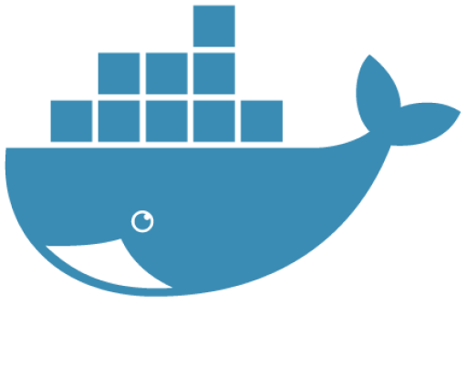




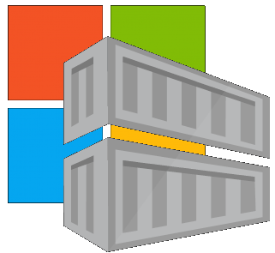


Distribution
Distribution may source from:
Public Aggregator Registries (Docker Hub, Quay, ECR)
Public Software Registries (MCR, NVIDIA, Oracle, …)
Private Registries (owned by companies with internal distribution)
Distribution to:
Public Aggregators may acquire content from software registries
Private registries consume content from all upstream sources, incorporating into their secured environment
As content is imported into privately maintained registries, content is:
Security scanned, to the policies of the company, with scan results attached
Signed, to attest to the scanning applied at the time of consumption

Slide 21
Distribution
Internal Library
Dev Teams
Prod Environments
ecr

Slide 22
Consumption
As content is consumed, it’s:
Validated for integrity
Validated for adherence to security policies
Validation is done at:
The point of import
(Evaluate SBOM and Signatures)
The point of consumption in a development environment (build time)
(Evaluate SBOM and Signatures)
The point of deployment. Should the deployment proceed?
(Evaluate SBOM and Signatures)
Instancing: is the integrity of the content, intact?
SBOMs haven’t changed, but has the content be tampered with? Is the environment scoped signature available and intact?

Slide 23
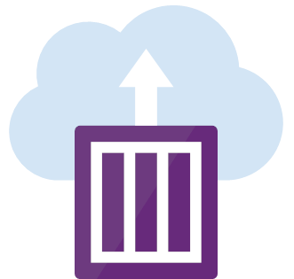

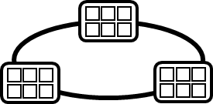
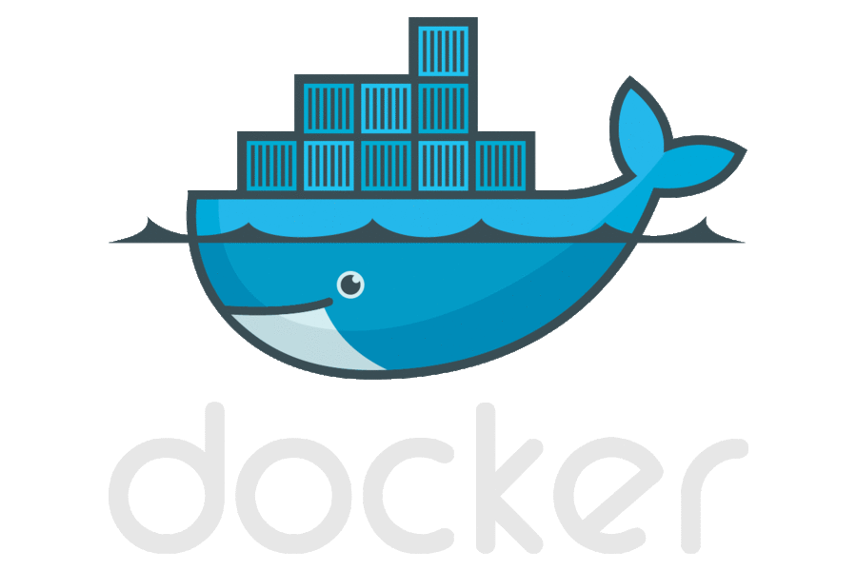









Container Lifecycle
Host agents monitor, protect and report running containers
Container Service
OS & Framework Patching
What happens when developers stop making code changes?
Run, Manage
Container Instances
Source Code Control
(SCC)
Build/CI,
Integrate,
Test
CD, Deploy
App Services
Production
environments
Upon release, set released flag in ACR (ACR-Auto-purge policies)
Service Fabric
.NET
Base Image Index
Azure Functions
Docker Hub
ACR Tasks
Azure Container Registry
IoT
Microsoft Container Registry
Image Security Scanning
Secure by default
Inner-Loop
Azure Batch
Run
Monitor and Diagnose
Code
Validate
Debug

Slide 25
OCI Artifact Reference Types
OCI Artifacts Reference Types: github.com/opencontainers/artifacts/pull/29
ORAS Reference Types: github.com/deislabs/oras/blob/reference-types/docs/artifact-manifest.md
CNCF Distribution Reference Types: github.com/notaryproject/distribution/blob/prototype-2/docs/reference-types.md
Notary v2: github.com/notaryproject/notaryproject
Steve Lasker
Program Manager
Azure Container Registries
Steve.Lasker@Microsoft.com
@SteveLasker
SteveLasker.blog
github.com/SteveLasker
github.com/SteveLasker/presentations
Thank You

