Slide 1






OCI Artifact Registries
Leveraging OCI Distribution for new Cloud Native Artifacts
The journey continues Adding support for Reference Types
Steve Lasker
Program Manager / Architect
Azure Container Registries
Steve.Lasker@Microsoft.com
@SteveLasker
SteveLasker.blog
github.com/SteveLasker
github.com/SteveLasker/presentations
OCI TOB member
OCI Artifact maintainer
CNCF Notary maintainer

Slide 2

OCI Artifacts Enabling the Supply Chain

Slide 3
Container Registries
Production resources, fed through dev output
High availability – critical production asset
High performance – thousands of nodes and users concurrently interacting
Production security – Auth & RBAC, Firewalls, VNets, Policy, Scanning, Audit Logs, Content Management, Double Encryption at rest,
Ubiquitous – Every major cloud has one, on-prem, integrated into devops and production workflows

Slide 4

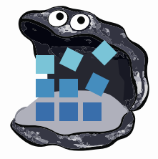












Container Registries
→ Artifact Registries
!
Y
Yet
Another
Storage
Solution
A
S
S

Slide 5
Supply Chain Artifacts
How OCI Artifacts supports Supply Chain Artifacts

Slide 6
What are the Supply Chain Artifact Types
Software Bill of Materials (SBoMs)
There are multiple formats
Security Scan Results, (list of vulnerabilities, at a point in time)
Formats starting to evolve (ossf/wg-vulnerability-disclosures)
More will exist
GPL Source, optionally including the source used to build the artifact
Anything that can be represented as collections of one or more files
Can be multiple collections of files as well

Slide 7




OCI Artifact: Reference Types
ACME Rockets Registry
Reference Types enable adding objects, which refer to a target artifact
net-monitor:v1
mediaType: oci.image.manifest
config (blob)
layer1 (blob)
layer2 (blob)
docker push net-monitor:v1
wabbit-networks signature
mediaType: oci.artifact.manifest.v1-rc1
referenceType: cncf.notary.v2
signature [blobs]
reference (subjectManifest)
nv2 sign net-monitor:v1 (nv2 cli incorporates push as a reference type)
SBoM Document
mediaType: oci.artifact.manifest.v1-rc1
referenceType: example.sbom.v0
sbom [blobs]
reference (subjectManifest)
sbom push net-monitor:v1
(sbom cli incorporates nv2 sign)
wabbit-networks signature
mediaType: oci.artifact.manifest.v1-rc1
referenceType: cncf.notary.v2
signature [blobs]
reference (subjectManifest)

Slide 8
OCI Artifact: Reference Type Principals
Multiple artifacts exist, and none should have to create YASS¹
Available alongside the target artifact
Solves the discovery problem & network isolated/air-gapped environments Reference Types artifacts can be copied with the target artifact
Associated with, but separable from the target artifact
Target artifact must not change when adding new artifacts
docker pull mcr.microsoft.com/dotnet/runtime:5.0
docker pull mcr.microsoft.com/dotnet/runtime@sha256:ca9c27f783381678c8a06d93944469c8cfc6669d7a244c26dd2cbbedfbcfd93f
Helm chart references
Kubedeploy.yaml references
1- YASS- Yet Another Storage Service

Slide 9

Demo Time
net-monitor:v1
mediaType: oci.image.manifest
config (blob)
layer1 (blob)
layer2 (blob)
wabbit-networks signature
mediaType: oci.artifact.manifest.v1-rc1
referenceType: cncf.notary.v2
signature [blobs]
reference (subjectManifest)
SBoM Document
mediaType: oci.artifact.manifest.v1-rc1
referenceType: example.sbom.v0
sbom [blobs]
reference (subjectManifest)
Push, Discover, Pull Supply Chain Reference Types
wabbit-networks signature
mediaType: oci.artifact.manifest.v1-rc1
referenceType: cncf.notary.v2
signature [blobs]
reference (subjectManifest)

Slide 10
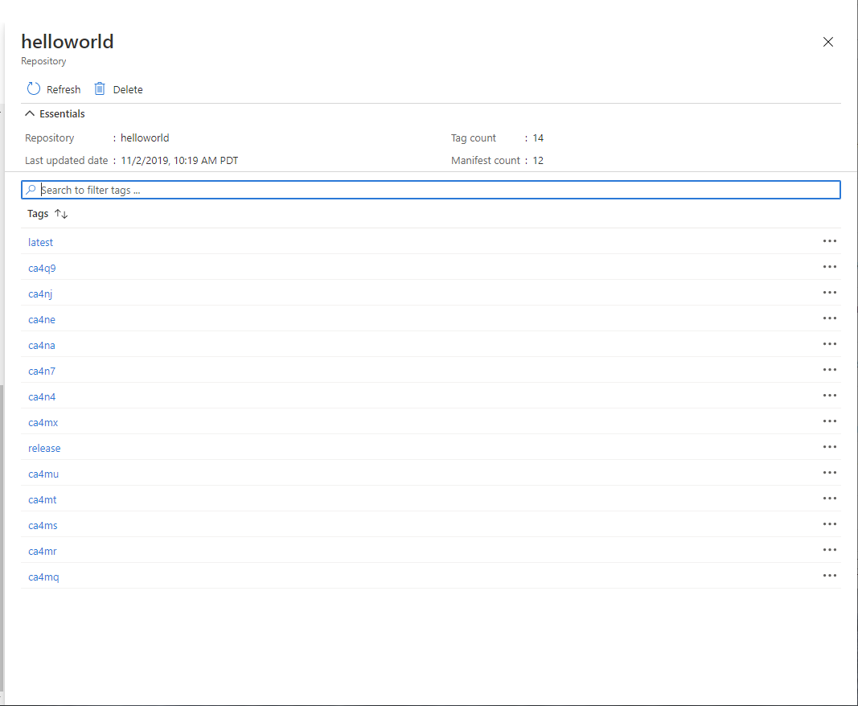
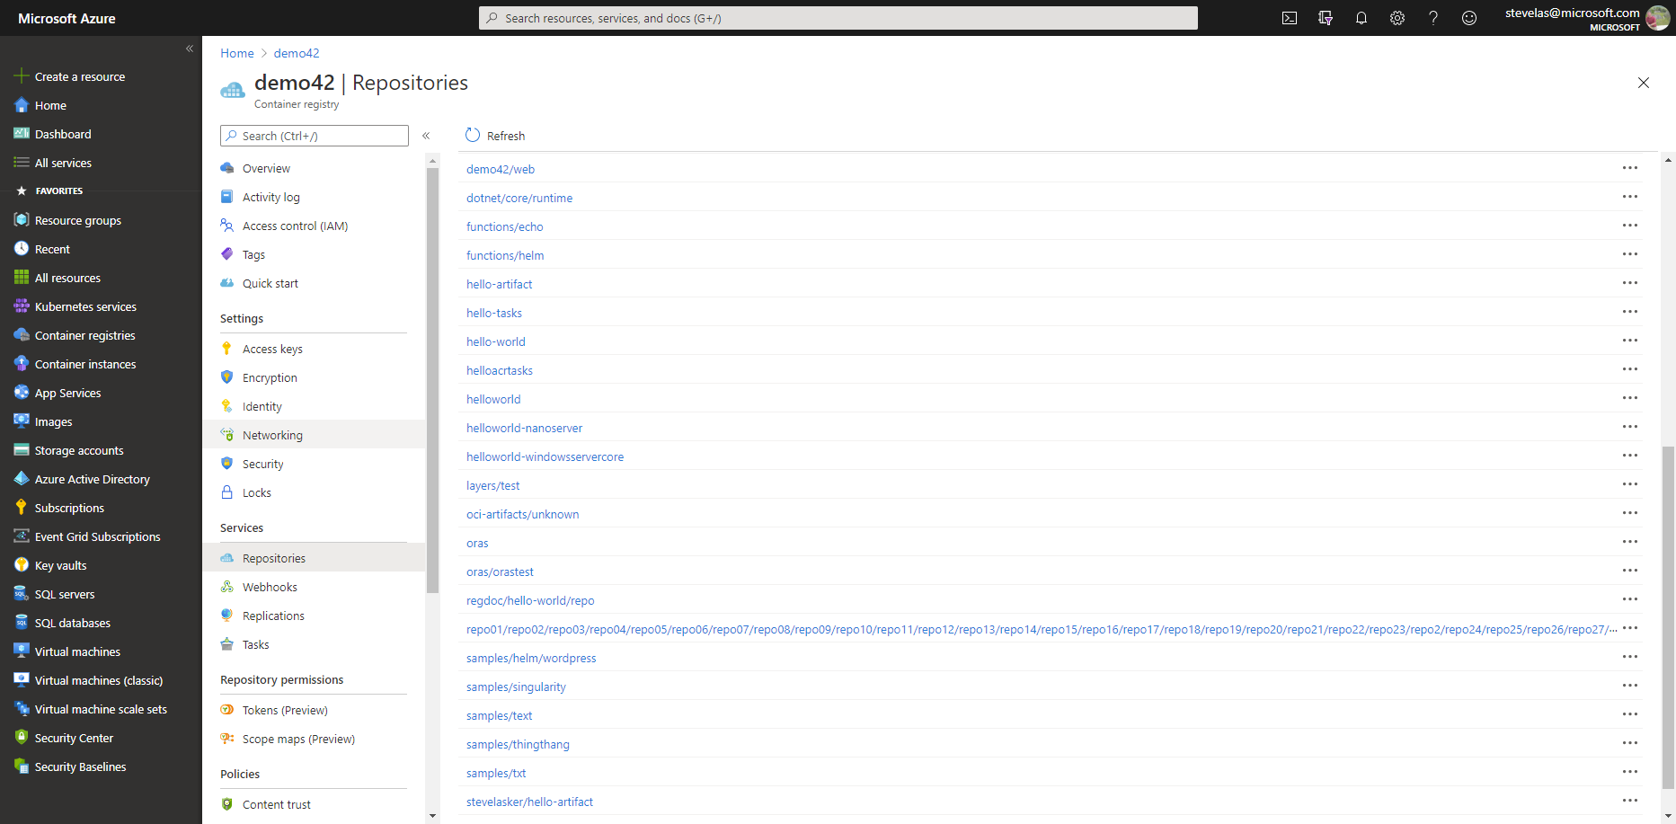


What should be seen?
latest
…
S
B
latest
o
M
ca4na
…
S
B
latest-signature
o
M
ca4nb
…
latest-signature-acme-rockets
…
ca4nc
latest-signature-wabbit-networks
…
ca4nd
ca4na
…
ca4ne
ca4na-signature
…
ca4ng
ca4na-signature-acme-rockets
…
ca4ng
ca4na-signature-wabbit-networks
…
ca4nh
ca4nb
…
ca4nj
ca4nb-signature
…
ca4nk
ca4nb-signature-acme-rockets
…
ca4nm
ca4nb-wabbit-networks

Slide 11


Individual Artifacts & Reference Artifacts
net-monitor:v1
notary v2 signature
config (blob)
layer1 (blob)
config (blob)
layer2 (blob)
signature (blob)
SBoM
notary v2 signature
config (blob)
config (blob)
SBoM-document (blob)
signature (blob)
YAAT
notary v2 signature
config (blob)
config (blob)
content (blob)
signature (blob)

Slide 12


Individual Artifacts & Reference Artifacts
net-monitor:v1
net-monitor:v1
config (blob)
notary v2 signature
layer1 (blob)
config (blob)
layer2 (blob)
layer1 (blob)
config (blob)
SBoM Document
Wabbit Networks signature
layer2 (blob)
signature (blob)
config (blob)
config (blob)
signature (blob)
signature (blob)
SBoM
notary v2 signature
Wabbit Networks signature
Docker signature
config (blob)
config (blob)
config (blob)
config (blob)
SBoM-document (blob)
signature (blob)
signature (blob)
signature (blob)
YAAT
notary v2 signature
ACME Rockets signature
YAAT Artifact
config (blob)
config (blob)
config (blob)
config (blob)
content (blob)
signature (blob)
signature (blob)
signature (blob)
Wabbit Networks signature
config (blob)
signature (blob)

Slide 13

OCI Artifact Copying
The reference graph enables deep, shallow of filtered copying
ACME Rockets
net-monitor:v1
net-monitor:v1
mediaType: oci.image.manifest
mediaType: oci.image.manifest
Artifact Copy
config (blob)
config (blob)
layer1 (blob)
layer1 (blob)
layer2 (blob)
layer2 (blob)

Slide 14

OCI Artifact Copying
oci-reg copy \
--source docker.io/wabbitnetworks/net-monitor \
--target registry.acme-rockets.io/base-artifacts/net-monitor:v1
oci-reg copy \
--source docker.io/wabbitnetworks/net-monitor \
--target registry.acme-rockets.io/base-artifacts/net-monitor:v1 \
--include-references org.cncf.notary.v2
oci-reg copy \
--source docker.io/wabbitnetworks/net-monitor \
--target registry.acme-rockets.io/base-artifacts/net-monitor:v1 \
--copy-references disabled
ACME Rockets
net-monitor:v1
net-monitor:v1
mediaType: oci.image.manifest
Artifact Copy
mediaType: oci.image.manifest
config (blob)
config (blob)
layer1 (blob)
layer1 (blob)
layer2 (blob)
layer2 (blob)
wabbit-networks signature
wabbit-networks signature
mediaType: oci.artifact.manifest.v1-rc1
referenceType: cncf.notary.v2
mediaType: oci.artifact.manifest.v1-rc1
referenceType: cncf.notary.v2
signature [blobs]
signature [blobs]
reference (subjectManifest)
reference (subjectManifest)
SBoM Document
SBoM Document
mediaType: oci.artifact.manifest.v1-rc1
referenceType: example.sbom.v0
mediaType: oci.artifact.manifest.v1-rc1
referenceType: example.sbom.v0
sbom [blobs]
sbom [blobs]
reference (subjectManifest)
reference (subjectManifest)
wabbit-networks signature
wabbit-networks signature
mediaType: oci.artifact.manifest.v1-rc1
referenceType: cncf.notary.v2
mediaType: oci.artifact.manifest.v1-rc1
referenceType: cncf.notary.v2
signature [blobs]
signature [blobs]
reference (subjectManifest)
reference (subjectManifest)

Slide 15
Deleting Reference Artifacts
DELETE
net-monitor:v1
config (blob)
layer1 (blob)
layer2 (blob)
SBoM Document
Wabbit Networks signature
config (blob)
config (blob)
signature (blob)
signature (blob)
notary v2 signature
Wabbit Networks signature
Docker signature
config (blob)
config (blob)
config (blob)
signature (blob)
signature (blob)
signature (blob)
notary v2 signature
ACME Rockets signature
YAAT Artifact
config (blob)
config (blob)
config (blob)
signature (blob)
signature (blob)
signature (blob)
Wabbit Networks signature
config (blob)
signature (blob)
Ref count -1

Slide 16
OCI Artifact Reference Types
OCI Artifacts Reference Types: github.com/opencontainers/artifacts/pull/29
ORAS Reference Types: github.com/deislabs/oras/blob/reference-types/docs/artifact-manifest.md
CNCF Distribution Reference Types: github.com/notaryproject/distribution/blob/prototype-2/docs/reference-types.md
Notary v2: github.com/notaryproject/notaryproject
Steve Lasker
Program Manager
Azure Container Registries
Steve.Lasker@Microsoft.com
@SteveLasker
SteveLasker.blog
github.com/SteveLasker
github.com/SteveLasker/presentations
Thank You

Slide 17
Run a Local Registry Instance
docker run -it -p 5000:5000 \
--name oci-artifact-registry \
notaryv2/registry:nv2-prototype-2

Slide 18
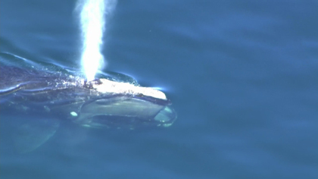
Coming up for air
OCI registries can support new artifact types
Leverage What Exists – focus on Your Thing
Declare a new mediaType to uniquely identify Your Thing
Register artifact mediaTypes with IANA.org
ORAS library available to ease development, but not required
Follow best practices for image tagging
stevelasker.blog/docker-tagging-best-practices-for-tagging-and-versioning-docker-images
oci.artifact.manifest – work in progress
github.com/opencontainers/artifacts/pull/29

Slide 19
Create an SBoM
sbom.json
{
"version": "0.0.0.0",
"image": "docker.io/hello-world:latest",
"contents": "good"
}
echo '{"version": "0.0.0.0", "image": "docker.io/hello-world:latest", "contents": "good"}' > sbom.json

Slide 20
Create an Scan Result
<?xml version='1.0' encoding='UTF-8'?>
<cvrfdoc>
<!-- Document wide context information -->
<DocumentTitle xml:lang="en">Acme Security Advisory for foo on bar - March 2017 - CSAF CVRF</DocumentTitle>
<DocumentType xml:lang="en">Acme Security Advisory</DocumentType>
<DocumentPublisher Type="Vendor"/>
<DocumentTracking>
<Identification>
<ID>acme-2017-42</ID>
</Identification>
<Status>Final</Status>
<Version>1.0</Version>
<RevisionHistory>
<Revision>
<Number>1.0</Number>
<Date>2017-03-17T12:34:56-06:00</Date>
<Description>Initial Distribution</Description>
</Revision>
<Revision>
<Number>1.1</Number>
<Date>2017-03-18T01:23:45-06:00</Date>
<Description>Corrected Distribution</Description>
</Revision>
</RevisionHistory>
<InitialReleaseDate>2017-01-17T12:34:56-06:00</InitialReleaseDate>
<CurrentReleaseDate>2017-01-18T01:23:34-06:00</CurrentReleaseDate>
</DocumentTracking>
<DocumentNotes>
<Note Audience="All" Ordinal="1" Title="Summary" Type="Summary" xml:lang="en">
This document contains descriptions of Acme product security vulnerabilities with details on impacted and non-impacted platform product combinations.
Additional information regarding these vulnerabilities including fix distribution information can be found at the Acme sites referenced in this document.</Note>
</DocumentNotes>
<DocumentDistribution>This document is published at: https://acme.example.com/sa/acme-2017-42-1-1.xml</DocumentDistribution>
<DocumentReferences>
<Reference Type="External">
<URL>https://acme.example.com/sa/acme-2017-42-1-1.json</URL>
<Description>URL to JSON version of Advisory</Description>
</Reference>
</DocumentReferences>
<Acknowledgments>
<Acknowledgment>
<Name>Some One (not to be named explicitly)</Name>
</Acknowledgment>
<Acknowledgment>
<Name>Jane Employee</Name>
<Organization>Acme Inc.</Organization>
</Acknowledgment>
</Acknowledgments>
<!-- Product tree section -->
<ProductTree xmlns="http://docs.oasis-open.org/csaf/ns/csaf-cvrf/v1.2/prod">
<Branch Name="Acme" Type="Vendor">
<Branch Name="Acme Things" Type="Product Family">
<Branch Name="Things On bar" Type="Product Name">
<Branch Name="1.9" Type="Product Version">
<FullProductName ProductID="AC-FOO-1.9-on-bar">Foo 1.9 on bar</FullProductName>
</Branch>
<Branch Name="2.1" Type="Product Version">
<FullProductName ProductID="AC-FOO-2.1-on-bar">Foo 2.1 on bar</FullProductName>
</Branch>
</Branch>
<Branch Name="Things On baz" Type="Product Name">
<Branch Name="1.9" Type="Product Version">
<FullProductName ProductID="AC-FOO-1.9-on-baz">Foo 1.9 on baz</FullProductName>
</Branch>
<Branch Name="2.1" Type="Product Version">
<FullProductName ProductID="AC-FOO-2.1-on-baz">Foo 2.1 on baz</FullProductName>
</Branch>
</Branch>
</Branch>
</Branch>
</ProductTree>
<!-- Vulnerability sections -->
<Vulnerability Ordinal="1" xmlns="http://docs.oasis-open.org/csaf/ns/csaf-cvrf/v1.2/vuln">
<Title>Vulnerability in the TCP component of Acme foo (CVE-2017-99999)</Title>
<Notes>
<Note Audience="All" Ordinal="1" Title="Details" Type="Details">
Vulnerability in the TCP component of Acme foo.
Supported versions that are affected are 1.9, and 2.0 when installed on bar but not affected when on baz.
Easily exploitable vulnerability allows unauthenticated attacker with network access via a single 0x42 value payload byte to compromise Acme foo.
Successful attacks of this vulnerability can result in unauthorized read access to a subset of Acme foo accessible data and unauthorized ability to cause a complete denial of service (DOS) of Acme foo.
CVSS 3.0 Base Score 9.8 (Confidentiality and Availability impacts).
CVSS Vector: CVSS:3.0/AV:N/AC:L/PR:N/UI:N/S:U/C:H/I:H/A:H).</Note>
</Notes>
<Involvements>
<Involvement Party="Vendor" Status="Completed">
<Description>Fix has been released</Description>
</Involvement>
</Involvements>
<CVE>CVE-2017-99999</CVE>
<ProductStatuses>
<Status Type="Known Affected">
<ProductID>AC-FOO-1.9-on-bar</ProductID>
<ProductID>AC-FOO-2.1-on-bar</ProductID>
</Status>
<Status Type="Known Not Affected">
<ProductID>AC-FOO-1.9-on-baz</ProductID>
<ProductID>AC-FOO-2.1-on-baz</ProductID>
</Status>
</ProductStatuses>
<CVSSScoreSets>
<ScoreSetV3>
<BaseScoreV3>9.8</BaseScoreV3>
<VectorV3>CVSS:3.0/AV:N/AC:L/PR:N/UI:N/S:U/C:H/I:H/A:H</VectorV3>
</ScoreSetV3>
</CVSSScoreSets>
<Remediations>
<Remediation Type="Vendor Fix">
<Description>acme-2017-42</Description>
<Entitlement xml:lang="it">Tutte le persone su questo pianeta</Entitlement>
<URL>https://acme.example.com/sa/acme-2017-42-1-1.html</URL>
<ProductID>AC-FOO-1.9-on-bar</ProductID>
<ProductID>AC-FOO-2.1-on-bar</ProductID>
</Remediation>
</Remediations>
</Vulnerability>
<!-- No more elements to follow -->
</cvrfdoc>
echo '{"version": "0.0.0.0", "image": "docker.io/hello-world:latest", "contents": "good"}' > sbom.json

Slide 21
OCI Artifact Copying
The reference graph enables deep, shallow of filtered copying
ACME Rockets
net-monitor:v1
net-monitor:v1
mediaType: oci.image.manifest
mediaType: oci.image.manifest
Artifact Copy
config (blob)
config (blob)
layer1 (blob)
layer1 (blob)
layer2 (blob)
layer2 (blob)

Slide 22
OCI Artifact Copying
oci-reg copy \
--source docker.io/wabbitnetworks/net-monitor \
--target registry.acme-rockets.io/base-artifacts/net-monitor:v1
oci-reg copy \
--source docker.io/wabbitnetworks/net-monitor \
--target registry.acme-rockets.io/base-artifacts/net-monitor:v1 \
--include-references org.cncf.notary.v2
oci-reg copy \
--source docker.io/wabbitnetworks/net-monitor \
--target registry.acme-rockets.io/base-artifacts/net-monitor:v1 \
--copy-references disabled
ACME Rockets
net-monitor:v1
net-monitor:v1
mediaType: oci.image.manifest
Artifact Copy
mediaType: oci.image.manifest
config (blob)
config (blob)
layer1 (blob)
layer1 (blob)
layer2 (blob)
layer2 (blob)
wabbit-networks signature
wabbit-networks signature
mediaType: oci.artifact.manifest.v1-rc1
referenceType: cncf.notary.v2
mediaType: oci.artifact.manifest.v1-rc1
referenceType: cncf.notary.v2
signature [blobs]
signature [blobs]
reference (subjectManifest)
reference (subjectManifest)
SBoM Document
SBoM Document
mediaType: oci.artifact.manifest.v1-rc1
referenceType: example.sbom.v0
mediaType: oci.artifact.manifest.v1-rc1
referenceType: example.sbom.v0
sbom [blobs]
sbom [blobs]
reference (subjectManifest)
reference (subjectManifest)
wabbit-networks signature
wabbit-networks signature
mediaType: oci.artifact.manifest.v1-rc1
referenceType: cncf.notary.v2
mediaType: oci.artifact.manifest.v1-rc1
referenceType: cncf.notary.v2
signature [blobs]
signature [blobs]
reference (subjectManifest)
reference (subjectManifest)

Slide 23
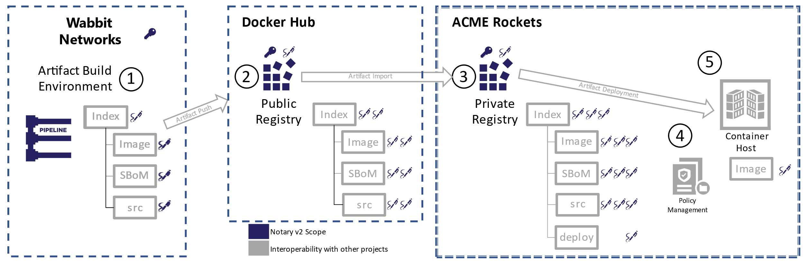
Secure Supply Chain Artifact Workflows

Slide 24
Notary v2 Goals
Support disconnected environments
Moving artifacts within and across different registries
The signature attests to the integrity of the content
What goes in, will come out
Notary v2 can wrap other contents, assuring what went in, comes out
Notary v2 is not limited to container images. Anything you put in a registry can be verified
Notary v2 is not limited to registries, as it supports a decentralized model
Registries are still authenticated, secured but dumb storage buckets
The storage now understands relationships

Slide 25
Separable Content
Clients can pull, just what they need
Notary v2 validations are done on the signatures, before the content is pulled
The container host can pull just the container image, now knowing about the signature
An IoT device doesn’t need the SBoM or even the signature
The existing toolchains don’t change.
Validations are done prior, as gates
Discovery is done through the target artifact, by the type
List all cncf.notary.v2 reference types for the net-monitor:v1 image

Slide 26
Reference Type Concepts
Pushing Artifacts
Push APIs for blobs and manifests already exist
Indexing Reference Types
Discovering Reference Artifacts
Lifecycle Management

Slide 27

Pushing Artifacts
Reference Types use the existing distribution PUSH APIs
Push blob(s)
Push manifest (tagged or untagged)
github.com/notaryproject/distribution/blob/prototype-2/docs/reference-types.md

Slide 28
Indexing References
Reference types are a reverse index
Enables finding artifacts, based on the subject manifest
Implemented by each registry, with CNCF Distribution reference
<root>
└── v2
└── repositories
└── net-monitor
└── _manifests
└── revisions
└── sha256
├── 73c803930ea3ba1e54bc25c2bdc53edd0284c62ed651fe7b00369da519a3c333 (image manifest)
│ ├── link
│ └── ref
│ └── digest(application/vnd.cncf.notary.v2)
│ └── sha256
│ └── 8ac803930ea3ba1e54bc25c2bdc53edd0284c62ed651fe7b00369da519a3c222 (signature manifest)
│ └── link
└── 8ac803930ea3ba1e54bc25c2bdc53edd0284c62ed651fe7b00369da519a3c222 (signature manifest)
└── link
net-monitor:v1
mediaType: oci.image.manifest
config (blob)
layer1 (blob)
layer2 (blob)
wabbit-networks signature
mediaType: oci.artifact.manifest.v1-rc1
referenceType: cncf.notary.v2
signature [blobs]
reference (subjectManifest)
github.com/notaryproject/distribution/blob/prototype-2/docs/reference-types.md

Slide 29
Discovery
What additional references exist for net-monitor:v1 ?
GET /v2/_ext/oci-artifacts/v1-rc1/{repository}/manifests/{digest}/referrers?
Returns a list of manifests that reference (refer) to a target manifest
Supports artifactType ^{(referenceType)} filtering & paging
/referrers?n=10 & referenceType=example.sbom.v0
Implemented by each registry, with CNCF Distribution reference
github.com/notaryproject/distribution/blob/prototype-2/docs/reference-types.md

Slide 30
Lifecycle Management
Garbage Collection (GC) needs metadata for when to maintain or delete content
Reference Types are untagged content
they exist as an extension to existing artifacts
they have no value unto themselves
Registries typically automatically delete untagged content
Establishing lineage to target artifact provides lifecycle context
When should content be deleted?
When the target artifact is deleted
github.com/SteveLasker/artifacts/blob/oci-artifact-manifest/artifact-manifest-spec.md#lifecycle-management

Slide 31
Reference Type Manifest
Manifest: "mediaType": "application/vnd.oci.artifact.manifest.v1-rc1+json"
Artifact Type: "referenceType": "cncf.notary.v2-rc1", "example.sbom.v0“, …
Content: blobs: "blobs": [collection of oci blob descriptors]
Target Artifact: "subjectManifest": {oci manifest descriptor}
Embedded Metadata: "annotations": {}
{
"schemaVersion": 3,
"mediaType": "application/vnd.oci.artifact.manifest.v1-rc1+json",
"referenceType": "cncf.notary.v2-rc1",
"blobs": [
{
"mediaType": "application/tar",
"digest": "sha256:9834876dcfb05cb167a5c24953eba58c4ac89b1adf57f28f2f9d09af107ee8f0",
"size": 32654
}
],
"subjectManifest": {
"mediaType": "application/vnd.oci.image.manifest.v1+json",
"digest": "sha256:73c803930ea3ba1e54bc25c2bdc53edd0284c62ed651fe7b00369da519a3c333",
"size": 16724
},
"annotations": {
"org.cncf.notary.v2.signature.subject": "wabbit-networks.io"
}
}

Slide 32
Appendix

Slide 33



Running A Storage Thing
VNET & Firewall Rules?
Documentation?
Authentication
What will you use?
Will it integrate with the rest of “the platform”
Security
How do you prevent hacks, DOS attacks, abuse?
Costs
Will you justify the costs to run the YASS?
Will you charge, offer for free- your YASS?
Multiple clouds?
Will other cloud vendors host this YASS for you?
Compliance
cache
<-> REST
Regional Replication?
Signing?

Slide 34
How Are Images Stored in OCI Registries
How Are Images Artifacts Stored in OCI Registries

Slide 35




Docker Pull Flow
demo42.azurecr.io
docker pull demo42.azurecr.io/hello-world:latest
1. Pull
<-> REST
cache
2. Manifest Returned
3. Delta Layer Requests
Manifests
Pull:
I want this “thing”,
Manifest:
What layers do I already have?
Manifest:
List of layer ID’s representing the entire thing
hello-world:latest
Image Cache
IMAGE ID REPOSITORY TAG SIZE
4. Blob URLs Returned
Wordpress-chart:5
5. Blob Request
hpctest:1
694950fbcb3f hello-world latest 1.2 GB
Layers Please:
Blobs
6. Layers Returned
Layer Cache
LAYER ID
cf4ecb49238476635f551fe11987ae4c3
e41864ee12411ff073f0a58417cf7e160
sha256:cf4ecb49238476635f551fe11987ae4c3
85bef57c324acc96f7067488d35b7e3c1
sha256:e41864ee12411ff073f0a58417cf7e160
sha256:85bef57c324acc96f7067488d35b7e3c1

Slide 36
Dissecting an OCI Image Manifest
OCI Image Manifest
{
"schemaVersion": 2,
"mediaType": "application/vnd.oci.image.manifest.v1+json",
"config": {
"mediaType": "application/vnd.oci.image.config.v1+json",
"digest": "sha256:bd698aa18aa02a2f083292b944813aef7845c336b8ad",
"size": 16078
},
"layers": [
{
"mediaType": "application/vnd.oci.image.layer.v1.tar+gzip",
"digest": "sha256:9a1a13172ed974323f7c35153e3127e640e45ef0aa",
"size": 23133155
},
{
"mediaType": "application/vnd.oci.image.layer.v1.tar+gzip",
"digest": "sha256:5094d5d656a95c6aa92a65db2947d7ce0c1a394",
"size": 226
}
]
}
OCI Manifest Types
oci.image.manifest – a single image
oci.image.index – a collection of images
OCI Content Descriptors
Consists of components, arranged in a Merkle Directed Acyclic Graph (DAG).
References between components in the graph are expressed through Content Descriptors.
Descriptors describes the disposition of the targeted content.
Descriptors include the type of content, a content identifier (digest), and the byte-size

Slide 37
Dissecting an OCI Image Manifest
OCI Image Manifest
{
"schemaVersion": 2,
"mediaType": "application/vnd.oci.image.manifest.v1+json",
"config": {
"mediaType": "application/vnd.oci.image.config.v1+json",
"digest": "sha256:bd698aa18aa02a2f083292b944813aef7845c336b8ad",
"size": 16078
},
"layers": [
{
"mediaType": "application/vnd.oci.image.layer.v1.tar+gzip",
"digest": "sha256:9a1a13172ed974323f7c35153e3127e640e45ef0aa",
"size": 23133155
},
{
"mediaType": "application/vnd.oci.image.layer.v1.tar+gzip",
"digest": "sha256:5094d5d656a95c6aa92a65db2947d7ce0c1a394",
"size": 226
}
]
}
OCI Manifest Types
oci.image.manifest – a single image
oci.image.index – a collection of images
Config
A blob, representing config info about the artifact. May be inspected prior to pulling the image artifact.
Layers
The content of the image artifact
Container images use this as an ordered, overlay of content

Slide 38
Dissecting an OCI Image Index
OCI Image Index
{
"schemaVersion": 2,
"mediaType": "application/vnd.oci.image.index.v1+json",
"manifests": [
{
"mediaType": "application/vnd.oci.image.manifest.v1+json",
"digest": "sha256:10b995d6204131069af3e4f00dc1d3758d5...",
"size": 4288,
"platform": {
"architecture": "amd64",
"os": "linux"
}
},
{
"mediaType": "application/vnd.oci.image.manifest.v1+json",
"digest": "sha256:33c5d954c76495826126178ded2113d1ada0a...",
"size": 4288,
"platform": {
"architecture": "amd64",
"os": "windows"
}
}
OCI Manifest Types
oci.image.manifest – a single image
oci.image.index – a collection of images
manifests
Collection of manifests, representing platform specific images
Layers
The content of the image artifact
Container images use this as an ordered, overlay of content
Platform Data
Used to determine which manifest to pull for the target host platform

Slide 39
Comparing an OCI Image Manifest & Index
OCI Image Manifest
{
"schemaVersion": 2,
"mediaType": "application/vnd.oci.image.manifest.v1+json",
"config": {
"mediaType": "application/vnd.oci.image.config.v1+json",
"digest": "sha256:bd698aa18aa02a2f083292b944813aef7845c336b8ad",
"size": 16078
},
"layers": [
{
"mediaType": "application/vnd.oci.image.layer.v1.tar+gzip",
"digest": "sha256:9a1a13172ed974323f7c35153e3127e640e45ef0aa",
"size": 23133155
},
{
"mediaType": "application/vnd.oci.image.layer.v1.tar+gzip",
"digest": "sha256:5094d5d656a95c6aa92a65db2947d7ce0c1a394",
"size": 226
}
]
}
OCI Image Index
{
"schemaVersion": 2,
"mediaType": "application/vnd.oci.image.index.v1+json",
"manifests": [
{
"mediaType": "application/vnd.oci.image.manifest.v1+json",
"digest": "sha256:10b995d6204131069af3e4f00dc1d3758d5...",
"size": 4288,
"platform": {
"architecture": "amd64",
"os": "linux"
}
},
{
"mediaType": "application/vnd.oci.image.manifest.v1+json",
"digest": "sha256:33c5d954c76495826126178ded2113d1ada0a...",
"size": 4288,
"platform": {
"architecture": " amd64 ",
"os": “windows"

Slide 40

Understanding the Artifact Type
Registries shall know the type they store
Vulnerability scanning products must know what they’re scanning
Registries may provide options, based on the type
Client tooling must know what they’re pulling – so they don’t fail
demo42.azurecr.io
<-> REST
helm update demo42.azurecr.io/charts/wordpress:5.7
docker run demo42.azurecr.io/charts/wordpress:5.7

Slide 41
Dissecting an OCI Image Manifest
manifest.config.mediaType Defines the Artifact Type
OCI Image Manifest
{
"schemaVersion": 2,
"mediaType": "application/vnd.oci.image.manifest.v1+json",
"config": {
"mediaType": "application/vnd.oci.image.config.v1+json",
"digest": "sha256:bd698aa18aa02a2f083292b944813aef7845c336b8ad",
"size": 16078
},
"layers": [
{
"mediaType": "application/vnd.oci.image.layer.v1.tar+gzip",
"digest": "sha256:9a1a13172ed974323f7c35153e3127e640e45ef0aa",
"size": 23133155
},
{
"mediaType": "application/vnd.oci.image.layer.v1.tar+gzip",
"digest": "sha256:5094d5d656a95c6aa92a65db2947d7ce0c1a394",
"size": 226
}
]
}
"application/vnd.docker.container.image.v1+json"
"application/vnd.oci.image.config.v1+json"
"application/vnd.cncf.helm.chart.config.v1+json"
"application/vnd.sylabs.sif.config.v1+json"
"application/vnd.cncf.openpolicyagent.config.v1+json"
Unique types registered with iana.org

Slide 42
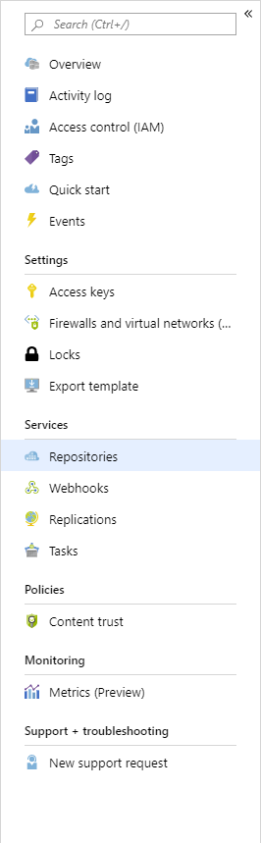
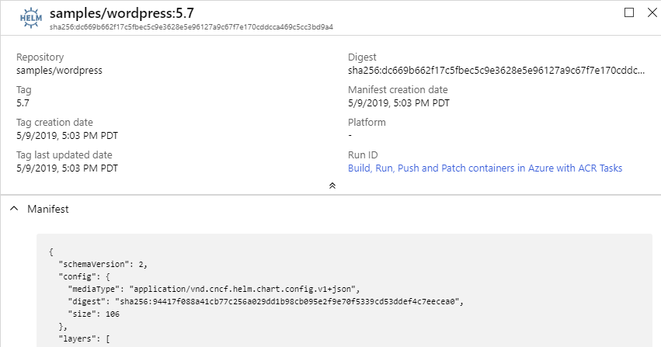
Type: Helm
repo/image:tag
How a registry knows it’s type

Slide 43
Why Config?
Started with manifest.artifactType
too impacting to existing OCI tooling
Minimal change to existing OCI compliant tooling
Enables artifact configuration data
The config object, can be null
Image Artifact Manifest
{
"schemaVersion": 2,
"mediaType": "application/vnd.oci.image.manifest.v1+json",
"artifactType": "application/vnd.cncf.helm.chart",
"config": {
"mediaType": "application/vnd.oci.image.config.v1+json",
"size": 16078,
"digest": "sha256:bd698aa18aa02a2f083292b9448130a3afaa9a3e5fba24fc0aef7845c336b8ad"
},
"layers": [
Image Artifact Manifest
Image Manifest
{
"schemaVersion": 2,
"mediaType": "application/vnd.oci.image.manifest.v1+json",
"config": {
"mediaType": "application/vnd.cncf.helm.chart.config.v1+json",
"size": 16078,
"digest": "sha256:bd698aa18aa02a2f083292b9448130a3afaa9a3e5fba24fc0aef7845c336b8ad"
},
"layers": [

Slide 44


Individual Artifacts & Reference Artifacts
net-monitor:v1
notary v2 signature
config (blob)
layer1 (blob)
config (blob)
layer2 (blob)
signature (blob)
wordpress:5
SBoM
notary v2 signature
config (blob)
config (blob)
config (blob)
layer1 (blob)
SBoM-document (blob)
signature (blob)
prod-policy:v9
YAAT
notary v2 signature
config (blob)
config (blob)
config (blob)
layer1 (blob)
content (blob)
signature (blob)

Slide 45
What should be seen?
latest
…
S
B
latest
o
M
ca4na
…
S
B
latest-signature
o
M
ca4nb
…
latest-signature-acme-rockets
…
ca4nc
latest-signature-wabbit-networks
…
ca4nd
ca4na
…
ca4ne
ca4na-signature
…
ca4ng
ca4na-signature-acme-rockets
…
ca4ng
ca4na-signature-wabbit-networks
…
ca4nh
ca4nb
…
ca4nj
ca4nb-signature
…
ca4nk
ca4nb-signature-acme-rockets
…
ca4nm
ca4nb-wabbit-networks

Slide 46
Individual Artifacts & Reference Artifacts
net-monitor:v1
notary v2 signature
config (blob)
layer1 (blob)
config (blob)
layer2 (blob)
signature (blob)
SBoM
notary v2 signature
config (blob)
config (blob)
SBoM-document (blob)
signature (blob)
YAAT
notary v2 signature
config (blob)
config (blob)
content (blob)
signature (blob)

Slide 47
Individual Artifacts & Reference Artifacts
net-monitor:v1
net-monitor:v1
config (blob)
notary v2 signature
layer1 (blob)
config (blob)
layer2 (blob)
layer1 (blob)
config (blob)
SBoM Document
Wabbit Networks signature
layer2 (blob)
signature (blob)
config (blob)
config (blob)
signature (blob)
signature (blob)
SBoM
notary v2 signature
Wabbit Networks signature
Docker signature
config (blob)
config (blob)
config (blob)
config (blob)
SBoM-document (blob)
signature (blob)
signature (blob)
signature (blob)
YAAT
notary v2 signature
ACME Rockets signature
YAAT Artifact
config (blob)
config (blob)
config (blob)
config (blob)
content (blob)
signature (blob)
signature (blob)
signature (blob)
Wabbit Networks signature
config (blob)
signature (blob)

Slide 48
Deleting Reference Artifacts
DELETE
net-monitor:v1
config (blob)
layer1 (blob)
layer2 (blob)
SBoM Document
Wabbit Networks signature
config (blob)
config (blob)
signature (blob)
signature (blob)
notary v2 signature
Wabbit Networks signature
Docker signature
config (blob)
config (blob)
config (blob)
signature (blob)
signature (blob)
signature (blob)
notary v2 signature
ACME Rockets signature
YAAT Artifact
config (blob)
config (blob)
config (blob)
signature (blob)
signature (blob)
signature (blob)
Wabbit Networks signature
config (blob)
signature (blob)
Ref count -1

Slide 49
Comparing OCI Image & Artifact Manifest
+ New Manifest Type
Differentiates from image.manifest & image.index
OCI Artifact Manifest
{
"schemaVersion": 1,
"mediaType": "application/vnd.oci.artifact.manifest.v1+json",
"artifactType": "application/vnd.cncf.notary.v2",
"config": {
"mediaType": "application/vnd.cncf.notary.config.v2+json",
"digest": "sha256:bd698aa18aa02a2f083292b944813aef7845c336b8ad",
"size": 16078
},
"blobs": [
{
"mediaType": "application/tar+gzip",
"digest": "sha256:9a1a13172ed974323f7c35153e3127e640e45ef0aa",
"size": 23133155
}
"manifests": [
{
"mediaType": "application/vnd.oci.image.manifest.v1+json",
"digest": "sha256:10b995d6204131069af3e4f00dc1d3758d5... ",
"size": 4288
}
]
}
+ artifactType
Formalizes the type of artifact (Notary, SBoM, Helm, CNAB, Nydus) from the config.mediaType
~ blobs
Renamed layers to blobs
+ manifests
References to existing manifests, already in the registry.

Slide 50
Comparing OCI Image & Artifact Manifest
OCI Image Manifest
{
"schemaVersion": 2,
"mediaType": "application/vnd.oci.image.manifest.v1+json",
"config": {
"mediaType": "application/vnd.oci.image.config.v1+json",
"digest": "sha256:bd698aa18aa02a2f083292b944813aef7845c336b8ad",
"size": 16078
},
"layers": [
{
"mediaType": "application/vnd.oci.image.layer.v1.tar+gzip",
"digest": "sha256:9a1a13172ed974323f7c35153e3127e640e45ef0aa",
"size": 23133155
},
{
"mediaType": "application/vnd.oci.image.layer.v1.tar+gzip",
"digest": "sha256:5094d5d656a95c6aa92a65db2947d7ce0c1a394",
"size": 226
}
]
}
OCI Artifact Manifest
{
"schemaVersion": 1,
"mediaType": "application/vnd.oci.artifact.manifest.v1+json",
"artifactType": "application/vnd.cncf.notary.v2",
"config": {
"mediaType": "application/vnd.cncf.notary.config.v2+json",
"digest": "sha256:bd698aa18aa02a2f083292b944813aef7845c336b8ad",
"size": 16078
},
"blobs": [
{
"mediaType": "application/tar+gzip",
"digest": "sha256:9a1a13172ed974323f7c35153e3127e640e45ef0aa",
"size": 23133155
}
"manifests": [
{
"mediaType": "application/vnd.oci.image.manifest.v1+json",
"digest": "sha256:10b995d6204131069af3e4f00dc1d3758d5... ",
"size": 4288
}
]
}
+1
~2
+3

Slide 51
Demo Time
Target e2e experience for Notary v2

Slide 52
Finding Reference Artifacts
How do you find linked artifacts?
OCI Artifacts Links API proposal:
/v2/_ext/oci-artifacts/{repository}/manifests/{digest}/links
What additional artifacts are related to net-monitor:v1
Convert the tag to a digest:
curl -v -H "Accept: application/vnd.docker.distribution.manifest.v2+json" \
registry.wabbit-networks.io/v2/net-monitor/manifests/v1 2>&1 | \
grep -i 'Docker-Content-Digest:' | \
awk '{print $3}'
Query list of linked artifacts ^{(not yet implemented)}
curl –k registry.wabbit-networks.io/v2/_ext/net-monitor/manifests/{digest}/links
Possible FIlters ^{(not yet implemented)}
?artifactType=application/vnd.oci.notary.v2.config+json

Slide 53
Coming up for air
OCI registries can support new artifact types
Leverage What Exists – focus on Your Thing
Declare a new mediaType to uniquely identify Your Thing
Register artifact mediaTypes with IANA.org
ORAS library available to ease development, but not required
Follow best practices for image tagging
stevelasker.blog/docker-tagging-best-practices-for-tagging-and-versioning-docker-images
oci.artifact.manifest – work in progress
github.com/opencontainers/artifacts/pull/29

Slide 54
Getting Involved with OCI Artifact Registries
OCI Artifacts: github.com/opencontainers/artifacts
ORAS: github/com/deislabs/oras
Notary v2: github.com/notaryproject/notaryproject
Getting Started: stevelasker.blog/authoring-oci-registry-artifacts-quick-guide
Getting Started in Azure: aka.ms/acr/artifacts
Slack: opencontainers.slack.com #artifact-registry
To Join: chat.opencontainers.org/
Steve Lasker
Program Manager
Azure Container Registries
Steve.Lasker@Microsoft.com
@SteveLasker
SteveLasker.blog
github.com/SteveLasker
github.com/SteveLasker/presentations
Thank You

