Slide 1
Azure Container Registry
Steve Lasker
Program Manager
Azure Developer Experiences
@SteveLasker

Slide 2
Why: Azure Container Registry
Keep Your Images Private
Stored in Azure with your resources
Network-Close
Deployed to your targets within the same data center
No ingress/egress fees or latency
Azure Active Directory Integration
Manage registry access using AAD
Familiar Open Source CLIs
docker login, pull, push

Slide 3

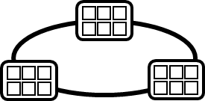


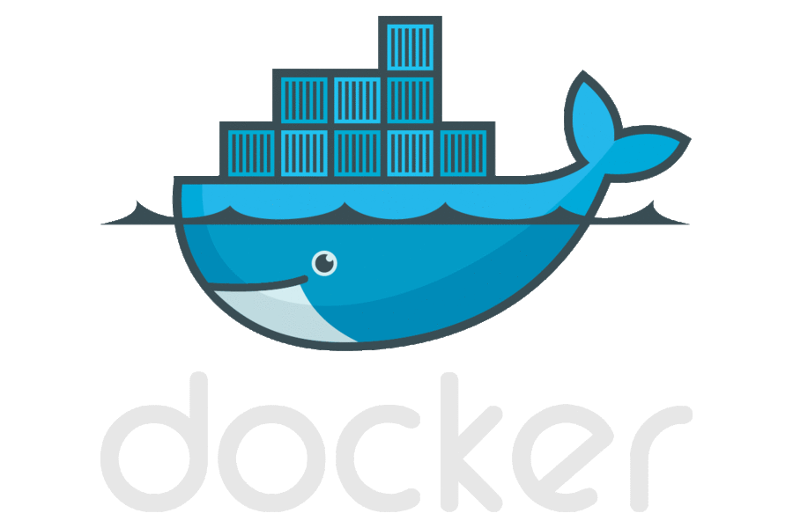



Container DevOps Workflow
Container Service
Run, Manage
Service Fabric
Source Code Control
(SCC)
Build/CI,
Integrate,
Test
CD, Deploy
App Services
Production
environments
Batch
Azure Container Registry
coming soon
…
Inner-Loop
…
Run
Monitor and Diagnose
Code
Validate
Debug

Slide 4
Demo

Slide 5


Azure Container Registry Partners
Vulnerability Scanning

Slide 6
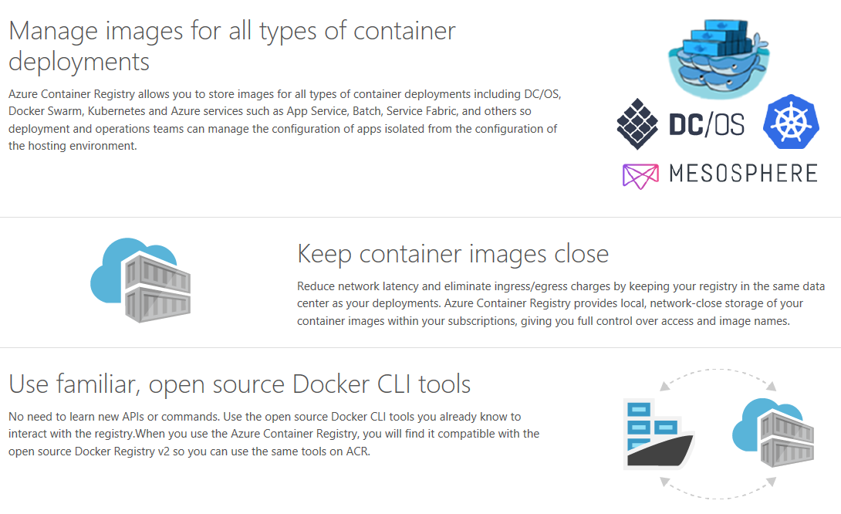
Get Started Today
Public Preview
November
GA
Spring ‘17
aka.ms/AzureContainerRegistry `

