Slide 1




Artifact References
Extending OCI Artifacts to Supporting Supply Chain Reference Types
Steve Lasker
Program Manager / Architect
Azure Container Registries
Steve.Lasker@Microsoft.com
@SteveLasker
SteveLasker.blog
github.com/SteveLasker
github.com/SteveLasker/presentations
.blog

Slide 2
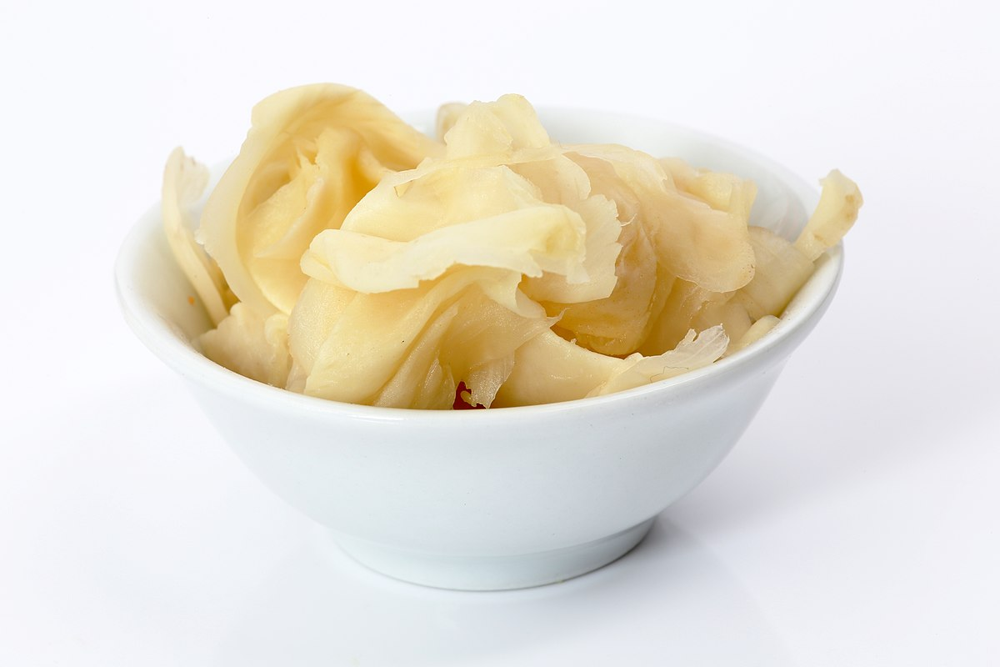
Starting Fresh

Slide 3
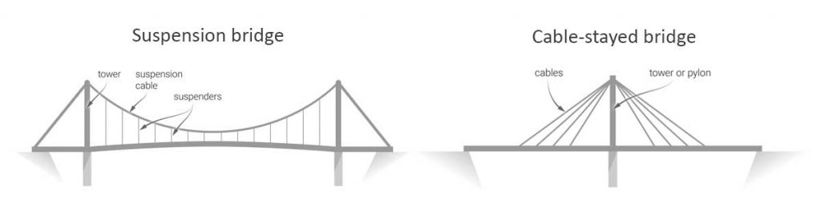
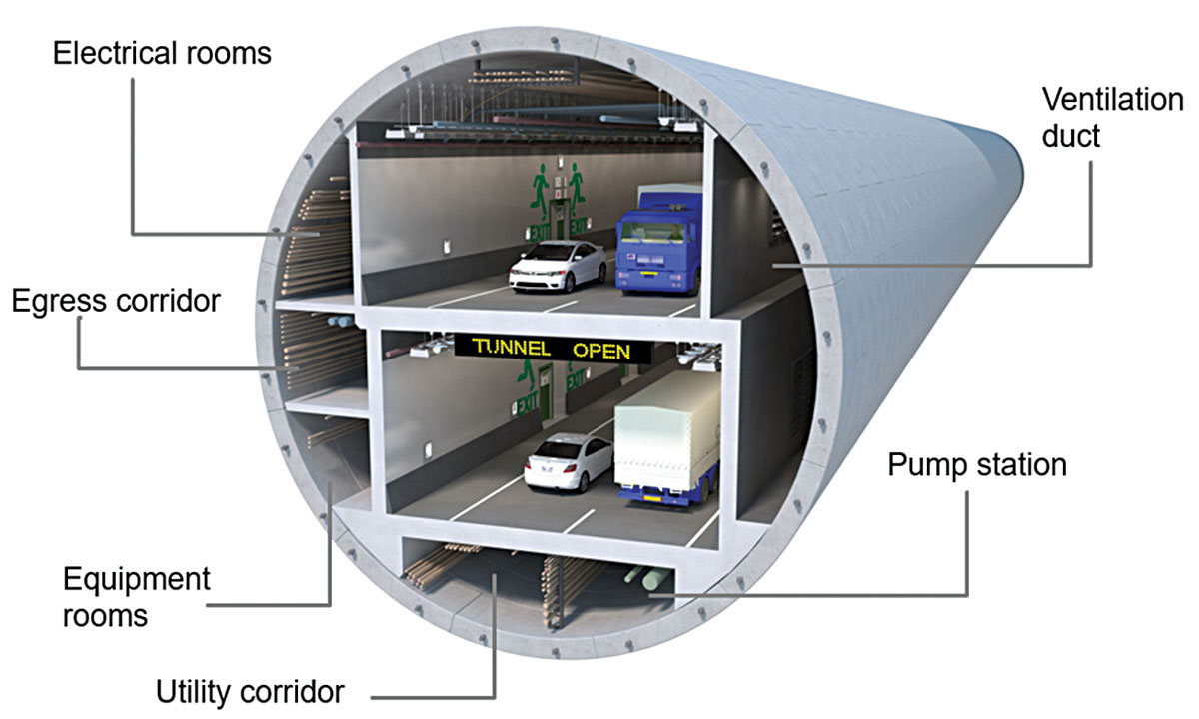
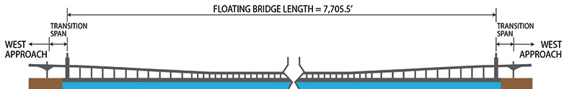
Which Is The Best Design?

Slide 4

Requirements Clarify Designs

Slide 5

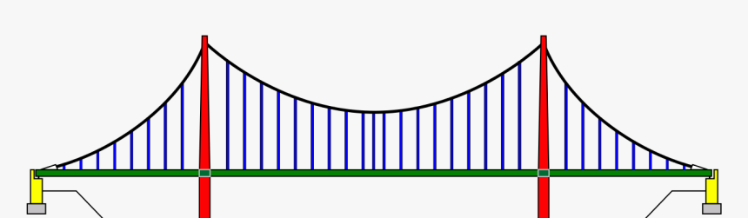
Requirements: Traversing Under Downtown Seattle

Slide 6
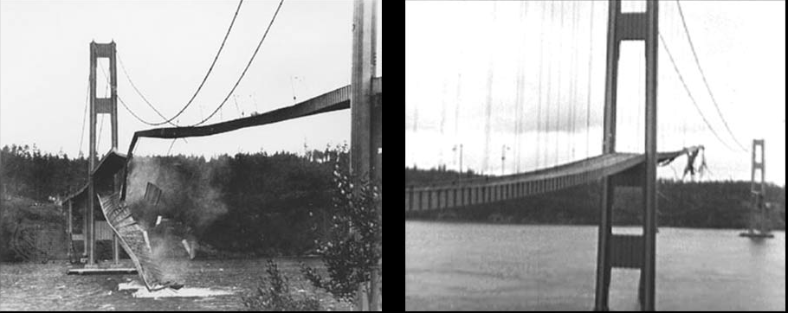
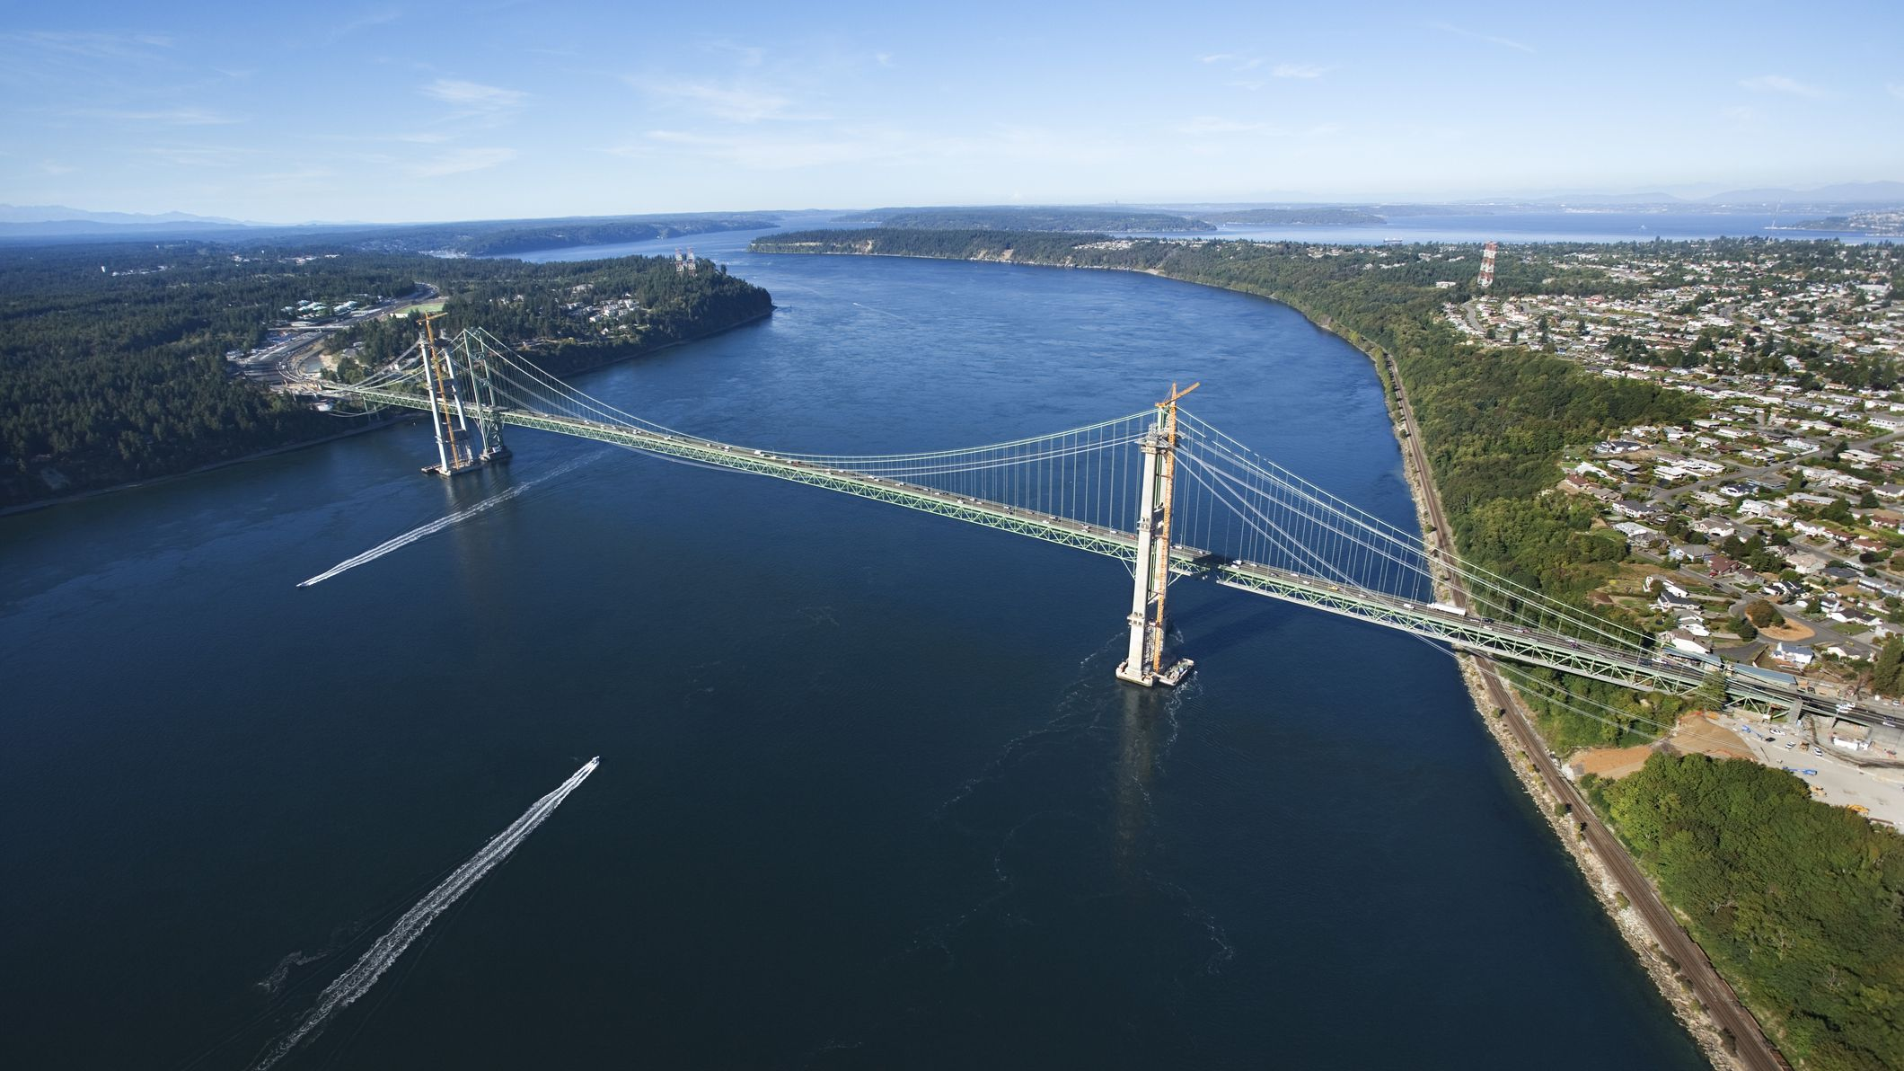
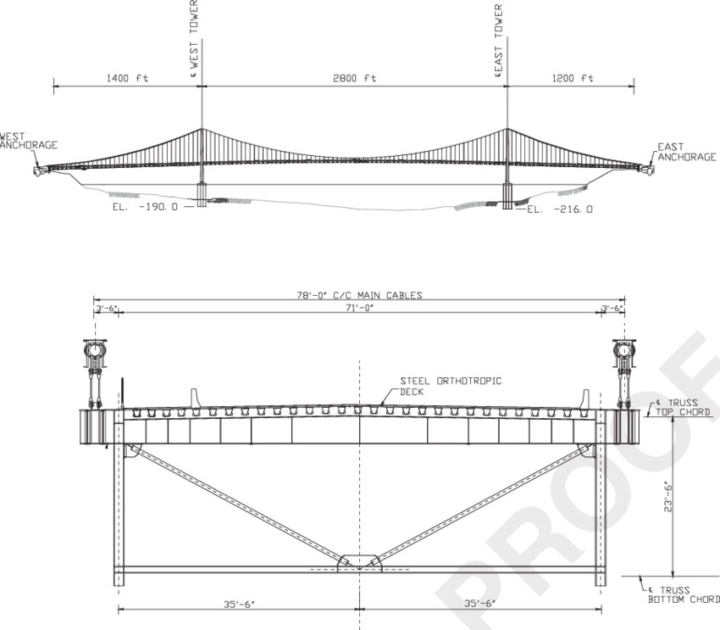
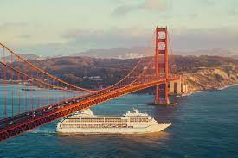
Requirements: Tacoma Narrows
Large Span
Shallow Bottom
Large Boat Traffic
Galloping Gurdy?

Slide 7
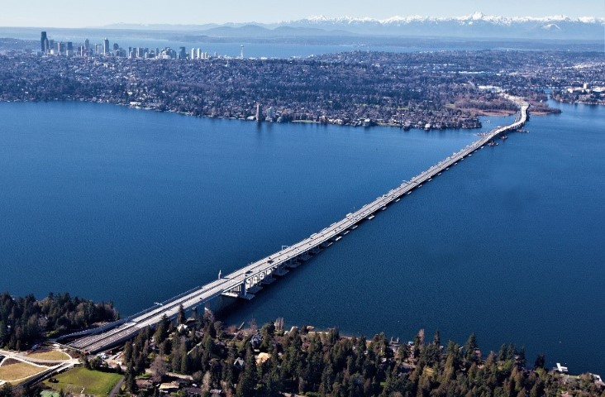

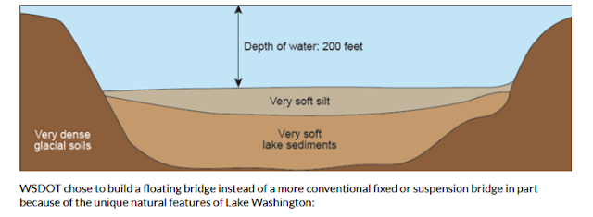
Requirements: Spanning Lake Washington
Deep Bottom, with Poor Soil
Protect the Seattle and Bellevue Skylines
Limited boat traffic over a height-controlled, deep lake
Notes:
https://www.shorelineareanews.com/2017/04/new-sr-520-floating-bridge-named.html

Slide 8
Requirements Clarify Designs

Slide 9
Notary v2 Requirements
Promote Signed Artifacts Within & Across Registries
Maintain Original Identifiers (Tags & Digests)
Offline Signature Creation
Multiple Signatures Per Artifact
Native Persistence – Registries Shouldn’t Understand Signatures
Air-gapped Networks ^{(not just submarines, vnets)}
github.com/notaryproject/notaryproject/blob/main/requirements.md

Slide 10
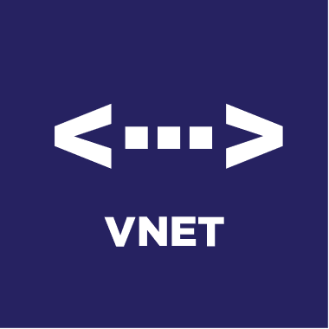



Enabling the Supply Chain
Content Promotion to Secured, Trusted Environments
Scope
Wabbit Networks
Docker Hub
ACME Rockets
Air-gapped network
Artifact Build Environment
5
1
2
Promote
3
Public Registry
Private Registry
Deployment
Image
Promote
Image
Image
SBoM
SBoM
SBoM
4
Container Host
src
src
src
Image
deploy
Policy Management

Slide 11
Artifact: Reference Type Principals
Multiple artifacts exist, and none should have to create YASS¹
Reference persisted alongside the subject artifact
Solves the discovery problem & network isolated/air-gapped environments
Reference type artifacts can be verified within the air-gapped environment
Associated with, but separable from the target artifact
Solves the trojan horse validation challenge
Target artifact must not change when adding new artifacts
docker pull mcr.microsoft.com/dotnet/runtime:5.0
docker pull mcr.microsoft.com/dotnet/runtime@sha256:ca9c27f79cfc669d74befcd93f
Helm chart references
Kubedeploy.yaml references
1- YASS- Yet Another Storage Service

Slide 12



Registry Requirements
Push Reference Types
Add anything to any existing artifact
1:many – 1 Artifact : Many References
Hide Metadata
References don’t pollute the UI
Discover References
What references exist for net-monitor:v1
Filter by artifactType and maybe annotations
Pull
Lifecycle Management
net-monitor:v1
mediaType: oci.image.manifest
config (blob)
layer1 (blob)
layer2 (blob)
wabbit-networks signature
signature [blobs]
reference (subject)
SBoM Document
sbom [blobs]
reference (subject)
wabbit-networks signature
signature [blobs]
reference (subject)

Slide 13
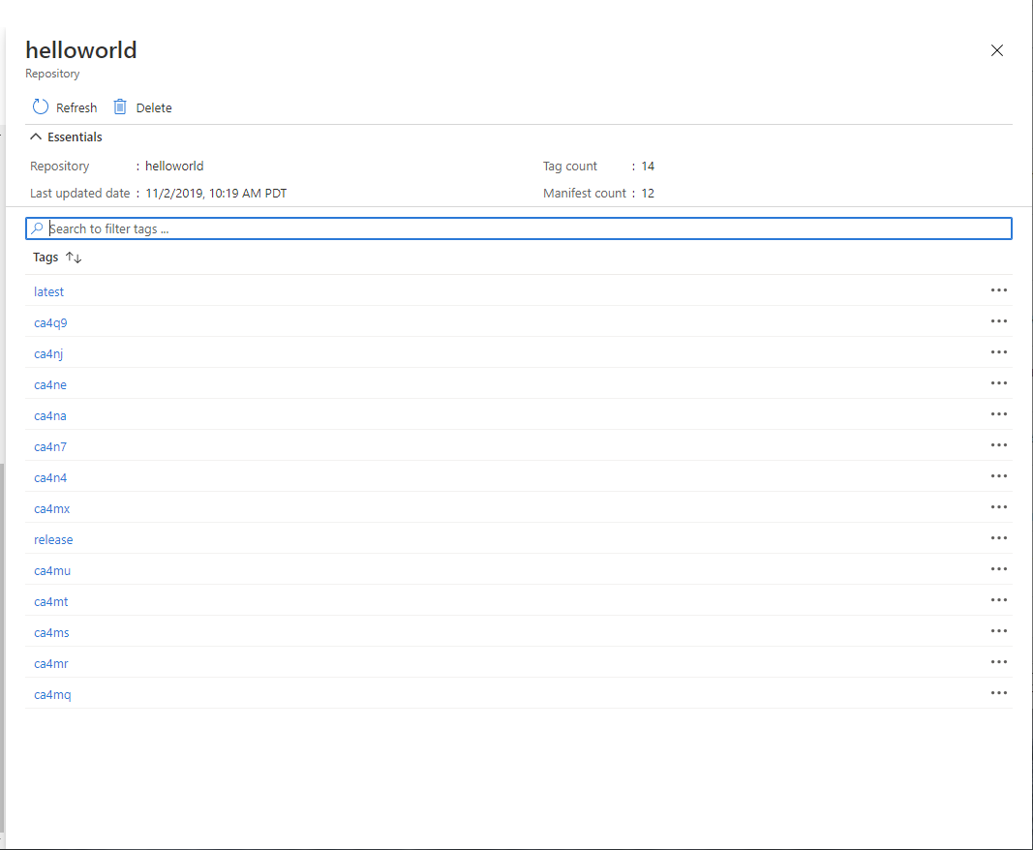




What should be seen?
latest
…
S
B
latest
o
M
ca4na
…
S
B
latest-signature
o
M
ca4nb
…
latest-signature-acme-rockets
…
ca4nc
latest-signature-wabbit-networks
…
ca4nd
ca4na
…
ca4ne
ca4na-signature
…
ca4ng
ca4na-signature-acme-rockets
…
ca4ng
ca4na-signature-wabbit-networks
…
ca4nh
ca4nb
…
ca4nj
ca4nb-signature
…
ca4nk
S
B
ca4nb-signature-acme-rockets
o
M
ca4nm
…
S
B
ca4nb-wabbit-networks
o
M

Slide 15
Registry Capabilities & Features
Capability | Feature
Security
Private Networking | Private Links
Sovereignty | Geo-replication
Limit public endpoints | Firewall Rules
Data exfiltration | Dedicated data endpoints
Double encryption at rest with Customer Managed Keys | Customer Manage Keys
Secure by default content | Quarantine
Policy management | Policy management
Integrated Security | Azure AD Objects
IoT/Device Security | Token Support
Repo Granularity | Repo Scoped Permissions
Public/Anonymous Access | Anonymous access
Locking a tag to a digest | Tag locking
Artifact Signing | Docker Content Trust & Notary v2
Automated content updating | Base Image Update Notifications
Capability | Feature
Reliability
Cross region redundancy | Geo-replication
In-region redundancy | Availability Zones
Performance
Locality | Geo-replication
In-network performance | Telport
Diagnostics & Troubleshooting
Diagnostics & Audit Logs | Diagnostics & Audit Logs
Health Check | Health Check CLI
Content Management
Auto-purging of aged out content | Auto Purge
Workflows
Asynchronous notifications | Regional Webhooks & Event Grid
Server-side content promotion | Import

Slide 16
Artifact: Reference Types
ACME Rockets Registry
Reference types enable adding artifacts which refer to a subject artifact
net-monitor:v1
mediaType: oci.image.manifest
config (blob)
layer1 (blob)
layer2 (blob)
docker push net-monitor:v1
wabbit-networks signature
mediaType: cncf.oras.artifact.manifest.v1
artifactType : org.cncf.notary.v2
signature [blobs]
reference (subject)
notation sign net-monitor:v1 (notation cli incorporates push as a reference type)
SBoM Document
mediaType: cncf.oras.artifact.manifest.v1
artifactType: org.spdx.sbom.v3
sbom [blobs]
reference (subject)
spdx report --push net-monitor:v1
(sbom cli could incorporate notation sign and oras-go push|discover|pull)
wabbit-networks signature
mediaType: cncf.oras.artifact.manifest.v1
artifactType: org.cncf.notary.v2
signature [blobs]
reference (subject)

Slide 17
net-monitor:v1
mediaType: oci.image.manifest
Demo Time
config (blob)
layer1 (blob)
layer2 (blob)
wabbit-networks signature
mediaType: cncf.oras.artifact.manifest.v1
artifactType: org.cncf.notary.v2
signature [blobs]
reference (subject)
SBoM Document
mediaType: cncf.oras.artifact.manifest.v1
artifactType: org.spdx.sbom.v3
Push, Discover, Pull Supply Chain Reference Types
sbom [blobs]
reference (subject)
wabbit-networks signature
mediaType: cncf.oras.artifact.manifest.v1
artifactType: org.cncf.notary.v2
signature [blobs]
reference (subject)

Slide 18

Artifact Copying
The reference graph enables deep, shallow of filtered copying
ACME Rockets
The reference graph enables deep, shallow of filtered copying
net-monitor:v1
net-monitor:v1
mediaType: oci.image.manifest
mediaType: oci.image.manifest
Artifact Copy
config (blob)
config (blob)
layer1 (blob)
layer1 (blob)
layer2 (blob)
layer2 (blob)

Slide 19

Artifact Copying
oci-reg copy \
--source docker.io/wabbitnetworks/net-monitor:v1 \
--target registry.acme-rockets.io/base-artifacts/net-monitor:v1
oci-reg copy \
--source docker.io/wabbitnetworks/net-monitor:v1 \
--target registry.acme-rockets.io/base-artifacts/net-monitor:v1 \
--include-references org.spdx.sbom.v3
oci-reg copy \
--source docker.io/wabbitnetworks/net-monitor \
--target registry.acme-rockets.io/base-artifacts/net-monitor:v1 \
--exclude-references org.scannerco.result.v1
ACME Rockets
net-monitor:v1
net-monitor:v1
mediaType: oci.image.manifest
mediaType: oci.image.manifest
config (blob)
config (blob)
layer1 (blob)
layer1 (blob)
layer2 (blob)
layer2 (blob)
wabbit-networks signature
wabbit-networks signature
mediaType: cncf.oras.artifact.manifest.v1
artifactType: cncf.notary.v2
mediaType: cncf.oras.artifact.manifest.v1
artifactType: cncf.notary.v2
signature [blobs]
signature [blobs]
reference (subject)
reference (subject)
Artifact Copy
SBoM Document
SBoM Document
mediaType: cncf.oras.artifact.manifest.v1
artifactType: org.spdx.sbom.v3
mediaType: cncf.oras.artifact.manifest.v1
artifactType: org.spdx.sbom.v3
sbom [blobs]
sbom [blobs]
reference (subject)
reference (subject)
wabbit-networks signature
wabbit-networks signature
mediaType: cncf.oras.artifact.manifest.v1
artifactType: cncf.notary.v2
mediaType: cncf.oras.artifact.manifest.v1
artifactType: cncf.notary.v2
signature [blobs]
signature [blobs]
reference (subject)
reference (subject)

Slide 20
Artifacts Specs & Reference Implementations
OCI Artifacts: github.com/opencontainers/artifacts
ORAS Artifact Spec: github.com/oras-project/artifacts-spec
CNCF Distribution w/Artifacts Support: github.com/oras-project/distribution
ORAS CLI: github.com/oras-project/oras
ORAS Library: github.com/oras-project/oras-go

Slide 21

Artifact Reference Types
OCI Artifacts: github.com/opencontainers/artifacts
ORAS Artifact Reference Types: github.com/oras-project/artifacts-spec
CNCF Distribution Reference Types: github.com/oras-project/distribution
Notary v2: github.com/notaryproject/notaryproject
Steve Lasker
Program Manager
Azure Container Registries
Steve.Lasker@Microsoft.com
@SteveLasker
SteveLasker.blog
github.com/SteveLasker
github.com/SteveLasker/presentations
Thank You

Slide 22
What Are Specs

Slide 23
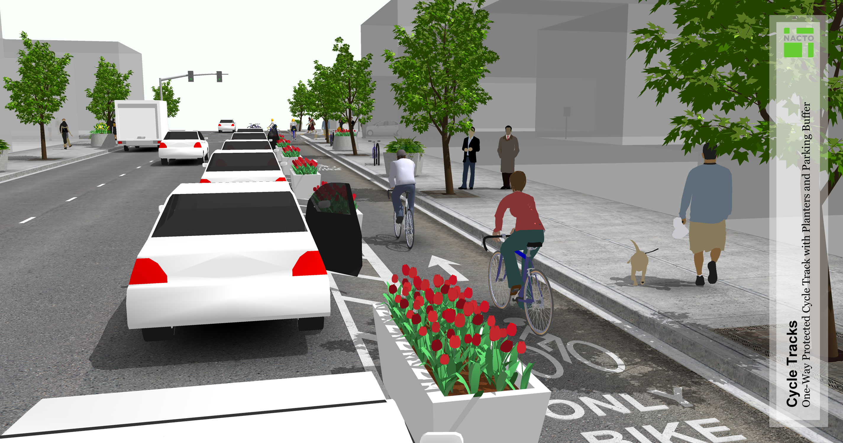
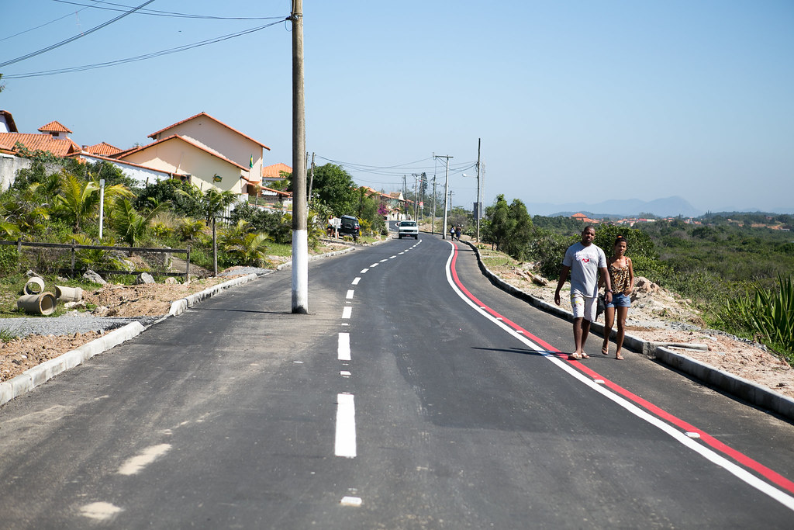
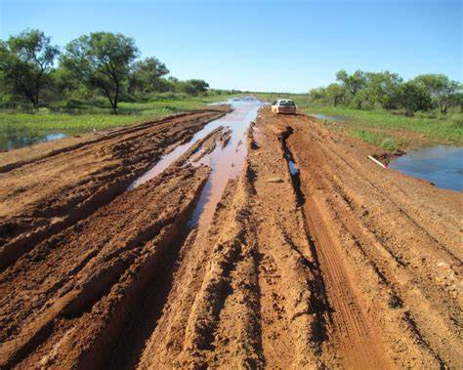
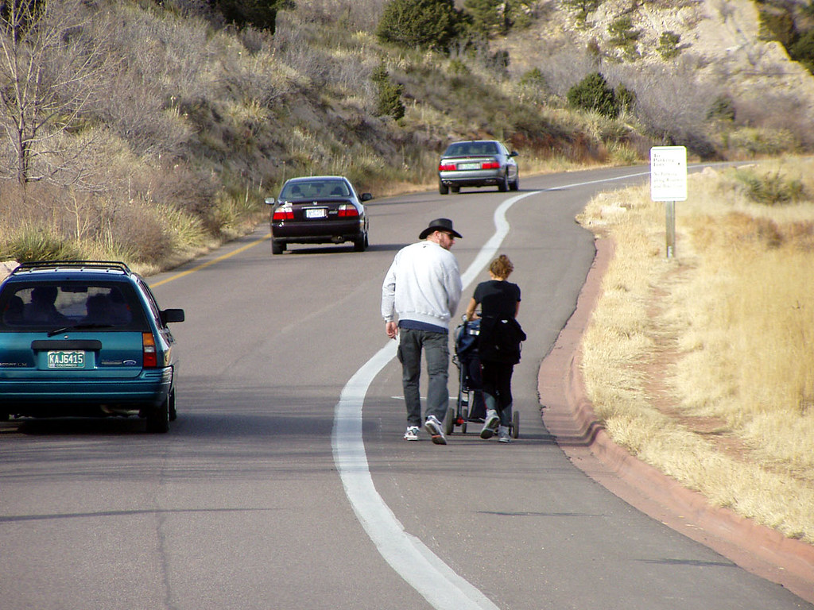
What Are Specs?

Slide 24
What Are Specs?
Identifying Common Use Cases
Establish Patterns
Set Standard Expectations

