Slide 1
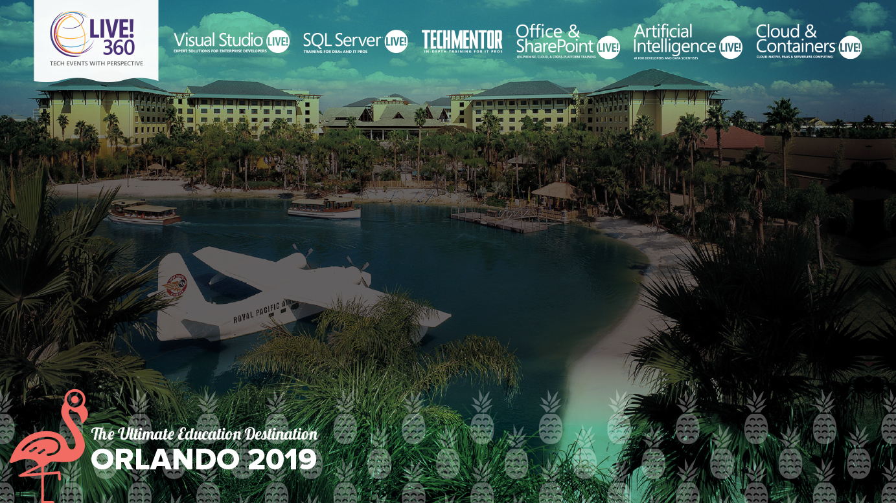
Leveraging Build Pipelines, Automating Container OS & Framework Patching
Steve Lasker
Program Manager
Azure Container Registries
Level: Intermediate Steve.Lasker@Microsoft.com
@SteveLasker
SteveLasker.blog
Notes:
Containers have become the modern packaging format, regardless of the host they're run on. You may be building your own images, or consuming images from ISVs. While containers have a focused subset of their VM ancestors, containers still have layers of the OS, runtimes and other components that are susceptible to vulnerabilities that must be remediated. Have you considered how you'll patch these deployments? Will you patch the running containers, as you patch VMs, hoping the software continues to run, as you continually patch the same deployed image?
We'll examine leveraging your build and deployment pipelines to automatically patch, test and deploy updates, during and long after you've moved onto another project. OS & Framework Patching can be an extension of what you're already doing today.

Slide 2
Containers: The App Packaging Format
Containers are the modern-day packaging format
Base images provide the base capabilities
Apps add capabilities atop the base (inheritance…)
Configuration extracted
Enabling the same image to be deployed
across different environments (dev, test, prod) different customer sites (Contoso, Northwind, AdventureWorks)

Slide 3




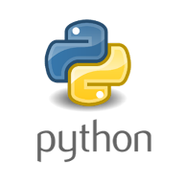







Containers: The App Packaging Format
Invocation
Response
contoso.azurecr.io/warranty/checkstatus:ab2q
<Code>
3.0preview
Version
9.341
2.1
9
1
Storage
Languages & runtimes
Secrets
Config

Slide 4
But, What About…
Where do the base artifacts come from?
Do you, should you, blindly trust upstream content?
How do you balance leveraging upstream content, while assuring stability?
Wrapping up a project, how do you patch containers?

Slide 5

How Do You Patch Containers?
Patch running containers, like VMs
Patch the container, at build time
Pull updated base images, rebuild, redeploy
Containers are a paradigm shift from VM workloads

Slide 6
Image Tagging
balancing servicing and stability

Slide 7

Deploy:
app:
web:1 x3
api:1 x3
cache:1 x4
HOST-A
3
Image Cache
web:1
digest: 91e
web:1
digest: 91e
app:
web:1 x3
api:1 x3
cache:1 x4
web:1
digest: 91e
api:1
digest: u82
api & cache are inconsistent states
1
cache:1
digest: 2re
cache:1
digest: 2re
docker build –t web:1
docker build –t api:1
docker build –t cache:1
docker images
REPOSITORY TAG DIGEST
web 1 91e
api 1 u82
cache 1 2re
docker push web:1
docker push api:1
docker push cache:1
HOST-B
Image Cache
api:1
digest: u82
api:1
digest: u82
9
8
api:1
digest: u82
5
cache:1
digest: 1n4
cache:1
digest: 2re
web:1
digest: 91e
cache:1
digest: 2re
api:1
digest: 3rp
api:1
digest: u82
cache:1
digest: 2re
cache:1
digest: 2re
Digests
91e
u82
2re
Image
web:1
api:1
cache:1
2
Digests
91e
u82
2re
3rp
1n4
web:1
digest: 91e
HOST-C
api:1
digest: u82
7
4
cache:1
digest: 2re
Image Cache
api:1
digest: 3rp
api:1
digest: 3rp
6
docker build –t api:1
docker build –t cache:1
docker images
REPOSITORY TAG DIGEST
api 1 3rp
cache 1 1n4
docker push api:1
docker push cache:1
cache:1
digest: 1n4
cache:1
digest: 1n4
api:1
digest: 3rp
cache:1
digest: 1n4
Notes:
Orchestrator icon from: http://cdn.marketplaceimages.windowsphone.com/v8/images/f58edb21-b20c-4315-b837-6cee21n442cd?imageType=ws_icon_large
https://git-scm.com/book/en/v2/Git-Branching-Basic-Branching-and-Merging

Slide 8
Tagging Techniques
Stable Tags
Tag
:latest
:1
:2
:3
:1.0
:1.1
:1.2
:2.0
:2.1
:3.0
Digest
91efj6
u82lq
2re7f
3rpn1
1n4ef
5wd1k
Build FROM
Serviced Stable Tags
Tag
:latest
:1
:2
:1.0
:1.1
:1.2
:2.0
Digest
91efj6
u82lq
e8s1f
1n4ef
2re7f
3rpn1
28efq
Deploy With
Unique Tagging
Tag
:12204
:12328
:12401
:33810
:35091
:4201
:50201
Digest
91efj6
u82lq
e8s1f
1n4ef
2re7f
3rpn1
28efq
Image Digest:
sha256:f875142531ccd91fbe8901c549fb453fee578f9a750b84d54e91f42fb95355b5
Supercalifragilisticexpialidocious
Pneumonoultramicroscopicsilicovolcanoconiosis
https://en.wikipedia.org/wiki/Longest_word_in_English
Notes:
[‎2/‎23/‎2018 3:18 PM] Sajay Antony:
https://git-scm.com/book/en/v2/Git-Branching-Basic-Branching-and-Merging
[‎2/‎23/‎2018 3:37 PM] Sajay Antony:
https://docs.docker.com/storage/storagedriver/
[‎2/‎23/‎2018 4:00 PM] Sajay Antony:
https://www.cockos.com/licecap/
[‎2/‎23/‎2018 5:10 PM] Sajay Antony:
https://docs.docker.com/datacenter/dtr/2.4/guides/user/create-promotion-policies/

Slide 9
Image Tagging
Base Images
Deployed Images
Use Stable Tags enable stability through patching
:latest
:1
:1.0
:1.1.1.1
:2
:2.0
:2.2.1
Always Unique
Stable Tags Create Instability
Build IDs are a great source
{buildsystem}-{build_id}
ak21fe
ak-21fe
305305t035

Slide 10

Repo & Tag Locking
Lock Repositories and image:tags for specific operations
Makes tags immutable
Lock a repository from new content
Block pulls
Block deletes for deployed images
Scenario:
Deploy an image
Block updates and deletes
az acr repository show --repository hello-world
{
"changeableAttributes": {
"deleteEnabled": true,
"listEnabled": true,
"readEnabled": true,
"writeEnabled": true
},…
az acr repository show --image hello-world:aabd
{
"changeableAttributes": {
"deleteEnabled": false,
"listEnabled": true,
"readEnabled": true,
"writeEnabled": false
},…
az acr repository update \
--image hello-world:aabd \
--write-enabled false \
--delete-enabled false

Slide 11

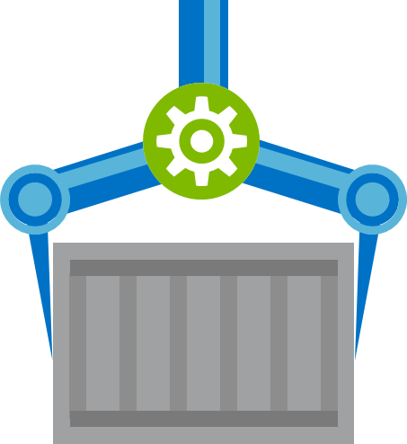


Build
Test
Deploy
Secure
Patch

Slide 12
Opportunity
What if:
You CI/CD pipeline was used for the life of the app
Your development unit and functional tests were used to validate base image updates?
The CI pipeline was triggered by base image updates, not just git commits

Slide 13



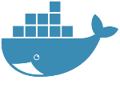



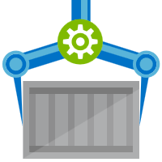






Are Your Base Artifacts Secure?
Images Secure?
Cover your bases
Buffer base artifacts in your secured environment
Validate changes with
security scanning
Unit & functional testing of base artifacts
Automate all of this
Be protected and available,
when things outside your control aren’t secured or available, shouldn’t you still be secured and available?
Public Registries
Your Environment
aws, azure, google, on-prem, …
FROM demo42.azurecr.io/base-artifacts/dotnet/core/runtime:2.1.10 AS base
WORKDIR /app
FROM demo42.azurecr.io/base-artifacts/dotnet/core/sdk:2.1 AS build
WORKDIR /src
COPY src/Important/Important.csproj src/Important/
RUN dotnet restore src/Important/Important.csproj
COPY . .
WORKDIR /src/src/Important
RUN dotnet build Important.csproj -c Release -o /app
FROM build AS publish
RUN dotnet publish Important.csproj -c Release -o /app
FROM base AS final
WORKDIR /app
COPY --from=publish /app .
ENV VERSION=0.0.25
ENTRYPOINT ["dotnet", "Important.dll"]
FROM microsoft/dotnet/core/runtime:2.1.10 AS base
WORKDIR /app
FROM microsoft/dotnet/core/sdk:2.1 AS build
WORKDIR /src
COPY src/Important/Important.csproj src/Important/
RUN dotnet restore src/Important/Important.csproj
COPY . .
WORKDIR /src/src/Important
RUN dotnet build Important.csproj -c Release -o /app
FROM build AS publish
RUN dotnet publish Important.csproj -c Release -o /app
FROM base AS final
WORKDIR /app
COPY --from=publish /app .
ENV VERSION=0.0.25
ENTRYPOINT ["dotnet", "Important.dll"]
FROM mcr.microsoft.com/dotnet/core/runtime:2.1.10 AS base
Private Registry
acr, ecr, gcr, dtr, harbor, jfrog, …
.NET
demo42.azurecr.io
Docker Hub
FROM mcr.microsoft.com/dotnet/core/sdk:2.1 AS build
Public Internet
Task Image Validation
node
java
MCR
dotnet
ACR Tasks
wordpress
base-artifacts
node
Red Hat
java
dotnet
gcr
wordpress
dev
faclon-team
warriors-team
gpr

Slide 14
Automating Base Image Updates
Public Registries
Your Environment
demo42.azurecr.io/hub
Private Registry
demo42.azurecr.io
Docker Hub
Public Internet
Task Image Validation
node
java
MCR
dotnet
ACR Tasks
wordpress
base-artifacts
node
java
dotnet
wordpress
dev
faclon-team
api:1
digest: u82
cache:1
digest: 2re
web:1
digest: 91e
api:1
digest: u82
cache:1
digest: 2re
web:1
digest: 91e
warriors-team

Slide 15


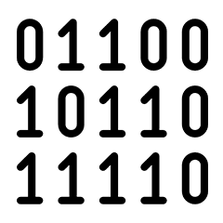
Are Your Base Artifacts Secure?
Images Secure?
Public Registries
Your Environment
aws, azure, google, on-prem, …
FROM demo42.azurecr.io/base-artifacts/dotnet/core/runtime:2.1.10 AS base
WORKDIR /app
FROM demo42.azurecr.io/base-artifacts/dotnet/core/sdk:2.1 AS build
WORKDIR /src
COPY src/Important/Important.csproj src/Important/
RUN dotnet restore src/Important/Important.csproj
COPY . .
WORKDIR /src/src/Important
RUN dotnet build Important.csproj -c Release -o /app
FROM build AS publish
RUN dotnet publish Important.csproj -c Release -o /app
FROM base AS final
WORKDIR /app
COPY --from=publish /app .
ENV VERSION=0.0.25
ENTRYPOINT ["dotnet", "Important.dll"]
FROM microsoft/dotnet/core/runtime:2.1.10 AS base
WORKDIR /app
FROM microsoft/dotnet/core/sdk:2.1 AS build
WORKDIR /src
COPY src/Important/Important.csproj src/Important/
RUN dotnet restore src/Important/Important.csproj
COPY . .
WORKDIR /src/src/Important
RUN dotnet build Important.csproj -c Release -o /app
FROM build AS publish
RUN dotnet publish Important.csproj -c Release -o /app
FROM base AS final
WORKDIR /app
COPY --from=publish /app .
ENV VERSION=0.0.25
ENTRYPOINT ["dotnet", "Important.dll"]
FROM mcr.microsoft.com/dotnet/core/runtime:2.1.10 AS base
Private Registry
acr, ecr, gcr, dtr, harbor, jfrog, …
.NET
demo42.azurecr.io
Docker Hub
FROM mcr.microsoft.com/dotnet/core/sdk:2.1 AS build
Public Internet
Task Image Validation
node
java
MCR
dotnet
ACR Tasks
wordpress
base-artifacts
node
Red Hat
java
dotnet
gcr
wordpress
dev
faclon-team
warriors-team
SCC
Source Code ControL
gpr

Slide 16
Demo: Base Artifact Updates
Public Registries
Your Environment
demo42.azurecr.io/hub
Private Registry
demo42.azurecr.io
Docker Hub
Public Internet
Task Image Validation
node
java
MCR
dotnet
ACR Tasks
wordpress
base-artifacts
node
java
dotnet
wordpress
dev
faclon-team
warriors-team
SCC
Source Code ControL

Slide 17

Demo
ACR Tasks A primitive of container lifecycle management
Build, Patch, Manage Container Artifacts
aka.ms/acr/tasks

Slide 18

Automating Base Artifact Validation
Public Registries
Your Environment
aws, azure, google, on-prem, …
Private Registry
acr, ecr, gcr, dtr, harbor, jfrog, …
demo42.azurecr.io
Docker Hub
Public Internet
Task Image Validation
node
java
MCR
dotnet
ACR Tasks
wordpress
base-artifacts
node
Red Hat
java
dotnet
gcr
wordpress
dev
faclon-team
helloworld
digest: 91e
warriors-team
SCC
Source Code ControL
gpr

Slide 19
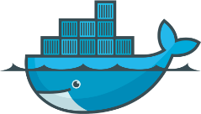

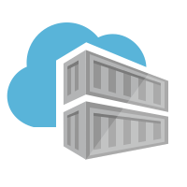
Container OS & Framework Patching
Triggers
Registries
Docker Hub
MCR
ACR
SCC Providers
ACR Tasks
Azure Container Registry
Timers
aka.ms/acr/tasks

Slide 20
Trust But Verify
Use OSS solutions
Validate each, and every download
Automate everything
Balance value with security
Investments during development, will accrue to the life of the app

Slide 21




Thank You
ACR Tasks aka.ms/acr/tasks
ACR Import aka.ms/acr/import
ACR Links aka.ms/acr/links
Presentations aka.ms/acr/presentations
Choosing a Registry stevelasker.blog
OCI Artifacts github.com/OpenContainers/Artifacts
Steve Lasker
Program Manager
Azure Container Registries
Steve.Lasker@Microsoft.com
@SteveLasker
SteveLasker.blog
github.com/SteveLasker
github.com/SteveLasker/presentations

