Slide 1
ACR Geo-Replicated Registries
Steve Lasker
Program Manager
Azure Developer Experiences
@SteveLasker
blogs.msdn.microsoft.com/SteveLasker
aka.ms/acr
aka.ms/acr/geo-replication

Slide 2
Registries should be deployed close to hosts
Are you supporting multiple regions?
Do you manage multiple registries?
With ACR Geo-replication, multiple regions are managed as one

Slide 3


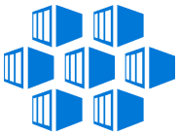
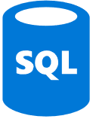


Push Built Images
docker push contosowestus.azurecr.io/web:1234
docker push contosowesteurope.azurecr.io/web:1234
Nodes Pull Images
docker pull contosowestus.azurecr.io/web:1234
docker pull contosowesteurope.azurecr.io/web:1234
Pulls are local, network-close, fast, reliable
Pulls are remote, across the public internet, slower, less reliable
Have network egress fees
Pulls are remote, across the public internet, slower, less reliable
Have network egress fees
West Europe
Canada Central
West US
East US
Developers must push images to n registries, requiring separate management and configuration

Slide 4

Push Built Images
docker push contoso.azurecr.io/web:1234
ACR Syncs Image Blobs
Regional Web Hooks fire for local deployments
Nodes Pull Images
docker pull contoso.azurecr.io/web:1234
Geo-replicate a single registry
All regions have a local replica
Geo-replicate a single registry
All regions have a local replica
West Europe
Canada Central
West US
East US
Each registry is pulling from a local, network close, reliable registry

Slide 5

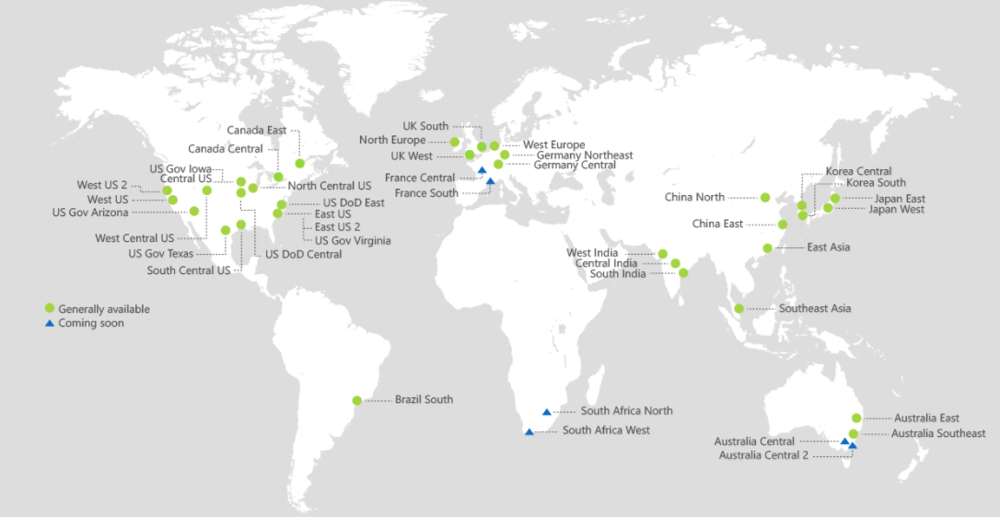
Azure Container Registry
Providing a single registry across the globe
aka.ms/ACR
aka.ms/ACR/Docs
aka.ms/ACR/Geo-replication
aka.ms/ACR/Roadmap

Slide 6
Geo-replication Q&A
Regions are multi-master
Each Docker push creates new image layers, eliminating normal update conflicts
Updating an existing tag; last writer wins, and will be eventually consistent across all regions
Push can be done to any region, replicated to others
RBAC is shared across all regions
Each region has geo-redundant storage

Slide 7
Geo-replication Q&A
Each region billed as a premium registry
Max storage and throughput, metered per registry
Can be configured through the portal, or az CLI
Original region is the primary region, which currently can’t be removed
Looking to integrate with Azure Event Grid for dead letter queue and retry notifications

Slide 8
Registry Routing
Uses Azure Traffic Manager for local routing
Regional Webhooks for local arrival notification
Replicas can be added/removed at any time
Traffic manager dynamically updated
Working from a remote location for a while, enable a replica, remove when complete

Slide 9
Replication over CDN
Geo-replication is multi-master
Push can be done to any region, replicated to others
Geo-replication: opt into replicated regions
CDN based on a single master
CDN costly
Cost comparison…

Slide 10
Statistics
Push/Pull in Milliseconds
Individual Registries
Push/Pull From | West US | East US | West Europe | Central India | Southeast Asia | Australia East | Japan East | Docker Hub
Within West US Data Center
Microsoft Office
Home Office ^{(Cable modem)}
Northern Europe
With Geo-replication
Push/Pull From | West US | East US | West Europe | Central India | Southeast Asia | Australia East | Japan East
Within West US Data Center
Microsoft Office
Home Office ^{(Cable modem)}
Northern Europe

Slide 11
Statistics Model
Standard Registries created in all regions
ASP.NET Core on Linux image pushed to all regions
ASP.NET Core on Nano image pushed to all regions
Local Cache cleared
Docker Pull from each measured
Docker RMI after each measurement

Slide 12


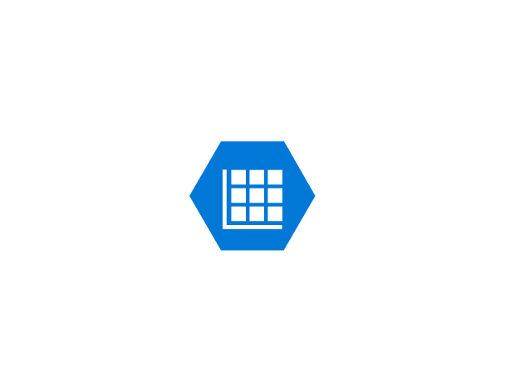
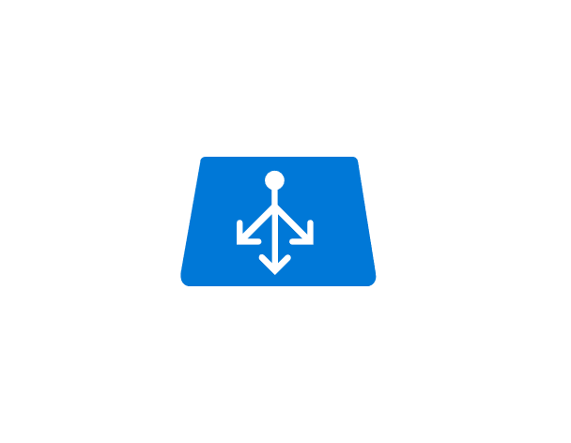
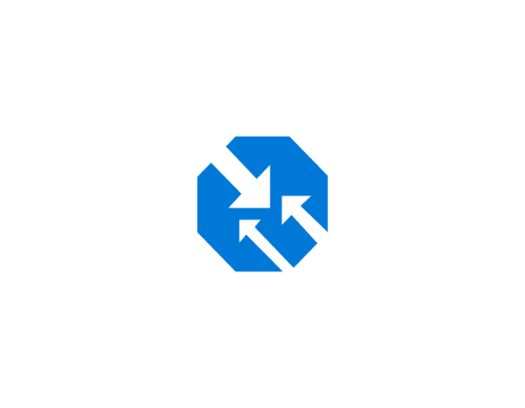
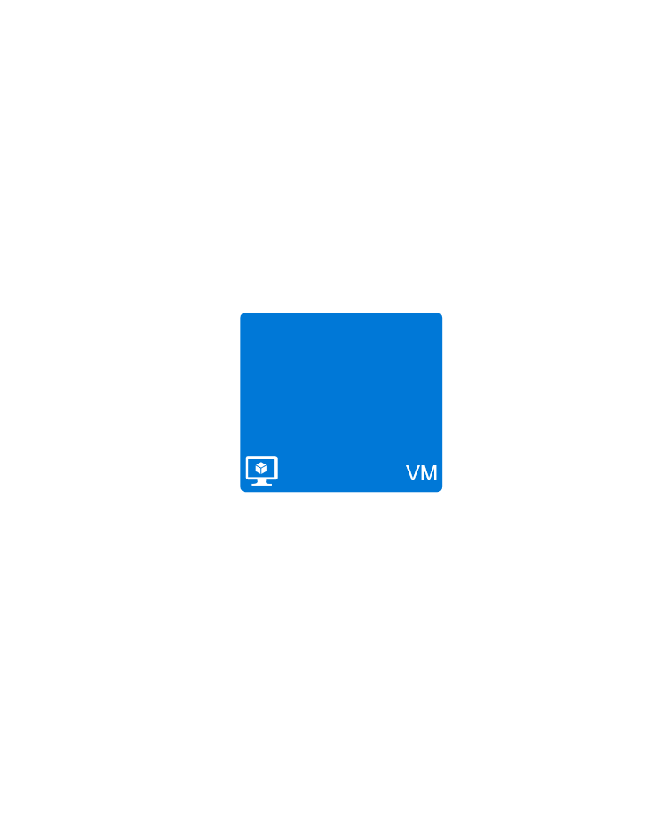

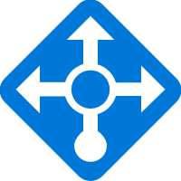


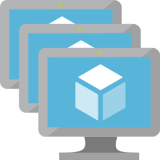


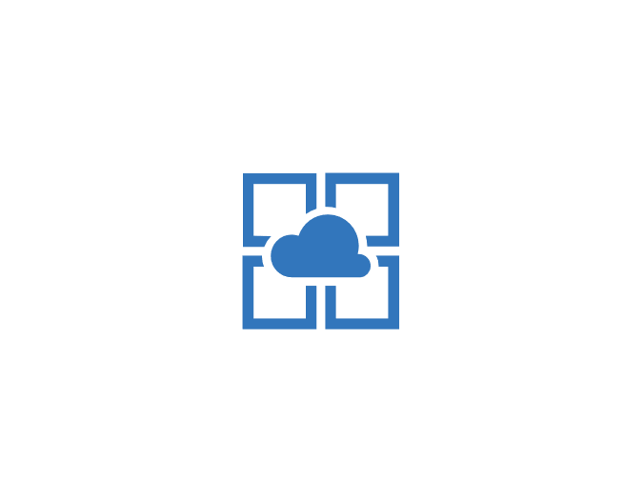
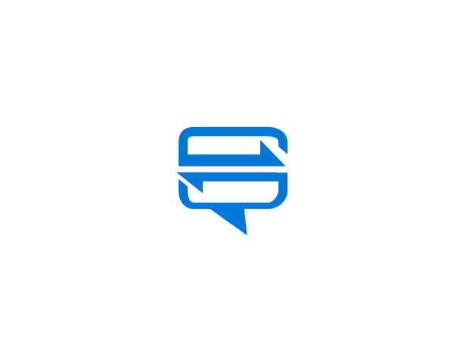
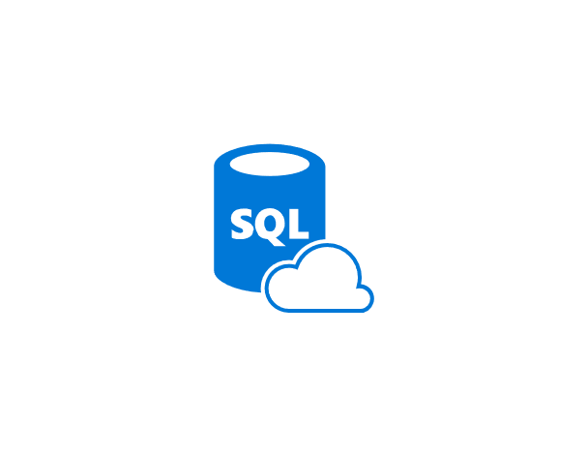


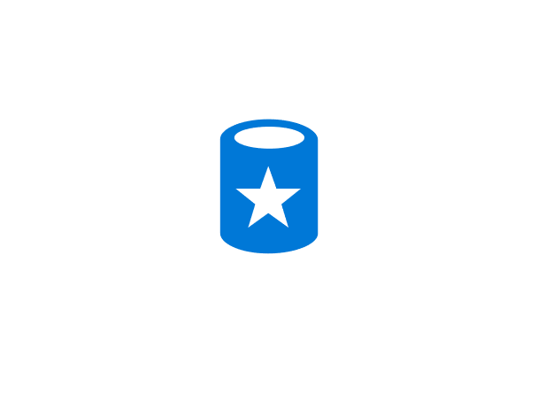




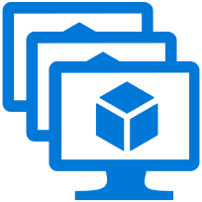

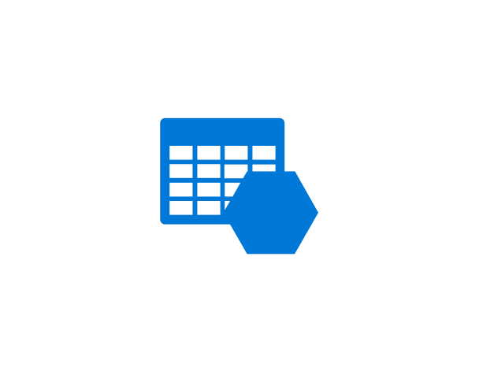



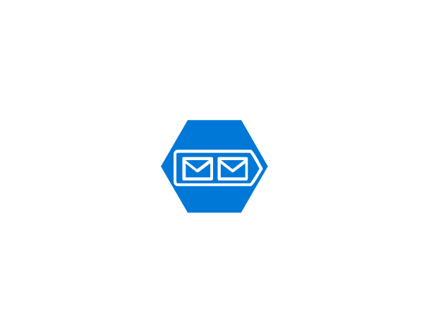
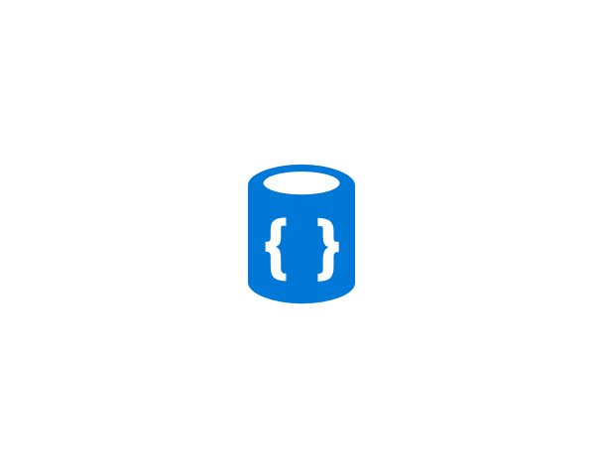
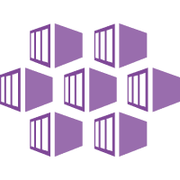


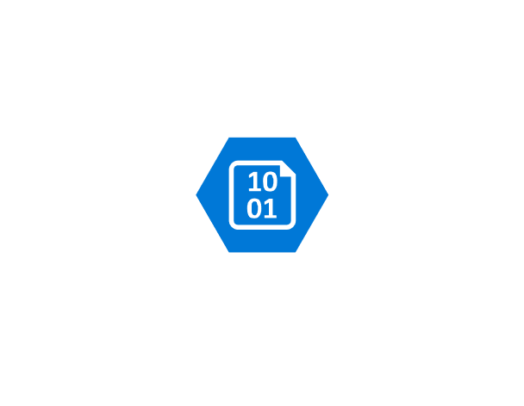



Slide 13

Canada Central
West US
East US

Slide 14
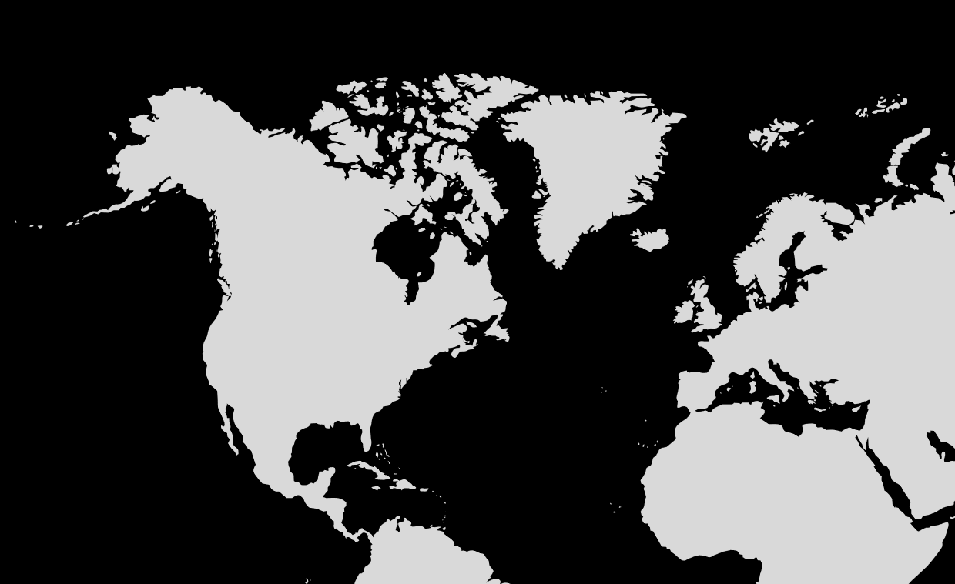
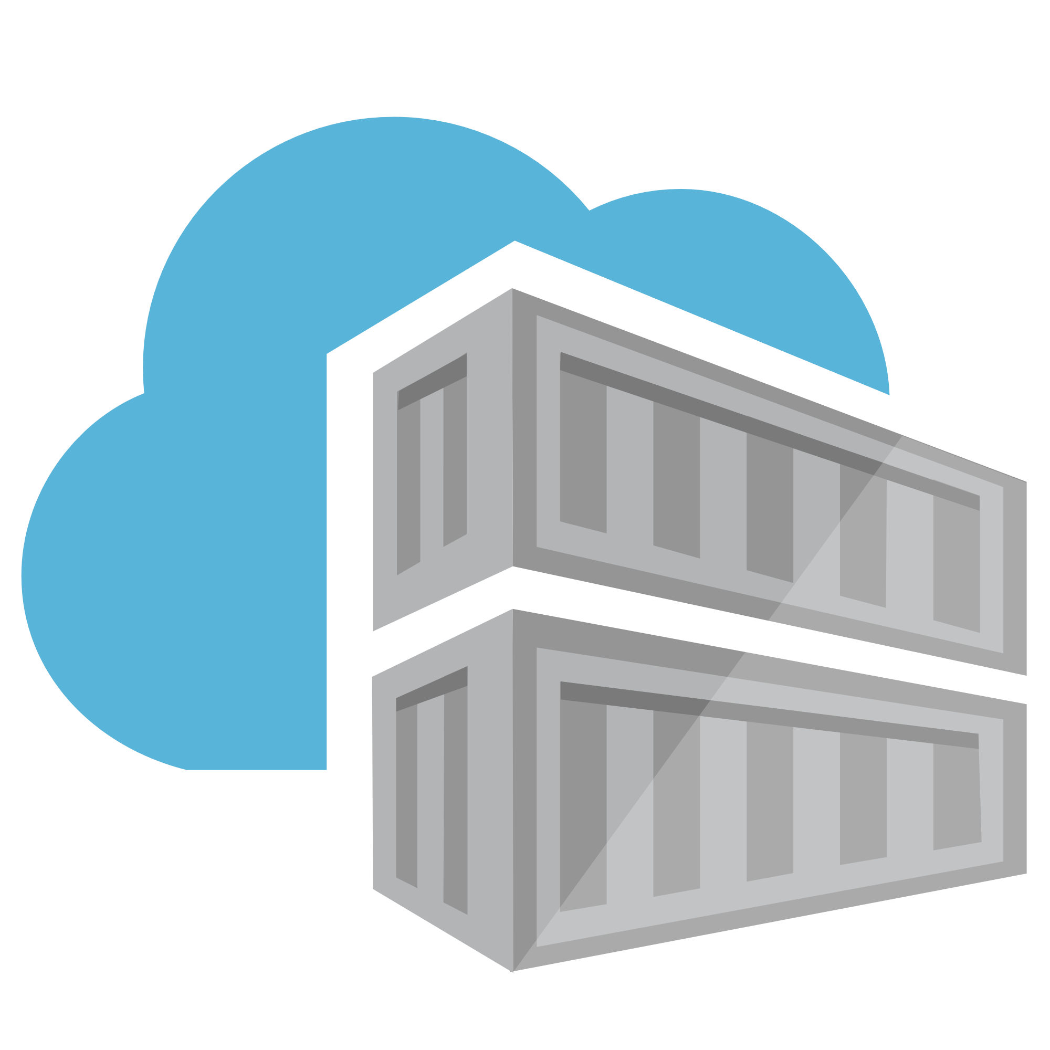
Geo-replicating Azure Container Registry
West Europe
West US

Slide 15
Canada Central
West US
East US

Slide 16

Geo-replicating Azure Container Registry
West Europe
WestCentral US

Slide 17
Geo-replicating Azure Container Registry
West Europe
WestCentral US

Slide 18


Geo-replicating Azure Container Registry
Hello From
WestCentral US
West US
East US
SouthCentral US

Slide 19
Geo-replicating Azure Container Registry
Hello From
WestCentral US
West US
East US
SouthCentral US

Slide 20

Geo-replicating Azure Container Registry
Hello From
WestCentral US
West US
East US
SouthCentral US

Slide 21
Geo-replicating Azure Container Registry
Hello From
WestCentral US
West US
East US
SouthCentral US

Slide 22
Geo-replicating Azure Container Registry
Hello From
West Europe
West US
East US
SouthCentral US

Slide 23
Geo-replicating Azure Container Registry
Hello From
Some unknown location…
Is your REGISTRY_URL set in the dockerfile
Does the registry exist?
WestCentral US
West US
East US
SouthCentral US

Slide 25
West Europe
Canada Central
Japan East
West US
East US
Brazil South
Australia East

