Slide 1
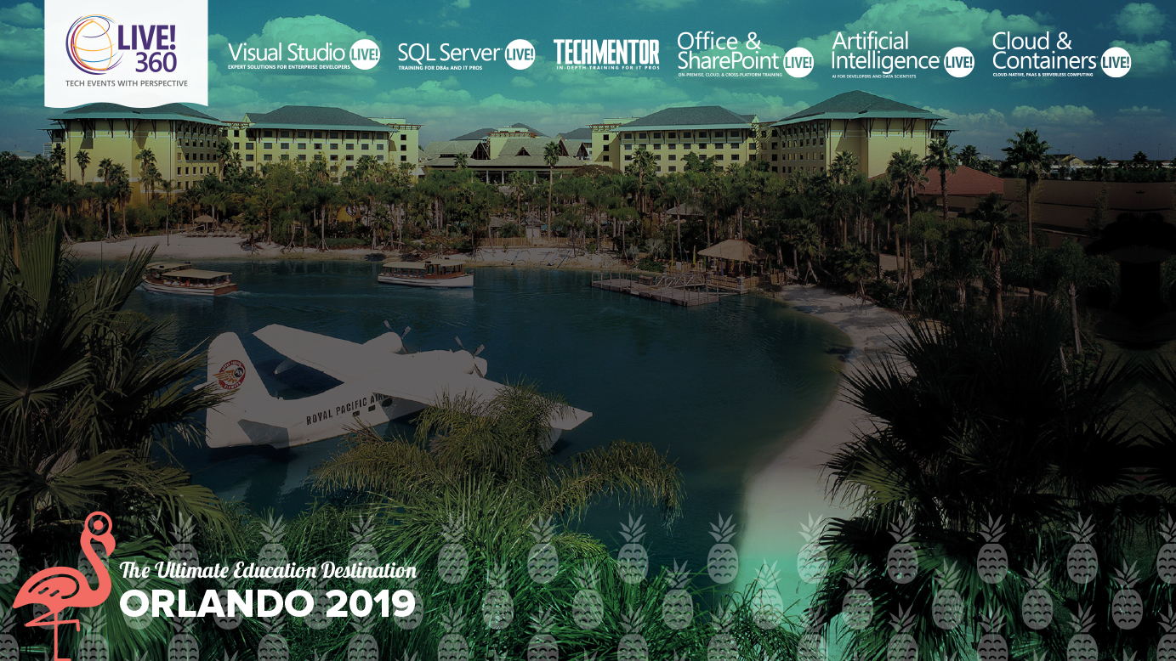
Leveraging Build Pipelines, Automating Container OS & Framework Patching
Steve Lasker
Program Manager
Azure Container Registries
Level: Intermediate Steve.Lasker@Microsoft.com
@SteveLasker
SteveLasker.blog
Notes:
Containers have become the modern packaging format, regardless of the host they're run on. You may be building your own images, or consuming images from ISVs. While containers have a focused subset of their VM ancestors, containers still have layers of the OS, runtimes and other components that are susceptible to vulnerabilities that must be remediated. Have you considered how you'll patch these deployments? Will you patch the running containers, as you patch VMs, hoping the software continues to run, as you continually patch the same deployed image?
We'll examine leveraging your build and deployment pipelines to automatically patch, test and deploy updates, during and long after you've moved onto another project. OS & Framework Patching can be an extension of what you're already doing today.

Slide 2
Containers: The App Packaging Format
Containers are the modern-day packaging format
Base images provide the base capabilities
Apps add capabilities atop the base (inheritance…)
Configuration extracted
Enabling the same image to be deployed across different environments (dev, test, prod) different customer sites (Contoso, Northwind, AdventureWorks)

Slide 3
But, What About…
Where do the base artifacts come from?
Do you, should you, blindly trust upstream content?
How do you balance leveraging upstream content, while assuring stability?
Wrapping up a project, how do you patch containers?
Containers are a paradigm shift from VM workloads

Slide 4









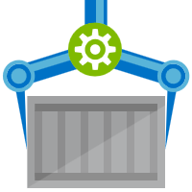






Are Your Base Artifacts Secure?
Images Secure?
Public Registries
Your Environment
aws, azure, google, on-prem, …
FROM contoso.azurecr.io/base-artifacts/dotnet/core/runtime:2 AS base
WORKDIR /app
ARG REGISTRY_NAME
ENV REGISTRY_NAME=${REGISTRY_NAME}
FROM contoso.azurecr.io/base-artifacts/dotnet/core/sdk:2 AS build
WORKDIR /src
COPY src/Important/Important.csproj src/Important/
RUN dotnet restore src/Important/Important.csproj
COPY . .
WORKDIR /src/src/Important
RUN dotnet build Important.csproj -c Release -o /app
FROM build AS publish
RUN dotnet publish Important.csproj -c Release -o /app
FROM base AS final
WORKDIR /app
COPY --from=publish /app .
ENV VERSION=0.0.25
ENTRYPOINT ["dotnet", "Important.dll"]
FROM mcr.microsoft.com/dotnet/core/runtime:2 AS base
WORKDIR /app
ARG REGISTRY_NAME
ENV REGISTRY_NAME=${REGISTRY_NAME}
FROM mcr.microsoft.com/dotnet/core/sdk:2 AS build
WORKDIR /src
COPY src/Important/Important.csproj src/Important/
RUN dotnet restore src/Important/Important.csproj
COPY . .
WORKDIR /src/src/Important
RUN dotnet build Important.csproj -c Release -o /app
FROM build AS publish
RUN dotnet publish Important.csproj -c Release -o /app
FROM base AS final
WORKDIR /app
COPY --from=publish /app .
ENV VERSION=0.0.25
ENTRYPOINT ["dotnet", "Important.dll"]
Private Registry
acr, ecr, gcr, dtr, harbor, jfrog, …
Buffer base artifacts in your secured environment
Scan, test, validate base artifacts
Automate all of this
Cover your assets
Be available and protected when things outside your control aren’t secured or available
contoso.azurecr.io
.NET
Docker Hub
Public Internet
staging-artifacts
node
java
MCR
dotnet
ACR Tasks
wordpress
base-artifacts
node
java
dotnet
wordpress
dev
faclon-team
warriors-team
integration
falcon-team
warriors-team

Slide 7




Steve Lasker
Program Manager
Azure Container Registries
Steve.Lasker@Microsoft.com
@SteveLasker
SteveLasker.blog
github.com/SteveLasker
github.com/SteveLasker/presentations

Slide 8
Bullet 1 for the slide
Sub-bullet
Sub bullet
Bullet 2 for the slide
Just to see how the copy looks if it goes deep enough to reach the bottom.
You never know how much copy will be on a slide
Bullet 3 for the slides
This is a critical point that needs to be communicated

