Slide 1
Deploying Containers to Azure App Services and Azure Container Service
Steve Lasker
Program Manager
Azure Developer Experiences
@SteveLasker
blogs.msdn.microsoft.com/stevelasker
Notes:
Now that you’ve been using Docker a bit, locally, you may be wondering how can I get my containers running in Azure.
Hi, I’m Steve Lasker, a program manager in the Azure Developer Experiences team. I work on our container tooling experiences and I wanted to share some of the publishing and configuration tooling we’ve included with Visual Studio 2017

Slide 2


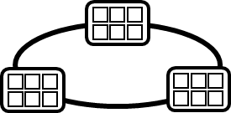

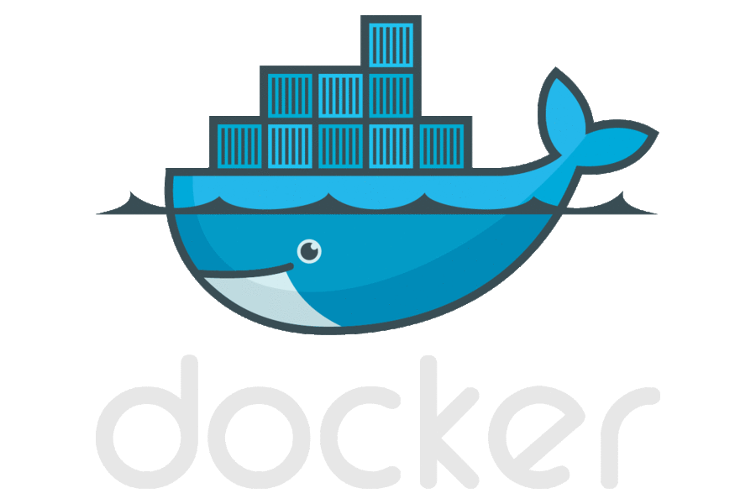



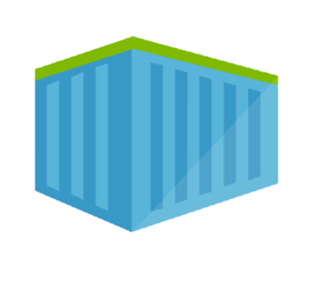
Containerized Workflow
Visual Studio Team Services
Container Service
2.
3.
4.
5.
Run, Manage
Service Fabric
Source Code Control
(SCC)
Build/CI,
Integrate,
Test
CD, Deploy
Batch
Production
environments
App Services
Azure Container Registry
Coming soon
Push
Code
…
Inner-Loop
6.
…
1.
Run
Code
Validate
Outer-Loop
Debug

Slide 3
Publishing Direct to Azure
Azure
CI/CD Pipeline
App Services
Azure Container Registry
Inner-Loop
1.
Run
Code
Validate
Debug

Slide 4
Visual Studio Container Tools
Installed w/Web Workload
Run, Debug, Test Web & Console apps in docker containers
Linux & Windows Server today, Nano Server coming soon
Multi Container Debugging
Edit & Refresh of code
Scaffolds docker assets
Dockerfile, docker-compose.yml, build artifacts
Publish to Azure App Services
Configure CI/CD w/VSTS to ACS

Slide 5
Demo

Slide 6
Visual Studio 2017 Container Tools
Get Started Today with Visual Studio 2017 & Docker for Windows
Publish .NET Core on Linux directly to Azure App Service
Configure Continuous Delivery with Visual Studio Team Services and Azure Container Service
Get the Continuous Deliver Extension at: aka.ms/cd4vs
@SteveLasker
blogs.msdn.microsoft.com/stevelasker
Notes:
Hopefully that gives you a good overview of the capabilities of Visual Studio Container Tools.
The publishing experience is currently supported for .NET Core container apps, targeting Linux Containers.
The Continuous Deployment configuration is built around the Azure Container Service, and currently supports DC/OS. However, we’ll have Kubernetes and Docker coming in the future.
With that, I let you get started with containers and continue your productivity while becoming a docker developer.

Slide 7
Notes:
Dark gray background.

