Slide 1
Docker Development with Visual Studio 2017
Steve Lasker
Program Manager
Azure Developer Experiences
@SteveLasker
blogs.msdn.microsoft.com/stevelasker
Notes:
You’ve likely heard about Docker, maybe even done some development. It’s an empowering way to bring continuous to your dev/ops workflows as containers resolve one of the key aspects of packaging our applications for deployment.
But, you may be wondering if you need to give up the productivity you’ve come accustomed to with Visual Studio.
Hi, I’m Steve Lasker, a program manager in the Azure Developer Experiences team. I work on our container tooling experiences and I wanted share with you the container tooling in Visual Studio to help you be empowered, not feel daunted by this game changing technology.

Slide 2


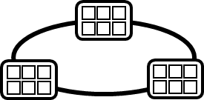

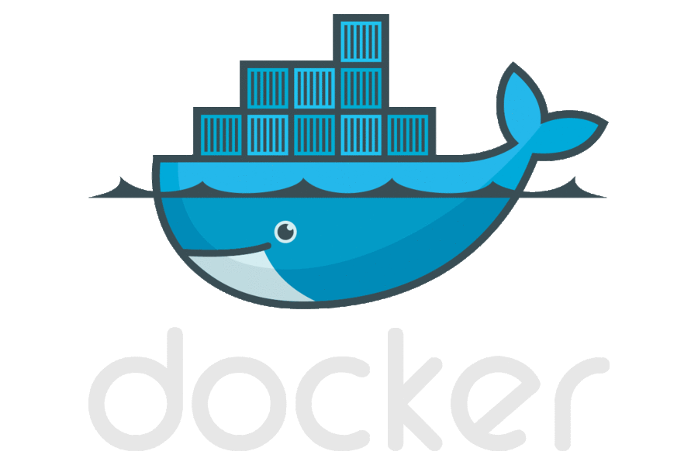




Containerized Workflow
Visual Studio Team Services
Container Service
2.
3.
4.
5.
Run, Manage
Service Fabric
Source Code Control
(SCC)
Build/CI,
Integrate,
Test
CD, Deploy
Batch
Production
environments
App Services
Azure Container Registry
Coming soon
Push
Code
…
Inner-Loop
6.
…
1.
Run
Code
Validate
Outer-Loop
Debug
Notes:
When we look at the container continuous worfklows, we see containers and registries are a key concept.
We start with what we call the inner loop. Which is everything you do before you commit code.
From the beginning of your development cycle, you’re building and running your code in containers.
We pull base images from a container registry. Either Docker Hub, or perhaps our private corporate registry.
As we’re happy with our code, we commit the code to a source code repository.
The build system takes our code, a dockerfile that describes the build system and builds the collection of images I need for deployment
The images are pushed to our private registry, with the environment configurations extracted from the image.
When deployment happens, we pull images, add the environment information and push it out to various environments.
In Azure, we have many different container hosting offerings.
From Azure Container Service, which hosts the best of breed open source orchestrators
To Service Fabric, which can host guest containers
Or, Azure Batch, App Services for single container workloads that can scale.
And Azure continues to expand it’s container hosts as containers are becoming the unit of deployment.

Slide 3
Visual Studio Container Tools
Installed w/Web Workload
Run, Debug, Test Web & Console apps in docker containers
Linux & Windows Server today, Nano Server coming soon
Multi Container Debugging
Edit & Refresh of code
Scaffolds docker assets
Dockerfile, docker-compose.yml, build artifacts
Publish to Azure App Services
Configure CI/CD w/VSTS to ACS
Notes:
But, how do I achieve the inner loop goals?
With Visual Studio 2017, we’ve worked hard to provide the productive Visual Studio experiences you’ve come to expect, while maintaining the core docker experience.
Visual Studio 2017 will scaffold the docker assets you need to get started. But, they become yours to iterate upon. If you have questions, simply look up the Docker docs.
The best way to show this, is to show the experience, so lets jump into the demo.

Slide 4
Demo

Slide 5
Visual Studio 2017 Container Tools
Get Started Today with Visual Studio 2017 & Docker for Windows
Lift & Shift your existing .NET Workloads into Windows Server Core Containers
Modernize your services with .NET Core and Nano Server, or Linux
@SteveLasker
blogs.msdn.microsoft.com/stevelasker
Notes:
Hopefully that gives you a good overview of the capabilities of Visual Studio Container Tools.
We support .NET Framework in Windows Server Core, enabling your first step of running your existing apps in Containers. Which gets you on your first steps towards a microservices architecture.
And .Net Core in Linux Containers, where you can build out new services.
Nano Container tooling support is coming soon to round out the matrix of options.
With that, I let you get started with containers and continue your productivity while becoming a docker developer.

Slide 6
Notes:
Dark gray background.

