Slide 1




Securing Container Workloads Build, Sign, Scan, Push, Deploy & VNets
Oh My
Steve Lasker
Program Manager
Azure Container Registries
Steve.Lasker@Microsoft.com
@SteveLasker
SteveLasker.blog
https://github.com/stevelasker

Slide 2
Where do you start? What are the components of securing workflows?

Slide 3
Multiple lines of defense
Authentication & Authorization
Container Workflows, w/Security

Slide 4


Security isn’t definitive it’s a matter of time, effort and how determined someone is.

Slide 5

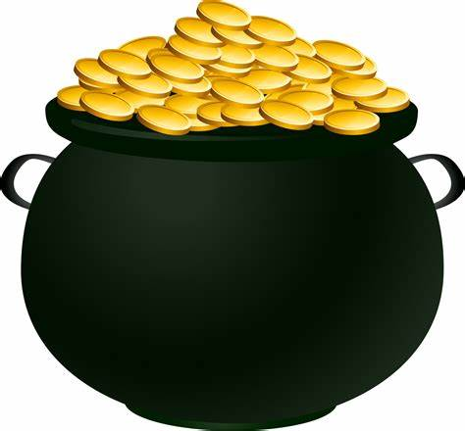
Multiple Lines Of Defense

Slide 6
Multiple Approaches
Authentication Boundaries
Active Scanning
Network Security
Content Verification

Slide 7
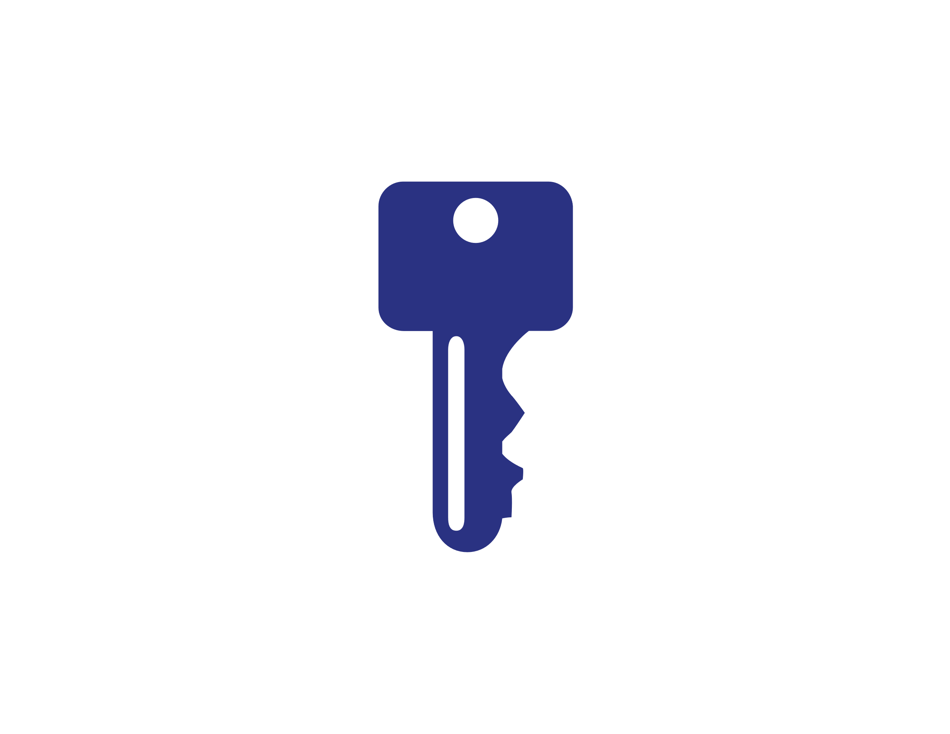
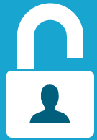
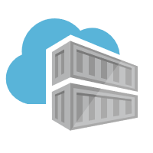


Authentication & Authorization
Require the most stringent authentication
Users – 2fa
Services – rotatable, revocable, time-based tokens
Provide the least permissions required to get the job done.
Runtime clusters should only be able pull images
CI Systems should be able to push
Who can sign images?
Authentication:
Username/Password?
2FA
Token
Certificate
Time based
Revocable?
Permissions:
Read – Pull
Write – Push
Sign – content trust
List – repos and tags
Delete
Update meta-data – expiration date
Users
Services

Slide 8

Managing Base Images

Slide 9

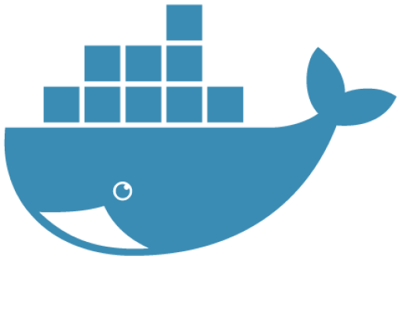

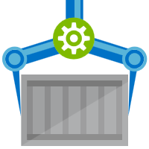
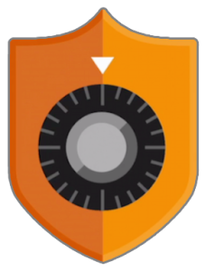
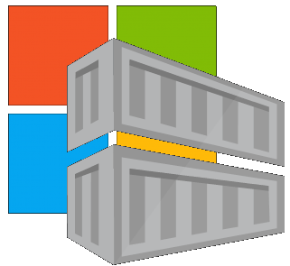


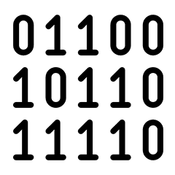
Are Your Base Images Secure?
Are Your Base Images Artifacts Secure?
Public Registries
Your Environment
aws, azure, google, on-prem, …
Private Registry
acr, ecr, gcr, dtr, harbor, jfrog, …
contoso.azurecr.io
Docker Hub
Public Internet
staging-artifacts
node
java
MCR
dotnet
wordpress
base-artifacts
Buffer base artifacts in your secured environment
Scan, test, validate base artifacts
Automate all of this
Be protected and available, when things outside your control aren’t secured or available
node
java
dotnet
wordpress
departments
marketing
warranty
dev
falcon-team
warriors-team

Slide 10
Container Workflows…

Slide 11
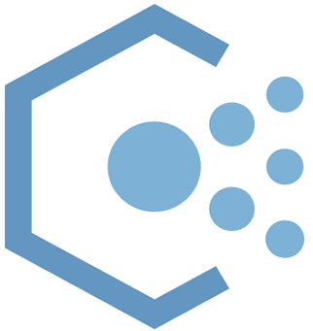
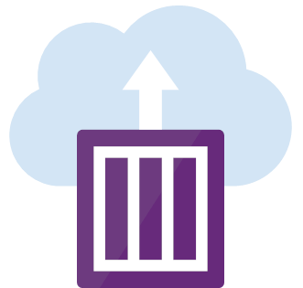






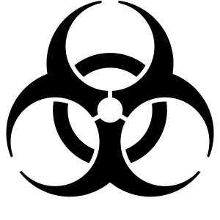

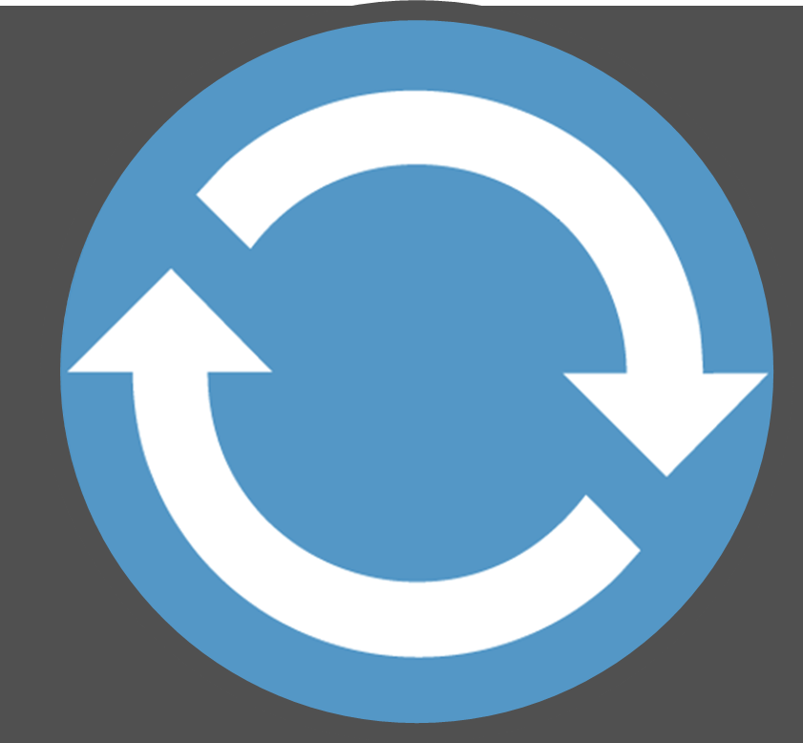
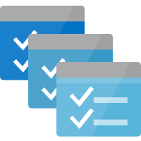

Container Lifecycle Primitives
Host agents monitor, protect and report running containers
3
Applying multiple lines of defense
Runtime scanning, everywhere you can
Apply policy to restrict images to secured registries
Quarantine images, until scanned and secured
Kubernetes Service
Source Code Control
(SCC)
Build/CI,
Integrate,
Test
CD, Deploy
Container Instances
7
Upon release, set released flag in ACR (ACR-Auto-purge policies)
App Services
.NET
Base Image Index
6
4
Service Fabric
8
1
2
Docker Hub
ACR Tasks
ACR
Functions
Azure Container Registry
Microsoft Container Registry
IoT
Inner-Loop
Image Security Scanning
Secure by default with by Quarantin-ing artifacts
Run
Batch
5
Code
Validate
Debug

Slide 12
Container Registries Secured by Default
Assuring a registry has images that are scanned and considered secure enough
The Container Quarantine Pattern

Slide 13
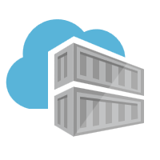
Secured By Default
Build/Push
Azure Container Registry
Container Hosts
Quarantine Tag
Digest
Tag
91efj6
:1.0
:1.1
u82lq
:1.2
e8s1f

Slide 14
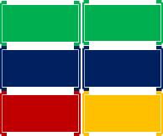
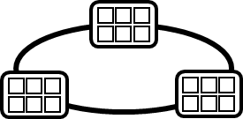
Container Service
Run, Manage
1
Release Management
Container Instances
docker push acrdemos.azurecr.io/th:1.0
Azure Container Registry
Production
environments
App Services
5
6
2
{
"id": "0d799b14-404b-4859-b2f6-50c5ee2a2c3a",
"timestamp": "2018-02-28T00:42:54.4509516Z",
"action": "push-quarantined",
"target": {
"size": 1791,
"digest": "sha256:91ef6
"length": 1791,
"repository": “th",
"tag": "1.0"},
"request": {
"id": "978fc988-1e06-49ee-bf71-4f6e331d1591",
"host": “acrdemos.azurecr.io",
"method": "PUT"}
}
{
"id": "0d799b14-404b-4859-b2f6-50c5ee2a2c3a",
"timestamp": "2018-02-28T00:42:56.4509516Z",
"action": "push",
"target": {
"size": 1791,
"digest": "sha256:91ef6
"length": 1791,
"repository": “th",
"tag": "1.0"},
"request": {
"id": "978fc988-1e06-49ee-bf71-4f6e331d1591",
"host": “acrdemos.azurecr.io",
"method": "PUT"}
}
Tag
Digest
91efj6
u82lq
e8s1f
3r2s7
Quarantine Tag
:1.0
:1.1
:1.0
:1.0
3
docker pull th@sha256:91ef6
4
az acr policy set –n acrdemos --quarantine-remove –-image th@sha256:91ef6
or
az acr policy set –n acrdemos --quarantine-block –-image th@sha256:91ef6
Notes:
{
"id": "0d799b14-404b-4859-b2f6-50c5ee2a2c3a",
"timestamp": "2018-02-28T00:42:54.4509516Z",
"action": "push-quarantined",
"target": {
"mediaType": "application/vnd.docker.distribution.manifest.v2+json",
"size": 1791,
"digest": "sha256:91ef6
"length": 1791,
"repository": “th",
"tag": "1.0"
},
"request": {
"id": "978fc988-1e06-49ee-bf71-4f6e331d1591",
"host": "jengademos.azurecr-test.io",
"method": "PUT",
"useragent": "docker/18.03.0-ce-rc1 go/go1.9.4 git-commit/c160c73 kernel/4.9.75-linuxkit-aufs os/linux arch/amd64 UpstreamClient(Docker-Client/18.03.0-ce-rc1 \\(windows\\))"
}
}

Slide 15

VNET & Firewalls
Securing registry access to private virtual networks

Slide 16
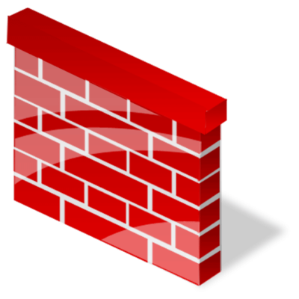




VNet & Firewall Rules
AKS
Public Internet
Node1
Node2
Node3
Azure virtual network
ACR
Other Resources
IP: 10.2.1.3
IP: 5.5.1.2
http://aka.ms/acr/vnet

