Slide 1


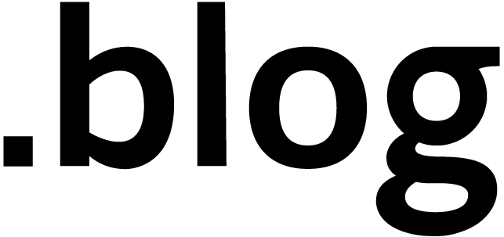

NOTARY V2: Deep Dive and Open Issues
Steve Lasker
Principal PM Architect
Azure Container Registries
Steve.Lasker@Microsoft.com
@SteveLasker
SteveLasker.blog
github.com/SteveLasker
github.com/SteveLasker/presentations
Justin Cormack
CTO
Docker
justin@docker.com
@justincormack
cloudatomiclab.com
github.com/justincormack

Slide 2
Today’s Agenda
Notary v2 Goals
Promotion Workflows
What are supply chain artifacts?
Who Do You Trust?
Open Questions

Slide 3
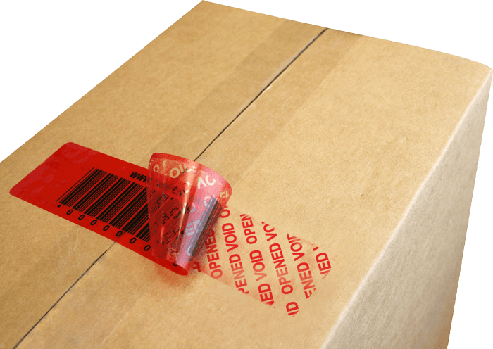
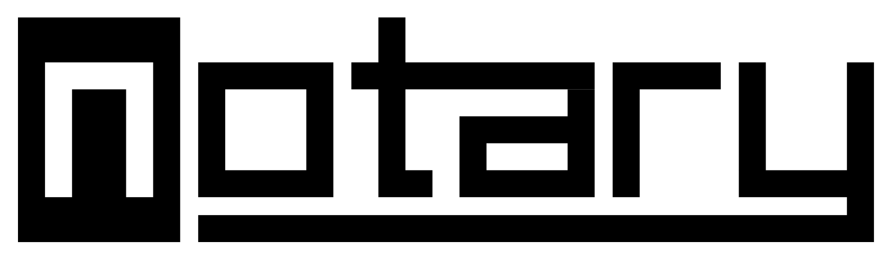
Notary v2 Goals
Best Practices for Secure Supply Chain Artifacts
Secure Promotion Workflows
Public → Private
Private → dev → staging → prod
Signatures, and all other supply chain artifacts flow with the images
Trust the integrity of the artifact made it from source to destination
Build on Existing Security Fundamentals
Building on existing specs, enhancing and adding as needed
Investing in security and supply chain libraries x.509, go-cose, notation-go, oras-go, artifacts-spec
Invest and Extend Existing Services
Registries are everywhere…
Investing in that core infrastructure
https://github.com/notaryproject/notaryproject/blob/main/requirements.md#goals

Slide 4
Stages of the Supply Chain
Creation of Content
The building of content (binaries, packages, images)
Distribution of Content
Distributing the content to consumers
Distribution includes promotion across different environments
Including all related content, signatures, scans, sboms, claims
Consumption of Content
To build other content
To import from other sources
To deploy
Notary v2

Slide 5
How Do You Deploy Today?
Unique tags? (my-service:ag-123)
Digests? (my-service@sha256:abs8a23823aaa8a8d8d8a...)
Convert a tag to a digest?
What do digests promise?
Do you track all the digests created, and who created them?
Do you accept unique digests from a set of identities?

Slide 6
Signing – what does it promise?
“All deployed content must be signed”
By who?
Who do you trust?
Who don’t you trust?
Who do you/don’t you trust for a given environment?
If you had signed content, from entities you trust, would you need to track individual digests?

Slide 7
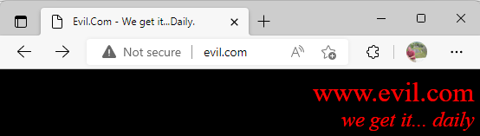
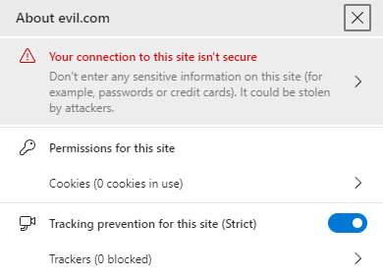
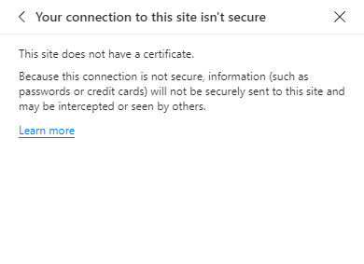
Who Do You Trust
No cert (not secure) = no trust

Slide 8
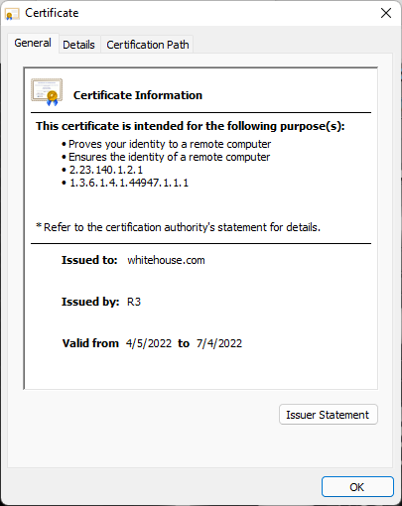
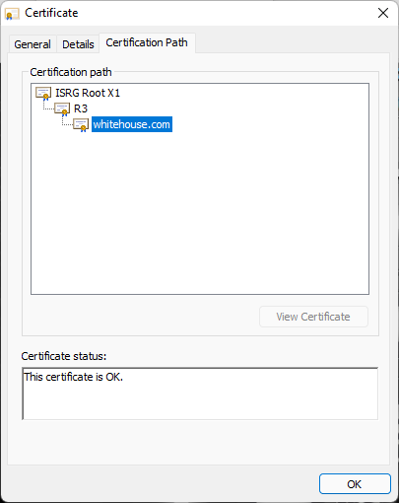
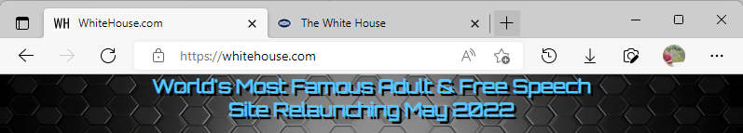
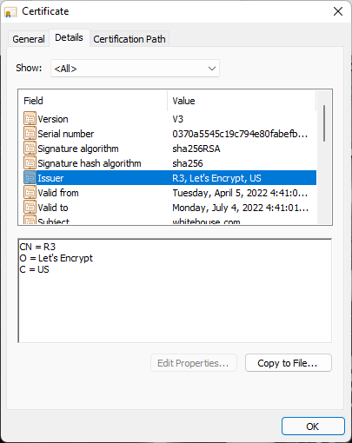
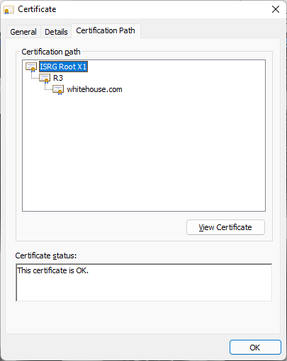
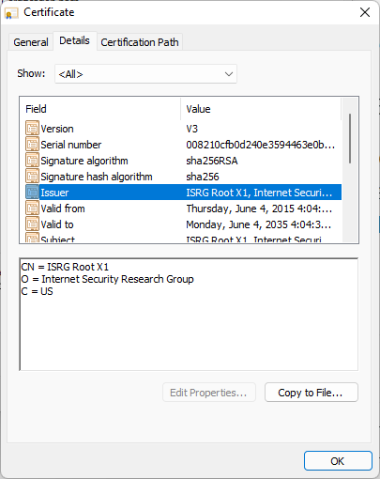
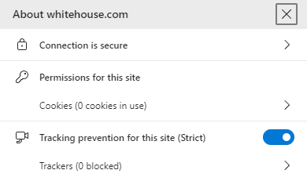
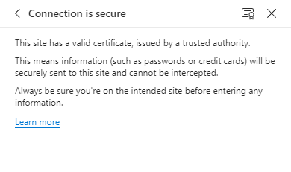
Who Do You Trust

Slide 9
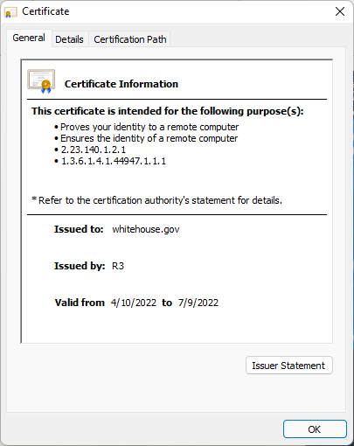

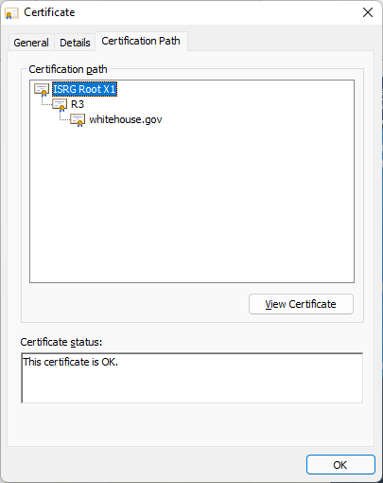
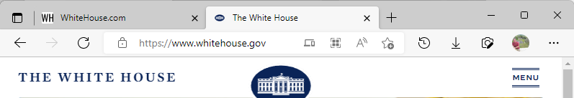
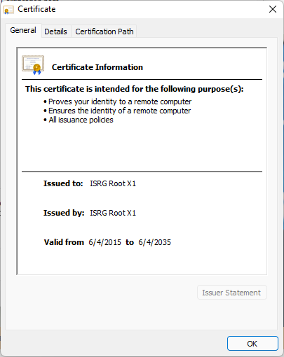

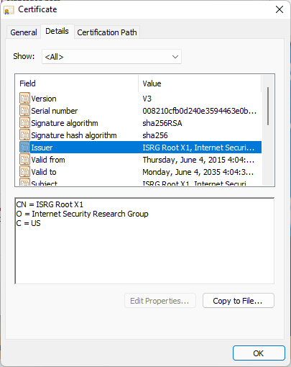

Who Do You Trust

Slide 10
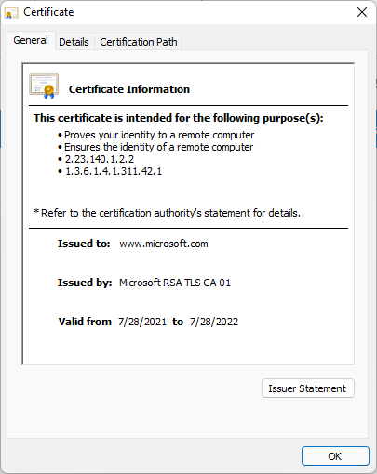
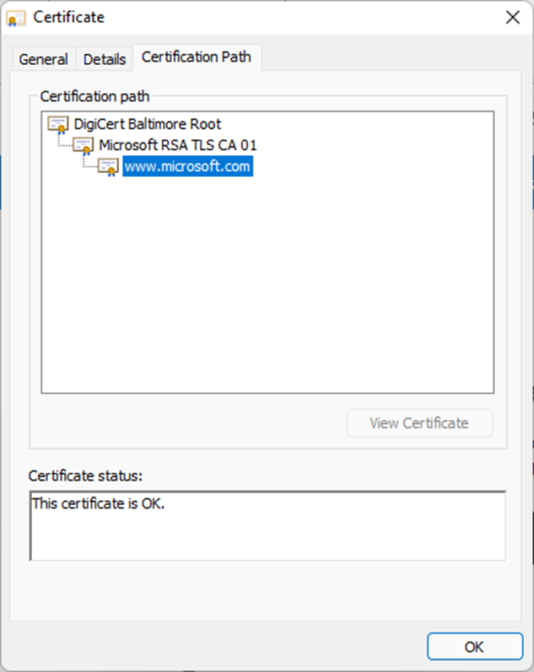
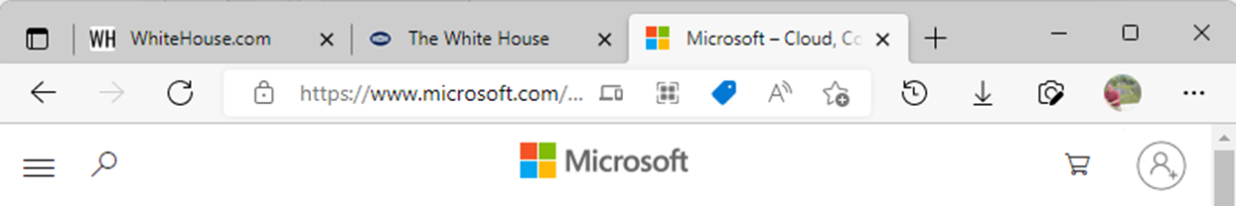
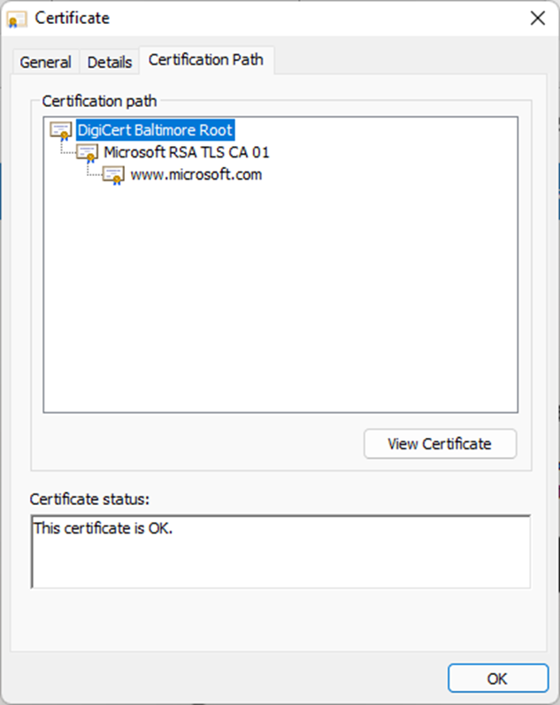
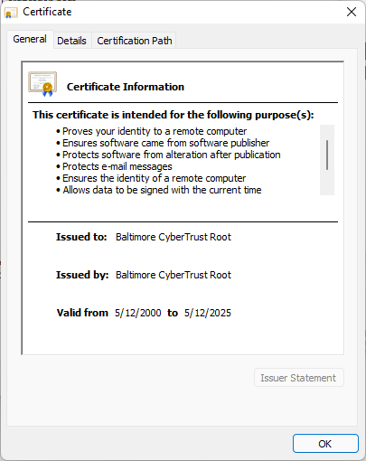
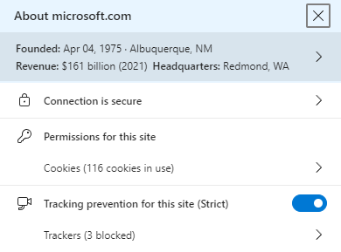
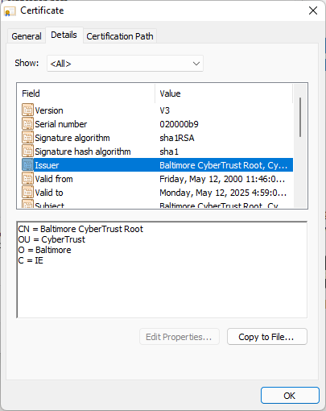
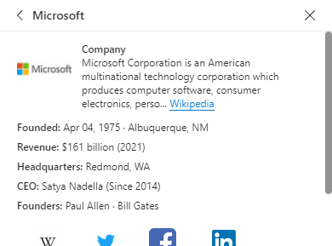
Who Do You Trust

Slide 11
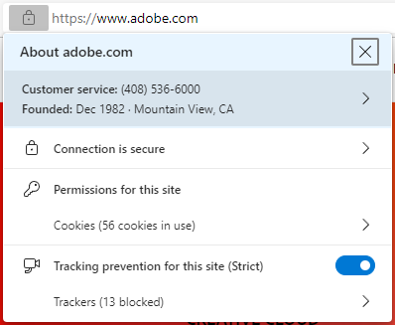
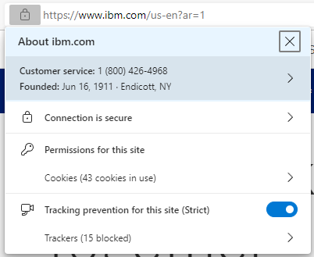
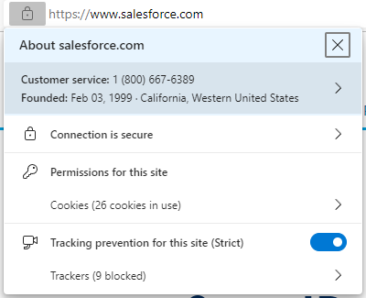
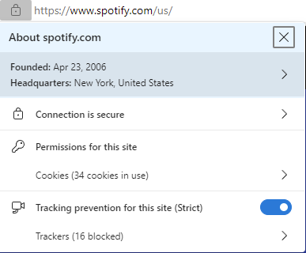
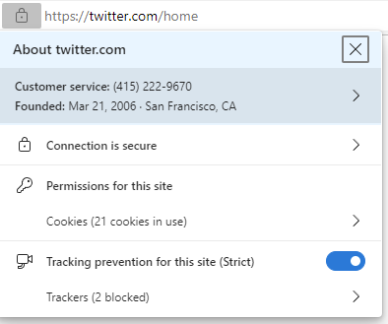
Who Do You Trust

Slide 12
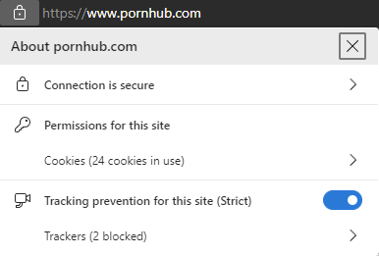
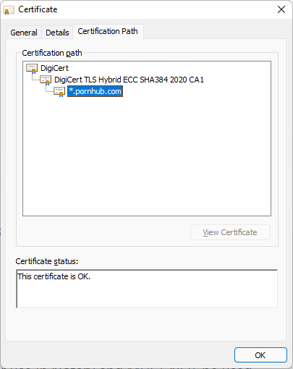
Different Levels of Trust
Who/what do you trust?
Do you defer everything you trust to central outside authorities?
Browsers are different, and similar
There are many “interesting” and “bad” sites that have valid https: keys
Does that mean you want your children to view them?
Do you have the same trust policies for:
Dev Box
Build Environment (SDKs and build tools)
Staging (secured from SDK and build tools)
Production (super secured)

Slide 13

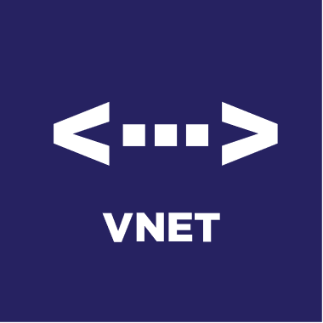

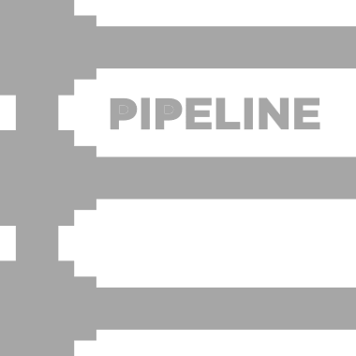

Artifact Promotion
Wabbit Networks
Docker Hub ^{(Distributor)}
ACME Rockets
Air-gapped network
Artifact Build Environment
Trust Policy
Wabbit Networks
Docker Hub
Image
Spacely Sprockets
Image
Image
Image
Image
Image
Image
Image
Cogswell Cogs
Internal Registry
Private Registry
Container Host
SBoM
SBoM
SBoM
SBoM
SBoM
SBoM
SBoM
SBoM
Policy Management
Scan Results
Scan Results
Scan Results
Scan Results
Scan Results
Scan Results
Scan Results
Scan Results
Claims
Claims
Claims
Claims
Claims
Claims
Claims
Claims
Air-gapped network
Spacely Sprockets
Spacely Sprockets
Artifact Build Environment
Private Registry
Container Host
Policy Management
Image
Image
Image
SBoM
SBoM
SBoM
Scan Results
Air-gapped network
Scan Results
Scan Results
Cogswell Cogs
Private Registry
Artifact Build Environment
Wabbit Networks built the net-monitor:v1 image (software)
ACME Rockets Imports net-monitor:v1
ACME tests it for their security posture (SBOM, Scans, Claims)
If net-monitor:v1 meets ACME standards, it’s “approved”
Approved is indicated with a signature and a new claim
Container Host
Policy Management
Image
Image
SBoM
SBoM
Scan Results
Scan Results

Slide 14
Notary v2 Policy Management
Notary v2 enables policy-based management, per environment
You configure which keys you trust, per environment
Integrate with OPA/Gatekeeper and other policy managers
Notary v2 supports key provider extensibility

Slide 15
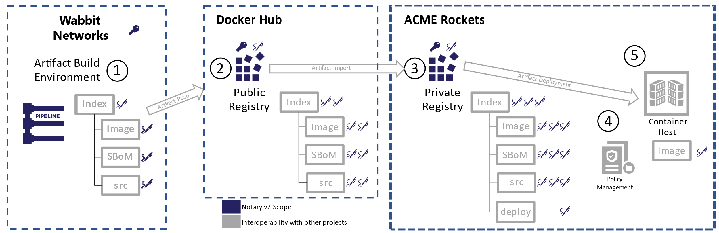
Supply Chain Artifact Challenges
Artifacts are promoted across environments
Pubic → Shared Internal → Dev → Staging → Prod
Many of these destinations are within restricted networks (Vnets)
The supply chain objects should travel with the artifacts
Enabling evaluation and validation of the supply chain objects, where the content is consumed from

Slide 16
How Notary v2 Enables Secure Workflows
Signatures are associated with a subject artifact
Signatures are promoted with the artifact
Multiple signatures may be associated with a given artifact
Signatures are separable, enabling protection from trojan horse attacks
Multiple Supply Chain Artifacts may be associated with a given artifact
SBOMs, Scan Results, Claims, Annotations
Anything in a registry may be signed with Notary v2

Slide 17
Demo
Local Signing and Verification
Notes:
Create a private/public key combination
Store in a private keyvault
Biuld an image
Retrieve the private key
Sign the image
Create an SBoM
Sign the SBoM
Scan the image
Associate the scan results
Sign the scan results
Sign the image with a scanned signature
Push the image
With the signatures, scan results and sbom
Promote to Production
Verify the signature
Verify the scan results & SBoM
Sign the image, with a prod signature (note, the image didn’t get pulled to add the signature)
Copy the

Slide 18
Remote Signing
Keep your private keys private
You may have access for signing
You likely won’t have access to the actual private keys
Leverages the existing x509 infrastructure most customers have

Slide 19
Notary Plug Ins
Private keys locked away in secured key vaults
Images and all other artifacts are remotely signed
Plugins are external to the Notary Project
Plugin specification: github.com/notaryproject/notaryproject/blob/main/specs/plugin-extensibility.md
Plugins have autonomy for creation and updates

Slide 20
Demo
Remote Signing and Verification
Notes:
Create a private/public key combination
Store in a private keyvault
Biuld an image
Retrieve the private key
Sign the image
Create an SBoM
Sign the SBoM
Scan the image
Associate the scan results
Sign the scan results
Sign the image with a scanned signature
Push the image
With the signatures, scan results and sbom
Promote to Production
Verify the signature
Verify the scan results & SBoM
Sign the image, with a prod signature (note, the image didn’t get pulled to add the signature)
Copy the

Slide 21
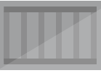
Securing Kubernetes Namespaces
Only allow the signing entities you trust
Secured at ingress with
Gatekeeper as the ingress controller
Ratify for configured validators
k8s Cluster
namespaces
Ingress Controller
not-secured
secured
Gatekeeper
nginx:1.21.6
net-monitor:v1
Constraints
ratify
kind: K8sSignedImages
Ratify-constraint
Namespace=secured
notary v2

Slide 22
Demo
Securing k8s Namespaces
Notes:
Create a private/public key combination
Store in a private keyvault
Biuld an image
Retrieve the private key
Sign the image
Create an SBoM
Sign the SBoM
Scan the image
Associate the scan results
Sign the scan results
Sign the image with a scanned signature
Push the image
With the signatures, scan results and sbom
Promote to Production
Verify the signature
Verify the scan results & SBoM
Sign the image, with a prod signature (note, the image didn’t get pulled to add the signature)
Copy the

Slide 23
Promoting Artifacts
Several tools were used to create various artifacts
Container Build Tools, SBoM Creation, Image Scan Results, Signatures
Once approved: promote from source to target, including the graph of artifacts
oras copy wabbit-networks.io/net-monitor:v1 \
acme-rockets.io/net-monitor:v1 -r
registry.wabbit-networks.io/net-monitor:v1 ├── application/vnd.cncf.notary.v2 │ └── sha256:8c0e82624475a4ad64ddca2d68c0f82e316ec758591cb916049fe59eaf27b5b4 ├── application/vnd.org.snyk.results.v0 │ └── sha256:95b97532a5b2d0c36cfcefd403b02779fb5afca07479a66bd509a635d5681e7f │ └── application/vnd.cncf.notary.v2 │ └── sha256:02f35a789d1ec2267727ac32c4f8ad643e88288528e648e4b71af42c2912699b └── sbom/example └── sha256:82d89db16266d13ab7680badfea3dbd91fd8e311c3b4291d9c0d4f9cff86fa50 └── application/vnd.cncf.notary.v2 └── sha256:413e8b4de5f09c1b458d9d0ab8f1cc510d4276ffaa710073daff721e89b07aa2

Slide 24
Demo
oras copy wabbit-networks.io/net-monitor:v1 \
acme-rockets.io/net-monitor:v1 -r
registry.wabbit-networks.io/net-monitor:v1 ├── application/vnd.cncf.notary.v2 │ └── sha256:8c0e82624475a4ad64ddca2d68c0f82e316ec758591cb916049fe59eaf27b5b4 ├── application/vnd.org.snyk.results.v0 │ └── sha256:95b97532a5b2d0c36cfcefd403b02779fb5afca07479a66bd509a635d5681e7f │ └── application/vnd.cncf.notary.v2 │ └── sha256:02f35a789d1ec2267727ac32c4f8ad643e88288528e648e4b71af42c2912699b └── sbom/example └── sha256:82d89db16266d13ab7680badfea3dbd91fd8e311c3b4291d9c0d4f9cff86fa50 └── application/vnd.cncf.notary.v2 └── sha256:413e8b4de5f09c1b458d9d0ab8f1cc510d4276ffaa710073daff721e89b07aa2
oras copy [source] [destination] --recursive
Notes:
Validate the signature of the source
Show list of repositories in target – none
IF → copy the graph
Show the list ore repositories in the target
Show list of tags

Slide 25
Notary v2 Policy Management
Notary v2 enables policy-based management, per environment
You configure which keys you trust, per environment
Integrate with Gatekeeper/Ratify and other policy managers
Notary v2 supports key plug-ins

Slide 26
Notary v2 Signed Content
Notary v2 finishing up RC1 this month (May)
Microsoft shipping signed images and supply chain artifacts
For Azure Service validations
For US Executive Order Conformance (Claims & signed SBOMs)
Notation alpha 1 signed images coming online
Other images:
mcr.microsoft.com/oss/kubernetes/kube-apiserver:v1.25.0-alpha.0
mcr.microsoft.com/oss/kubernetes/ingress/nginx-ingress-controller:v1.2.0
More info at: aka.ms/mcr
notation verify --cert msft_supply_chain \
mcr.microsoft.com/mcr/hello-world-oras-canary:demo

Slide 27
Notary v2 Status
Specs finalizing
Notary Signature Specification
Enhancing w/COSE envelopes to support breadth of signing scenarios
Signing and Verification
Trust Stores and Policy
Releases
v0.7.1-alpha.1 released, with preview support in Azure
Supports remotely secured and signed x509 certs, verified and deployed to k8s
Azure Key Vault Provider
AWS in progress
RC1 April
RC1 stable with feature/signature compatibility with 1.0

Slide 28
Open Questions
Additional Identities?
SSH Keys for Build Systems & OSS projects/people
Distributed Identity Support
Widening the types of identities, with validations
Policy, to decide the types of identities you wish to trust, for each environment

Slide 29
Wrapping Up
Signatures enable attestation of an artifact by a given entity
You choose which entities you trust, for each environment
As you promote, stamp with a signature for that environment
Notary v2 references, generalized for all supply chain reference types
ORAS enables promoting a graph of artifacts into the environment you trust
…and have access to

Slide 30
Thank You
Notary v2: github.com/notaryproject/notaryproject
OCI Artifacts: github.com/opencontainers/artifacts
ORAS Artifact (Reference Types): github.com/oras-project/artifacts-spec
ORAS CLI: github.com/oras-project/oras
ORAS Library: github.com/oras-project/oras-go
Ratify: github.com/deislabs/ratify
CNCF Distribution Reference Types: github.com/oras-project/distribution
Steve Lasker
Principal PM Architect
Azure Container Registries
Steve.Lasker@Microsoft.com
@SteveLasker
SteveLasker.blog
github.com/SteveLasker
github.com/SteveLasker/presentations
Justin Cormack
CTO
Docker
justin@docker.com
@justincormack
cloudatomiclab.com
github.com/justincormack

