Slide 1
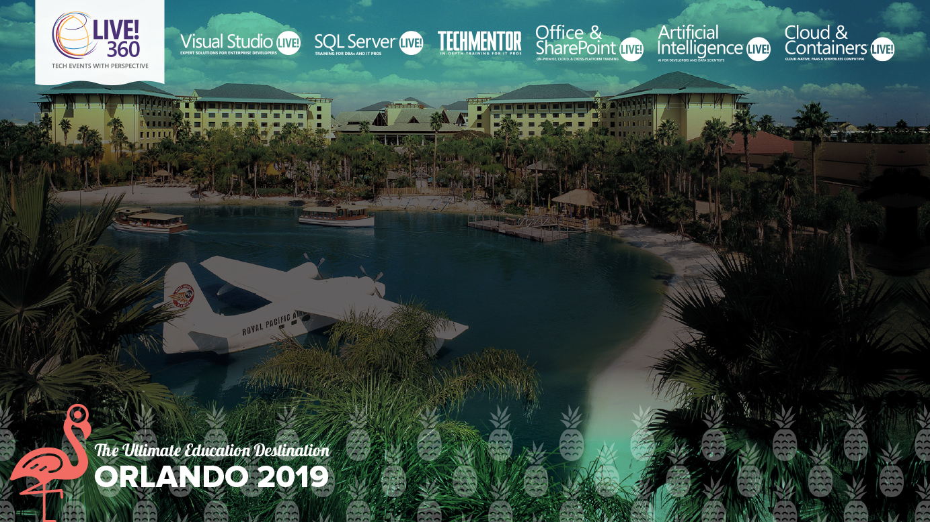
Leveraging Build Pipelines, Automating Container OS & Framework Patching
Steve Lasker
Program Manager
Azure Container Registries
Level: Intermediate Steve.Lasker@Microsoft.com
@SteveLasker
SteveLasker.blog
Notes:
Containers have become the modern packaging format, regardless of the host they're run on. You may be building your own images, or consuming images from ISVs. While containers have a focused subset of their VM ancestors, containers still have layers of the OS, runtimes and other components that are susceptible to vulnerabilities that must be remediated. Have you considered how you'll patch these deployments? Will you patch the running containers, as you patch VMs, hoping the software continues to run, as you continually patch the same deployed image?
We'll examine leveraging your build and deployment pipelines to automatically patch, test and deploy updates, during and long after you've moved onto another project. OS & Framework Patching can be an extension of what you're already doing today.

Slide 2
Containers: The App Packaging Format
Containers are the modern-day packaging format
Base images provide the base capabilities
Apps add capabilities atop the base (inheritance…)
Configuration extracted
Enabling the same image to be deployed across different environments (dev, test, prod) different customer sites (Contoso, Northwind, AdventureWorks)

Slide 3
But, What About…
Where do the base artifacts come from?
Do you, should you, blindly trust upstream content?
How do you balance leveraging upstream content, while assuring stability?
Wrapping up a project, how do you patch containers?

Slide 4

How Do You Patch Containers?
Patch running containers, like VMs
Patch the container, at build time
Pull updated base images, rebuild, redeploy
Containers are a paradigm shift from VM workloads

Slide 5
Image Tagging
balancing servicing and stability

Slide 6



Orchestration Provides Infrastructure Resiliency
Release Management
Resource Pool
Orchestration
HOST-A
Deploy:
web:1 x3
quotes:1 x3
important:1 x4
Image Cache
3
web:1
digest: 91e
web:1
digest: 91e
Foo:
web:1 x3
quotes:1 x3
important:1 x4
web:1
digest: 91e
quotes:1
digest: u82
Container Builder
important:1
digest: 2re
important:1
digest: 2re
Container Registry
HOST-B
Image Cache
quotes:1
digest: u82
quotes:1
digest: u82
7
6
quotes:1
digest: u82
5
web:1
digest: 91e
important:1
digest: 2re
important:1
digest: 2re
important:1
digest: 2re
quotes:1
digest: u82
1
quotes:1
digest: u82
docker build –t web:1
docker build –t quotes:1
docker build –t important:1
docker push web:1
docker push quotes:1
docker push important:1
important:1
digest: 2re
important:1
digest: 2re
Image
web:1
quotes:1
important:1
2
Digests
91e
u82
2re
web:1
digest: 91e
HOST-C
quotes:1
digest: u82
4
important:1
digest: 2re
8
Image Cache
quotes:1
digest: u82
quotes:1
digest: u82
important:1
digest: 2re
important:1
digest: 2re
Notes:
Orchestrator icon from: http://cdn.marketplaceimages.windowsphone.com/v8/images/f58edb21-b20c-4315-b837-6cee21n442cd?imageType=ws_icon_large
https://git-scm.com/book/en/v2/Git-Branching-Basic-Branching-and-Merging

Slide 7

HOST-A
Deploy:
web:1 x3
api:1 x3
cache:1 x4
Image Cache
3
web:1
digest: 91e
web:1
digest: 91e
Foo:
web:1 x3
api:1 x3
cache:1 x4
web:1
digest: 91e
api:1
digest: u82
api & cache are inconsistent states
1
cache:1
digest: 2re
cache:1
digest: 2re
docker build –t web:1
docker build –t api:1
docker build –t cache:1
docker images
REPOSITORY TAG DIGEST
web 1 91e
api 1 u82
cache 1 2re
docker push web:1
docker push api:1
docker push cache:1
HOST-B
Image Cache
api:1
digest: u82
api:1
digest: u82
9
8
5
api:1
digest: 3rp
api:1
digest: u82
cache:1
digest: 2re
api:1
digest: u82
cache:1
digest: 2re
web:1
digest: 91e
cache:1
digest: 1n4
cache:1
digest: 2re
cache:1
digest: 2re
Digests
91e
u82
2re
Image
web:1
api:1
cache:1
2
Digests
91e
u82
2re
3rp
1n4
web:1
digest: 91e
HOST-C
api:1
digest: u82
7
4
cache:1
digest: 2re
Image Cache
api:1
digest: 3rp
api:1
digest: 3rp
6
docker build –t api:1
docker build –t cache:1
docker images
REPOSITORY TAG DIGEST
api 1 3rp
cache 1 1n4
docker push api:1
docker push cache:1
cache:1
digest: 1n4
cache:1
digest: 1n4
api:1
digest: 3rp
cache:1
digest: 1n4
Notes:
Orchestrator icon from: http://cdn.marketplaceimages.windowsphone.com/v8/images/f58edb21-b20c-4315-b837-6cee21n442cd?imageType=ws_icon_large
https://git-scm.com/book/en/v2/Git-Branching-Basic-Branching-and-Merging

Slide 8
Tagging Techniques
Stable Tags
Tag
:latest
:1
:2
:3
:1.0
:1.1
:1.2
:2.0
:2.1
:3.0
Digest
91efj6
u82lq
2re7f
3rpn1
1n4ef
5wd1k
Servicing Stable Tags
Tag
:latest
:1
:2
:1.0
:1.1
:1.2
:2.0
Digest
91efj6
u82lq
e8s1f
1n4ef
2re7f
3rpn1
28efq
Unique Tagging
Tag
:12204
:12328
:12401
:33810
:35091
:4201
:50201
Digest
91efj6
u82lq
e8s1f
1n4ef
2re7f
3rpn1
28efq
Notes:
[‎2/‎23/‎2018 3:18 PM] Sajay Antony:
https://git-scm.com/book/en/v2/Git-Branching-Basic-Branching-and-Merging
[‎2/‎23/‎2018 3:37 PM] Sajay Antony:
https://docs.docker.com/storage/storagedriver/
[‎2/‎23/‎2018 4:00 PM] Sajay Antony:
https://www.cockos.com/licecap/
[‎2/‎23/‎2018 5:10 PM] Sajay Antony:
https://docs.docker.com/datacenter/dtr/2.4/guides/user/create-promotion-policies/

Slide 9
Image Tagging
Base Images
Deployed Images
Always Unique
Stable Tags create instability
Build IDs are a great source
{buildsystem}-{build_id}
10192409
1833583
305305t035
Stable Tags
:latest
:1.0
:1.1.1.1
:2.0
:2.2.1

Slide 10
Opportunity
DevOps pipelines build, test deploy
They’re triggered by git-commits

Slide 11













Are Your Base Artifacts Secure?
Images Secure?
Public Registries
Your Environment
aws, azure, google, on-prem, …
Private Registry
acr, ecr, gcr, dtr, harbor, jfrog, …
.NET
contoso.azurecr.io
Buffer base artifacts in your secured environment
Scan, test, validate base artifacts
Automate all of this
Be protected and available, when things outside your control aren’t secured or available
Docker Hub
Public Internet
staging-artifacts
node
java
MCR
dotnet
ACR Tasks
wordpress
base-artifacts
node
java
dotnet
wordpress
departments
marketing
warranty
dev
falcon-team
warriors-team

Slide 14




Steve Lasker
Program Manager
Azure Container Registries
Steve.Lasker@Microsoft.com
@SteveLasker
SteveLasker.blog
github.com/SteveLasker
github.com/SteveLasker/presentations

Slide 15
Bullet 1 for the slide
Sub-bullet
Sub bullet
Bullet 2 for the slide
Just to see how the copy looks if it goes deep enough to reach the bottom.
You never know how much copy will be on a slide
Bullet 3 for the slides
This is a critical point that needs to be communicated

