Slide 2
Building Resilient Microservices with .NET Core and Azure Container Services (AKS)
Glenn Condron
Program Manager – ASP.NET
@condrong
Steve Lasker
Program Manager – Azure Developer Experiences
@stevelasker
BRK2141
Notes:
Building Resilient Microservices with .NET Core and Azure Container Services (AKS)
Code: BRK2141
Type: Breakout 45 minute
Track(s): Applications and Infrastructure
Speaker(s): Glenn Condron, Steve Lasker
Timeslot: Monday, May 7 2:45 PM-3:30 PM
Abstract:Microservices are highly scalable, resilient, and composable units of deployment for modern applications. But building them is hard. There are a lot of development and deployment considerations to take into account. In this session we'll show you how we're making .NET Core microservices easier to build with new application patterns in .NET Core 2.1 as well as how to deploy and manage them with Kubernetes and Helm.

Slide 3
Abstract:Microservices are highly scalable, resilient, and composable units of deployment for modern applications. But building them is hard. There are a lot of development and deployment considerations to take into account. In this session we'll show you how we're making .NET Core microservices easier to build with new application patterns in .NET Core 2.1 as well as how to deploy and manage them with Kubernetes and Helm

Slide 4
Abstract
Building Reliable Systems
What makes a system reliable?
Pics/Animation of forms of reliability – what people do
Patterns of reliability
Developing for services that aren’t critical or cable of being 100% reliable
Developing for services that must be available 100%
How Containers can make your service 100% reliable
Why Microservices – is it just the latest fad?
Why microservices enable reliability
No individual service can be 100% reliable
How .NET Core enables reliability
How you can build reliable systems on top of unreliable things

Slide 5
What Makes a System Reliable?
Are individual components 100% reliable?
Is power 100% reliable?
Is network connectivity 100% reliable?
Is the OS and/or Framework 100% reliable?
Is your custom code 100% reliable?
Does it need to be 100% reliable?

Slide 6
Failure Is A Thing
If you assume things will fail, you’re prepared for reality
It’s not a matter of avoiding failure, it’s preparing for what to do when things fail
Building reliable systems embraces failure and provides for alternative paths

Slide 7
Balancing the “Cost” of Reliability
What are “costs”?
How much code are you willing to write
How many redundant instances will you pay for?
How many regions should you deploy to
Can you answer these questions:
What if that that service didn’t work for _____ amount of time?
Would your customer be able to complete the task?
Should the whole system fail because one minor piece failed?
, test
, maintain?
, and pay for?

Slide 8
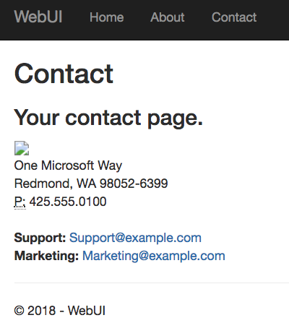
What’s the most basic fault-tolerant feature of HTML?
HTTP 404 - Broken Image

Slide 9
What Can You Do?
What has changed, in this wave of technology?
Reliable Computing
Container Orchestration – designed with failure as a design principal
Microservices – Smaller, isolated, idempotent units of capability

Slide 10



Release Management
Resource Pool
Orchestration
HOST-A
Deploy:
web:1 x3
api:1 x3
cache:1 x4
Image Cache
3
web:1
digest: 91e
web:1
digest: 91e
Foo:
web:1 x3
api:1 x3
cache:1 x4
web:1
digest: 91e
api:1
digest: u82
Container Builder
cache:1
digest: 2re
cache:1
digest: 2re
Container Registry
HOST-B
Image Cache
api:1
digest: u82
api:1
digest: u82
7
6
api:1
digest: u82
5
web:1
digest: 91e
api:1
digest: u82
cache:1
digest: 2re
api:1
digest: u82
cache:1
digest: 2re
1
cache:1
digest: 2re
docker build –t web:1
docker build –t api:1
docker build –t cache:1
docker push web:1
docker push api:1
docker push cache:1
cache:1
digest: 2re
cache:1
digest: 2re
Image
web:1
api:1
cache:1
2
Digests
91e
u82
2re
web:1
digest: 91e
HOST-C
api:1
digest: u82
4
cache:1
digest: 2re
8
Image Cache
api:1
digest: u82
api:1
digest: u82
cache:1
digest: 2re
cache:1
digest: 2re
Notes:
Orchestrator icon from: http://cdn.marketplaceimages.windowsphone.com/v8/images/f58edb21-b20c-4315-b837-6cee21n442cd?imageType=ws_icon_large
https://git-scm.com/book/en/v2/Git-Branching-Basic-Branching-and-Merging

Slide 11
Microservice Resiliency
Coding for failure…

Slide 12
Demo
.NET Core 2.1
Coding for Failure

Slide 13


Deploying & Managing Reliable Systems

Slide 14
Service Boundary Definition
Helm Charts
Kubernetes application deployment declaration
A set of “files” that describe the intent of what you want deployed
Values to fill in for incremental deployments
Name & Version
Collection of expandable Go templates, used to generate a Kubernetes Deployment file ^{(Similar to T4)}
Solves dynamic values used for each deployment
Chart.yaml
Values.yaml
\templates
webapp.yaml
quotesapi.yaml
secrets.yaml
_helpers.tpl
\charts
nginx-ingress-0.12.0.tgz
Custom template, for not-yet-known standards
A complete chart for an existing thing
RabbitMQ, NGINX, Jenkins

Slide 15
Demo
Deploying to AKS w/Helm
Azure Kubernetes Service
Managing Reliable & Unreliable Services
Notes:
High-level, walk through a helm chart
Helm upgrade

Slide 16
Helm – what are the controls you need to know?
Initial Deployment
helm install [directory] –n [name]
Upgrading an existing deployment
helm upgrade [name] [directory]
helm upgrade demo42 .
--reuse-values \
--set [name]=value

Slide 18
Coming into port…
Building 100% reliability is like chasing chickens
Accept failure and you’ll sleep well at night
Use the modern tools and technologies
Containers are the “unreliable” packaging format
Orchestrators (Kubernetes) are your nighttime managers
Take the time to fully adapt – this is a paradigm shift
.NET Core 2.1 provides coding for the unreliable pattern

Slide 19
Scrub checklist
Upload your final deck on the speaker portal on or before May 4, 2018 at 5:00pm PST and receive priority for expedited deck scrub. If you are not able to upload the deck, bring it to the Speaker Workroom as soon as possible and your deck will be queued up to complete deck scrub.
The Scrub Process will include:
Verification that required slides are included
Remove any non-template logos and graphics from the walk-in slide
Remove any unused placeholder slides from the deck
Remove all comments, hidden slides and speaker notes from slides
Set file properties box
Reset printability to grayscale
Notify Speaker of any images identified as unlicensed for immediate resolution
Rename PPT file to match naming convention
Correct session title and session code to match Schedule Builder
PRINTING: This template is intentionally set to print in color or grayscale, not black and white
As speakers, you must:
Use the provided event template and associated colors, fonts, layout and transition slides
Correct product names to follow applicable branding rules
Remove any unlicensed images
Notes:
© 2010 Microsoft Corporation. All rights reserved. Microsoft, Windows, Windows Vista and other product names are or may be registered trademarks and/or trademarks in the U.S. and/or other countries.
The information herein is for informational purposes only and represents the current view of Microsoft Corporation as of the date of this presentation. Because Microsoft must respond to changing market conditions, it should not be interpreted to be a commitment on the part of Microsoft, and Microsoft cannot guarantee the accuracy of any information provided after the date of this presentation. MICROSOFT MAKES NO WARRANTIES, EXPRESS, IMPLIED OR STATUTORY, AS TO THE INFORMATION IN THIS PRESENTATION.

Slide 20

Brand photography library
Looking for photography resources?
Explore the library on Brand Central.

Slide 21
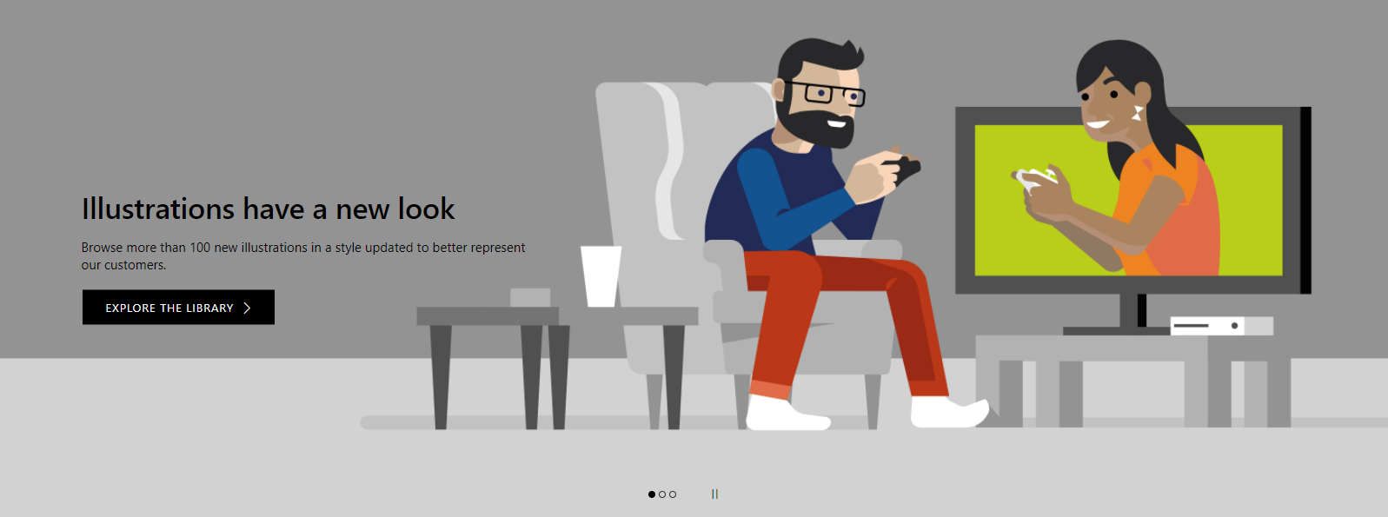
Illustration library
Looking for illustration resources?
Explore the library on Brand Central.

Slide 22
Section title

Slide 23
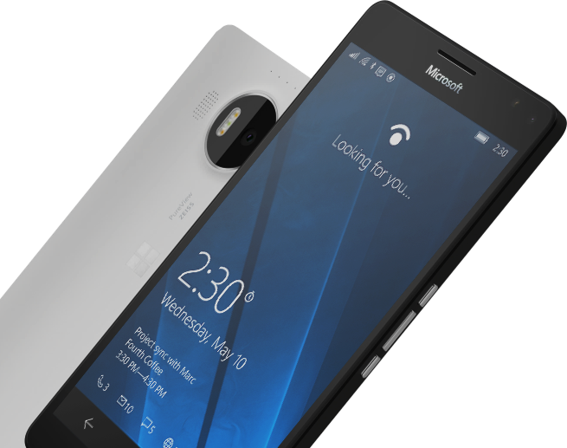
Please Complete An Evaluation Form for every session you attend. Your input is important!
#MSBuild

