Slide 1


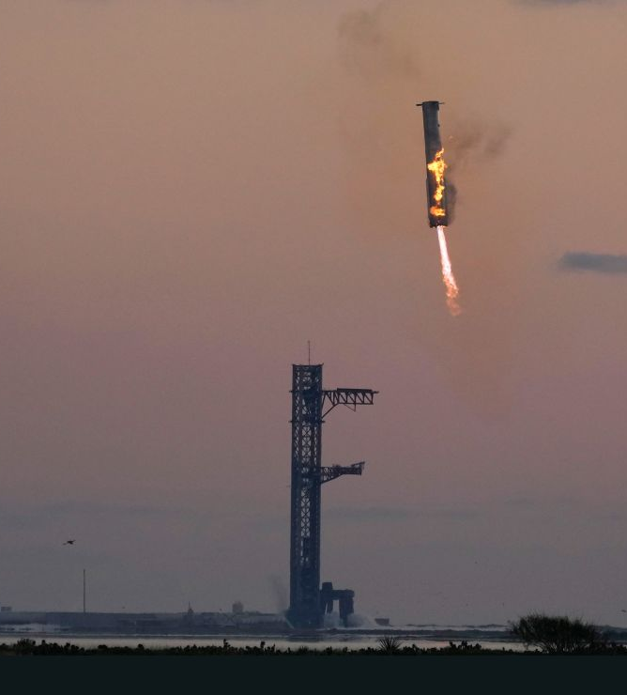




Slide 2

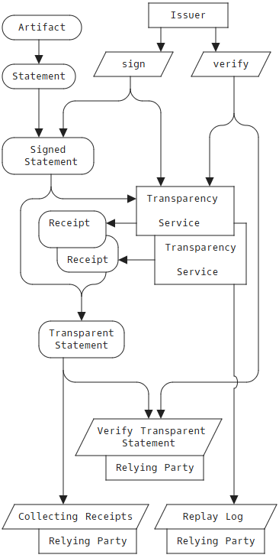
datatracker.ietf.org/wg/scitt
S upply
C hain, I ntegrity, T ransparency & T rust
Steve Lasker
Director of Ecosystem
DataTrails
Steve.Lasker@DataTrails.ai
@SteveLasker
Associating Trust In the Information We Share & Consume
Notes:
At DataTrails, we’ve been contributing to new IETF standards for securing Supply Chains with Integrity, Transparency and Trust.
The IETF is the Internet Engineering Task Force, which produces RFCs enabling interoperability across vendors, network operators and devices.

Slide 3
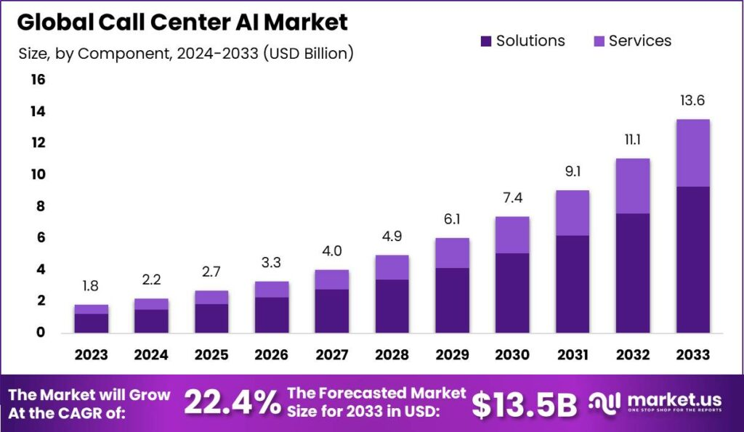
https://market.us/report/call-center-ai-market

Slide 4

Elements of Information We Make Decisions Upon
A Standards Based Approach

Slide 5

The Internet Engineering Task Force has developed open and interoperable methods for Vitual Conversations (vCon) and Supply Chain Integrity Transparency and Trust (SCITT)
vCon
Define a universal format for recording, storing and exchanging conversational data, including voice, video and text communications
Ensure interoperability across different communication systems
Enables seamless integration and analysis of conversations records while maintaining security and privacy standards
SCITT
Enables continuous verification of data and services in multiparty supply chains
Ensures parties consuming a vCon know when and who updated a vCon
Ensures the authenticity of entities, evidence, policies and artifacts
Guarantees the actions of entities are authorized, non-repudiable, immutable and auditable

Slide 6





SCITT records
Who made
an immutable Statement
about an Artifact
recorded “when”
Identity
Statement
Artifact

Slide 7


Who are the Who’s
People (Whoville who’s)
Services
Processes
Companies
Anything with any type of identity
Parties to a Conversation
Identity
Statement
Artifact

Slide 8
SCITT records immutable Statements about Artifacts
What is an Artifact?
Binary data (software, AI Training Data)
Digital media (pictures, videos, contracts)
Virtual Conversation (vCon)
Identity
Subject: vCon Identifier
Statement
Artifact

Slide 9


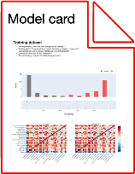


What are Statements?
SBOMs about binaries
Test results
Compliance to certifications
Security Scans
VEX Reports
Responsible AI Claims
Model Cards
Text Messages
Voicemail Recordings
Updates about vCons
Transcription Completed
Transcription Updated
Approval (Consent) for Use
Consumed for use
Revocation of Use
Confirmed Removal
Identity
Subject: vCon identifier
Statement
Artifact
Updates
Notes:
A Statement is simply information about the Artifact, including a Software Bill of Materials, [CLICK]
A statement for how your Machine Learning Model was trained, whether the product meets some compliance requirement, a contract, [CLICK]
or a C2PA Manifest, assuring the metadata can’t be stripped from the media.
A statement references the Artifact by setting a subject property, providing a feed of signed statements about the Artifact.

Slide 10



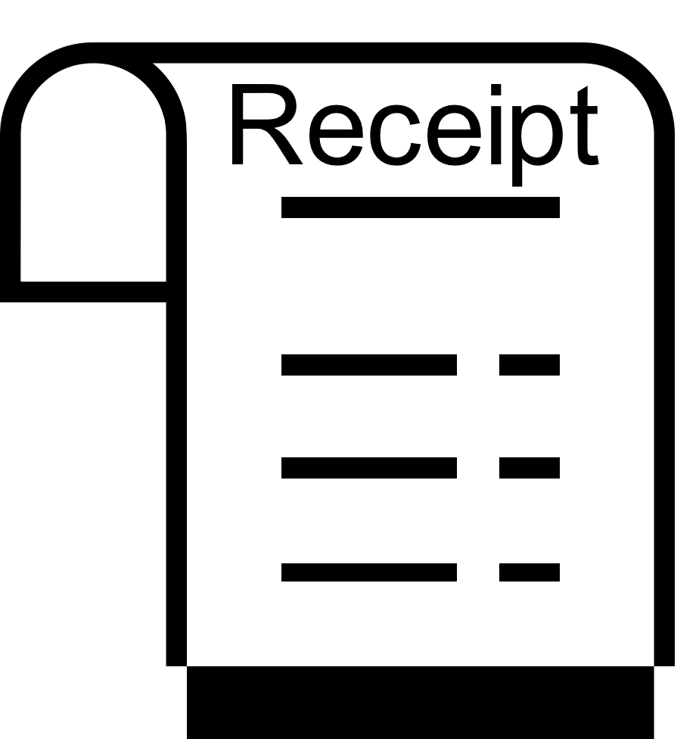


Ledger
eNotary
Identity
Subject: vCon identifier
Statement
Artifact
The envelope is submitted to the DataTrails SCITT APIs
registration is evaluated
the identity is verified
upon entry to the ledger, a receipt is returned
COSE Envelope
Concise
Binary
Object
Representation
CBOR
Object
Signing and
Encryption

Slide 11

SCITT Statement (vCon)
Issuer
Envelope : COSE_SIGN1
Statement
Artifact
18( / COSE Sign 1 /
[
h'a4012603...6d706c65', / Protected /
h’ea478a4g…..a20abe28’, / Payload /
h'79ada558...3a28bae4’, / Signature /
h’a023b128…..210gbaeh’ / Unprotected /
)
vCon (UUID)
vCon hash
Protected_Header
{ Protected
16: application/hash+cose / type /
1: -7, (ECDSA w/ SHA-256) / Algorithm /
TBD2: application/vcon+json, / payload_preimage_content_type /
4: h'50685f55...50523255', / Key identifier /
-42,-16 (SHA-256) / payload-hash-alg /
TBD3: vcon.service/2aefa…afaf9,/ Statement Location /
TBD4: [ meta-map /
0: vcon_operation: create / key:value /
]
15: { CWT Claims
1: ztelco.com, / Issuer /
2: vcon://2aefa…afaf9, / Subject /
}
}
Unprotected_Header
{ / Unprotected /
}

Slide 12

Lifecycle of a vCon

Slide 13
Enabling Adherence to Privacy Governance
CCPA and GDPR: Businesses Sharing Personal Data with Others Must Enter Into Contracts Outlining the Purpose Limitation and Other Rules
In many jurisdictions, businesses (data controllers) sharing personal data with others must enter into agreements outlining the purpose limitation and other data handling rules.
For example, this rule applies under the General Data Privacy Regulation (GDPR) and California Consumer Privacy Act (CCPA).
This is akin to a "data use license" and is already widely being used. The requirements for the agreement's contents differ slightly between jurisdictions, but it is possible to develop a "best practices" agreement template.
Diana James CIPP/US Attorney | Telecom | Privacy The CommLaw Group

Slide 14
Enabling Adherence to Privacy Governance
Businesses (data controllers) have a legal obligation to communicate a consumer's deletion request to others with whom the data was shared (e.g., service providers and data processors)
GDPR: The data controller must take reasonable steps (considering the available technology and the cost of implementation) to inform other entities which are processing the personal data requested to be erased of any links to, or copy or replication of, those personal data.
CCPA: The businesses must notify their service providers or contractors and all third parties with whom the business has shared the personal data to delete the data a consumer requested to be deleted unless this proves impossible or involves disproportionate effort.
Data processors (service providers and contractors) in general are not required to comply with a direct erasure request from a consumer but must inform the data controller (the principal business making decisions about personal data handling).
Diana James CIPP/US Attorney | Telecom | Privacy The CommLaw Group

Slide 15


Gavin – (Consumer)
Dealer Network
Data Source
zTelco
Data Controller
vConGPT
Hash:aaaa..1111
Hash:aaaa..1111
Hash:bbbb..2222
{ vcon_uuid: abc123,
created: 01-01-2024-00-01,
dailog: {
call.mp3},
consent: {
111-867-5309,
111-555-0199}
}
{ vcon_uuid: abc123,
created: 01-01-2024-00-01,
dialog: {
call.mp3},
consent: {
111-867-5309,
111-555-0199}
}
{ vcon_uuid: abc123,
created: 01-01-2024-00-01,
updated: 01-01-2024-00-02,
dialog: {
call.mp3
transcription},
consent: {
111-867-5309,
111-555-0199},
*license: private,
consenst_lifetime: 15d,
data_controller: vcongpt
}
subject: vcon://abc123
Registered: 01-01-2024-00-01
Payload: aaaa..1111
vcon_operation: create
subject: vcon://abc123
Registered: 01-01-2024-00-02
Payload: bbbb..2222
vcon_operation: transcribe
SCITT
Notes:
vCon Create → DataController

Slide 16
Gavin – (Consumer)
Data Processor
ACME-Rockets
Dealer Network
Data Processor
ACME-Rockets
Data Processor
ACME-Rockets
Data Source
zTelco
Data Controller
vConGPT
Data Processor
Strolid
Hash:aaaa..1111
Hash:aaaa..1111
Hash:bbbb..2222
{ vcon_uuid: abc123,
created: 01-01-2024-00-01,
dialog: {
call.mp3},
consent: {
111-867-5309,
111-555-0199}
}
Hash:bbbb..2222
{ vcon_uuid: abc123,
created: 01-01-2024-00-01,
dialog: {
call.mp3},
consent: {
111-867-5309,
111-555-0199},
*license: private,
consenst_lifetime: 15d,
data_controller: vcongpt
}
Hash:cccc..3333
{ vcon_uuid: abc123,
created: 01-01-2024-00-01,
updated: 01-01-2024-00-02,
dialog: {
call.mp3
transcription},
consent: {
111-867-5309,
111-555-0199},
*license: private,
consenst_lifetime: 15d,
data_controller: vcongpt
}
{ vcon_uuid: abc123,
created: 01-01-2024-00-01,
updated: 01-01-2024-00-02,
dialog: {
call.mp3
transcription},
consent: {
111-867-5309,
111-555-0199},
*license: private,
consenst_lifetime: 15d,
data_controller: vcongpt
}
{ vcon_uuid: abc123,
created: 01-01-2024-00-01,
updated: 01-01-2024-00-03,
dialog: {
call.mp3
transcription,
sentiment,
leads},
consent: {
111-867-5309,
111-555-0199},
*license: private,
consenst_lifetime: 15d,
data_controller: vcongpt
}
subject: vcon://abc123
Registered: 01-01-2024-00-01
Payload: aaaa..1111
vcon_operation: create
subject: vcon://abc123
Registered: 01-01-2024-00-02
Payload: bbbb..2222
vcon_operation: transcribe
subject: vcon://abc123
Registered: 01-01-2024-00-03
Payload: cccc..3333
vcon_operation: sentiment
SCITT
Notes:
DataController → Processor

Slide 17

Gavin – (Consumer)
Data Processor
ACME-Rockets
Dealer Network
Data Processor
ACME-Rockets
Data Processor
ACME-Rockets
Data Source
zTelco
Data Controller
vConGPT
Data Processor
Strolid
Dealer1
Dealer2
Hash:aaaa..1111
Hash:aaaa..1111
Dealer3
{ vcon_uuid: abc123,
created: 01-01-2024-00-01,
dialog: {
call.mp3},
consent: {
111-867-5309,
111-555-0199},
}
Hash:bbbb..2222
Hash:bbbb..2222
{ vcon_uuid: abc123,
created: 01-01-2024-00-01,
dialog: {
call.mp3},
consent: {
111-867-5309,
111-555-0199},
*license: private,
consenst_lifetime: 15d,
data_controller: vcongpt
}
Hash:cccc..3333
{ vcon_uuid: abc123,
created: 01-01-2024-00-01,
updated: 01-01-2024-00-02,
dialog: {
call.mp3
transcription},
consent: {
111-867-5309,
111-555-0199},
*license: private,
consenst_lifetime: 15d,
data_controller: vcongpt
}
{ vcon_uuid: abc123,
created: 01-01-2024-00-01,
updated: 01-01-2024-00-02,
dialog: {
call.mp3
transcription},
consent: {
111-867-5309,
111-555-0199},
*license: private,
consenst_lifetime: 15d,
data_controller: vcongpt
}
{ vcon_uuid: abc123,
created: 01-01-2024-00-01,
updated: 01-01-2024-00-03,
dialog: {
call.mp3
transcription,
sentiment,
leads}
consent: {
111-867-5309,
111-555-0199},
*license: private,
consenst_lifetime: 15d,
data_controller: vcongpt
}
Dealer4
Dealer5
subject: vcon://abc123
Registered: 01-01-2024-00-01
Payload: aaaa..1111
vcon_operation: create
subject: vcon://abc123
Registered: 01-01-2024-00-02
Payload: bbbb..2222
vcon_operation: transcribe
subject: vcon://abc123
Registered: 01-01-2024-00-03
Payload: cccc..3333
vcon_operation: sentiment
SCITT
Notes:
Dealer keeps calling

Slide 18
Gavin – (Consumer)
Data Processor
ACME-Rockets
Dealer Network
Data Processor
ACME-Rockets
Data Processor
ACME-Rockets
Data Source
zTelco
Data Controller
vConGPT
Data Processor
Strolid
Dealer1
Dealer2
Hash:aaaa..1111
Hash:bbbb..2222
Dealer3
Hash:bbbb..2222
Hash:bbbb..2222
{ vcon_uuid: abc123,
created: 01-01-2024-00-01,
dialog: {
call.mp3},
consent: {
111-867-5309,
111-555-0199},
}
{ vcon_uuid: abc123,
created: 01-01-2024-00-01,
updated: 01-01-2024-00-02,
dialog: {
call.mp3
transcription},
consent: {
111-867-5309,
111-555-0199},
*license: private,
consenst_lifetime: 15d,
data_controller: vcongpt
}
Hash:cccc..3333
{ vcon_uuid: abc123,
created: 01-01-2024-00-01,
updated: 01-01-2024-00-02,
dialog: {
call.mp3
transcription},
consent: {
111-867-5309,
111-555-0199},
*license: private,
consenst_lifetime: 15d,
data_controller: vcongpt
}
{ vcon_uuid: abc123,
created: 01-01-2024-00-01,
updated: 01-01-2024-00-02,
dialog: {
call.mp3
transcription},
consent: {
111-867-5309,
111-555-0199},
*license: private,
consenst_lifetime: 15d,
data_controller: vcongpt
}
Hash:dddd..4444
{ vcon_uuid: abc123,
created: 01-01-2024-00-01,
updated: 01-01-2024-00-03,
dialog: {
call.mp3
transcription,
sentiment,
leads}
consent: {
111-867-5309,
111-555-0199},
*license: private,
consenst_lifetime: 15d,
data_controller: vcongpt
}
{ vcon_uuid: abc123,
created: 01-01-2024-00-01,
updated: 01-20-2024-00-04,
dialog: {
call.mp3
transcription},
consent: {
111-555-0199},
revoke-consent: {
111-867-5309}
*license: private,
consenst_lifetime: 15d,
data_controller: vcongpt
}
Dealer4
Dealer5
subject: vcon://abc123
Registered: 01-01-2024-00-01
Payload: aaaa..1111
vcon_operation: create
subject: vcon://abc123
Registered: 01-01-2024-00-02
Payload: bbbb..2222
vcon_operation: transcribe
subject: vcon://abc123
Registered: 01-01-2024-00-03
Payload: cccc..3333
vcon_operation: sentiment
SCITT
subject: vcon://abc123
Registered: 01-01-2024-00-04
Payload: dddd..4444
vcon_operation: revoke-consent
Notes:
Consumer revokes consent

Slide 19



Gavin – (Consumer)
Data Processor
ACME-Rockets
Dealer Network
Data Processor
ACME-Rockets
Data Processor
ACME-Rockets
Data Source
zTelco
Data Controller
vConGPT
Data Processor
Strolid
Dealer1
Dealer2
Hash:aaaa..1111
Hash:bbbb..2222
Dealer3
Hash:bbbb..2222
Hash:bbbb..2222
{ vcon_uuid: abc123,
created: 01-01-2024-00-01,
dialog: {
call.mp3},
consent: {
111-867-5309,
111-555-0199},
}
{ vcon_uuid: abc123,
created: 01-01-2024-00-01,
updated: 01-01-2024-00-02,
dialog: {
call.mp3
transcription},
consent: {
111-867-5309,
111-555-0199},
*license: private,
consenst_lifetime: 15d,
data_controller: vcongpt
}
Hash:cccc..3333
{ vcon_uuid: abc123,
created: 01-01-2024-00-01,
updated: 01-01-2024-00-02,
dialog: {
call.mp3
transcription},
consent: {
111-867-5309,
111-555-0199},
*license: private,
consenst_lifetime: 15d,
data_controller: vcongpt
}
{ vcon_uuid: abc123,
created: 01-01-2024-00-01,
updated: 01-01-2024-00-02,
dialog: {
call.mp3
transcription }
consent: {
111-867-5309,
111-555-0199},
*license: private,
consenst_lifetime: 15d
}
Hash:dddd..4444
{ vcon_uuid: abc123,
created: 01-01-2024-00-01,
updated: 01-01-2024-00-03,
dialog: {
call.mp3
transcription,
sentiment,
leads}
consent: {
111-867-5309,
111-555-0199},
*license: private,
consenst_lifetime: 15d,
data_controller: vcongpt }
{ vcon_uuid: abc123,
created: 01-01-2024-00-01,
updated: 01-20-2024-00-04,
dialog: {
call.mp3
transcription},
consent: {
111-555-0199},
revoke-consent: {
111-867-5309}
*license: private,
consenst_lifetime: 15d,
data_controller: vcongpt
}
Dealer4
Dealer5
subject: vcon://abc123
vcon_operation: create
Payload: aaaa..1111
Registered: 01-01-2024-00-01
subject: vcon://abc123
vcon_operation: transcribe
Payload: bbbb..2222
Registered: 01-01-2024-00-02
subject: vcon://abc123
vcon_operation: sentiment
Payload: cccc..3333
Registered: 01-01-2024-00-03
SCITT
subject: vcon://abc123
Registered: 01-01-2024-00-04
Payload: dddd..4444
vcon_operation: revoke-consent
Notes:
Contractual Arrangements

Slide 20
Inclusion & Consistency
Data Source
zTelco
Hash:aaaa..1111
Data Controller
vConGPT
Hash:aaaa..1111
SCITT
Hash:bbbb..2222
Hash:dddd..4444
Ledger
subject: vcon://abc123
vcon_operation: create
Payload: aaaa..1111
Registered: 01-01-2024-00-01
Data Processor
Strolid
Hash:bbbb..2222
subject: vcon://abc123
vcon_operation: transcribe
Payload: bbbb..2222
Registered: 01-01-2024-00-02
Hash:cccc..3333
Hash:dddd..4444
Data Processor
ACME-Rockets
subject: vcon://abc123
vcon_operation: sentiment
Payload: cccc..3333
Registered: 01-01-2024-00-03
Hash:bbbb..2222
Hash:cccc..3333
Data Processor
Wabbit-Networks
subject: vcon://abc123
Registered: 01-01-2024-00-04
Payload: dddd..4444
vcon_operation: revoke-consent
Hash:bbbb..2222
Hash:dddd..4444
Hash:eeee..6666

Slide 21

Personally Identifiable Information
How is PII managed with SCITT?

Slide 22



PII & SCITT
PII, SCITT & DataTrails Implementation
Verifiable Data Structure
Signed Statement Hash
SCITT Registration
Immutable Ledger
DataTrails Events
meta-map
signed-statement
Evidentiary Data Store
COSE Envelope
Index for Queries

Slide 23
PII, SCITT & DataTrails Implementation
Verifiable Data Structure
Signed Statement Hash
SCITT Registration
Immutable Ledger
DataTrails Events
meta-map
signed-statement
Evidentiary Data Store
Indexing
Index for Queries

Slide 24
PII, SCITT & DataTrails Implementation
Verifiable Data Structure
Signed Statement Hash
SCITT Registration
Immutable Ledger
The SCITT Ledger is immutable
There’s no PII data is in the Ledger
The DataTrails Evidentiary store can be deleted
The Signed Statements can be deleted (aka “forgotten”)
Evidentiary data can be redacted
Each change creates a DataTrails Event noting deletion or redaction
vCons
No PII Data is persisted
Nothing to delete
DataTrails Events
meta-map
signed-statement
Evidentiary Data Store
Indexing
cwt.subject: “vcon://abc123” (vCon ID)
payload: “dddd..4444” (Hash of the vCon)
payload_hash_alg: SHA-256
payload_location: “vcons.org/abc123-dddd..4444”
payload_preimage_content_type: “application/vcon+json”
meta-map:
"conserver_link": "scitt"
"conserver_link_name": "scitt_created“
"conserver_link_version": "0.2.0"
"timestamp_declared": "2024-05-07T16:33:29.004994“
"vcon_operation": "vcon_create“
"vcon_draft_version": "01"
Index for Queries

Slide 25
SCITT Provides
A standards-based means to associate Who made a Statement, about an Artifact, recorded at a point in Time
Recording Immutable statements in history
A means to find collaborative or conflicting Statements, made by other Who’s, about the same Artifact
Protecting Integrity, Inclusion, and Consistency
Proof statements weren’t altered
Proof statements weren’t removed
Proof of ordering of statements

Slide 26
DataTrails Provides
Evidentiary storage
Ability to delete (forget) the metadata
Ability to redact – limiting who has access to the “metadata”
Indexing and Query Services
Role Based Access Control
Redaction and other constraints on access

Slide 27
& SCITT
SCITT provides standards for creating immutable statements about artifacts
DataTrails provides SCITT capabilities as a robust platform
Get started today at DataTrails.ai/getting-started
Steve Lasker Director of Ecosystem Steve.Lasker@DataTrails.ai @SteveLasker
SCITT.io
datatracker.ietf.org/wg/scitt
docs.datatrails.ai/developers/developer-patterns/scitt-api

