Slide 1

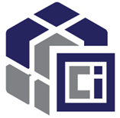




OCI Artifacts
Leveraging OCI Distribution
for new Cloud Native Artifacts
github.com/opencontainers/artifacts
Steve Lasker
Program Manager
Azure Container Registries
Steve.Lasker@Microsoft.com
@SteveLasker
SteveLasker.blog
github.com/SteveLasker
github.com/SteveLasker/presentations

Slide 2




You have a new thing. Where will you store your thing?
YASS?
cache
<-> REST
{ [] } Eng
Thing
Notes:
You’re already building the thing, and all the experiences around the thing
What do you do for storage?
Build yet another storage solution (YASS)?
Leverage an existing solution?

Slide 3
Running A Storage Thing
VNET & Firewall Rules?
Documentation?
Authentication
What will you use?
Will it integrate with the rest of “the platform”
Security
How do you prevent hacks, DOS attacks, abuse?
Costs & COGS
Can you justify the costs to build the YASS?
Will you justify the costs to run the YASS?
Will you charge, offer for free - your YASS?
Multiple clouds?
Will other cloud vendors host this YASS for you?
Compliance
Lifecycle Management
cache
<-> REST
{ [] } Eng
Signing?
Regional Replication?

Slide 4
What it takes to run a storage thing
~10-20 engineers - full time
Support
Compliance
Regional Rollouts
Feature Asks
Patching & Mediation of CVE Events
{ [] } Eng

Slide 5
OCI Registries
Feature/Instance | OCI Registry | YASS Thing
REST API for meta data
Layered/Cache for large artifacts
Blob storage
√
√
√
√
√
√
Cloud & Vendor Implementations (acr, ecr, gcr, quay, …)
Feature/Instance | OCI Registry | YASS Thing
Integrated Authenticated Access
Role Based Access Control (RBAC)
Compliance
Support
Documentation
Added Capabilities VNET & Firewall Rules, Signing, Auto Purge, Geo-Replicated, Lifecycle Management
√
√
√
√
√
√
√
√
√
√
√
√
√
√
√
√
√
√

Slide 6
Tailored Experience For Your Thing

Slide 7

thing login
thing push
thing pull
thing do
thing info
YASS - Thing
{…}
OCI Artifact Registry
thing login demo42.azurecr.io -u $user -p $pwd
thing push demo42.azurecr.io/marketing/campaign/thingthang:1.0 ./thingthang
thing pull demo42.azurecr.io/marketing/campaign/thingthang:1.0
thing do demo42.azurecr.io/marketing/campaign/thingthang:1.0

Slide 8



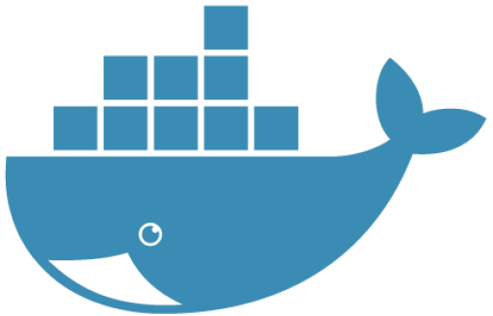
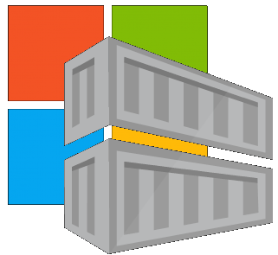



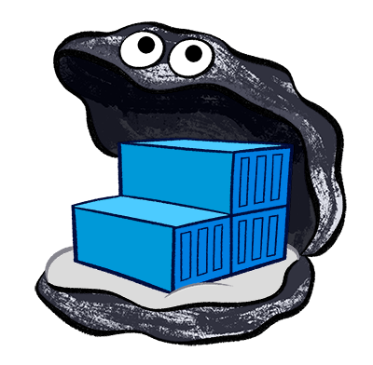







Container Registries
Artifact Registries
Planned
Current Support
GitHub gpr
Google gcr
RedHat Registry
JFrog
Docker Hub
MCR
Quay
Harbor
AWS ecr
distribution
ACR
OCI Artifact Registry
github.com/opencontainers/artifacts
{manifest}
github.com/deislabs/oras

Slide 9
How Are Images Stored in OCI Registries

Slide 10




Docker Pull Flow
demo42.azurecr.io
docker pull demo42.azurecr.io/hello-world:latest
1. Pull
<-> REST
cache
2. Manifest Returned
3. Delta Layer Requests
Manifests
Pull:
I want this “thing”,
Manifest:
What layers do I already have?
Manifest:
List of layer ID’s representing the entire thing
hello-world:latest
Image Cache
IMAGE ID REPOSITORY TAG SIZE
4. Layer URLs Returned
Wordpress-chart:5
5. Layer Request
hpctest:1
694950fbcb3f hello-world latest 1.2 GB
Layers Please:
Layers
6. Layers Returned
Layer Cache
LAYER ID
cf4ecb49238476635f551fe11987ae4c3
e41864ee12411ff073f0a58417cf7e160
sha256:cf4ecb49238476635f551fe11987ae4c3
85bef57c324acc96f7067488d35b7e3c1
sha256:e41864ee12411ff073f0a58417cf7e160
sha256:85bef57c324acc96f7067488d35b7e3c1

Slide 11
Dissecting an OCI Image
demo42.azurecr.io
<-> REST
cache
OCI Image: an ordinal collection of layers, where each layer overlays the previous contents
Manifests
hello-world:latest
Image Manifest
{
"schemaVersion": 2,
"mediaType": "application/vnd.oci.image.manifest.v1+json",
"config": {
"mediaType": "application/vnd.oci.image.config.v1+json",
"size": 16078,
"digest": "sha256:bd698aa18aa02a2f083292b9448130a3afaa9a3e5fba24fc0aef7845c336b8ad"
},
"layers": [
{
"mediaType": "application/vnd.oci.image.layer.v1.tar+gzip",
"size": 23133155,
"digest": "sha256:9a1a13172ed974323f7c35153e8b23b8fa1c85355b6b26cc3127e640e45ef0aa"
},
{
"mediaType": "application/vnd.oci.image.layer.v1.tar+gzip",
"size": 226,
"digest": "sha256:5094d5d656a95c6aa92f5f2adc56a794564b1e340bc4065db2947d7ce0c1a394"
}
]
}
Wordpress-chart:5
Contest Addressable Manifest
Describes the collection of layers
hpctest:1
<-> REST
Image Manifest
Layers
Config
cf4ecb49238476635f551fe11987ae4c3
e41864ee12411ff073f0a58417cf7e160
Layers[]
85bef57c324acc96f7067488d35b7e3c1
Layers – Blob Storage
GET demo42.azurecr.io/v2/hello-world/blobs/sha256:9a1a1…
Layer A
Layer href="https://managedteststore3.blob.core.windows.net/75a9eeebd1942155-7b07d607ec09477b99f12fc13fb77342-662c16123e//docker/registry/v2/blobs/sha256/75/75a9eeebd194.../data?se=2019-05-01T19%3A22%3A00Z&amp;sig=vw7v2SVhGjtievmBs7....GGxdcoCg%3D&amp;sp=r&amp;sr=b&amp;sv=2016-05-31&amp;regid=7b07d607...77342"
Layer: each layer is a tarball of the files
Layer B
Layer …

Slide 12
<-> REST
Image Index
An optional collection of manifests
Manifests[]
Platform
Image Index
{
"schemaVersion": 2,
"mediaType": "application/vnd.oci.image.index.v1+json",
"manifests": [
{
"mediaType": "application/vnd.oci.image.manifest.v1+json",
"size": 4288,
"digest": "sha256:10b995d6204131069af3e4f00dc1d3758d5...",
"platform": {
"architecture": "amd64",
"os": "linux"
}
},
{
"mediaType": "application/vnd.oci.image.manifest.v1+json",
"size": 4288,
"digest": "sha256:33c5d954c76495826126178ded2113d1ada0a...",
"platform": {
"architecture": " amd64 ",
"os": “windows"
"platform": {
"architecture": "amd64",
"os": "linux"
"platform": {
"architecture": “amd64",
"os": “windows"
<-> REST
Image Manifest
<-> REST
Image Manifest
Config
Config
Layers[]
Layers[]
Layers – Blob Storage
Layers – Blob Storage
Layer A
Layer A
Layer B
Layer B
Layer …
Layer …

Slide 13
Images to Artifacts
demo42.azurecr.io
<-> REST
cache
Manifests
hello-world:latest
Wordpress-chart:5
hpctest:1
<-> REST
Image Manifest
Artifact Manifest
Layers
Config
cf4ecb49238476635f551fe11987ae4c3
e41864ee12411ff073f0a58417cf7e160
Layers[]
85bef57c324acc96f7067488d35b7e3c1
Layers – Blob Storage
Layer A
Layer B
Layer …

Slide 14
Understanding the Artifact Type
Registries shall know the type they store
Vulnerability scanning products must know what they’re scanning
Registries may provide options, based on the type
Client tooling must know what they’re pulling – so they don’t fail
demo42.azurecr.io
<-> REST
helm update demo42.azurecr.io/charts/wordpress:5.7
docker run demo42.azurecr.io/charts/wordpress:5.7

Slide 15
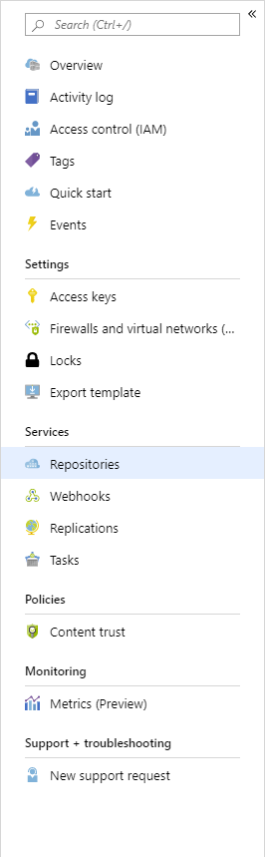
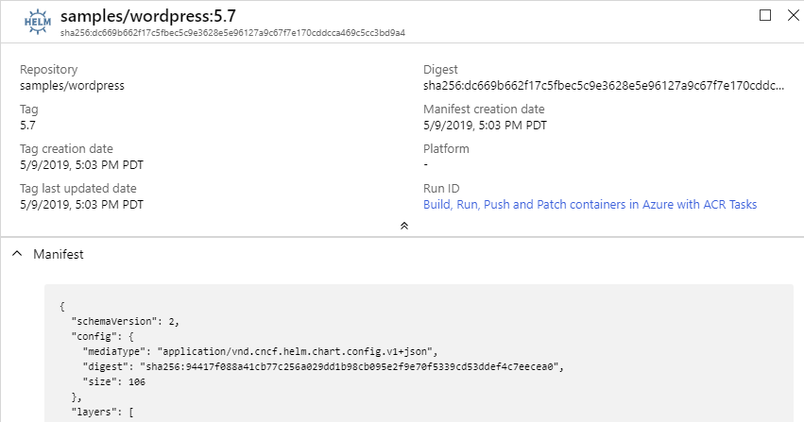
Type: Helm
repo/image:tag
How a registry knows it’s type

Slide 16
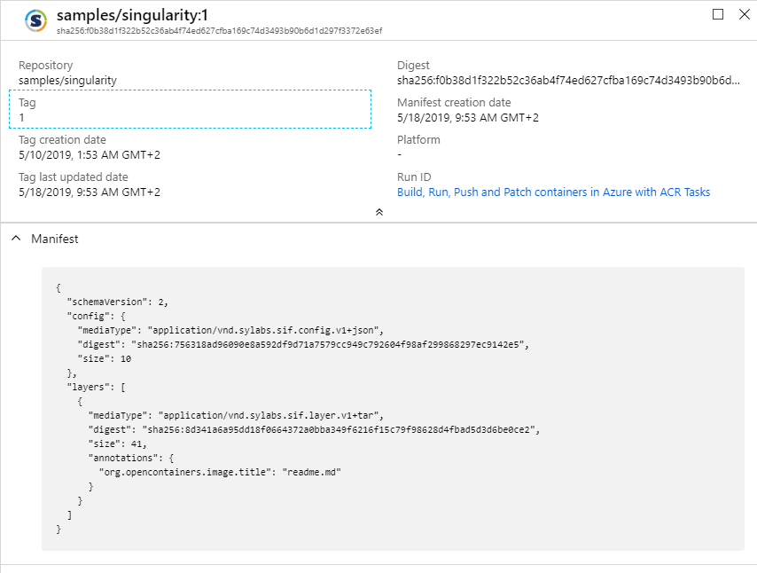
Type: Singularity
repo/image:tag
How a registry knows it’s type

Slide 17
Differentiating Artifact Types
demo42.azurecr.io
<-> REST
manifest.config.mediaType Defines the Artifact Type
Manifests
hello-world:latest
Image Manifest
{
"schemaVersion": 2,
"mediaType": "application/vnd.oci.image.manifest.v1+json",
"config": {
"mediaType": "application/vnd.oci.image.config.v1+json",
"size": 16078,
"digest": "sha256:bd698aa18aa02a2f083292b9448130a3afaa9a3e5fba24fc0aef7845c336b8ad"
},
"layers": [
{
"mediaType": "application/vnd.oci.image.layer.v1.tar+gzip",
"size": 23133155,
"digest": "sha256:9a1a13172ed974323f7c35153e8b23b8fa1c85355b6b26cc3127e640e45ef0aa"
},
{
"mediaType": "application/vnd.oci.image.layer.v1.tar+gzip",
"size": 226,
"digest": "sha256:5094d5d656a95c6aa92f5f2adc56a794564b1e340bc4065db2947d7ce0c1a394"
}
]
}
Wordpress-chart:5
hpctest:1
<-> REST
Image Manifest
Layers
Config
cf4ecb49238476635f551fe11987ae4c3
e41864ee12411ff073f0a58417cf7e160
Layers[]
85bef57c324acc96f7067488d35b7e3c1
Layers – Blob Storage
Layer A
Layer B
Layer …

Slide 18
Different Artifact Types
"application/vnd.docker.container.image.v1+json"
"application/vnd.oci.image.config.v1+json"
"application/vnd.cncf.helm.chart.config.v1+json"
"application/vnd.sylabs.sif.config.v1+json"
"application/vnd.cncf.openpolicyagent.config.v1+json"
Image Artifact Manifest
{
"schemaVersion": 2,
"mediaType": "application/vnd.oci.image.manifest.v1+json",
"config": {
"mediaType": "application/vnd.oci.image.config.v1+json",
"size": 16078,
"digest": "sha256:bd698aa18aa02a2f083292b9448130a3afaa9a3e5fba24fc0aef7845c336b8ad"
},
"layers": [
"mediaType": "application/vnd.docker.container.image.v1+json",
"mediaType": "application/vnd.cncf.helm.chart.config.v1+json",
"mediaType": "application/vnd.sylabs.sif.config.v1+json",
"mediaType": "application/vnd.cncf.openpolicyagent.config.v1+json",

Slide 19
What should OCI Image Mean
"application/vnd.docker.container.image.v1+json"
"application/vnd.oci.image.config.v1+json"
Is oci.image the new “docker” image?
Can all container tools pull & run oci.image ?
If so, what happens if things that aren’t runnable images use oci.image
What is the equivalent of “unknown” file.

Slide 20
What about OCI Index?
Scenarios:
Collection of arbitrary artifacts
Images, pivoted on architecture
Images, Docs and scan results
Images, Policies and Helm Chart – but not a CNAB
The collection is a thing
CNAB

Slide 21
Why Config?
Started with artifactType – too impacting to existing OCI tooling
Minimal change to existing OCI compliant tooling
Enables artifact configuration data
The config object, can be null
Image Artifact Manifest
{
"schemaVersion": 2,
"mediaType": "application/vnd.oci.image.manifest.v1+json",
"artifactType": "application/vnd.cncf.helm.chart",
"config": {
"mediaType": "application/vnd.oci.image.config.v1+json",
"size": 16078,
"digest": "sha256:bd698aa18aa02a2f083292b9448130a3afaa9a3e5fba24fc0aef7845c336b8ad"
},
"layers": [

Slide 22
Getting Involved with OCI Artifact Registries
Getting Started: stevelasker.blog
Authoring OCI Registry Artifacts – Quick Guide
Contribute to the Spec: github.com/opencontainers/artifacts
Slack: opencontainers.slack.com #artifact-registry
To Join: chat.opencontainers.org/
ORAS: github/com/deislabs/oras
Steve Lasker
Program Manager
Azure Container Registries
Steve.Lasker@Microsoft.com
@SteveLasker
SteveLasker.blog
github.com/SteveLasker
github.com/SteveLasker/presentations

