Slide 1
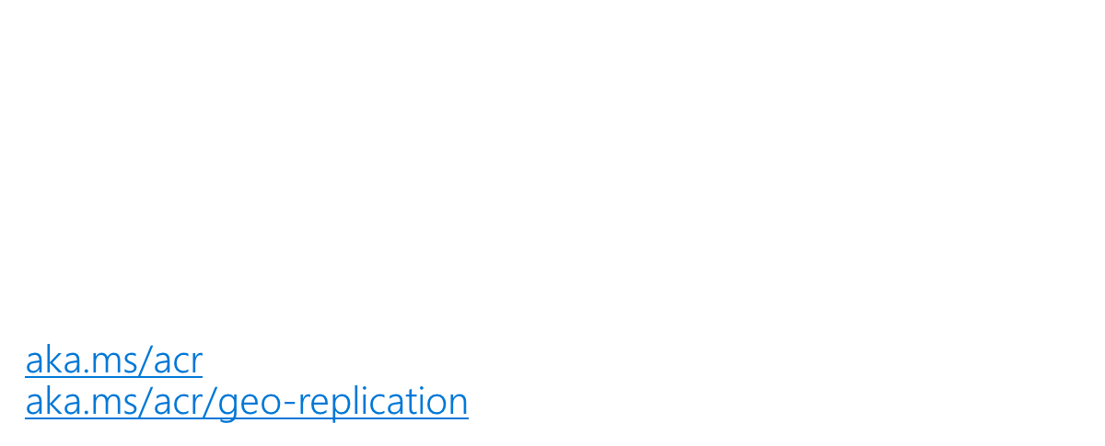
Azure Containers – E2E Journeys

Slide 2
Containers strategy
Make Azure the best place to run container workloads
Make getting started super easy
Containers as a common deployment currency for Azure services

Slide 3
Shipping Manifest
Containers are the Unit of Deployment
Registries at the center
Container Orchestration & Reliability
Orchestrators are just the next low level OS
Container Build Workflows
Tagging Best Practices
Base images & App Deployments
OS & Framework Patching

Slide 4
Containers as a common deployment currency
ACS
ACI
Service Fabric
App Service
IoT
Machine Learning
…
Private Registry
Custom Apps
ISV, Packaged Apps
Azure Container Registry
Azure clients: PS, CLI, Portal, SDK)
Developer tools: VS, VS Code, VSTS
OSS clients: GitHub, Terraform, Draft, Helm, etc.,

Slide 5
Container Registries
Image Layers – delta content management
Central storage and management – regardless of hosting
Image State Management*
Vulnerability Status
Single pane of glass for where container are running*

Slide 6
Why: Azure Container Registry
Keeping your Images Network-Close
Deployed to your targets within the same data center
No ingress/egress fees, latency with better reliability
Keep Your Images Private
Stored in Azure, secured at rest, secured with AAD with the rest of your Azure resources
Geo Replicated Across the Globe
Manage global deployments as one resource, keeping the network-close
Azure Active Directory Integration
Manage registry access using AAD (individual and service auth)
Familiar Open Source CLIs
docker login, pull, push
Secure & Patched
OS & Framework patching coming with ACR Builder

Slide 7
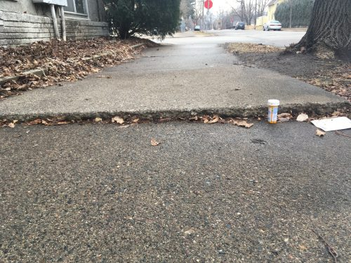



Container Orchestration & Reliability
Design with the belief something will fail at any point

Slide 8

Instancing Multiple Copies
You need:
10 web front ends
8 API instances
4 Redis Cache
1 Database

Slide 9

Web
Web
Web
Web
Web
API
API
API
Cache
Cache

Slide 10

Load Balancing & Fault Tolerance
DOCKER_HOST
Docker daemon
Containers
Image Cache
Web
Web
Web
Web
Web
Web
API
Cache
API
API
API
Cache
Cache

Slide 11


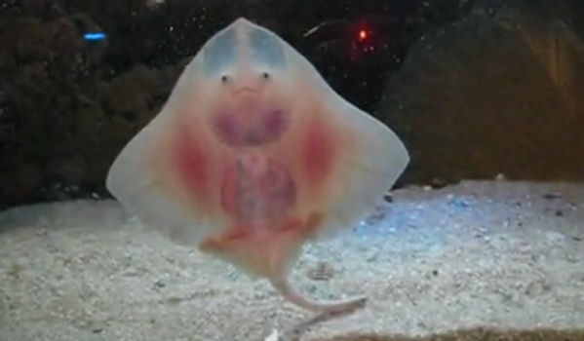
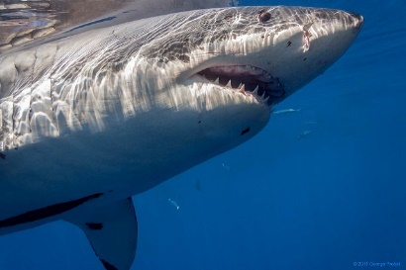
Distribution
DOCKER_HOST
DOCKER_HOST
Docker daemon
Docker daemon
Containers
Image Cache
Containers
Image Cache
Container Scheduling
Container Orchestration
DOCKER_HOST
DOCKER_HOST
DOCKER_HOST
DOCKER_HOST
Docker daemon
Docker daemon
Docker daemon
Docker daemon
Containers
Image Cache
Containers
Image Cache
Containers
Image Cache
Containers
Image Cache
Web
Web
Web
Web
Web
Web
Cache
API
Cache
Web
Web
API
Cache
API
Cache
API
API
API
Cache
Cache

Slide 12
Containers are the modern Virtualization Stack An evolution, revolution, or circle of service?

Slide 13
– Mainframes
CIRCA 1980

Slide 14
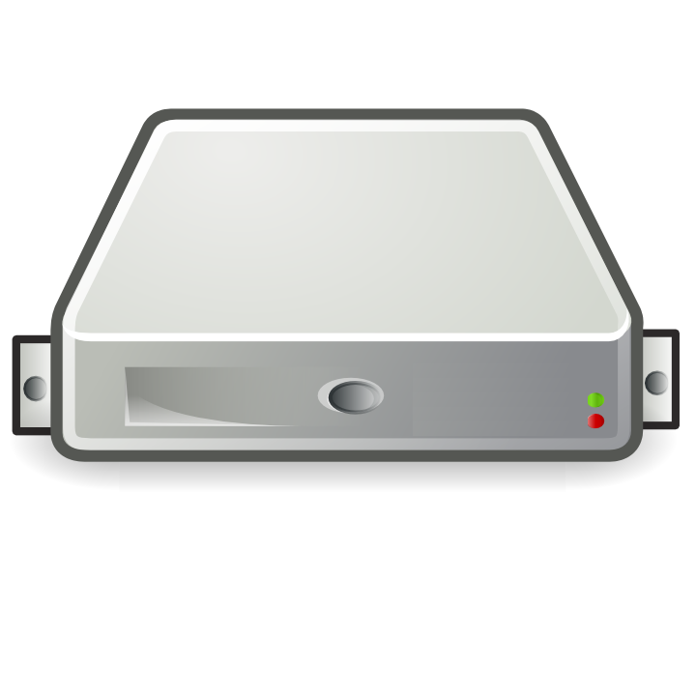
– PC → Server Revolution
CIRCA 1990
$
$
$
$
$
$
$
$
$
$
$
$
$
$
$
$
$
$
$
$
$
$
$
$
$
$
$
$
$
$
$
$
$
$
$
$
$
$
$
$
$
$
$
$
$
$
$
$
$
$
$
$
$
$
$

Slide 15
– Server → VM Evolution
CIRCA 2000
Guest OS #5
Guest OS #6
Guest OS #7
Guest OS #8
Guest OS #5
Guest OS #6
Guest OS #7
Guest OS #8
Guest OS #5
Guest OS #6
Guest OS #7
Guest OS #8
Guest OS #5
Guest OS #6
Guest OS #7
Guest OS #8
Guest OS #5
Guest OS #6
Guest OS #7
Guest OS #8
Guest OS #1
Guest OS #2
Guest OS #3
Guest OS #4
Guest OS #1
Guest OS #2
Guest OS #3
Guest OS #4
Guest OS #1
Guest OS #2
Guest OS #3
Guest OS #4
Guest OS #1
Guest OS #2
Guest OS #3
Guest OS #4
Guest OS #1
Guest OS #2
Guest OS #3
Guest OS #4
Hyper Visor
Hyper Visor
Hyper Visor
Hyper Visor
Hyper Visor
$
$
$
$
$

Slide 16
– VM → Cloud Evolvement
CIRCA 2015
Guest OS #5
Guest OS #6
Guest OS #7
Guest OS #8
Guest OS #5
Guest OS #6
Guest OS #7
Guest OS #8
Guest OS #5
Guest OS #6
Guest OS #7
Guest OS #8
Guest OS #5
Guest OS #6
Guest OS #7
Guest OS #8
Guest OS #5
Guest OS #6
Guest OS #7
Guest OS #8
$
$
$
$
$
$
$
$
$
$
$
$
$
$
$
$
$
$
$
$
Guest OS #1
Guest OS #2
Guest OS #3
Guest OS #4
Guest OS #1
Guest OS #2
Guest OS #3
Guest OS #4
Guest OS #1
Guest OS #2
Guest OS #3
Guest OS #4
Guest OS #1
Guest OS #2
Guest OS #3
Guest OS #4
Guest OS #1
Guest OS #2
Guest OS #3
Guest OS #4
$
$
$
$
$
$
$
$
$
$
$
$
$
$
$
$
$
$
$
$
Hyper Visor
Hyper Visor
Hyper Visor
Hyper Visor
Hyper Visor

Slide 17
– Cloud → Containerization
CIRCA 2015
Guest OS #2
Guest OS #2
Guest OS #2
Guest OS #2
Guest OS #2
$
$
$
$
$
Guest OS #1
Guest OS #2
Guest OS #3
Guest OS #4
Guest OS #1
Guest OS #2
Guest OS #3
Guest OS #4
Guest OS #1
Guest OS #2
Guest OS #3
Guest OS #4
Guest OS #1
Guest OS #2
Guest OS #3
Guest OS #4
Guest OS #1
Guest OS #2
Guest OS #3
Guest OS #4
$
$
$
$
$
Hyper Visor
Hyper Visor
Hyper Visor
Hyper Visor
Hyper Visor

Slide 18
Containers as a 1st Class Primitive
Distributed, Scalable Mainframe
CIRCA 2017
Azure Container Instances

Slide 19
Container Dev/Ops Workflows Similar, yet different…

Slide 20

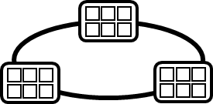


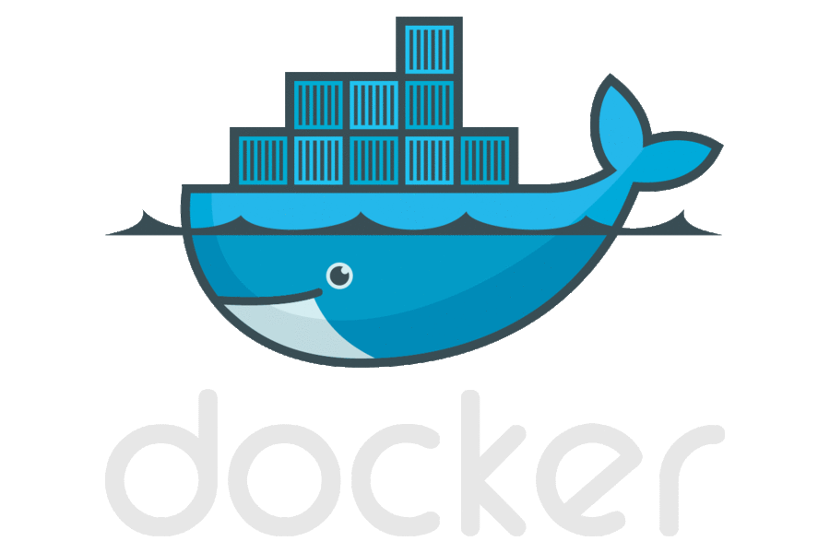
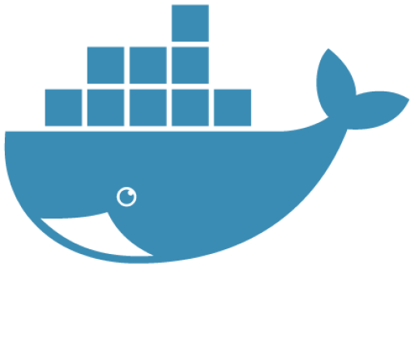

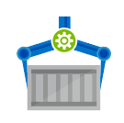

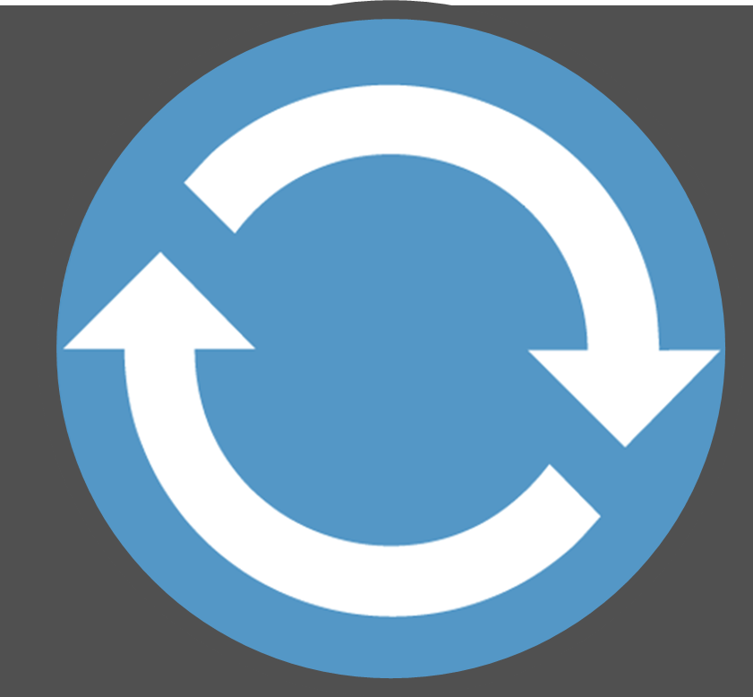
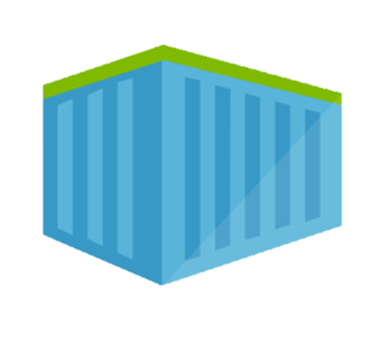
Container DevOps Workflow
Container Service
OS & Framework Patching
What happens when developers stop making code changes?
Run, Manage
Service Fabric
Source Code Control
(SCC)
Build/CI,
Integrate,
Test
CD, Deploy
App Services
Production
environments
coming soon
Base Image Index
…
Docker Hub
Azure Container _Builder*
Azure Container Registry
…
Inner-Loop
…
Run
Monitor and Diagnose
Code
Validate
Debug

Slide 21
Image Tagging A balance of servicing and stability

Slide 22
Tagging Best Practices
Base Images
Deployed Images
:latest
:1.0
:1.1.1.1
:2.0
:2.2.1
Always Unique
Stable Tags create instability

Slide 23
Stable Tags Create Instability
ACR
Deploy
Run
Build
ACR
web:1.0 = digest a
web:1.0 = digest a
web:1.0
Orchestrator
web:1.0 = digest a
Web
web:1.0 = digest b
web:1.0 = digest b
web:1.0 = digest a
Web
web:1.0 = digest a
web:1.0
Web
web:1.0 = digest a
Web
web:1.0 = digest b
Web

Slide 24
Unique Tags Create Stability
ACR
Deploy
Run
Build
ACR
web:111
web:111
web:111
Orchestrator
web:111
web:1114
Web
web:111
web:1112
web:1112
web:1114
Web
web:111
web:1113
web:1113
web:1114
web:111
Web
web:111
web:1114
web:1114
web:1114
web:1114
Web
web:111
web:1114
Web

Slide 25
Authenticating with ACR
Using familiar docker CLIs
Individual Identity, using Azure Active Directory Identity
Server/Headless identity using AAD Service Principals
Provision Service Principals, with scoped access control
Contributor – Push/Pull
Reader – Pull Only
Eg: assign the Kubernetes created principal, desired access to each registry
az login
az acr login --name [registryName]
docker push / pull

Slide 26
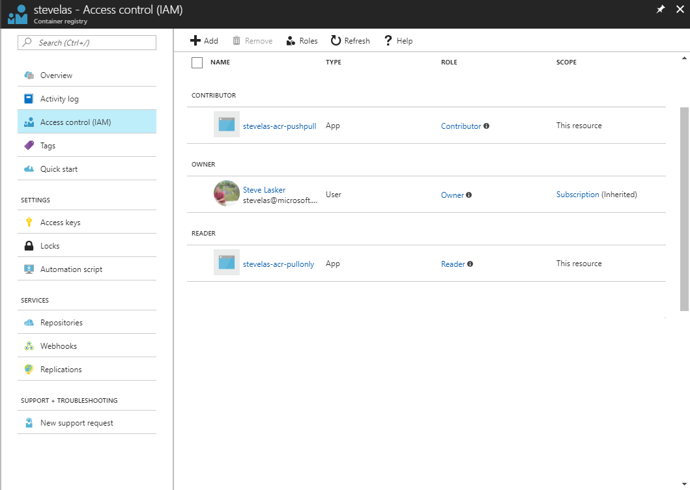
Owner – Push, Pull, ARM Resource Management eg: IAM configuration
Contributor – Push, Pull
Reader – Pull Only

Slide 27
Container Security

Slide 28
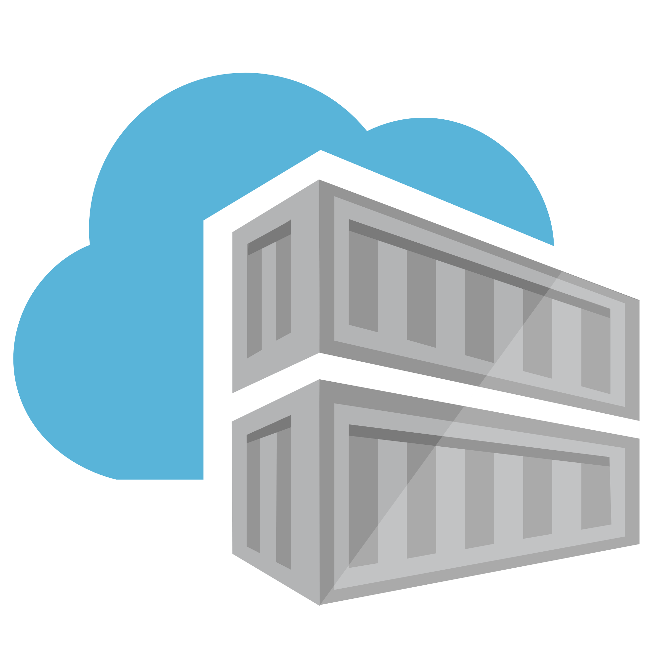

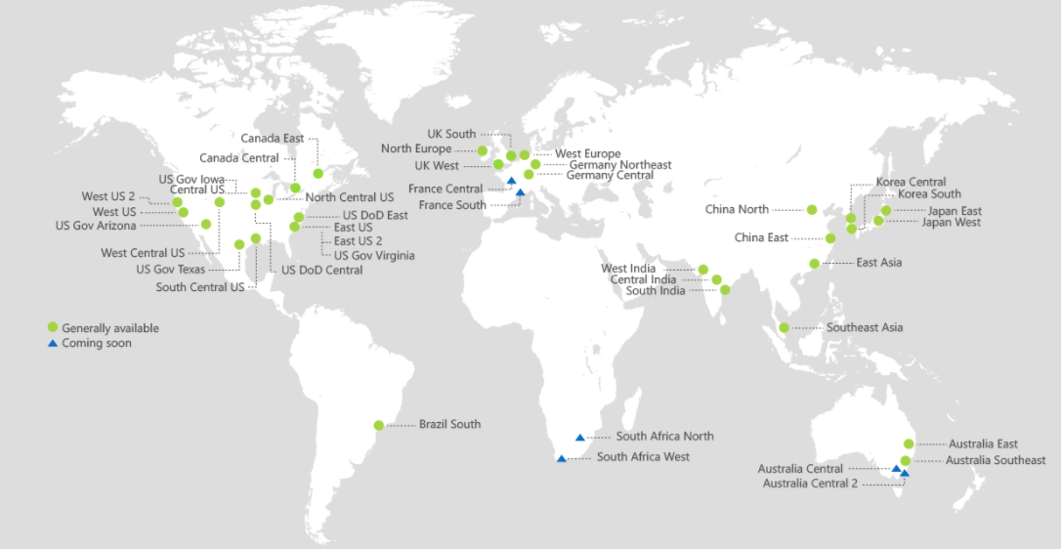
ACR Geo-replication
Mange your global/local deployments as one resource

Slide 29


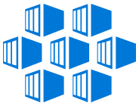
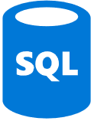

Push Built Images
docker push contosowestus.azurecr.io/web:1234
docker push contosowesteurope.azurecr.io/web:1234
Nodes Pull Images
docker pull contosowestus.azurecr.io/web:1234
docker pull contosowesteurope.azurecr.io/web:1234
Pulls are local, network-close, fast, reliable
Pulls are remote, across the public internet, slower, less reliable
Have network egress fees
Pulls are remote, across the public internet, slower, less reliable
Have network egress fees
West Europe
Canada Central
West US
East US
Developers must push images to n registries, requiring separate management and configuration

Slide 30

Push Built Images
docker push contoso.azurecr.io/web:1234
ACR Syncs Image Blobs
Regional Web Hooks fire for local deployments
Nodes Pull Images
docker pull contoso.azurecr.io/web:1234
Geo-replicate a single registry
All regions have a local replica
Geo-replicate a single registry
All regions have a local replica
West Europe
Canada Central
West US
East US
Each registry is pulling from a local, network close, reliable registry

Slide 31
Azure Container Registry
Providing a single registry across the globe
aka.ms/ACR
aka.ms/ACR/Docs
aka.ms/ACR/Geo-replication
aka.ms/ACR/Roadmap

Slide 32
ACR Current Features
Feature | Description
Managed Service | Storage and APIs managed by Azure
Data Secure & Redundant | Images are encrypted at rest, and geo-redundant using Azure Storage
http://aka.ms/acr/roadmap

Slide 33
ACR Roadmap: H1 2018
Feature | Description
Existing VNET | Add ACR to an existing VNET
ACR Build | OS & Framework Patching
Additional Clouds | China, US Gov, Germany
Event Grid Integration | Base Image Updates, ACR Image Push, Delete
Overage Meters | Enabling customers that have large storage
Auto-Purge | Maintaining a pruned registry
Trusted Registries | Support Signed Images
ISO, HIPPA, HITRUST, PCI Compliance | Assure ACR adheres to the strictest compliance standards
Image Telemetry | Image pull statistics
Image Quarantine | Limiting access to newly pushed images, until vulnerability scanning completed
CDN Support | Additional performance to Premium Registries
http://aka.ms/acr/roadmap

Slide 34
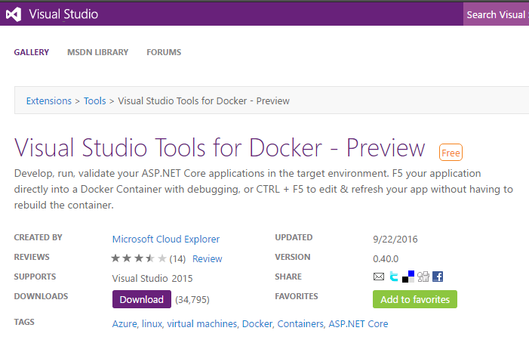
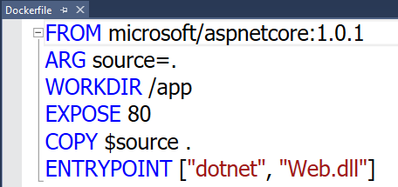
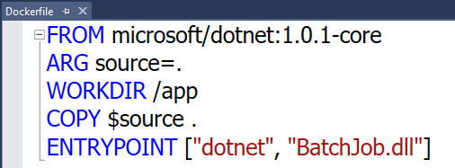

Visual Studio Docker Tools
Run, Debug, Test Web & Console apps in docker containers
Linux today, Windows Server & Nano Server coming soon
F5 Debugging
Edit & Refresh of code
Scaffolds docker assets
Dockerfile, docker-compose.yml
aka.ms/DockerToolsForVS

Slide 35
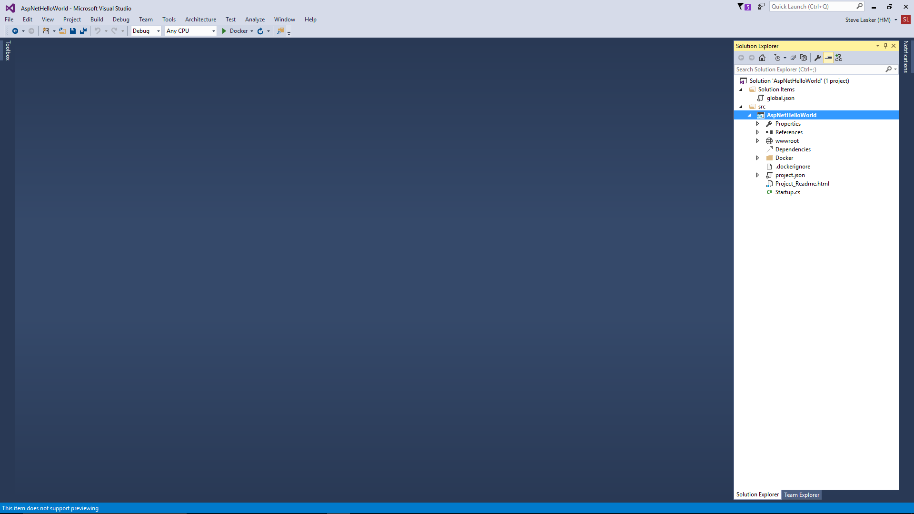
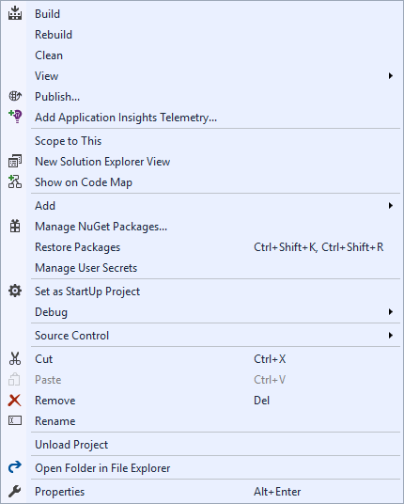
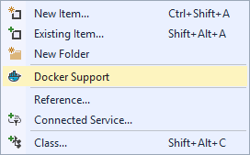
Docker Tools for Visual Studio

Slide 36

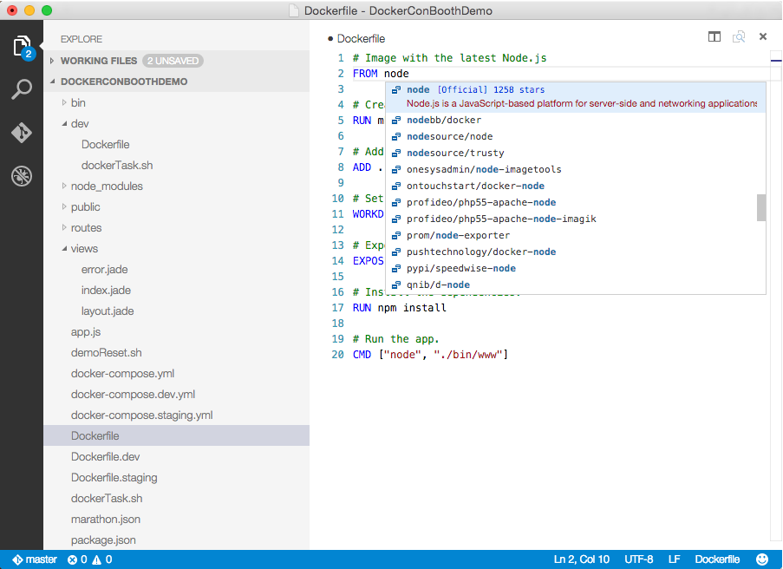
Visual Studio Code
OS X, Linux, Windows
Lightweight, keyboard focused
IntelliSense, GoTo Def, refactoring
Git SCC integration
Extensible platform
Docker Asset Editing - extension
aka.ms/VSCode
aka.ms/DockerToolsForVSCode

Slide 37
Q&A
Notes:
Open source aci –connector that you can connect to any cloud
Using K8 to run ACI
Here is the demo script I used:
helm install charts/fr-demo --name demo
kubectl get nodes
helm install charts/aci-connector --name aci-connector --namespace kube-system
kubectl get nodes
kubectl scale deploy demo-fr-ir-aci --replicas 10
Here is talk track:
I’m going to install a Facial Recognition application that consists of a frontend, a backend, and a set of image recognizers [Enter]
Let’s wait a moment for the application to start up.
OK we have our frontend and backend running, plus two image recognizers.
Let’s check out the frontend and see if the application is live.
Great, we are processing images, though things are a little slow.
Why so slow? This is a single node AKS cluster [Enter]
Let’s use Azure Container Instances and the Kubernetes connector to speed things up.
I’m going to use Helm to install the ACI Connector for Kubernetes.
Let’s wait a moment for the ACI connector to start up. [Enter]
Here we can see the ACI connector has registered as a new node in Kubernetes.
Now let’s scale up the image recognizer replicas to 10 using `kubectl`. [Enter]
Though we are using `kubectl`, the ACI Connector is dispatching pods to Azure Container Instances transparently, via the ACI connector node.
This virtual node has unlimited capacity and a per-second billing model, making it perfect for burst compute scenarios like this one.
If we wait a minute or so for the ACI containers to warm up, we should see image recognizer throughput increase dramatically.
[Wait]
Here we can see throughput really beginning to pick up, thanks to burst capacity provided by ACI.
This is powerful stuff. Here we can see AKS and ACI combine to provide the best of “serverless” computing – invisible infrastructure and micro-billing – all managed through the open Kubernetes APIs. This kind of innovation – the marriage of containers and serverless computing -- is important for the industry, and Microsoft is working hard to make it a reality.

