Slide 1
Consuming Public Content
A workflow enabling reliability, security, and performance
https://opencontainers.org/posts/blog/2020-10-30-consuming-public-content/
https://aka.ms/consuming-public-content
https://aka.ms/acr/tasks/gated-import

Slide 2


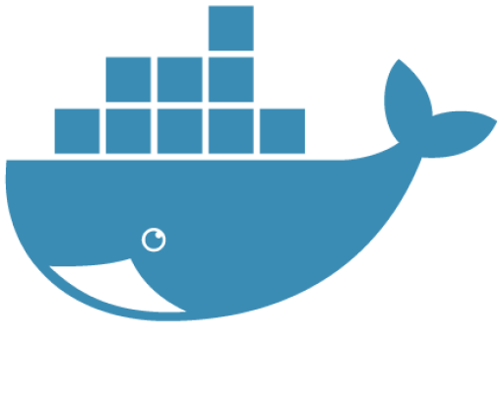




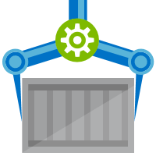
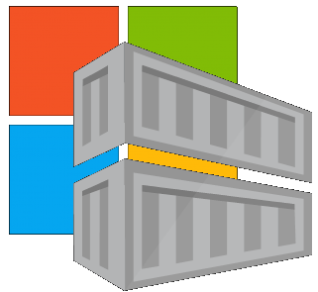





Are Your Base Images Secure?
Buffer base artifacts in your secured environment
Scan, test, validate base artifacts
Automate all of this
Be protected and available, when things outside your control aren’t secured or available
Are Your Base Images Artifacts Secure?
Public Registries
Your Environment
aws, azure, google, on-prem, …
Private Registry
acr, ecr, gcr, dtr, harbor, jfrog, …
.NET
contoso.azurecr.io
Docker Hub
Public Internet
staging-artifacts
node
java
MCR
dotnet
ACR Tasks
wordpress
base-artifacts
node
java
dotnet
wordpress
departments
marketing
warranty
dev
falcon-team
warriors-team

Slide 3
Regional Reliability

Slide 4









ISP
CDN
DNS
LB
EastUS

Slide 5
ISP
ISP
CDN
DNS
LB
LB
WestUS
EastUS

Slide 6
China
India
Japan
DNS
Google
IBM
AWS
ISP
LB
Australia
Public Registry
WestEU
WestUS
EastUS
DigitalOcean
CircleCI
GitHub

Slide 7
China
India
Japan
DNS
Google
IBM
AWS
ISP
Public Registry
WestEU
WestUS
EastUS
DigitalOcean
CircleCI
GitHub

Slide 8



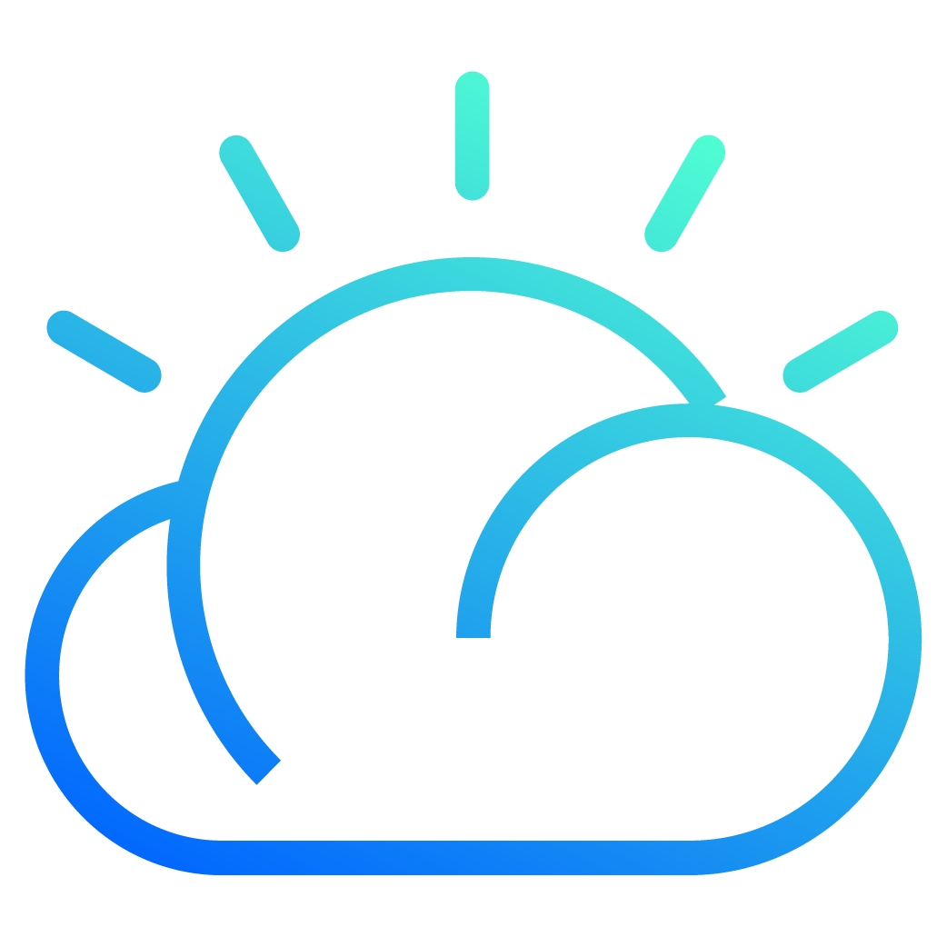


Docker Hub
Dependent on public content, w/regional DNS outage
region-a
region-b
region-a
region-b
region-a
region-b
region-a
region-b
region-c
region-d
region-c
region-d
region-c
region-d
region-c
region-d
MCR
CDN
DNS
Public Registry
region-a
region-b
region-a
region-b
region-a
region-b
region-a
region-b
Regional Registries, w/regional DNS outage
region-c
region-d
region-c
region-d
region-c
region-d
region-c
region-d

Slide 9




Public Registries
Acme-Rockets
azure, aws, google, ibm, on-prem, …
Private Registry
acr, ecr, gcr, dtr, harbor, jfrog, …
registry.acme-rockets.io/
Docker Hub
import-staging/
dotnet
node
Internet
alpine
MCR
nginx
base-artifacts/
dotnet
node
Inner Loop
RedHat
alpine
nginx
Developer
gcr
dev/
team-tasmania
team-gossamer
prod/
marketing
GitHub
warranty

Slide 10




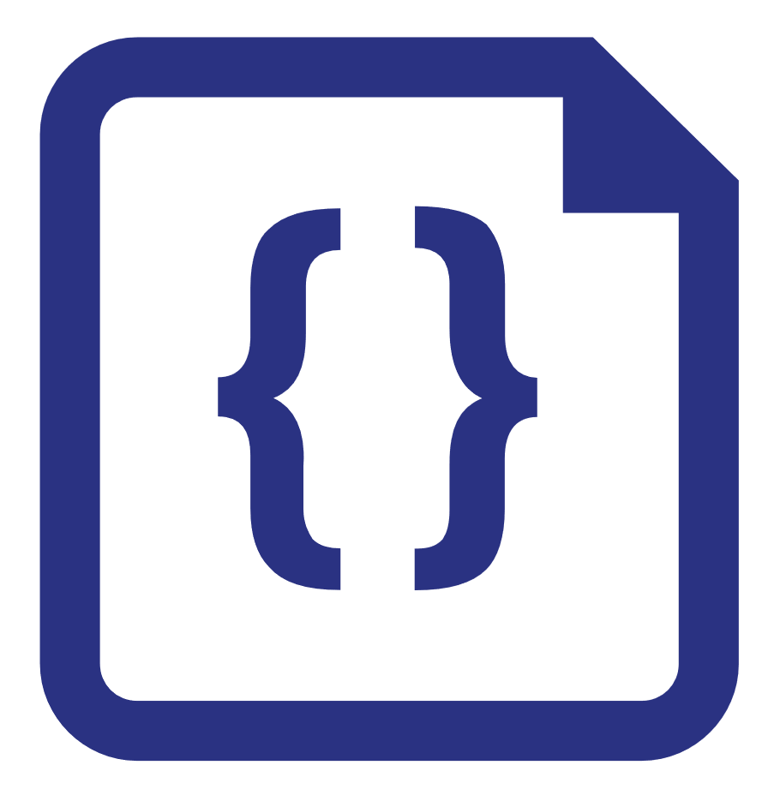
7
1
KeyVault
Secrets
github-token
registry-contoso-user
registry-contoso-password
registry-baseartifacts-user
registry-baseartifacts-password
registry-publicregistry-user
registry-publicregistry-password
registry-dockerhub-user
registry-dockerhub-password
ACR
Registries
publicregistry
baseartifacts
contoso
2
ACR Tasks
Registry Task Name
publicregistry node-public
baseartifacts base-import-node
contoso hello-world
3
ACR Task
Task Name
base-import-node
hello-world
4
ACR Task Credentials
Task Registry -u/-p
base-import-node docker.io keyvault→
hello-world publicregistry.azurecr.io keyvault→
hello-world baseartifacts.azurecr.io keyvault→
5
8
ACR Task Secrets
Task Name Value
hello-world registry-user keyvault→
hello-world registry-password keyvault→
Container Instance
hello-world-aci
6
ACR Task Values
Task Name Value
hello-world ACI hello-world-aci
hello-world ACI_RG hello-world-aci-rg
hello-world KEYVAULT acr-tasks-credentials
<all> REGISTRY_FROM_URL docker.io
Imagery from: https://aka.ms/acr/tasks/gated-import
git repo: https://github.com/importing-public-content

