Slide 1
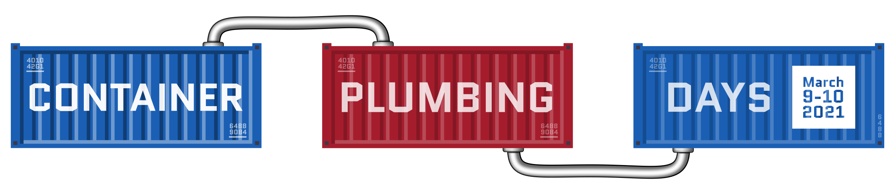






OCI Artifact Registries
Leveraging OCI Distribution for new Cloud Native Artifacts
The journey continues Adding support for Reference Types
Steve Lasker
Program Manager / Architect
Azure Container Registries
Steve.Lasker@Microsoft.com
@SteveLasker
SteveLasker.blog
github.com/SteveLasker
github.com/SteveLasker/presentations
OCI TOB member
OCI Artifact maintainer
CNCF Notary maintainer
OCI Artifacts: Adding Support for Reference Types | Container Plumbing Days

Slide 2

What is OCI Artifacts
And why do you care?

Slide 3
Container Registries
Production resources, fed through dev output
High availability – critical production asset
High performance – thousands of nodes and users concurrently interacting
Production security – Auth & RBAC, Firewalls, VNets, Policy, Scanning, Audit Logs, Content Management, Double Encryption at rest,
Ubiquitous – Every major cloud has one, on-prem, integrated into devops and production workflows

Slide 4



Running A Storage Thing
VNET & Firewall Rules?
Documentation?
Authentication
What will you use?
Will it integrate with the rest of “the platform”
Security
How do you prevent hacks, DOS attacks, abuse?
Costs
Will you justify the costs to run the YASS?
Will you charge, offer for free- your YASS?
Multiple clouds?
Will other cloud vendors host this YASS for you?
Compliance
cache
<-> REST
Regional Replication?
Signing?

Slide 5














Container Registries
→ Artifact Registries
!
Y
Yet
Another
Storage
Solution
A
S
S

Slide 6
How Are Images Stored in OCI Registries
How Are Images Artifacts Stored in OCI Registries

Slide 7




Docker Pull Flow
demo42.azurecr.io
docker pull demo42.azurecr.io/hello-world:latest
1. Pull
<-> REST
cache
2. Manifest Returned
3. Delta Layer Requests
Manifests
Pull:
I want this “thing”,
Manifest:
What layers do I already have?
Manifest:
List of layer ID’s representing the entire thing
hello-world:latest
Image Cache
IMAGE ID REPOSITORY TAG SIZE
4. Blob URLs Returned
Wordpress-chart:5
5. Blob Request
hpctest:1
694950fbcb3f hello-world latest 1.2 GB
Layers Please:
Blobs
6. Layers Returned
Layer Cache
LAYER ID
cf4ecb49238476635f551fe11987ae4c3
e41864ee12411ff073f0a58417cf7e160
sha256:cf4ecb49238476635f551fe11987ae4c3
85bef57c324acc96f7067488d35b7e3c1
sha256:e41864ee12411ff073f0a58417cf7e160
sha256:85bef57c324acc96f7067488d35b7e3c1

Slide 8
Dissecting an OCI Image Manifest
OCI Image Manifest
{
"schemaVersion": 2,
"mediaType": "application/vnd.oci.image.manifest.v1+json",
"config": {
"mediaType": "application/vnd.oci.image.config.v1+json",
"digest": "sha256:bd698aa18aa02a2f083292b944813aef7845c336b8ad",
"size": 16078
},
"layers": [
{
"mediaType": "application/vnd.oci.image.layer.v1.tar+gzip",
"digest": "sha256:9a1a13172ed974323f7c35153e3127e640e45ef0aa",
"size": 23133155
},
{
"mediaType": "application/vnd.oci.image.layer.v1.tar+gzip",
"digest": "sha256:5094d5d656a95c6aa92a65db2947d7ce0c1a394",
"size": 226
}
]
}
OCI Manifest Types
oci.image.manifest – a single image
oci.image.index – a collection of images
OCI Content Descriptors
Consists of components, arranged in a Merkle Directed Acyclic Graph (DAG).
References between components in the graph are expressed through Content Descriptors.
Descriptors describes the disposition of the targeted content.
Descriptors include the type of content, a content identifier (digest), and the byte-size

Slide 9
Dissecting an OCI Image Manifest
OCI Image Manifest
{
"schemaVersion": 2,
"mediaType": "application/vnd.oci.image.manifest.v1+json",
"config": {
"mediaType": "application/vnd.oci.image.config.v1+json",
"digest": "sha256:bd698aa18aa02a2f083292b944813aef7845c336b8ad",
"size": 16078
},
"layers": [
{
"mediaType": "application/vnd.oci.image.layer.v1.tar+gzip",
"digest": "sha256:9a1a13172ed974323f7c35153e3127e640e45ef0aa",
"size": 23133155
},
{
"mediaType": "application/vnd.oci.image.layer.v1.tar+gzip",
"digest": "sha256:5094d5d656a95c6aa92a65db2947d7ce0c1a394",
"size": 226
}
]
}
OCI Manifest Types
oci.image.manifest – a single image
oci.image.index – a collection of images
Config
A blob, representing config info about the artifact. May be inspected prior to pulling the image artifact.
Layers
The content of the image artifact
Container images use this as an ordered, overlay of content

Slide 10
Dissecting an OCI Image Index
OCI Image Index
{
"schemaVersion": 2,
"mediaType": "application/vnd.oci.image.index.v1+json",
"manifests": [
{
"mediaType": "application/vnd.oci.image.manifest.v1+json",
"digest": "sha256:10b995d6204131069af3e4f00dc1d3758d5...",
"size": 4288,
"platform": {
"architecture": "amd64",
"os": "linux"
}
},
{
"mediaType": "application/vnd.oci.image.manifest.v1+json",
"digest": "sha256:33c5d954c76495826126178ded2113d1ada0a...",
"size": 4288,
"platform": {
"architecture": "amd64",
"os": "windows"
}
}
OCI Manifest Types
oci.image.manifest – a single image
oci.image.index – a collection of images
manifests
Collection of manifests, representing platform specific images
Layers
The content of the image artifact
Container images use this as an ordered, overlay of content
Platform Data
Used to determine which manifest to pull for the target host platform

Slide 11
Comparing an OCI Image Manifest & Index
OCI Image Manifest
{
"schemaVersion": 2,
"mediaType": "application/vnd.oci.image.manifest.v1+json",
"config": {
"mediaType": "application/vnd.oci.image.config.v1+json",
"digest": "sha256:bd698aa18aa02a2f083292b944813aef7845c336b8ad",
"size": 16078
},
"layers": [
{
"mediaType": "application/vnd.oci.image.layer.v1.tar+gzip",
"digest": "sha256:9a1a13172ed974323f7c35153e3127e640e45ef0aa",
"size": 23133155
},
{
"mediaType": "application/vnd.oci.image.layer.v1.tar+gzip",
"digest": "sha256:5094d5d656a95c6aa92a65db2947d7ce0c1a394",
"size": 226
}
]
}
OCI Image Index
{
"schemaVersion": 2,
"mediaType": "application/vnd.oci.image.index.v1+json",
"manifests": [
{
"mediaType": "application/vnd.oci.image.manifest.v1+json",
"digest": "sha256:10b995d6204131069af3e4f00dc1d3758d5...",
"size": 4288,
"platform": {
"architecture": "amd64",
"os": "linux"
}
},
{
"mediaType": "application/vnd.oci.image.manifest.v1+json",
"digest": "sha256:33c5d954c76495826126178ded2113d1ada0a...",
"size": 4288,
"platform": {
"architecture": " amd64 ",
"os": “windows"

Slide 12

Understanding the Artifact Type
Registries shall know the type they store
Vulnerability scanning products must know what they’re scanning
Registries may provide options, based on the type
Client tooling must know what they’re pulling – so they don’t fail
demo42.azurecr.io
<-> REST
helm update demo42.azurecr.io/charts/wordpress:5.7
docker run demo42.azurecr.io/charts/wordpress:5.7

Slide 13
Dissecting an OCI Image Manifest
manifest.config.mediaType Defines the Artifact Type
OCI Image Manifest
{
"schemaVersion": 2,
"mediaType": "application/vnd.oci.image.manifest.v1+json",
"config": {
"mediaType": "application/vnd.oci.image.config.v1+json",
"digest": "sha256:bd698aa18aa02a2f083292b944813aef7845c336b8ad",
"size": 16078
},
"layers": [
{
"mediaType": "application/vnd.oci.image.layer.v1.tar+gzip",
"digest": "sha256:9a1a13172ed974323f7c35153e3127e640e45ef0aa",
"size": 23133155
},
{
"mediaType": "application/vnd.oci.image.layer.v1.tar+gzip",
"digest": "sha256:5094d5d656a95c6aa92a65db2947d7ce0c1a394",
"size": 226
}
]
}
"application/vnd.docker.container.image.v1+json"
"application/vnd.oci.image.config.v1+json"
"application/vnd.cncf.helm.chart.config.v1+json"
"application/vnd.sylabs.sif.config.v1+json"
"application/vnd.cncf.openpolicyagent.config.v1+json"
Unique types registered with iana.org

Slide 14
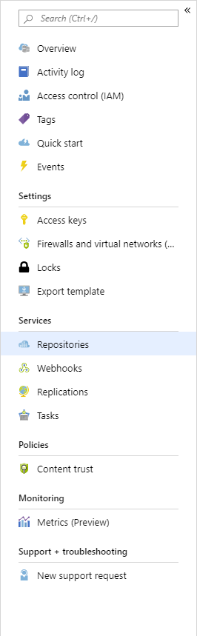
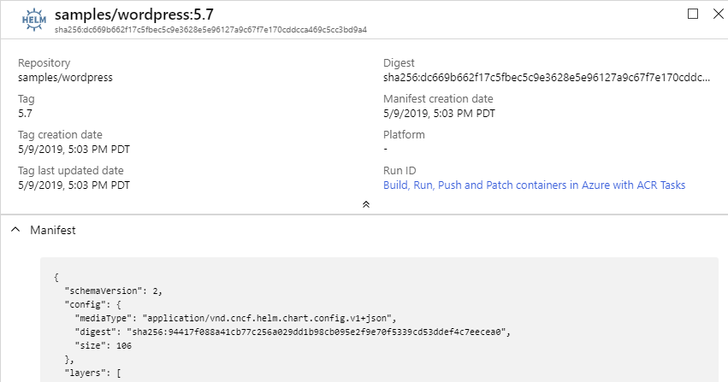
Type: Helm
repo/image:tag
How a registry knows it’s type

Slide 15
Why Config?
Started with manifest.artifactType
too impacting to existing OCI tooling
Minimal change to existing OCI compliant tooling
Enables artifact configuration data
The config object, can be null
Image Artifact Manifest
{
"schemaVersion": 2,
"mediaType": "application/vnd.oci.image.manifest.v1+json",
"artifactType": "application/vnd.cncf.helm.chart",
"config": {
"mediaType": "application/vnd.oci.image.config.v1+json",
"size": 16078,
"digest": "sha256:bd698aa18aa02a2f083292b9448130a3afaa9a3e5fba24fc0aef7845c336b8ad"
},
"layers": [
Image Artifact Manifest
Image Manifest
{
"schemaVersion": 2,
"mediaType": "application/vnd.oci.image.manifest.v1+json",
"config": {
"mediaType": "application/vnd.cncf.helm.chart.config.v1+json",
"size": 16078,
"digest": "sha256:bd698aa18aa02a2f083292b9448130a3afaa9a3e5fba24fc0aef7845c336b8ad"
},
"layers": [

Slide 16






Individual Artifacts & Reference Artifacts
net-monitor:v1
notary v2 signature
config (blob)
layer1 (blob)
config (blob)
layer2 (blob)
signature (blob)
wordpress:5
SBoM
notary v2 signature
config (blob)
config (blob)
config (blob)
layer1 (blob)
SBoM-document (blob)
signature (blob)
prod-policy:v9
YAAT
notary v2 signature
config (blob)
config (blob)
config (blob)
layer1 (blob)
content (blob)
signature (blob)

Slide 17
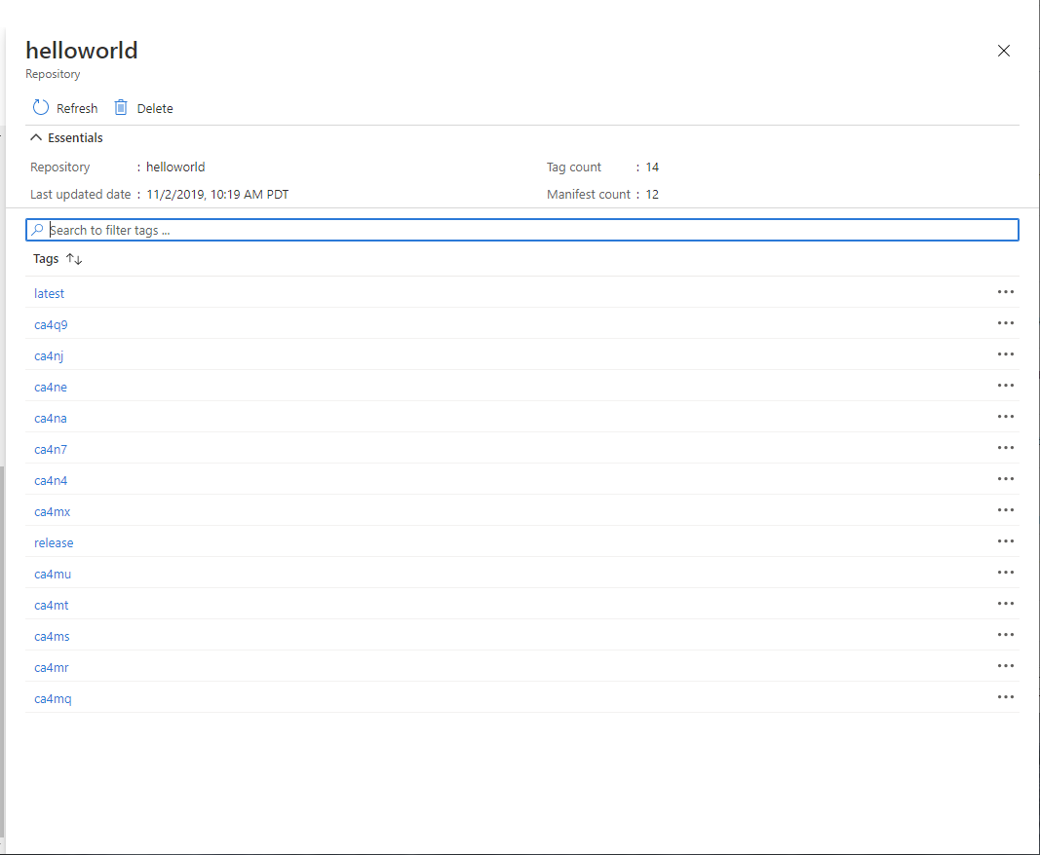
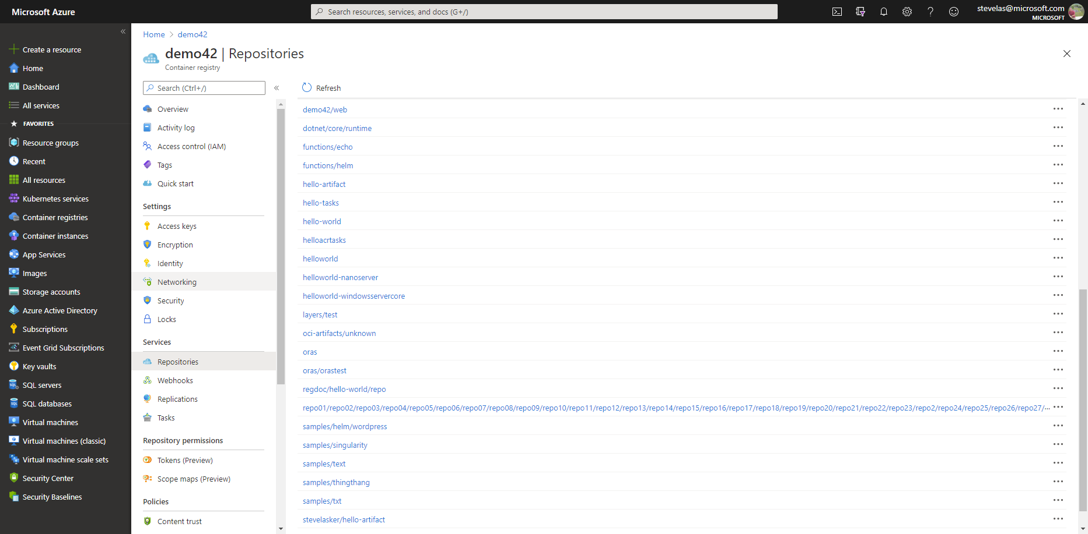



What should be seen?
latest
…
S
B
latest
o
M
ca4na
…
S
B
latest-signature
o
M
ca4nb
…
latest-signature-acme-rockets
…
ca4nc
latest-signature-wabbit-networks
…
ca4nd
ca4na
…
ca4ne
ca4na-signature
…
ca4ng
ca4na-signature-acme-rockets
…
ca4ng
ca4na-signature-wabbit-networks
…
ca4nh
ca4nb
…
ca4nj
ca4nb-signature
…
ca4nk
ca4nb-signature-acme-rockets
…
ca4nm
ca4nb-wabbit-networks

Slide 18

Individual Artifacts & Reference Artifacts
net-monitor:v1
notary v2 signature
config (blob)
layer1 (blob)
config (blob)
layer2 (blob)
signature (blob)
net-monitor:v1
SBoM
notary v2 signature
config (blob)
config (blob)
config (blob)
layer1 (blob)
SBoM-document (blob)
signature (blob)
layer2 (blob)
Wabbit Networks signature
YAAT
notary v2 signature
Docker certified signature
ACME Rockets signature
config (blob)
config (blob)
SBoM Document
content (blob)
signature (blob)
Wabbit Networks signature
YAAT
Wabbit Networks signature

Slide 19
Comparing OCI Image & Artifact Manifest
+ New Manifest Type
Differentiates from image.manifest & image.index
OCI Artifact Manifest
{
"schemaVersion": 1,
"mediaType": "application/vnd.oci.artifact.manifest.v1+json",
"artifactType": "application/vnd.cncf.notary.v2",
"config": {
"mediaType": "application/vnd.cncf.notary.config.v2+json",
"digest": "sha256:bd698aa18aa02a2f083292b944813aef7845c336b8ad",
"size": 16078
},
"blobs": [
{
"mediaType": "application/tar+gzip",
"digest": "sha256:9a1a13172ed974323f7c35153e3127e640e45ef0aa",
"size": 23133155
}
"manifests": [
{
"mediaType": "application/vnd.oci.image.manifest.v1+json",
"digest": "sha256:10b995d6204131069af3e4f00dc1d3758d5... ",
"size": 4288
}
]
}
+ artifactType
Formalizes the type of artifact (Notary, SBoM, Helm, CNAB, Nydus) from the config.mediaType
~ blobs
Renamed layers to blobs
+ manifests
References to existing manifests, already in the registry.

Slide 20
Comparing OCI Image & Artifact Manifest
OCI Image Manifest
{
"schemaVersion": 2,
"mediaType": "application/vnd.oci.image.manifest.v1+json",
"config": {
"mediaType": "application/vnd.oci.image.config.v1+json",
"digest": "sha256:bd698aa18aa02a2f083292b944813aef7845c336b8ad",
"size": 16078
},
"layers": [
{
"mediaType": "application/vnd.oci.image.layer.v1.tar+gzip",
"digest": "sha256:9a1a13172ed974323f7c35153e3127e640e45ef0aa",
"size": 23133155
},
{
"mediaType": "application/vnd.oci.image.layer.v1.tar+gzip",
"digest": "sha256:5094d5d656a95c6aa92a65db2947d7ce0c1a394",
"size": 226
}
]
}
OCI Artifact Manifest
{
"schemaVersion": 1,
"mediaType": "application/vnd.oci.artifact.manifest.v1+json",
"artifactType": "application/vnd.cncf.notary.v2",
"config": {
"mediaType": "application/vnd.cncf.notary.config.v2+json",
"digest": "sha256:bd698aa18aa02a2f083292b944813aef7845c336b8ad",
"size": 16078
},
"blobs": [
{
"mediaType": "application/tar+gzip",
"digest": "sha256:9a1a13172ed974323f7c35153e3127e640e45ef0aa",
"size": 23133155
}
"manifests": [
{
"mediaType": "application/vnd.oci.image.manifest.v1+json",
"digest": "sha256:10b995d6204131069af3e4f00dc1d3758d5... ",
"size": 4288
}
]
}
+1
~2
+3

Slide 21
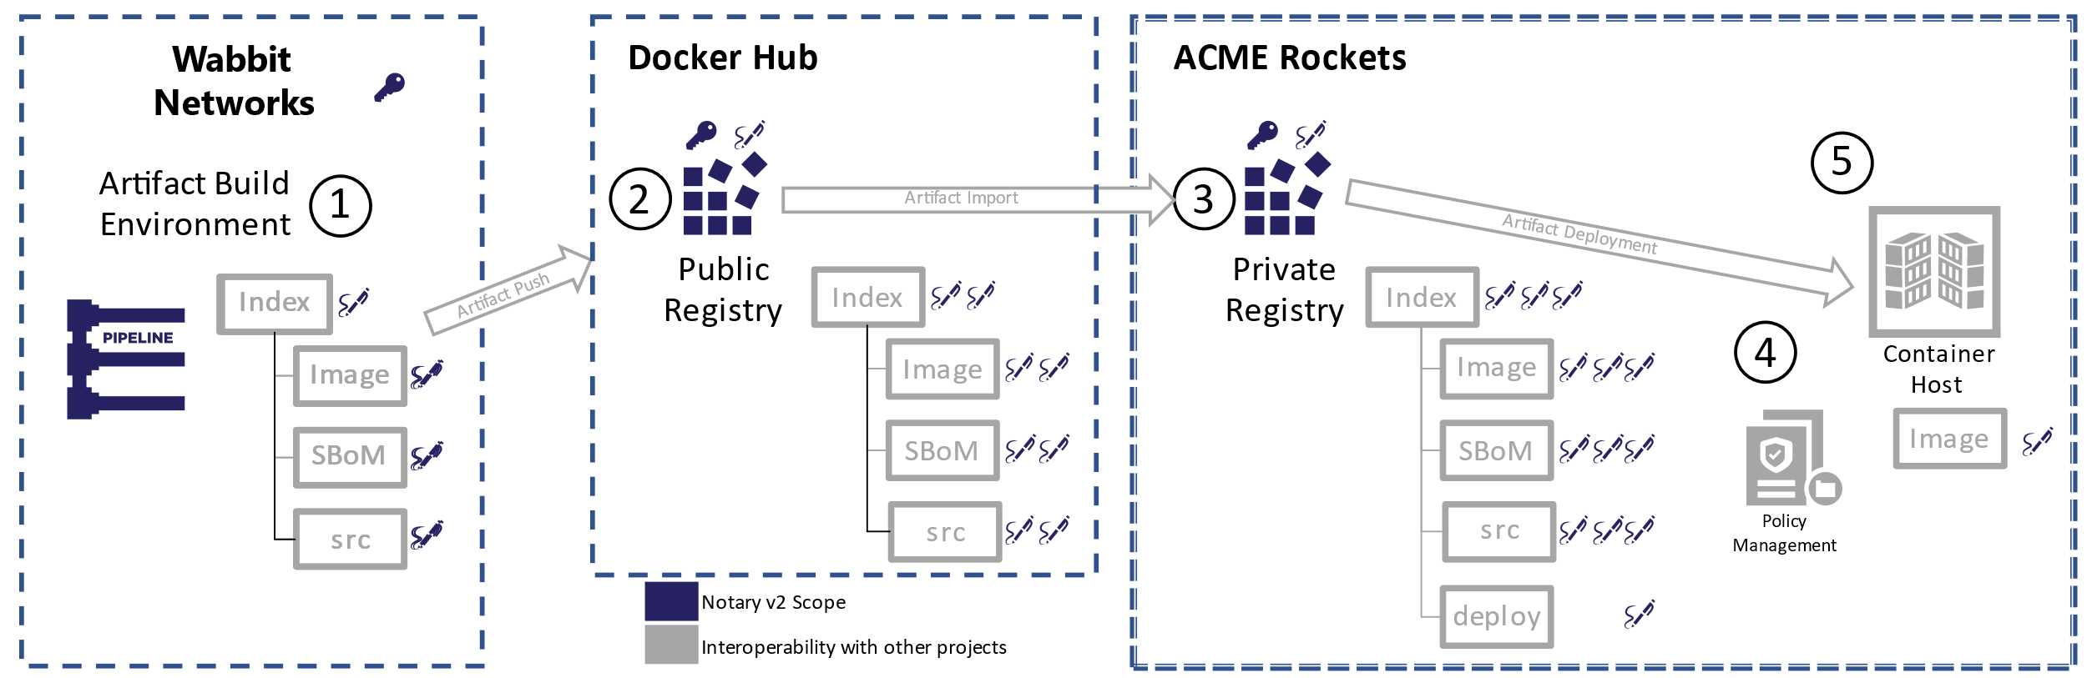

Demo Time
Target e2e experience for Notary v2

Slide 22
Finding Reference Artifacts
How do you find linked artifacts?
OCI Artifacts Links API proposal:
/v2/_ext/{repository}/manifests/{digest}/links
What additional artifacts are related to net-monitor:v1
Convert the tag to a digest:
curl -v -H "Accept: application/vnd.docker.distribution.manifest.v2+json" \
registry.wabbit-networks.io/v2/net-monitor/manifests/v1 2>&1 | \
grep -i 'Docker-Content-Digest:' | \
awk '{print $3}'
Query list of linked artifacts ^{(not yet implemented)}
curl –k registry.wabbit-networks.io/v2/_ext/net-monitor/manifests/{digest}/links
Possible FIlters ^{(not yet implemented)}
?artifactType=application/vnd.oci.notary.v2.config+json

Slide 23
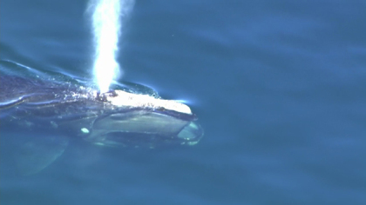
Coming up for air
OCI registries can support new artifact types
Leverage What Exists – focus on Your Thing
Declare a new mediaType to uniquely identify Your Thing
Register artifact mediaTypes with IANA.org
ORAS library available to ease development, but not required
Follow best practices for image tagging
stevelasker.blog/docker-tagging-best-practices-for-tagging-and-versioning-docker-images
oci.artifact.manifest – work in progress
github.com/opencontainers/artifacts/pull/29

Slide 24
Getting Involved with OCI Artifact Registries
OCI Artifacts: github.com/opencontainers/artifacts
ORAS: github/com/deislabs/oras
Notary v2: github.com/notaryproject/notaryproject
Getting Started: stevelasker.blog/authoring-oci-registry-artifacts-quick-guide
Getting Started in Azure: aka.ms/acr/artifacts
Slack: opencontainers.slack.com #artifact-registry
To Join: chat.opencontainers.org/
Steve Lasker
Program Manager
Azure Container Registries
Steve.Lasker@Microsoft.com
@SteveLasker
SteveLasker.blog
github.com/SteveLasker
github.com/SteveLasker/presentations
Thank You

