Slide 1
Evolving Service Costs Amortization
Steve Lasker
Program Manager
Azure Developer Experiences
blogs.msdn.microsoft.com/SteveLasker
@SteveLasker
Steve.Lasker@Microsoft.com

Slide 2
Amortizing Costs An evolution, revolution, or circle of service?

Slide 3
– Mainframes
CIRCA 1980

Slide 4
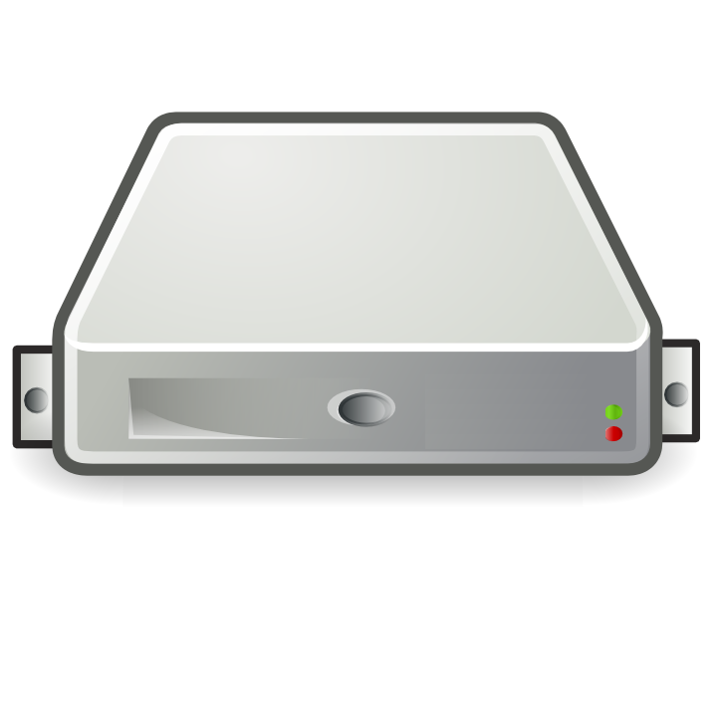
– PC → Server Revolution
CIRCA 1990
$
$
$
$
$
$
$
$
$
$
$
$
$
$
$
$
$
$
$
$
$
$
$
$
$
$
$
$
$
$
$
$
$
$
$
$
$
$
$
$
$
$
$
$
$
$
$
$
$
$
$
$
$
$
$

Slide 5
– Server → VM Evolution
CIRCA 2000
Guest OS #5
Guest OS #6
Guest OS #7
Guest OS #8
Guest OS #5
Guest OS #6
Guest OS #7
Guest OS #8
Guest OS #5
Guest OS #6
Guest OS #7
Guest OS #8
Guest OS #5
Guest OS #6
Guest OS #7
Guest OS #8
Guest OS #5
Guest OS #6
Guest OS #7
Guest OS #8
Guest OS #1
Guest OS #2
Guest OS #3
Guest OS #4
Guest OS #1
Guest OS #2
Guest OS #3
Guest OS #4
Guest OS #1
Guest OS #2
Guest OS #3
Guest OS #4
Guest OS #1
Guest OS #2
Guest OS #3
Guest OS #4
Guest OS #1
Guest OS #2
Guest OS #3
Guest OS #4
Hyper Visor
Hyper Visor
Hyper Visor
Hyper Visor
Hyper Visor
$
$
$
$
$

Slide 6
– VM → Cloud Evolvement
CIRCA 2015
Guest OS #5
Guest OS #6
Guest OS #7
Guest OS #8
Guest OS #5
Guest OS #6
Guest OS #7
Guest OS #8
Guest OS #5
Guest OS #6
Guest OS #7
Guest OS #8
Guest OS #5
Guest OS #6
Guest OS #7
Guest OS #8
Guest OS #5
Guest OS #6
Guest OS #7
Guest OS #8
$
$
$
$
$
$
$
$
$
$
$
$
$
$
$
$
$
$
$
$
Guest OS #1
Guest OS #2
Guest OS #3
Guest OS #4
Guest OS #1
Guest OS #2
Guest OS #3
Guest OS #4
Guest OS #1
Guest OS #2
Guest OS #3
Guest OS #4
Guest OS #1
Guest OS #2
Guest OS #3
Guest OS #4
Guest OS #1
Guest OS #2
Guest OS #3
Guest OS #4
$
$
$
$
$
$
$
$
$
$
$
$
$
$
$
$
$
$
$
$
Hyper Visor
Hyper Visor
Hyper Visor
Hyper Visor
Hyper Visor

Slide 7
Distributed, Scalable Mainframe
– Cloud → Containerization
CIRCA 2015
Guest OS #2
Guest OS #2
Guest OS #2
Guest OS #2
Guest OS #2
$
$
$
$
$
Guest OS #1
Guest OS #2
Guest OS #3
Guest OS #4
Guest OS #1
Guest OS #2
Guest OS #3
Guest OS #4
Guest OS #1
Guest OS #2
Guest OS #3
Guest OS #4
Guest OS #1
Guest OS #2
Guest OS #3
Guest OS #4
Guest OS #1
Guest OS #2
Guest OS #3
Guest OS #4
$
$
$
$
$
Hyper Visor
Hyper Visor
Hyper Visor
Hyper Visor
Hyper Visor

Slide 8
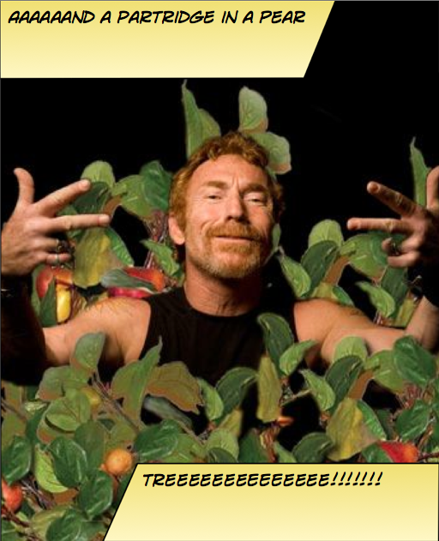
Instancing Multiple Copies
You need:
10 web front ends
8 API instances
4 Redis Cache
1 Database

Slide 9

Web
Web
Web
Web
Web
API
API
API
Cache
Cache

Slide 10

Load Balancing & Fault Tolerance
DOCKER_HOST
Docker daemon
Containers
Image Cache
Web
Web
Web
Web
Web
Web
API
Cache
API
API
API
Cache
Cache

Slide 11


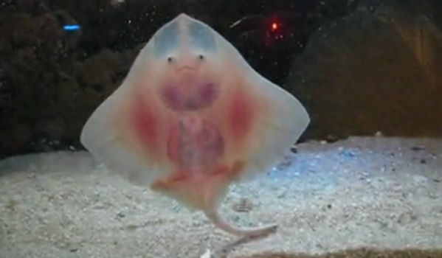
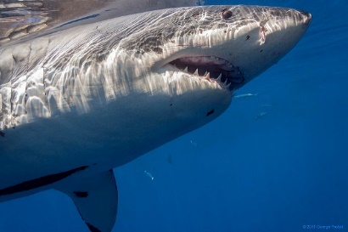
Distribution
DOCKER_HOST
DOCKER_HOST
Docker daemon
Docker daemon
Containers
Image Cache
Containers
Image Cache
Container Scheduling
Container Orchestration
DOCKER_HOST
DOCKER_HOST
DOCKER_HOST
DOCKER_HOST
Docker daemon
Docker daemon
Docker daemon
Docker daemon
Containers
Image Cache
Containers
Image Cache
Containers
Image Cache
Containers
Image Cache
Web
Web
Web
Web
Web
Web
Cache
API
Cache
Web
Web
API
Cache
API
Cache
API
API
API
Cache
Cache

