Slide 1
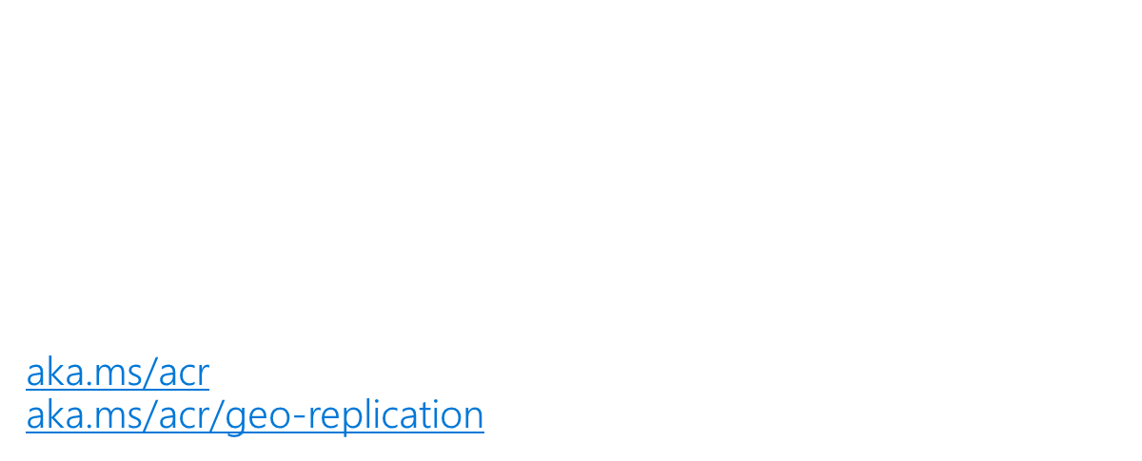
Azure Containers – E2E Journeys

Slide 2
Containers strategy
Make Azure the best place to run container workloads
Make getting started super easy
Containers as a common deployment currency for Azure services

Slide 3
Shipping Manifest
Containers are the Unit of Deployment
Registries at the center
Container Orchestration & Reliability
Container Build Workflows
Tagging Best Practices
Base images & App Deployments
Orchestrators are just the next low level OS
Componentized Mainframe
OS & Framework Patching

Slide 4
Containers as a common deployment currency
ACS
ACI
Service Fabric
App Service
IoT
Machine Learning
…
Private Registry
Custom Apps
ISV, Packaged Apps
Azure Container Registry
Azure clients: PS, CLI, Portal, SDK)
Developer tools: VS, VS Code, VSTS
OSS clients: GitHub, Terraform, Draft, Helm, etc.,

Slide 5
Container Registries
Image Layers – delta content management
Central storage and management – regardless of hosting
Image State Management*
Vulnerability Status
Single pane of glass for where container are running*

Slide 6
Why: Azure Container Registry
Keeping your Images Network-Close
Deployed to your targets within the same data center
No ingress/egress fees, latency with better reliability
Keep Your Images Private
Stored in Azure, secured at rest, secured with AAD with the rest of your Azure resources
Geo Replicated Across the Globe
Manage global deployments as one resource, keeping the network-close
Azure Active Directory Integration
Manage registry access using AAD (individual and service auth)
Familiar Open Source CLIs
docker login, pull, push
Secure & Patched
OS & Framework patching coming with ACR Builder

Slide 7
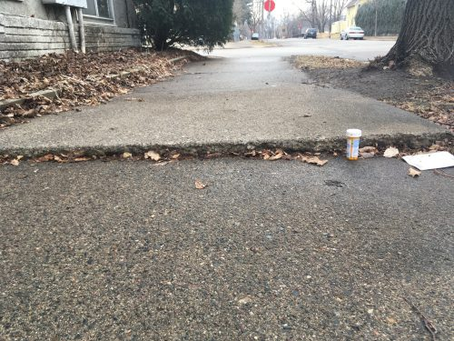



Container Orchestration & Reliability
Design with the belief something will fail at any point

Slide 8
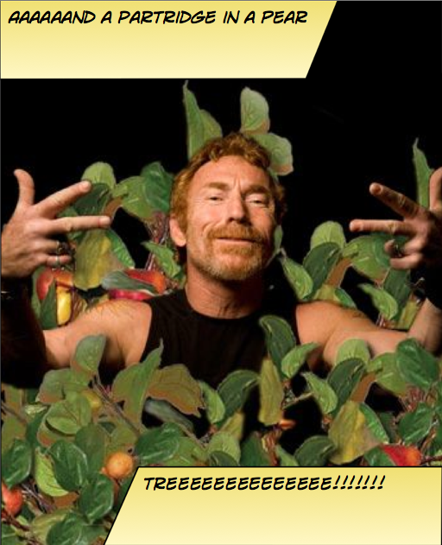
Instancing Multiple Copies
You need:
10 web front ends
8 API instances
4 Redis Cache
1 Database

Slide 9
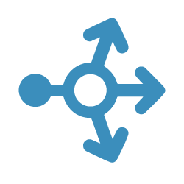
Web
Web
Web
Web
Web
API
API
API
Cache
Cache

Slide 10

Load Balancing & Fault Tolerance
DOCKER_HOST
Docker daemon
Containers
Image Cache
Web
Web
Web
Web
Web
Web
API
Cache
API
API
API
Cache
Cache

Slide 11


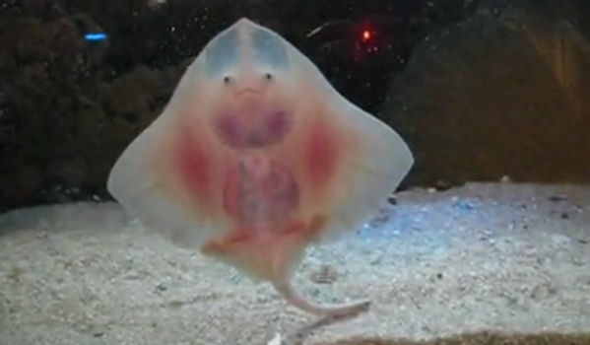
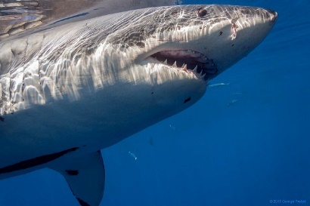
Distribution
DOCKER_HOST
DOCKER_HOST
Docker daemon
Docker daemon
Containers
Image Cache
Containers
Image Cache
Container Scheduling
Container Orchestration
DOCKER_HOST
DOCKER_HOST
DOCKER_HOST
DOCKER_HOST
Docker daemon
Docker daemon
Docker daemon
Docker daemon
Containers
Image Cache
Containers
Image Cache
Containers
Image Cache
Containers
Image Cache
Web
Web
Web
Web
Web
Web
Cache
API
Cache
Web
Web
API
Cache
API
Cache
API
API
API
Cache
Cache

Slide 12
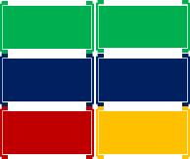
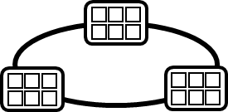


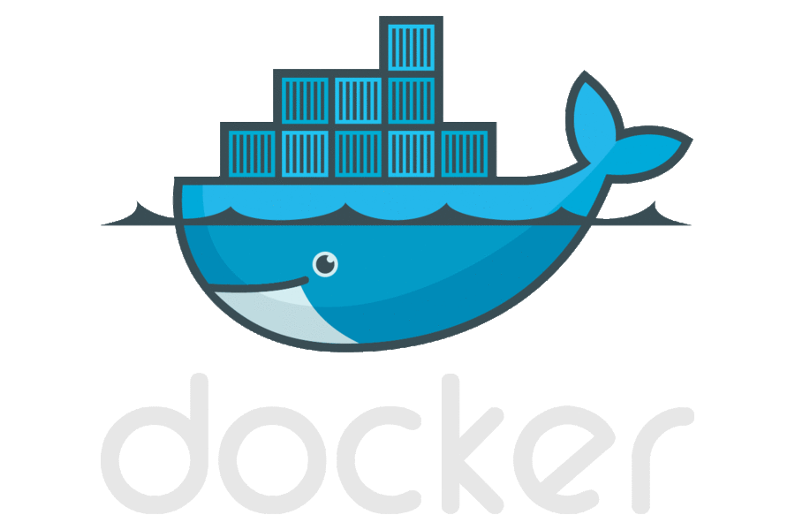
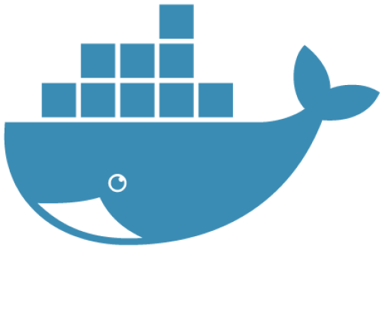

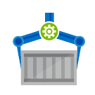

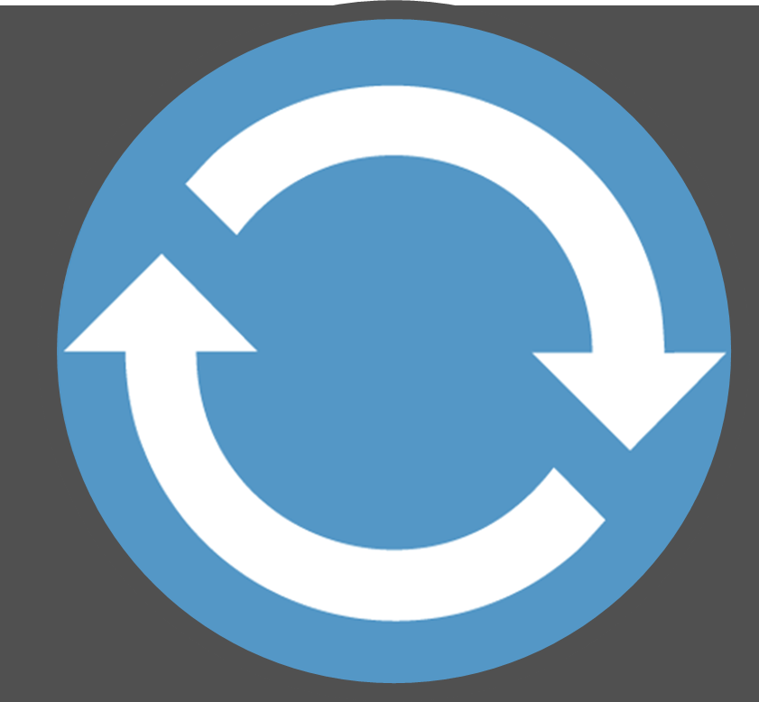
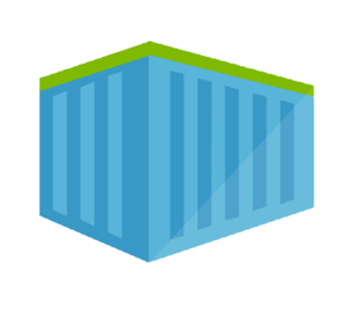
Container DevOps Workflow
Container Service
OS & Framework Patching
What happens when developers stop making code changes?
Run, Manage
Service Fabric
Source Code Control
(SCC)
Build/CI,
Integrate,
Test
CD, Deploy
App Services
Production
environments
coming soon
Base Image Index
…
Docker Hub
Azure Container _Builder*
Azure Container Registry
…
Inner-Loop
…
Run
Monitor and Diagnose
Code
Validate
Debug

Slide 13
Amortizing Costs An evolution, revolution, or circle of service?

Slide 14
– Mainframes
CIRCA 1980

Slide 15
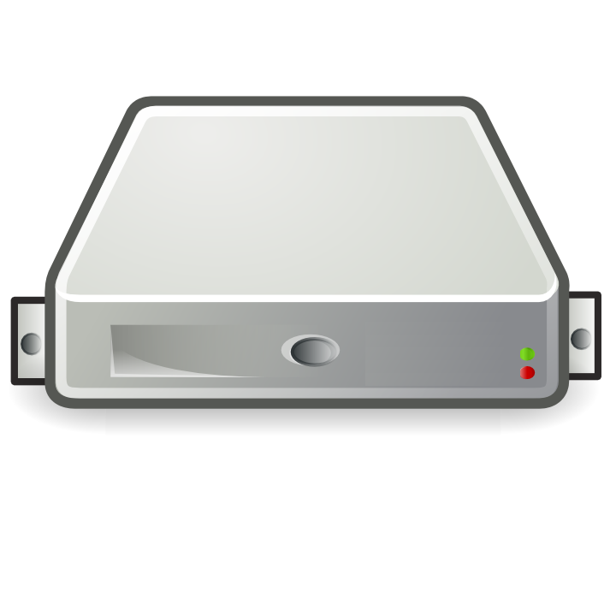
– PC → Server Revolution
CIRCA 1990
$
$
$
$
$
$
$
$
$
$
$
$
$
$
$
$
$
$
$
$
$
$
$
$
$
$
$
$
$
$
$
$
$
$
$
$
$
$
$
$
$
$
$
$
$
$
$
$
$
$
$
$
$
$
$

Slide 16
– Server → VM Evolution
CIRCA 2000
Guest OS #5
Guest OS #6
Guest OS #7
Guest OS #8
Guest OS #5
Guest OS #6
Guest OS #7
Guest OS #8
Guest OS #5
Guest OS #6
Guest OS #7
Guest OS #8
Guest OS #5
Guest OS #6
Guest OS #7
Guest OS #8
Guest OS #5
Guest OS #6
Guest OS #7
Guest OS #8
Guest OS #1
Guest OS #2
Guest OS #3
Guest OS #4
Guest OS #1
Guest OS #2
Guest OS #3
Guest OS #4
Guest OS #1
Guest OS #2
Guest OS #3
Guest OS #4
Guest OS #1
Guest OS #2
Guest OS #3
Guest OS #4
Guest OS #1
Guest OS #2
Guest OS #3
Guest OS #4
Hyper Visor
Hyper Visor
Hyper Visor
Hyper Visor
Hyper Visor
$
$
$
$
$

Slide 17
– VM → Cloud Evolvement
CIRCA 2015
Guest OS #5
Guest OS #6
Guest OS #7
Guest OS #8
Guest OS #5
Guest OS #6
Guest OS #7
Guest OS #8
Guest OS #5
Guest OS #6
Guest OS #7
Guest OS #8
Guest OS #5
Guest OS #6
Guest OS #7
Guest OS #8
Guest OS #5
Guest OS #6
Guest OS #7
Guest OS #8
$
$
$
$
$
$
$
$
$
$
$
$
$
$
$
$
$
$
$
$
Guest OS #1
Guest OS #2
Guest OS #3
Guest OS #4
Guest OS #1
Guest OS #2
Guest OS #3
Guest OS #4
Guest OS #1
Guest OS #2
Guest OS #3
Guest OS #4
Guest OS #1
Guest OS #2
Guest OS #3
Guest OS #4
Guest OS #1
Guest OS #2
Guest OS #3
Guest OS #4
$
$
$
$
$
$
$
$
$
$
$
$
$
$
$
$
$
$
$
$
Hyper Visor
Hyper Visor
Hyper Visor
Hyper Visor
Hyper Visor

Slide 18
Distributed, Scalable Mainframe
– Cloud → Containerization
CIRCA 2015
Guest OS #2
Guest OS #2
Guest OS #2
Guest OS #2
Guest OS #2
$
$
$
$
$
Guest OS #1
Guest OS #2
Guest OS #3
Guest OS #4
Guest OS #1
Guest OS #2
Guest OS #3
Guest OS #4
Guest OS #1
Guest OS #2
Guest OS #3
Guest OS #4
Guest OS #1
Guest OS #2
Guest OS #3
Guest OS #4
Guest OS #1
Guest OS #2
Guest OS #3
Guest OS #4
$
$
$
$
$
Hyper Visor
Hyper Visor
Hyper Visor
Hyper Visor
Hyper Visor

Slide 19
Tagging Best Practices
Base Images
Deployed Images
:latest
:1.0
:1.1.1.1
:2.0
:2.2.1
Always Unique
Stable Tags create instability

Slide 20
Distribution
Build web:1.0
Container Scheduling
Container Orchestration
DOCKER_HOST
DOCKER_HOST
DOCKER_HOST
DOCKER_HOST
Docker daemon
Docker daemon
Docker daemon
Docker daemon
Containers
Image Cache
Containers
Image Cache
Containers
Image Cache
Containers
Image Cache
Web
Web
Web
Web
Web
Web
Cache
API
Cache
Web
Web
API
Cache
API
Cache
API
API
API
Cache
Cache

Slide 21
Stable Tags Create Instability
Build
ACR
Deploy
Run
web:1.0 = manifest a
web:1.0 = manifest a
web:1.0
Orchestrator
web:1.0 = manifest a
Web
web:1.0 = manifest b
web:1.0 = manifest b
web:1.0 = manifest a
Web
web:1.0 = manifest a
web:1.0
Web
web:1.0 = manifest a
Web
web:1.0 = manifest b
Web

Slide 22
Unique Tags Create Stability
Build
ACR
Deploy
Run
web:111
web:111
web:111
Orchestrator
web:111
web:1114
Web
web:111
web:1112
web:1112
web:1114
Web
web:111
web:1113
web:1113
web:1114
web:111
Web
web:111
web:1114
web:1114
web:1114
web:1114
Web
web:111
web:1114
Web

Slide 23
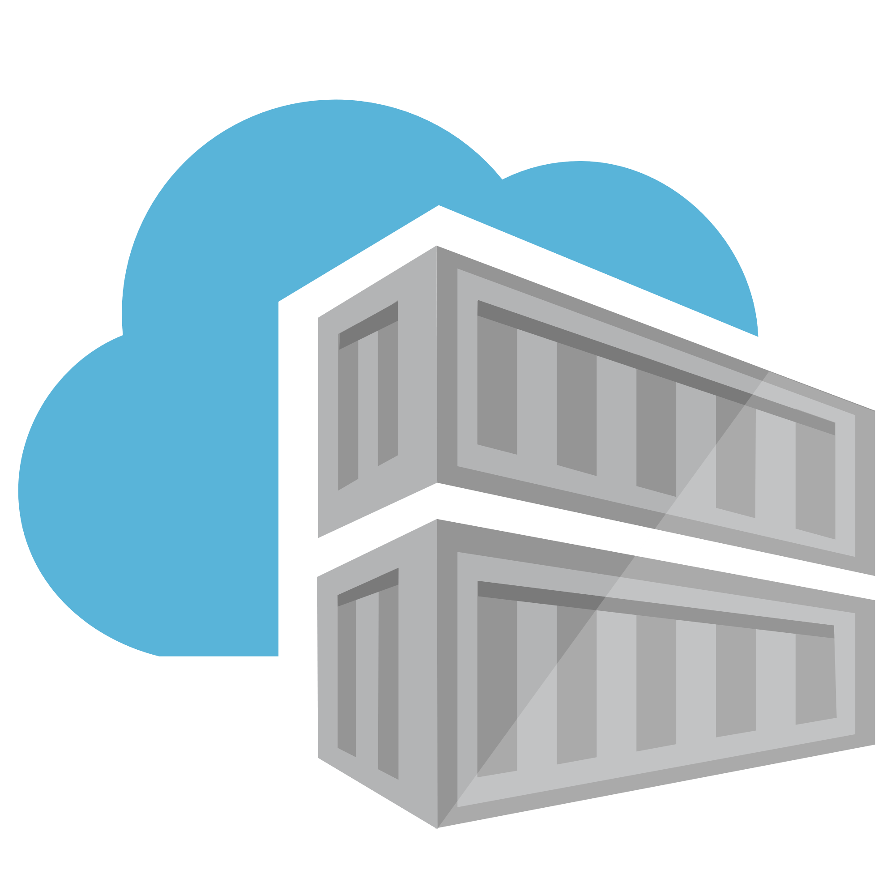

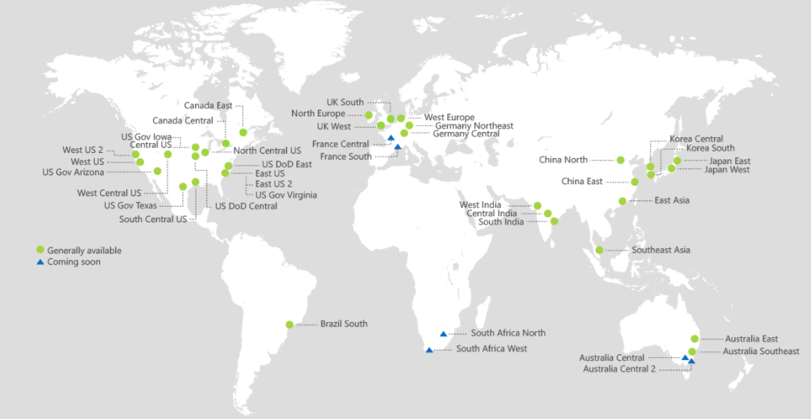
ACR Geo-replication
Mange your global/local deployments as one resource

Slide 24


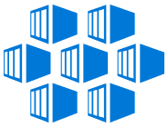
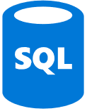

Push Built Images
docker push contosowestus.azurecr.io/web:1234
docker push contosowesteurope.azurecr.io/web:1234
Nodes Pull Images
docker pull contosowestus.azurecr.io/web:1234
docker pull contosowesteurope.azurecr.io/web:1234
Pulls are local, network-close, fast, reliable
Pulls are remote, across the public internet, slower, less reliable
Have network egress fees
Pulls are remote, across the public internet, slower, less reliable
Have network egress fees
West Europe
Canada Central
West US
East US
Developers must push images to n registries, requiring separate management and configuration

Slide 25

Push Built Images
docker push contoso.azurecr.io/web:1234
ACR Syncs Image Blobs
Regional Web Hooks fire for local deployments
Nodes Pull Images
docker pull contoso.azurecr.io/web:1234
Geo-replicate a single registry
All regions have a local replica
Geo-replicate a single registry
All regions have a local replica
West Europe
Canada Central
West US
East US
Each registry is pulling from a local, network close, reliable registry

Slide 26
Azure Container Registry
Providing a single registry across the globe
aka.ms/ACR
aka.ms/ACR/Docs
aka.ms/ACR/Geo-replication
aka.ms/ACR/Roadmap

