Slide 1
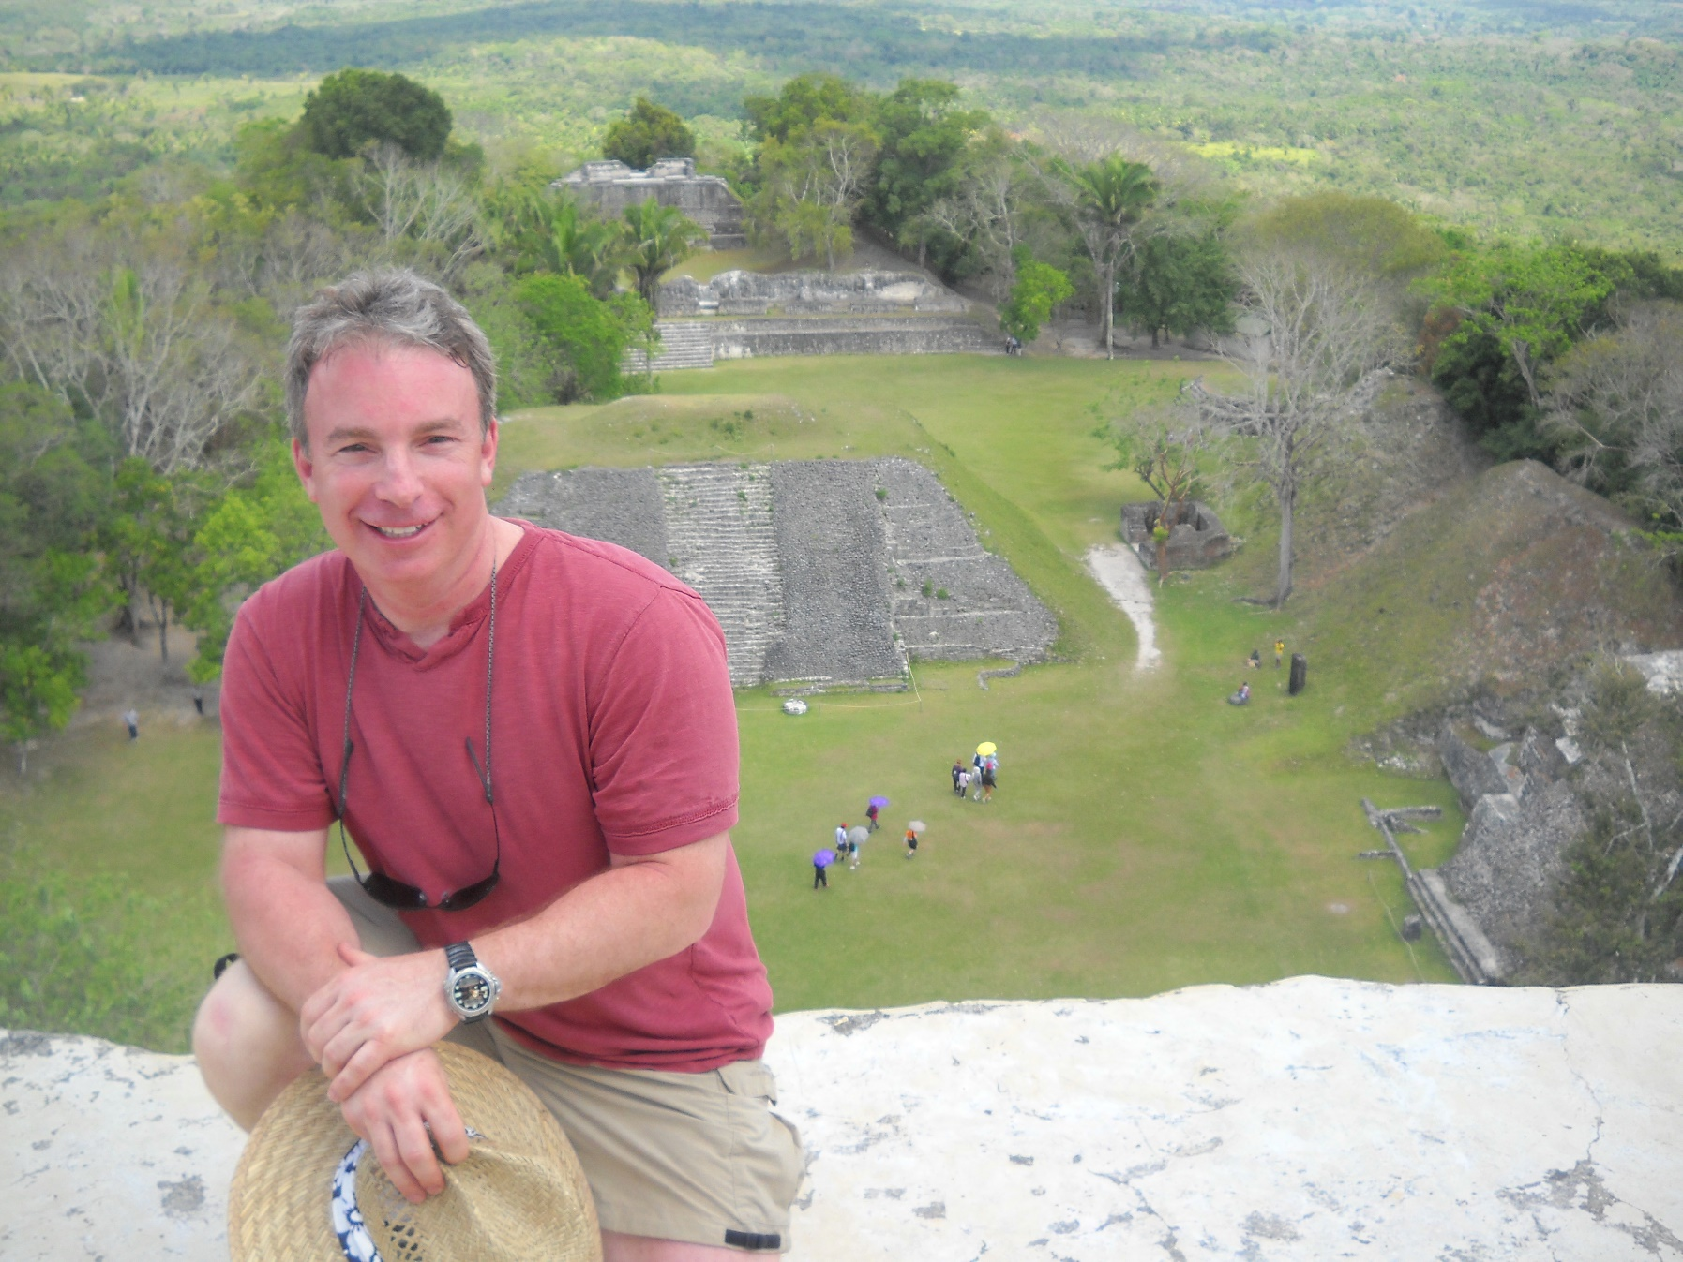

Workflows for Developing Containerized Applications
Steve Lasker
Program Manager
Microsoft Azure Developer Experiences

Slide 2



Container Workflow
Test
SCC
Registry
Docker-compose
Test.env
CI
Docker-compose.yml
Base Image
Staging
Dockerfile
Build
Docker-compose
Push
Compiled Code
Integration
Client
Stag.env
Int.env
Write/Edit
Docker build
Production
Debug
Docker-compose up
Docker-compose
Docker push
Tests
Run
Prod.env
Local Development Environment

Slide 3


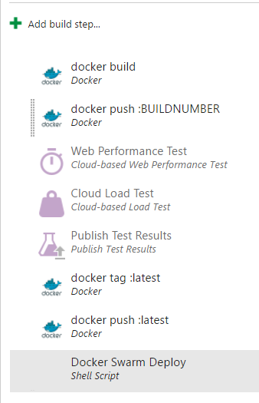
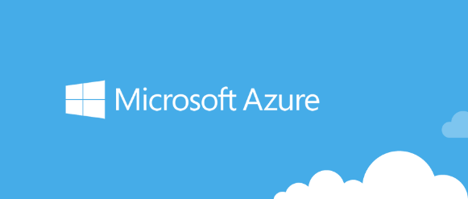





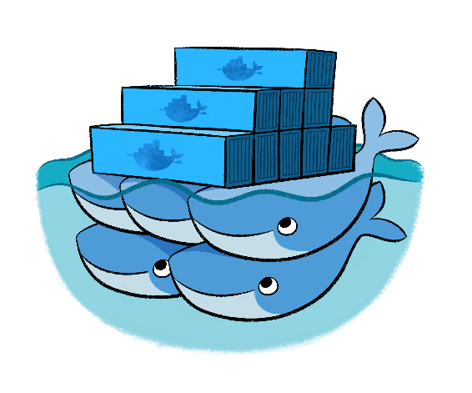


Todays Session Demo…
Visual Studio Team Services
Azure Container Service
Docker Data Center
Visual Studio Code
for mac
Web
API
.NET Core

Slide 5
Container Workflow
Test
SCC
Registry
Docker-compose
Test.env
CI
Docker-compose.yml
Base Image
Staging
Dockerfile
Build
Docker-compose
Push
Compiled Code
Integration
Client
Stag.env
Int.env
Write/Edit
Docker build
Production
Debug
Docker-compose up
Docker-compose
Docker push
Tests
Run
Prod.env
Local Development Environment

Slide 6









public registry
VM Scale Sets
Azure Container Service
Azure Hosted Docker Private Registry
.NET Core
Test
Visual Studio Team Services
Azure Hosted Private Registry*
Source Code Control
Build
Continuous Integration
3rd Party Integration:
Azure Container Service
Staging
VSTS Build Agents w/ Docker
Orchestration & Scheduling - Marathon / Docker Swarm
Visual Studio
Integration
ASP.NET
In Container Development
Edit & Refresh
Breakpoint Debugging
Production
Debug
Write/Edit
Run
Visual Studio Code
Docker Language Services
Docker Scaffolding w/yo docker

Slide 7


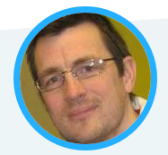
Tools
Azure.com/Tools
aka.ms/yodocker
aka.ms/DockerToolsForVS
aka.ms/DockerToolsForVSCode
aka.ms/DockerToolsForVSTS
Services
aka.ms/AzureContainerService
aka.ms/WindowsContainers
Presentation/Demos
github.com/SteveLasker/Presentations
github.com/SteveLasker/Polyglot...
github.com/SteveLasker/WorksOnMyMachine
github.com/SteveLasker/DotNetCoreMultiService
Other Sessions
Windows Server and Docker - The Internals Behind Bringing Docker and Containers to Windows 5:20pm - 6:05pm Ballroom 6C
Tuesday Keynote – Microsoft & Docker 9:00am – 10:30am
It Takes an Ecosystem to Build a Production Application Tuesday 3:55pm – 4:40pm Ballroom 6A
Steve Lasker
@SteveLasker
blogs.msdn.com/SteveLasker
Steve.Lasker@Microsoft.com

