Slide 1

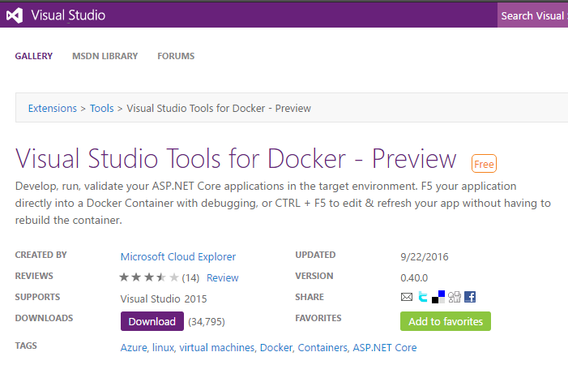
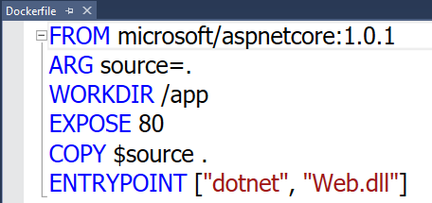
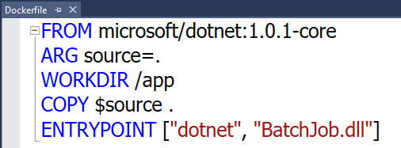

Visual Studio Docker Tools
Run, Debug, Test Web & Console apps in docker containers
Linux today, Windows Server & Nano Server coming soon
F5 Debugging
Edit & Refresh of code
Scaffolds docker assets
Dockerfile, docker-compose.yml
aka.ms/DockerToolsForVS

