Slide 1







OCI Artifact Registries
Leveraging OCI Distribution for new Cloud Native Artifacts
The journey of adding Helm Repos to ACR…
Steve Lasker
Program Manager
Azure Container Registries
Steve.Lasker@Microsoft.com
@SteveLasker
SteveLasker.blog
github.com/SteveLasker
github.com/SteveLasker/presentations
#REJEKTS2019

Slide 2
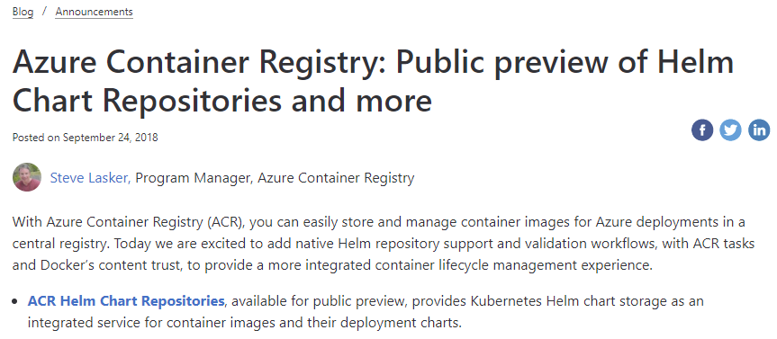





Adding Helm Repos to Azure Container Registry
http://aka.ms/acr/helm-repos
HELM 2
ACR Sprawl…
HELM 3 with OCI Artifacts
$ az acr cnab ...
$ az acr singularity ...
$ az acr msix ...
$ az acr terraform ...
$ az acr opa ...
$ az login
$ az acr helm repo add -r $registry
$ helm package ./wordpress
$ az acr helm push wordpress-5.7.tgz
$ helm fetch $registry/wordpress --version ..
$ helm registry login $registry -u $user -p $pwd
$ helm chart save wordpress/ $registry/wordpress:5.7
$ helm chart push $registry/wordpress:5.7
$ helm chart pull $registry/wordpress:5.7

Slide 3
WIFM ^{[wiff-em]}
W hat’s
I n it
F or
M e
https://www.urbandictionary.com/define.php?term=WIFM

Slide 4




You have a thing. Where will you store your thing?
YASS?
cache
<-> REST
Thing
Notes:
You’re already building the thing, and all the experiences around the thing
What do you do for storage?
Build yet another storage solution (YASS)?
Leverage an existing solution?

Slide 5
Running A Storage Thing
VNET & Firewall Rules?
Documentation?
Authentication
What will you use?
Will it integrate with the rest of “the platform”
Security
How do you prevent hacks, DOS attacks, abuse?
Costs
Will you justify the costs to run the YASS?
Will you charge, offer for free- your YASS?
Multiple clouds?
Will other cloud vendors host this YASS for you?
Compliance
cache
<-> REST
Regional Replication?
Signing?

Slide 6
What it takes to run a storage thing
~10 engineers - full time
Support
Compliance
Regional Rollouts
Feature Asks
Patching & Mediation of CVE Events
{ [] } Devs

Slide 7






Managed Versions Of YASS → YAPS
Notes:
Will each cloud run a managed instance of your YASS Thing?
What does it take to convince each vendor to host your YASS Thing?
Does a customer have to run your YASS Thing in their environment?

Slide 8
OCI Registries
Feature/Instance | OCI Registry | YASS Thing
REST API for meta data
Layered/Cache for large artifacts
Blob storage
√
√
√
√
√
√
Cloud & Vendor Implementations (acr, ecr, gcr, quay, …)
Feature/Instance | OCI Registry | YASS Thing
Integrated Authenticated Access
Role Based Access Control (RBAC)
Compliance
Support
Documentation
Added Capabilities VNET & Firewall Rules, Signing, Auto Purge, Geo-Replicated
√
√
√
√
√
√
√
√
√
√
√
√
√
√
√
√
√
√

Slide 9
Tailored Experience For Your Thing

Slide 10

thing login
thing push
thing pull
thing do
thing info
YASS - Thing
{…}
OCI Artifact Registry
thing login demo42.azurecr.io -u $user -p $pwd
thing push demo42.azurecr.io/marketing/campaign/thingthang:1.0 ./thingthang
thing pull demo42.azurecr.io/marketing/campaign/thingthang:1.0
thing do demo42.azurecr.io/marketing/campaign/thingthang:1.0

Slide 11
How Are Images Stored in OCI Registries

Slide 12




Docker Pull Flow
demo42.azurecr.io
docker pull demo42.azurecr.io/hello-world:latest
1. Pull
<-> REST
cache
2. Manifest Returned
3. Delta Layer Requests
Manifests
Pull:
I want this “thing”,
Manifest:
What layers do I already have?
Manifest:
List of layer ID’s representing the entire thing
hello-world:latest
Image Cache
IMAGE ID REPOSITORY TAG SIZE
4. Layer URLs Returned
Wordpress-chart:5
5. Layer Request
hpctest:1
694950fbcb3f hello-world latest 1.2 GB
Layers Please:
Layers
6. Layers Returned
Layer Cache
LAYER ID
cf4ecb49238476635f551fe11987ae4c3
e41864ee12411ff073f0a58417cf7e160
sha256:cf4ecb49238476635f551fe11987ae4c3
85bef57c324acc96f7067488d35b7e3c1
sha256:e41864ee12411ff073f0a58417cf7e160
sha256:85bef57c324acc96f7067488d35b7e3c1

Slide 13
Dissecting an OCI Image
demo42.azurecr.io
<-> REST
cache
OCI Image: an ordinal collection of layers, where each layer overlays the previous contents
Manifests
hello-world:latest
Image Manifest
{
"schemaVersion": 2,
"mediaType": "application/vnd.oci.image.manifest.v1+json",
"config": {
"mediaType": "application/vnd.oci.image.config.v1+json",
"size": 16078,
"digest": "sha256:bd698aa18aa02a2f083292b9448130a3afaa9a3e5fba24fc0aef7845c336b8ad"
},
"layers": [
{
"mediaType": "application/vnd.oci.image.layer.v1.tar+gzip",
"size": 23133155,
"digest": "sha256:9a1a13172ed974323f7c35153e8b23b8fa1c85355b6b26cc3127e640e45ef0aa"
},
{
"mediaType": "application/vnd.oci.image.layer.v1.tar+gzip",
"size": 226,
"digest": "sha256:5094d5d656a95c6aa92f5f2adc56a794564b1e340bc4065db2947d7ce0c1a394"
}
]
}
Wordpress-chart:5
Contest Addressable Manifest
Describes the collection of layers
hpctest:1
<-> REST
Image Manifest
Layers
Config
cf4ecb49238476635f551fe11987ae4c3
e41864ee12411ff073f0a58417cf7e160
Layers[]
85bef57c324acc96f7067488d35b7e3c1
Layers – Blob Storage
GET demo42.azurecr.io/v2/hello-world/blobs/sha256:9a1a1…
Layer A
Layer href="https://managedteststore3.blob.core.windows.net/75a9eeebd1942155-7b07d607ec09477b99f12fc13fb77342-662c16123e//docker/registry/v2/blobs/sha256/75/75a9eeebd194.../data?se=2019-05-01T19%3A22%3A00Z&amp;sig=vw7v2SVhGjtievmBs7....GGxdcoCg%3D&amp;sp=r&amp;sr=b&amp;sv=2016-05-31&amp;regid=7b07d607...77342"
Layer: each layer is a tarball of the files
Layer B
Layer …

Slide 14
<-> REST
Image Index
An optional collection of manifests
Manifests[]
Platform
Image Index
{
"schemaVersion": 2,
"mediaType": "application/vnd.oci.image.index.v1+json",
"manifests": [
{
"mediaType": "application/vnd.oci.image.manifest.v1+json",
"size": 4288,
"digest": "sha256:10b995d6204131069af3e4f00dc1d3758d5...",
"platform": {
"architecture": "amd64",
"os": "linux"
}
},
{
"mediaType": "application/vnd.oci.image.manifest.v1+json",
"size": 4288,
"digest": "sha256:33c5d954c76495826126178ded2113d1ada0a...",
"platform": {
"architecture": " amd64 ",
"os": “windows"
"platform": {
"architecture": "amd64",
"os": "linux"
"platform": {
"architecture": “amd64",
"os": “windows"
<-> REST
Image Manifest
<-> REST
Image Manifest
Config
Config
Layers[]
Layers[]
Layers – Blob Storage
Layers – Blob Storage
Layer A
Layer A
Layer B
Layer B
Layer …
Layer …

Slide 15
Images to Artifacts
demo42.azurecr.io
<-> REST
cache
Manifests
hello-world:latest
Wordpress-chart:5
hpctest:1
<-> REST
Image Manifest
Artifact Manifest
Layers
Config
cf4ecb49238476635f551fe11987ae4c3
e41864ee12411ff073f0a58417cf7e160
Layers[]
85bef57c324acc96f7067488d35b7e3c1
Layers – Blob Storage
Layer A
Layer B
Layer …

Slide 16

Understanding the Artifact Type
Registries shall know the type they store
Vulnerability scanning products must know what they’re scanning
Registries may provide options, based on the type
Client tooling must know what they’re pulling – so they don’t fail
demo42.azurecr.io
<-> REST
helm update demo42.azurecr.io/charts/wordpress:5.7
docker run demo42.azurecr.io/charts/wordpress:5.7

Slide 17
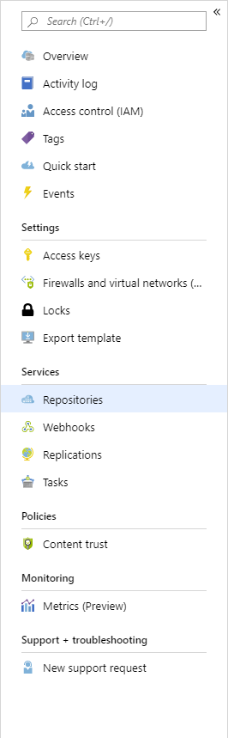
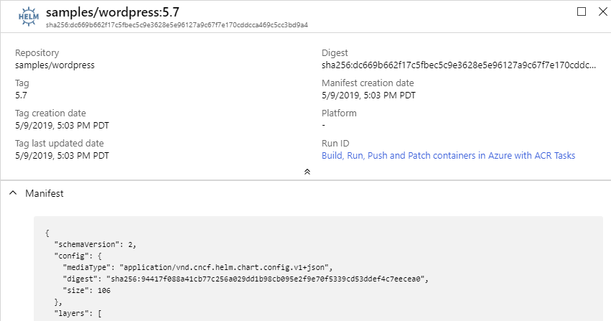
Type: Helm
repo/image:tag
How a registry knows it’s type

Slide 18
Differentiating Artifact Types
demo42.azurecr.io
<-> REST
manifest.config.mediaType Defines the Artifact Type
Manifests
hello-world:latest
Image Manifest
{
"schemaVersion": 2,
"mediaType": "application/vnd.oci.image.manifest.v1+json",
"config": {
"mediaType": "application/vnd.oci.image.config.v1+json",
"size": 16078,
"digest": "sha256:bd698aa18aa02a2f083292b9448130a3afaa9a3e5fba24fc0aef7845c336b8ad"
},
"layers": [
{
"mediaType": "application/vnd.oci.image.layer.v1.tar+gzip",
"size": 23133155,
"digest": "sha256:9a1a13172ed974323f7c35153e8b23b8fa1c85355b6b26cc3127e640e45ef0aa"
},
{
"mediaType": "application/vnd.oci.image.layer.v1.tar+gzip",
"size": 226,
"digest": "sha256:5094d5d656a95c6aa92f5f2adc56a794564b1e340bc4065db2947d7ce0c1a394"
}
]
}
Wordpress-chart:5
hpctest:1
<-> REST
Image Manifest
Layers
Config
cf4ecb49238476635f551fe11987ae4c3
e41864ee12411ff073f0a58417cf7e160
Layers[]
85bef57c324acc96f7067488d35b7e3c1
Layers – Blob Storage
Layer A
Layer B
Layer …

Slide 19
Different Artifact Types
"application/vnd.docker.container.image.v1+json"
"application/vnd.oci.image.config.v1+json"
"application/vnd.cncf.helm.chart.config.v1+json"
"application/vnd.sylabs.sif.config.v1+json"
"application/vnd.cncf.openpolicyagent.config.v1+json"
Image Artifact Manifest
{
"schemaVersion": 2,
"mediaType": "application/vnd.oci.image.manifest.v1+json",
"config": {
"mediaType": "application/vnd.oci.image.config.v1+json",
"size": 16078,
"digest": "sha256:bd698aa18aa02a2f083292b9448130a3afaa9a3e5fba24fc0aef7845c336b8ad"
},
"layers": [
"mediaType": "application/vnd.docker.container.image.v1+json",
"mediaType": "application/vnd.cncf.helm.chart.config.v1+json",
"mediaType": "application/vnd.sylabs.sif.config.v1+json",
"mediaType": "application/vnd.cncf.openpolicyagent.config.v1+json",

Slide 20
Why Config?
Started with artifactType – too impacting to existing OCI tooling
Minimal change to existing OCI compliant tooling
Enables artifact configuration data
The config object, can be null
Image Artifact Manifest
{
"schemaVersion": 2,
"mediaType": "application/vnd.oci.image.manifest.v1+json",
"artifactType": "application/vnd.cncf.helm.chart",
"config": {
"mediaType": "application/vnd.oci.image.config.v1+json",
"size": 16078,
"digest": "sha256:bd698aa18aa02a2f083292b9448130a3afaa9a3e5fba24fc0aef7845c336b8ad"
},
"layers": [

Slide 21
Lets Make A New Thing

Slide 22
Docs in Markdown dim.exe
Storing docs as an object I can retrieve for offline usage
dim login demo42.azurecr.io -u $user -p $pwd
dim push demo42.azurecr.io/thingthang:1.0 ./thingthang
Pushes a directory of docs to a registry, naming it as thingthang:1.0
dim pull demo42.azurecr.io/thingthang:1.0 ./myDocs/
Pulls a doc set from the registry, expands on disk

Slide 23
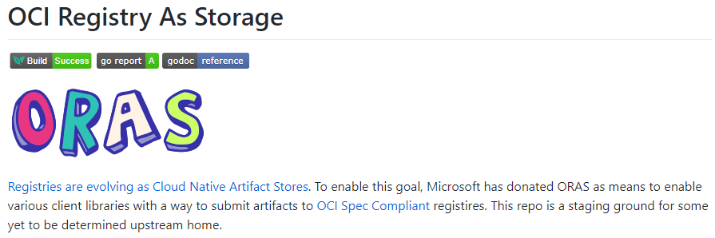
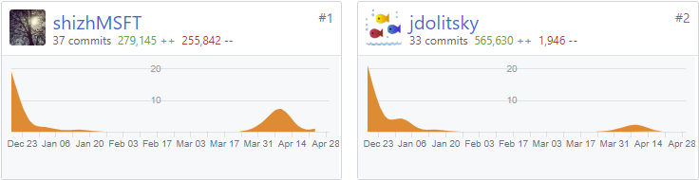
Great: Is there a helper library?
Why, yes there is:
https://github.com/deislabs/oras/
Core Maintainers:

Slide 24
Demo
Pushing & Pulling docs in markdown to an OCI Registry

Slide 25
Demo: Push OCI Image Artifact
ORAS:
$ oras login demo42.azurecr.io -u $user -p $pwd
WARNING! Using –password via the CLI is insecure. Use –password-stdin.
Login Succeeded
$ oras push demo42.azurecr.io/samples/docs-in-markdown:v1 \
./readme.md \
./detail.md
Uploading 767f3c907f24 moredetail.md
Uploading d15f3b9978be readme.md
Pushed demo42.azurecr.io/samples/docs-in-markdown:1
Digest: sha256:a7109494abadf849e0c2cccc2ac870fa837698381d1ec9e57e46d5878918a956

Slide 26
Demo: Push OCI Image Artifact
ORAS:
Artifact Manifest
{
"schemaVersion": 2,
"config": {
"mediaType": "application/vnd.oci.image.config.v1+json",
"digest": "sha256:44136fa355b3678a1146ad16f7e8649e94fb4fc21fe77e8310c060f61caaff8a",
"size": 2
},
"layers": [
{
"mediaType": "application/vnd.oci.image.layer.v1.tar",
"digest": "sha256:d15f3b9978be09aa01e42c806d3daf95ecac58d53df1e9cd472600ae01e0f96b",
"size": 398,
"annotations": {
"org.opencontainers.image.title": "readme.md"
}
},
{
"mediaType": "application/vnd.oci.image.layer.v1.tar",
"digest": "sha256:767f3c907f24e463b263137827dac9ce1882213abec1e8752ce55a8c2ecec2c4",
"size": 149,
"annotations": {
"org.opencontainers.image.title": "moredetail.md"
}
}
]
}
$ oras login demo42.azurecr.io -u $user -p $pwd
WARNING! Using –password via the CLI is insecure. Use –password-stdin.
Login Succeeded
$ oras push demo42.azurecr.io/samples/docs-in-markdown:v1 \
./readme.md \
./detail.md
Uploading 767f3c907f24 moredetail.md
Uploading d15f3b9978be readme.md
Pushed demo42.azurecr.io/samples/docs-in-markdown:1
Digest: sha256:a7109494abadf849e0c2cccc2ac870fa837698381d1ec9e57e46d5878918a956

Slide 27
Demo: Push doc-in-markdown Artifact
ORAS:
Custom manifest-config to represent our unique Artifact Type
Custom manifest-config.mediaType to identify our artifact type
$ oras login demo42.azurecr.io -u $user -p $pwd
WARNING! Using –password via the CLI is insecure. Use –password-stdin.
Login Succeeded
$ oras push demo42.azurecr.io/samples/docs-in-markdown:1 \
--manifest-config ./config.json:application/vnd.stevelasker.docsinmarkdown.config.v1+json \
./readme.md:application/vnd.stevelasker.docsinmarkdown.layer.v1+md \
./detail.tar:application/vnd.stevelasker.docsinmarkdown.layer.v1+tar
Uploading 767f3c907f24 moredetail.tar
Uploading d15f3b9978be readme.md
Pushed demo42.azurecr.io/samples/docs-in-markdown:1
Digest: sha256:f52fbb75a6fe3f291ff2d3c0020851c29a5f614b876bc0a77cb6d4fa80402ae3
Custom layer mediaType to identify our layers

Slide 28
Demo: Push doc-in-markdown Artifact
ORAS:
Artifact Manifest
{
"schemaVersion": 2,
"config": {
"mediaType": "application/vnd.stevelasker.docsinmarkdown.config.v1+json",
"digest": "sha256:44136fa355b3678a1146ad16f7e8649e94fb4fc21fe77e8310c060f61caaff8a",
"size": 2
},
"layers": [
{
"mediaType": "application/vnd.stevelasker.docsinmarkdown.layer.v1+md",
"digest": "sha256:d15f3b9978be09aa01e42c806d3daf95ecac58d53df1e9cd472600ae01e0f96b",
"size": 398,
"annotations": {
"org.opencontainers.image.title": "readme.md"
}
},
{
"mediaType": "application/vnd.stevelasker.docsinmarkdown.layer.v1+tar",
"digest": "sha256:767f3c907f24e463b263137827dac9ce1882213abec1e8752ce55a8c2ecec2c4",
"size": 149,
"annotations": {
"org.opencontainers.image.title": "moredetail.md"
}
}
]
}
$ oras login demo42.azurecr.io -u $user -p $pwd
WARNING! Using –password via the CLI is insecure. Use –password-stdin.
Login Succeeded
$ oras push demo42.azurecr.io/samples/docs-in-markdown:1 \
--manifest-config ./config.json:application/vnd.stevelasker.docsinmarkdown.config.v1+json \
./readme.md:application/vnd.stevelasker.docsinmarkdown.layer.v1+md \
./detail.tar:application/vnd.stevelasker.docsinmarkdown.layer.v1+tar
Uploading 767f3c907f24 moredetail.tar
Uploading d15f3b9978be readme.md
Pushed demo42.azurecr.io/samples/docs-in-markdown:1
Digest: sha256:f52fbb75a6fe3f291ff2d3c0020851c29a5f614b876bc0a77cb6d4fa80402ae3

Slide 29

Surfacing Your mediaType
{
"schemaVersion": 1,
"mediaTypes": [
{
"mediaType": "application/vnd.oci.image.config.v1+json",
"title": "OCI Image",
"description": "OCI Image Format",
"icon": "https://raw.githubusercontent.com/opencontainers/artwork/master/oci/icon/color/oci-icon-color.svg",
"url": "https://www.opencontainers.org/",
"tools": [
{
"title": "OCI Tools",
"url": "https://github.com/opencontainers/runtime-tools"
}
],
"schemaReference": https://raw.githubusercontent.com/opencontainers/image-spec/master/schema/config-schema.json,
"layerMediaTypes": [
{
"mediaType": "application/vnd.oci.image.layer.v1.tar",
"description": "",
"spec": "https://github.com/opencontainers/image-spec/blob/master/layer.md#gzip-media-types"
}
},
{
"mediaType": "application/vnd.cncf.helm.config.v3+json",
"title": "Helm Chart",
"description": "The package manager for Kubernetes",
"icon": "https://raw.githubusercontent.com/helm/helm/master/docs/logos/helm-blue-vector.svg",
"url": "https://helm.sh/",
"tools": [
{
"title": "Helm",
"url": "https://github.com/helm/helm#install"
}
]
}
]
}
mediaTypeMapping.json

Slide 30
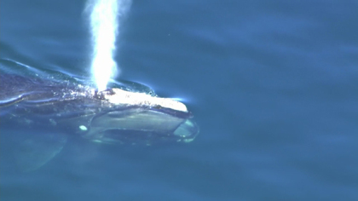
Coming up for air
OCI Registries Can Support New Artifact Types
Leverage What Exists – focus on Your Thing
Declare A New mediaType to uniquely identify Your Thing
Register Artifact mediaTypes with OCI Distribution
Cloud Registries will pickup your new mediaTypes
ORAS library available to ease development, but not required
Follow Best Practices for Image Tagging
OCI Index not yet Artifact Aware – work in progress

Slide 31
Thank You

Slide 32
Getting Involved with OCI Artifact Registries
Getting Started: stevelasker.blog
Authoring OCI Registry Artifacts – Quick Guide
Slack: opencontainers.slack.com #artifact-registry
To Join: chat.opencontainers.org/
ORAS: github/com/deislabs/oras
Docs In Markdown (dim): https://github.com/SteveLasker/dim
Steve Lasker
Program Manager
Azure Container Registries
Steve.Lasker@Microsoft.com
@SteveLasker
SteveLasker.blog
github.com/SteveLasker
github.com/SteveLasker/presentations

Slide 33

Distribution-spec
Implemented as a Registry
Image-spec
{
"manifests": [
{
"mediaType": ,
"platform": {
"architecture":,
{
"config": {
"mediaType": ,
…
},
"layers": [{}]
OPTIONAL
Based on artifactType
Image Index
Image Manifest
manifest.config

Slide 34
Distribution-spec
Implemented as a Registry
Artifacts-spec
Uses manifest and index* to define multiple artifacts
{
"manifests": [
{
"mediaType": ,
"platform": {
"architecture":,
{
"config": {
"mediaType": ,
…
},
"layers": [{}]
OPTIONAL
Based on artifactType
Image Index
Image Manifest
manifest.config
Image-spec : typeOf Artifact
Helm : typeOf Artifact
Singularity : typeOf Artifact

