Slide 1
OCI Artifacts & Collections
OCI Weekly Call 9/30/2020

Slide 2




Wabbit Networks
Docker Hub
ACME Rockets
Artifact Build Environment
5
1
2
Artifact Import
3
Public Registry
Private Registry
Artifact Deployment
Index
Artifact Push
Index
Index
Index
Image
Image
Image
4
Container Host
Image
SBoM
SBoM
SBoM
Image
SBoM
src
src
src
Policy Management
src
Notary v2 Scope
deploy
Interoperability with other projects
An entity authors content
signs their content with their key
Publish to a well-known location
May get certified by the aggregator
Consume the public content into an entity's private registry
Add a verification signature, attesting to its usage in the company
Policy management enforces which keys can be used for deployment, even what registries content can be pulled from
Only after all signatures and policies are verified can the artifact be deployed

Slide 3






Distribution-spec
Implemented as a Registry
Artifacts-spec
Uses manifest and index* to define multiple artifacts
{
"manifests": [
{
"mediaType": ,
"platform": {
"architecture":,
{
"config": {
"mediaType": ,
…
},
"layers": [{}]
Image Index
Image Manifest
Image-spec : typeOf Artifact (Index & Manifest)
CNAB : typeOf Artifact (Index & Manifest)
Helm : typeOf Artifact (Manifest)
Singularity : typeOf Artifact (Manifest)
WASM : typeOf Artifact (Manifest)

Slide 4
Distribution Persistence Types
Individual Types
Collection Types
Container Images
Singularity Images
WASM modules
Helm Charts
Terraform
Azure Resource Manager Templates
AWS Cloud Formation Templates
Multi-arch index
CNAB
Signatures?
Artifacts that reference other artifacts Not “collections” of artifacts, but a collection of references

Slide 5


Reference Types
OCI Artifact
oci.image
OCI Artifact
wordpress:v3.1
notary.v2
3
OCI Artifact
cncf.helm
OCI Artifact
Wabbit-networks
1
wordpress:v3.1
sha256:888m…
oci.image
4
net-monitor:v1
sha256:111m…
OCI Artifact
oci.image
2
OCI Artifact
Mysql:5.7
notary.v2
docker-hub
OCI Artifact
1:1
1:many
many:1
A thing
sha256:---
OCI Artifact
OCI Artifact
notary.v2
A thing
sha256:---
Acme-rockets

Slide 6
Distribution Persistence Types
Individual Types
Reference Types
Collection Types
Container Images
Singularity Images
WASM modules
Signatures
Helm Charts
Terraform Templates
Azure Resource Manager Templates
AWS Cloud Formation Templates
Multi-arch index
CNAB

Slide 7

Collection Types
Collection Reference Types
OCI Artifact
oci.image
OCI Artifact
3
notary.v2
OCI Artifact
wordpress:v3.1
cncf.helm
OCI Artifact
Invocation image
1
wordpress:v3.1
sha256:888m…
CNAB
4
wordpress:v1
sha256:111m…
2
OCI Artifact
oci.image
Mysql:5.7
OCI Artifact
oci.image
OCI Artifact
1:1
1:many
many:1
wordpress:v3.1
A thing
sha256:---
OCI Artifact
A thing
sha256:---

Slide 8
Distribution Persistence Types
Individual Types
Reference Types
Collection Types
Container Images
Singularity Images
WASM modules
Signatures*
Helm Charts
Terraform Templates
Azure Resource Manager Templates
AWS Cloud Formation Templates
CNAB
Multi-arch index
Is a signature an Artifact, or an Attribute of an artifact?

Slide 9
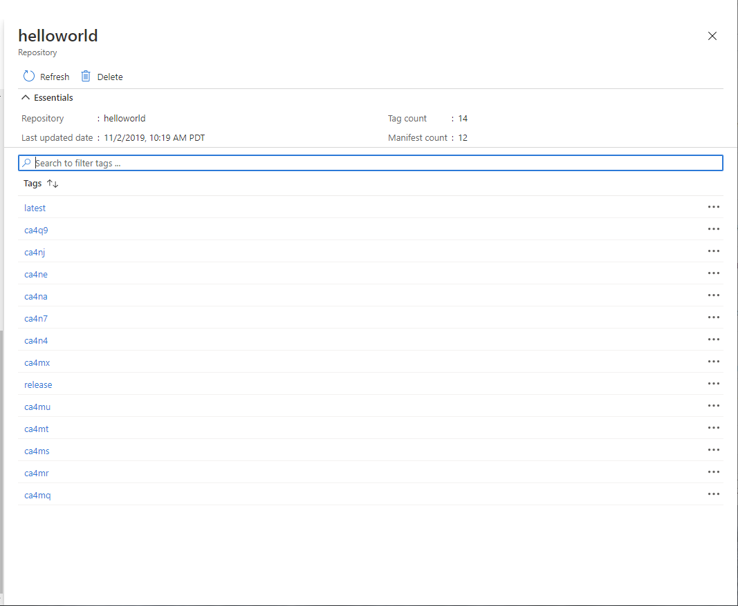
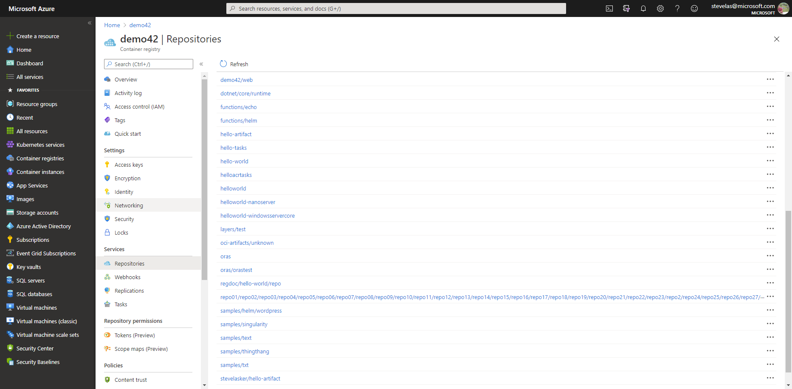

What should be seen?
latest
…
S
B
latest
o
M
ca4na
…
S
B
latest-signature
o
M
ca4nb
…
latest-signature-acme-rockets
…
ca4nc
latest-signature-wabbit-networks
…
ca4nd
ca4na
…
ca4ne
ca4na-signature
…
ca4ng
ca4na-signature-acme-rockets
…
ca4ng
ca4na-signature-wabbit-networks
…
ca4nh
ca4nb
…
ca4nj
ca4nb-signature
…
ca4nk
ca4nb-signature-acme-rockets
…
ca4nm
ca4nb-wabbit-networks

Slide 10
Distribution Persistence – Meta-data Services
Artifacts
Meta-data
Container Images
Singularity Images
WASM modules
Helm Charts
Terraform Templates
Azure Resource Manager Templates
AWS Cloud Formation Templates
CNAB
Signatures
SBoMs
Vulnerability Summaries
Hub –esque Docs/Descriptions
LastTag
TagHistory
PullCount
LastPullDate
ExpirationDate
DeployedTo

Slide 11
Distribution-spec
Implemented as a Registry
Artifacts-spec
Uses manifest and index* to define multiple artifacts
{
"manifests": [
{
"mediaType": ,
"platform": {
"architecture":,
{
"config": {
"mediaType": ,
…
},
"layers": [{}]
{
"config": {
"mediaType": ,
…
},
“blobs": [{}]
“refs": [{}]
Image Index
Image Manifest
Artifact Manifest
Image-spec : typeOf Artifact (Index & Manifest)
CNAB : typeOf Artifact (Index & Manifest)
Helm : typeOf Artifact (Manifest)
Singularity : typeOf Artifact (Manifest)
WASM : typeOf Artifact (Manifest)
S
B
o
M

Slide 12
Root Key

Slide 13

ACME Rockets
mysql:8
mysql:8
Artifact Copy
layer1
layer1
layer2
layer2

Slide 14
ACME Rockets
mysql:8
mysql:8
Artifact Import
Layer1
Artifact Import
Layer1
Layer2
Layer2
wordpress:v5
Layer1
Layer2

Slide 15


ACME Rockets
mysql:8
mysql:8
Layer1
Artifact Import
Layer1
Layer2
Layer2
MySQL signature
MySQL signature
Docker community signature
Docker community signature
ACME Rockets signature
ACME Rockets signature
notary v2 signature
wordpress:v5
config-blob
Layer1
signature-blob
Layer2
Docker community signature

Slide 16

Public Registry
ACME Rockets
wordpress-chart:v5
mysql:8
Helm community signature
Artifact Import
MySQL signature
wordpress:v5
Docker community signature
ACME Rockets signature
Docker community signature
wordpress-chart:v5
mysql:8
Helm community signature
MySQL signature
wordpress:v5
Docker community signature
ACME Rockets signature
Docker community signature

Slide 17

Public Registry
ACME Rockets
mysql:8
wordpress-cnab:v5
Artifact Import
MySQL signature
Helm community signature
Docker community signature
helm-cli:v3
ACME Rockets signature
Helm community signature
wordpress-chart:v5
wordpress-chart:v5
Helm community signature
wordpress:v5
Helm community signature
wordpress:v5
Docker community signature
wordpress-cnab:v5
Docker community signature
mysql:8
Helm community signature
MySQL signature
helm-cli:v3
Docker community signature
Helm community signature
ACME Rockets signature

