Slide 1
Salesforce Metadata Tracking Example for Jenkins
Acumen Solutions
GaRy Hamilton
June 2016

Slide 2
This is a sample GitHub project for Salesforce CI
Overview
The project can be found here:
https://github.com/gary-hamilton/SalesforceDevTrackingExample
Project contains the following:
README.md with notes on how to run it
build.properties with dummy username and password
build.xml with one task: deployCodeCheckOnly
unpackaged folder with package.xml covering generic metadata
SalesforceDevTrackingExample.pptx
Allows quickly creating job to retrieve development metadata

Slide 3
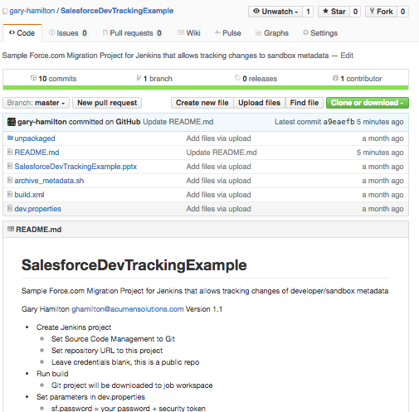
Here is the GitHub project

Slide 4
Before you create the project
Install Apache Ant
Download Force.com Migration Tool
Copy ant-salesforce.jar to /apache-ant-<version>/lib directory
Test sample task from command line: ‘ant retrieveUnpackaged’ will retrieve Apex code and pages
Install Git
Install Jenkins
Make sure that the Jenkins user has permission to access any files and folders you create
You may want to run your dev version of Jenkins under your user id

Slide 5
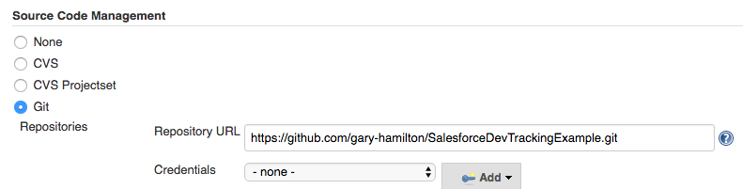
Create the Jenkins project
Point GitHub to sample repository
No credentials required for public repo

Slide 6
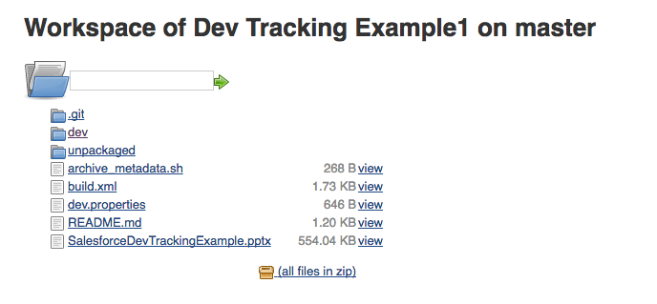
Click “Build Now to download repo into workspace

Slide 7
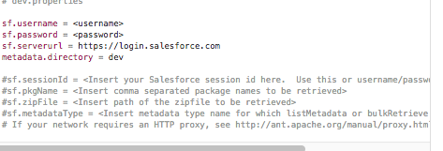
Update dev.properties parameters

Slide 8
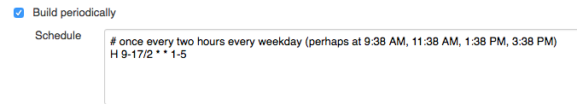
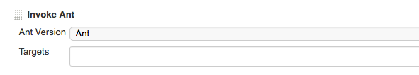
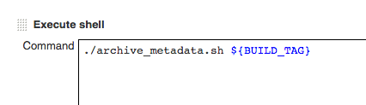

Modify the project and test build
Schedule job
Leave blank for defaults or set Ant parameters:
-Dsf.serverurl=test.salesforce.com -Dsf.username=<username> -Dsf.password=<password + security token>
Sample shell script commits changes to local git repo
Run job to test

Slide 9
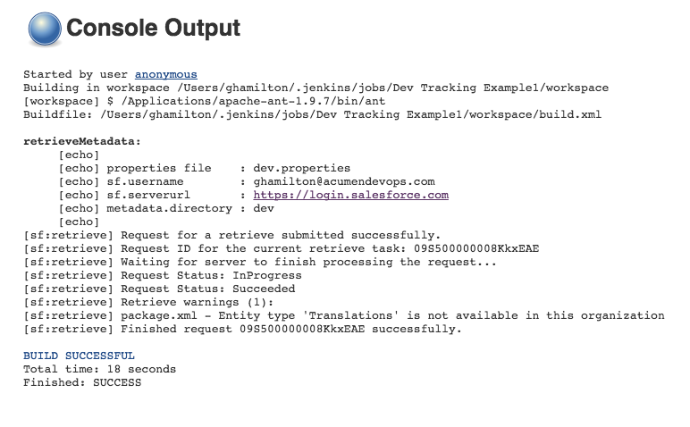
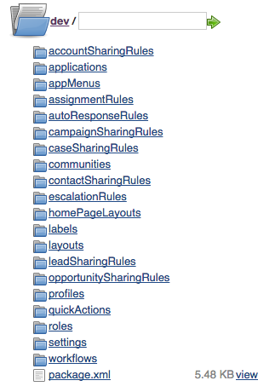
Review Console Output and Workspace

