Slide 1
Salesforce Metadata Tracking Example for Jenkins
Acumen Solutions
GaRy Hamilton
June 2016

Slide 2
1: Create .properties file for each Salesforce org
# dev.properties
# dev.properties is default, prefix with org name: dev.properties, uat.properties, etc.
# org information
sf.username = <username>
sf.password = <password+securitytoken>
sf.serverurl = https://test.salesforce.com
# metadata folder
metadata.directory = dev

Slide 3
2: Customize build.xml template
<project name="Sample Salesforce Ant tasks for multiple orgs" default="retrieveMetadata" basedir="." xmlns:sf="antlib:com.salesforce">
<property environment="env"/>
<condition property="sf.org" value="dev"> <not> <isset property="sf.org"/> </not> </condition>
<property file="${sf.org}.properties"/>
<!-- Setting default value for username, password and session id properties to empty string
so unset values are treated as empty. Without this, ant expressions such as ${sf.username}
will be treated literally.
-->
<condition property="sf.username" value=""> <not> <isset property="sf.username"/> </not> </condition>
<condition property="sf.password" value=""> <not> <isset property="sf.password"/> </not> </condition>
<condition property="sf.sessionId" value=""> <not> <isset property="sf.sessionId"/> </not> </condition>
<taskdef resource="com/salesforce/antlib.xml" uri="antlib:com.salesforce">
<classpath>
<pathelement location="../ant-salesforce.jar" />
</classpath>
</taskdef>
Continued…

Slide 4
2: (Continued) Customize build.xml template
<!-- Retrieve metadata from org -->
<target name="retrieveMetadata">
<echo>
properties file : ${sf.org}.properties
sf.username : ${sf.username}
sf.serverurl : ${sf.serverurl}
metadata.directory : ${metadata.directory}
</echo>
<mkdir dir="${metadata.directory}"/>
<delete includeEmptyDirs="true"> <fileset dir="${metadata.directory}" includes="**/*"/> </delete>
<sf:retrieve username="${sf.username}" password="${sf.password}"
sessionId="${sf.sessionId}" serverurl="${sf.serverurl}"
maxPoll="500" pollWaitMillis="10000" retrieveTarget="${metadata.directory}"
unpackaged="unpackaged/package.xml"/>
</target>
</project>

Slide 5
3: Create git shell script archive_metadata.sh
#!/bin/bash
# check if git is initialized
ls .git > /dev/null
if [ $? != 0 ] ; then
git init
fi
FIRST_ARGUMENT="$1"
echo "Build: $FIRST_ARGUMENT"
echo "git add *"
git add *
echo "git commit -a -m \"$FIRST_ARGUMENT\""
git commit -a -m "$FIRST_ARGUMENT"
git tag $FIRST_ARGUMENT

Slide 6

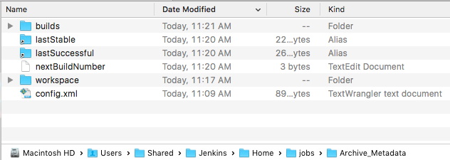
4: Create empty Jenkins and run to create workspace

Slide 7
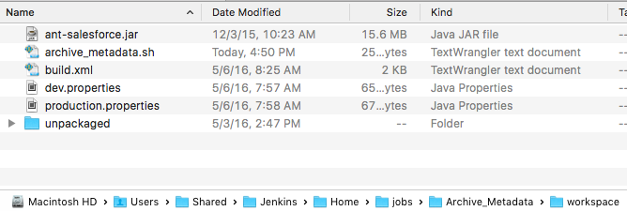
5: Copy files to job workspace

Slide 8
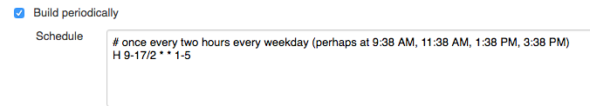
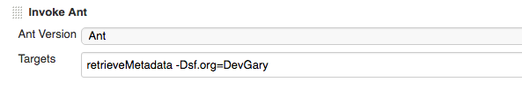
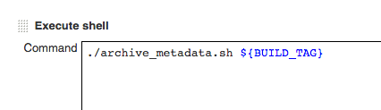
6: Configure Jenkins archive project

Slide 9
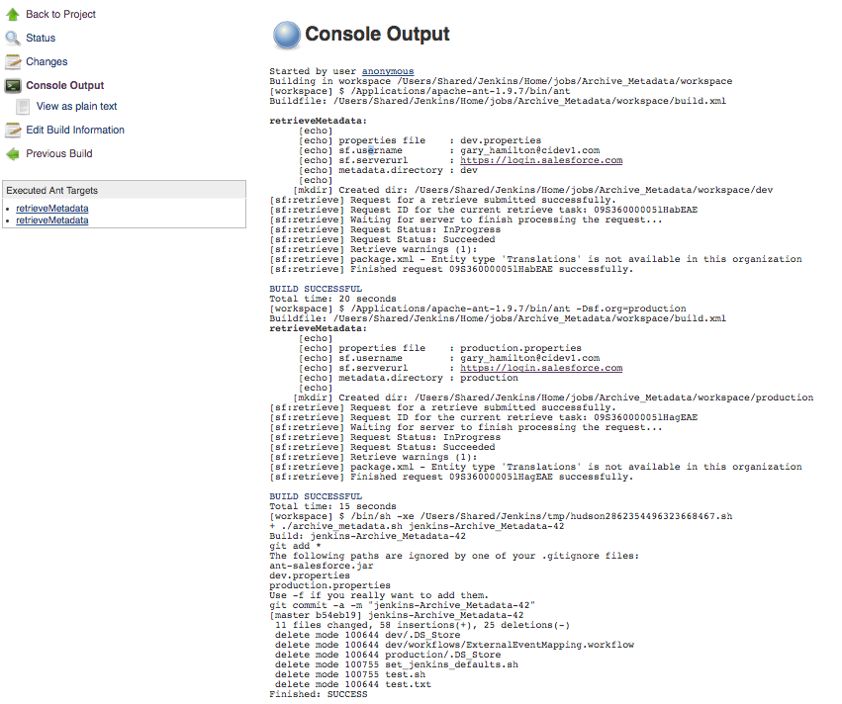
7: Test Jenkins archive project

