Slide 1

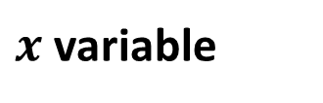
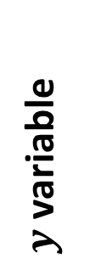

$y$ variable
$$y=0$$
$$x=0$$
$x$ variable

Slide 2



${y=β}_{0}+ β_{1}∙x$ (line)
$y$ variable
$β_{1}$ (slope)
$β_{0}$ (intercept)
$$y=0$$
$$x=0$$
$x$ variable

Slide 3
Residual
Square of residual
$y$ variable
$$y=0$$
$$x=0$$
$x$ variable

Slide 4
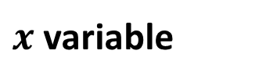
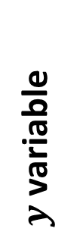


$y$ variable
$β_{0}$ (intercept)
$$x=0$$
$x$ variable

Slide 5



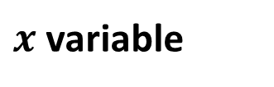

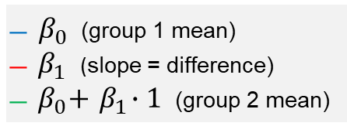

${y=β}_{0}+ β_{1}∙x$ (line)
$y$ variable
$β_{1}$ (slope)
$$β_{0}$$
$$y=0$$
̶ $β_{0}$ (group 1 mean)
̶ ${ β}_{1}$ (slope = difference)
̶ ${ β}_{0}+{ β}_{1}∙1$ (group 2 mean)
$$x=0$$
$$x=1$$
$x$ variable

Slide 6

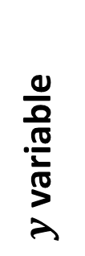
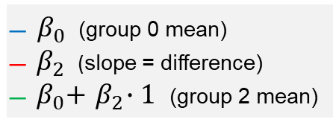

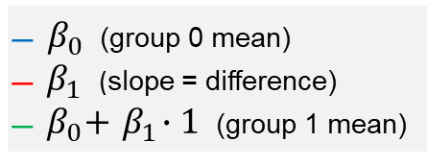



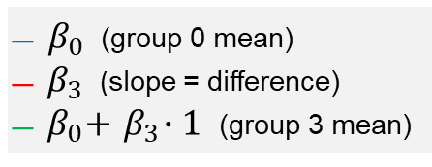
Group A
Group B
Group A
Group C
Group 0
Group 3
$y$ variable
$β_{1}$ (slope)
$$β_{2}$$
$$β_{0}$$
$$β_{3}$$
$$y=0$$
x₁ , x₂ , x₃ = 0
x₁ = 1
x₁ , x₂ , x₃ = 0
x₂ = 1
x₁ , x₂ , x₃ = 0
x₃ = 1
Group 1 dummy
Group 2 dummy
Group 3 dummy
̶ $β_{0}$ (group 0 mean)
̶ ${ β}_{1}$ (slope = difference)
̶ ${ β}_{0}+{ β}_{1}∙1$ (group 1 mean)
̶ $β_{0}$ (group 0 mean)
̶ ${ β}_{2}$ (slope = difference)
̶ ${ β}_{0}+{ β}_{2}∙1$ (group 2 mean)
̶ $β_{0}$ (group 0 mean)
̶ ${ β}_{3}$ (slope = difference)
̶ ${ β}_{0}+{ β}_{3}∙1$ (group 3 mean)

Slide 7

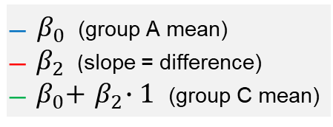
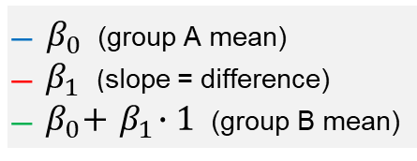
Group A
Group B
Group A
Group C
$y$ variable
$β_{1}$ (slope)
$$β_{2}$$
$$β_{0}$$
$$y=0$$
x₁ and x₂ = 0
x₁ = 1
x₁ and x₂ = 0
x₂ = 1
Group B dummy (x₁)
Group C dummy (x₂)
̶ $β_{0}$ (group A mean)
̶ ${ β}_{1}$ (slope = difference)
̶ ${ β}_{0}+{ β}_{1}∙1$ (group B mean)
̶ $β_{0}$ (group A mean)
̶ ${ β}_{2}$ (slope = difference)
̶ ${ β}_{0}+{ β}_{2}∙1$ (group C mean)

Slide 8
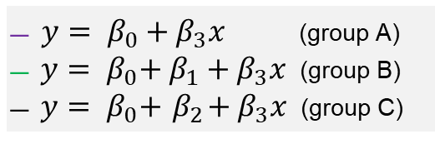





Group C
Group B
Group A
$y$ variable (value)
$$β_{2}$$
$$β_{1}$$
$β_{3}$ (slope)
$$β_{0}$$
$$y=0$$
̶ ${y= β}_{0}+β_{3}x$ (group A)
̶ ${ y= β}_{0}+$ $β_{1}+β_{3}x$ (group B)
̶ ${ y= β}_{0}+{ β}_{2}+β_{3}x$ (group C)
x variable (age)

