Slide 1
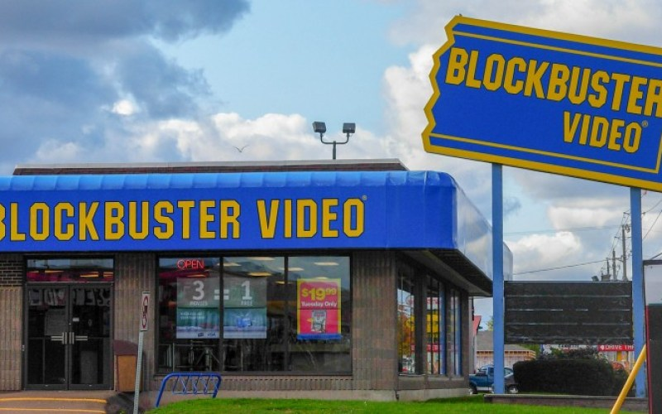
Rockbuster Stealth: Report
Analysis for 2020 Online Launch
and Business Strategy
R
R

Slide 2
Objectives
Motivations
Rockbuster Stealth LLC used to have stores around the world. However, the company is now taking a more online based approach. Facing stiff competition from Netflix and Amazon, plans to use its existing movie licenses to launch an online video rental service in order to stay competitive.
We need to know where our strengths lie, in order to properly compete in the online jungle.
Which movies contributed the most/least to revenue gain?
What was the average rental duration for all videos?
Which countries are Rockbuster customers based in?
Where are customers with a high lifetime value based in?
Do sales figures vary between geographic regions?

Slide 3
Rockbuster Business Overview
Average
Rental Rate
$2.98
Average
Customer Spend
$4.20
Average
Rental Duration
5 Days
Customers in
597 Cities
Total Films
1,000
Total Customers
599
Customers in
108 Countries
Total Genres
16
Total Revenue
$61,312

Slide 4
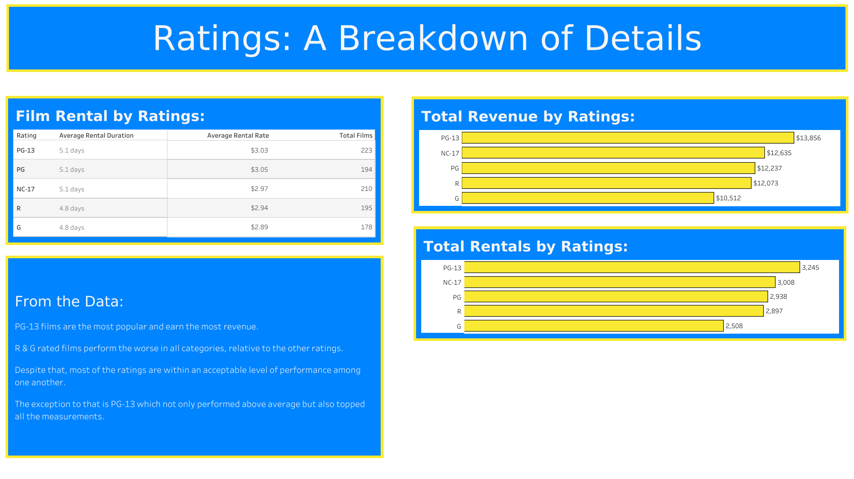



Slide 5
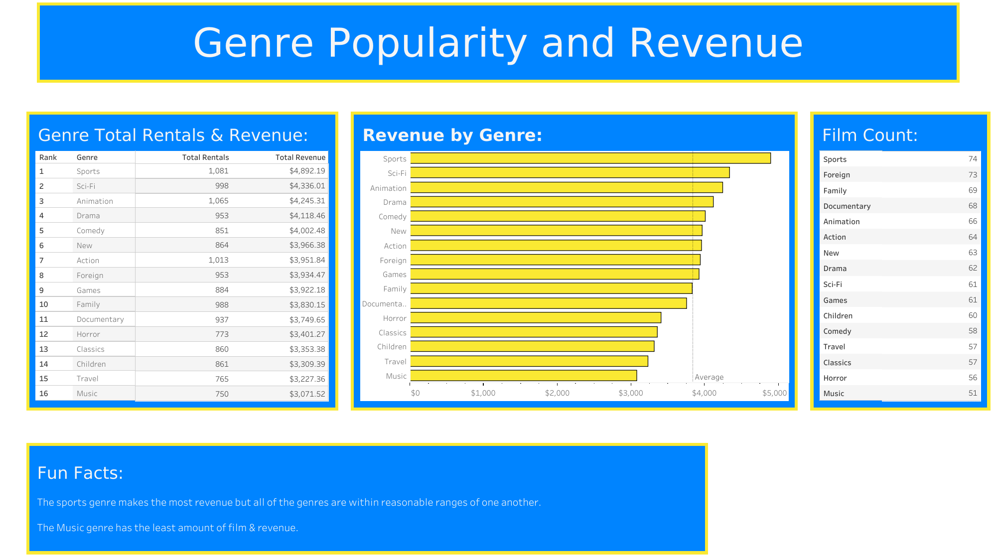


Slide 6
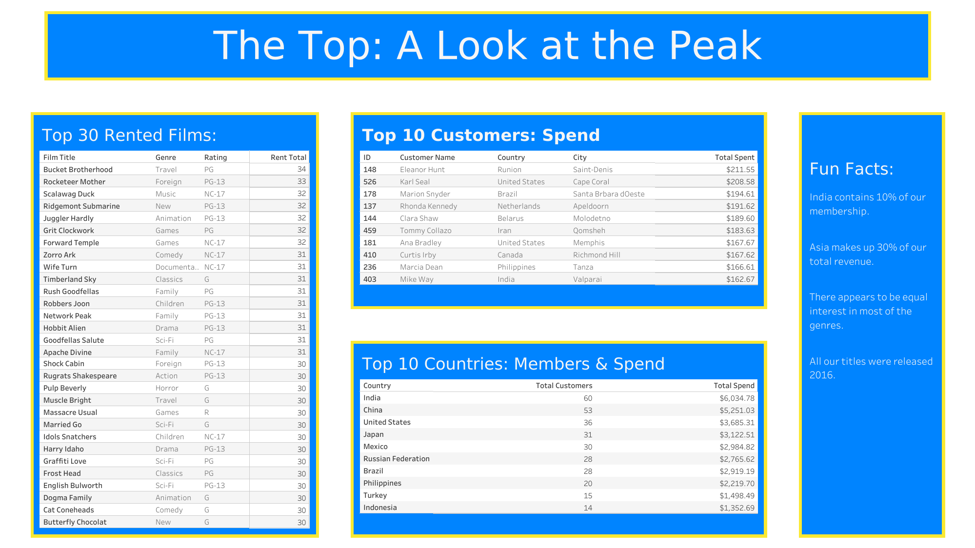

Slide 7
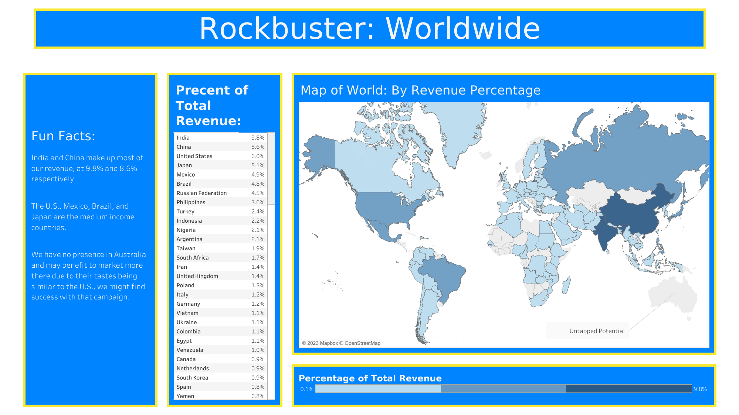

Slide 8
Conclusions & Recommendations
PG-13 Rated Films and the Sport genre contributed the most to revenue.
G Rated films and the Music genre contributed the least.
Sales figures vary by region, with the continent of Asia contributing most to our revenue. We can prioritize this region to continue our growth.
While there were highs and lows, most of the genres contributed similarly to our revenue. The following genres performed above average, so it would be ideal to extend them within our library: Sports, Sci-Fi, Animation, Drama, Comedy, New, Action, Foreign, & Games.
There is an opportunity to grow by advertising to the Australian continent.
We may grow in popularity if we extend beyond films released in 2006.

Slide 9
Thank You For Your Time
All Visualizations Available on Tableau Public: Click Here

