Slide 1
SQL Server Performance Tuning for Developers
Presented by
Steve Stedman
http://SteveStedman.com
Follow me on Twitter @SqlEmt

Slide 2
Presenter: Steve Stedman
DBA/Consultant/Trainer/Speaker/Writer
Been using SQL Server since 1990
Taught SQL Server classes at WWU
SQL Server consultant
Author of the only book on Common Table Expressions
Working at Emergency Reporting
Volunteer Firefighter and EMT
http://SteveStedman.com for more information.
http://SteveStedman.com
Follow me on Twitter @SqlEmt

Slide 3
Overview
Is Tuning Necessary for the Developer
Understanding Tables and Indexes
Understanding Execution Plans
Statistics IO and TIME
Understanding Table Size
Procedure Cache and Parameterization
Seven Deadly Sins
Tips For Writing Queries

Slide 4
Objectives
To provide the tools and knowledge to developers so that they can create the best performing queries.
Everyone usually has the best intentions, but that’s not enough anymore.

Slide 5
Is Tuning Necessary for the Developer
Remember your reputation will follow you.
YES if you want to write sustainable code.
You don’t want to be known as the developer that cost the company 3 years of development time to undo their mess.
YES if you don’t have a DBA.

Slide 6
But that’s the job of the DBA
True… part of the job of the DBA is to clean up the messes made by developers.
DBA’s also like to gripe and complain about those who cause the most trouble.
2 types of developer TSQL code from the DBA perspective:
The problem code
The code that they never have to deal with
Wouldn’t it be better to be the developer that the DBA never uses as the example or their excuse.
“Sorry, but I can’t do my job because Joe Developer messed up the database.”

Slide 7
Understanding Tables and Indexes
Heap – table with no clustered index
Rows are organized as they are inserted
Non Clustered Indexes
Traditional indexing – a separate structure that contains pointers to the data. Can include extra data – included columns
Clustered Indexes
The base table structure on disk and in memory is based on the structure of the index
Covered Indexes
Returns the query result from an index without accessing the table
Indexed Views – To Do

Slide 8
Other Indexing – Not Covered In This
Filtered Indexes – not covered in this presentation. Too many restrictions.
XML Indexes – not covered in this presentation.

Slide 9
Index Example
I need 4 volunteers
Heap
Clustered Index
Non Clustered Index
Covering Index
Notes:
use AdventureWorks2012;
go
SELECT
PhoneNumber,
concat(LastName, ', ', FirstName, ' ', MiddleName),
ROW_NUMBER() OVER (ORDER BY Lastname, FirstName, MiddleName, PhoneNumber ASC) as RowNum
FROM person.Person p
INNER JOIN person.personphone pp ON p.BusinessEntityID = pp.BusinessEntityID
where PhoneNumber like '9%'
AND len(concat(LastName, ', ', FirstName, ' ', MiddleName)) < 30
and len(concat(LastName, ', ', FirstName, ' ', MiddleName)) > 12
--order by newid() asc;
--order by Lastname, FirstName, MiddleName, PhoneNumber;
order by PhoneNumber;

Slide 10
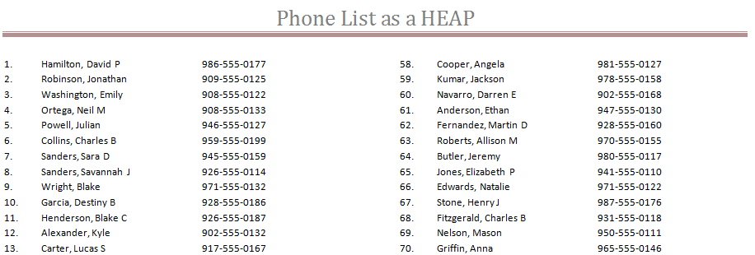
HEAP
Find the phone number for David P Hamilton.
Find the phone number for all David P Hamilton’s.
Find the phone number for Haley L Butler.
Hint: Page 6 line 646

Slide 11
HEAP
SELECT PhoneNumber FROM PhoneTable WHERE Name = ‘Hamilton, David P’
Search row by row, for every row on every page
Full Table Scan

Slide 12
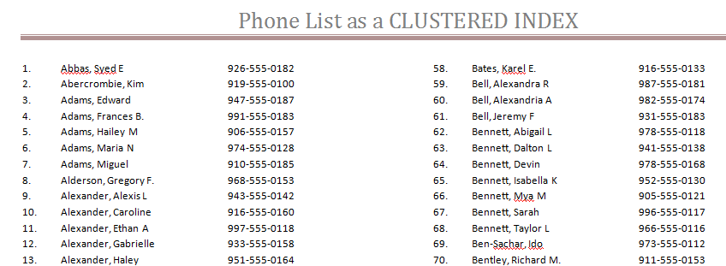
CLUSTERED INDEX
Clustered by Name
Find the phone number for all people named David P Hamilton.
Line 315

Slide 13
CLUSTERED INDEX
SELECT PhoneNumber FROM PhoneTable WHERE Name = ‘Hamilton, David P’
Find Hamilton, alphabetically and get them all.
Clustered Index Seek
Much faster than the full table scan
How about this one:
SELECT PhoneNumber FROM PhoneTable WHERE Name = ‘%ton, David P’

Slide 14
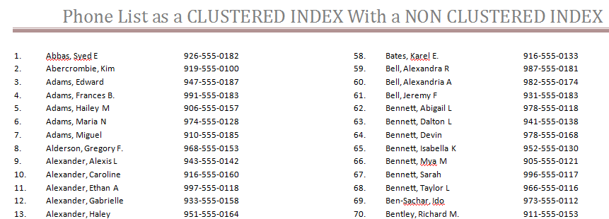
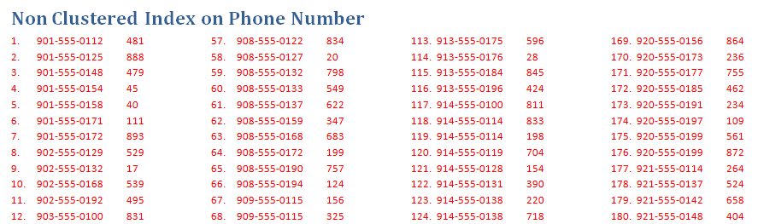
CLUSTERED w/ NONCLUSTERED INDEX
Find all names with a phone number of 901-555-0112
First Find 901-555-0112 in the non clustered index
Look up row 481 in the clustered index

Slide 15
CLUSTERED w/ NONCLUSTERED INDEX
SELECT Name
FROM PhoneTable WHERE Phone = ‘901-555-0112’
Index Seek (NonClustered), Index Seek Clustered.
Row 1, top left of page 9, followed by row 481, left middle of page 5.

Slide 16
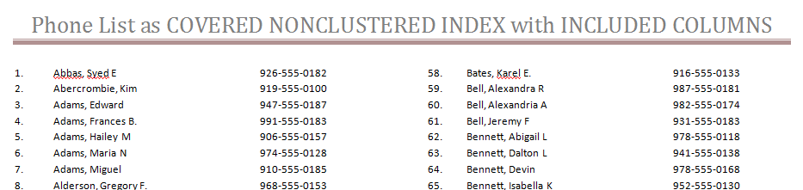
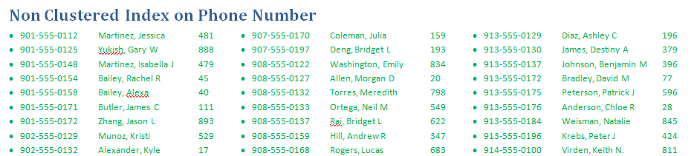
COVERING INDEX
Find all names with a phone number of 901-555-0112
Find 901-555-0112 in the non clustered index, and you are done

Slide 17
COVERING INDEX
SELECT Name
FROM PhoneTable WHERE Phone = ‘901-555-0112’
Find 901-555-0112 in the non-clustered index, and notice that the name your are looking for is included.
Index Seek (NonClustered).
Row 1, top left of page 9.

Slide 18
Index Type Summary
Heap
Clustered Index
Non Clustered Index
Covering Index

Slide 19
Index Waste
Duplicate Indexes
Exact Duplicate vs Partial Duplicates
Excess duplicate indexes slow down inserts and updates with no added value
May slow down the query optimizer
Unused Indexes
These are indexes that have never been used in a query
Why?
They are indexing on columns that aren't being queries?
There is a better index, or duplicate index that is being used instead
Slows down inserts and updates

Slide 20
Duplicate Indexes – Waste Example
Sample of Duplicates
Table People
Index1: Column1 and Column2
Index2: Column1
Index3: Column1, Column2, Column3
See Database Health Reports
Available at http://DatabaseHealth.com
More of a DBA tool, but useful for developers also.

Slide 21
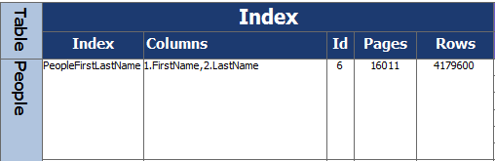
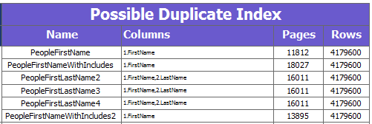
SQL Server Health Reports
Possible Duplicate Index Report

Slide 22
Unused Indexes – Example
SELECT iv.table_name, i.name AS index_name,
iv.seeks + iv.scans + iv.lookups AS total_accesses,
iv.seeks, iv.scans, iv.lookups, t.IndexType, t.IndexSizeMB
FROM (SELECT i.object_id, Object_name(i.object_id) AS table_name,
i.index_id, SUM(i.user_seeks) AS seeks, SUM(i.user_scans) AS scans, SUM(i.user_lookups) AS lookups
FROM sys.tables t
INNER JOIN sys.dm_db_index_usage_stats i ON t.object_id = i.object_id
GROUP BY i.object_id, i.index_id) AS iv
INNER JOIN sys.indexes i ON iv.object_id = i.object_id AND iv.index_id = i.index_id
INNER JOIN (SELECT sys_schemas.name AS SchemaName ,sys_objects.name AS TableName
,sys_indexes.name AS IndexName ,sys_indexes.type_desc AS IndexType ,CAST(partition_stats.used_page_count * 8 / 1024.00 AS Decimal(10,3))AS IndexSizeMB
FROM sys.dm_db_partition_stats partition_stats
INNER JOIN sys.indexes sys_indexes ON partition_stats.[object_id] = sys_indexes.[object_id] AND partition_stats.index_id = sys_indexes.index_id AND sys_indexes.type_desc <> 'HEAP'
INNER JOIN sys.objects sys_objects ON sys_objects.[object_id] = partition_stats.[object_id]
INNER JOIN sys.schemas sys_schemas ON sys_objects.[schema_id] = sys_schemas.[schema_id] AND sys_schemas.name <> 'SYS'
) AS t ON t.IndexName = i.name AND t.TableName = iv.table_name
WHERE --t.IndexSizeMB > 200 and
iv.seeks + iv.scans + iv.lookups = 0
ORDER BY total_accesses asc ;
Yes, its ugly, but it gets the job done. Just copy and paste.

Slide 23
Index Waste – Real World Example
Developer learned just enough about indexes to be dangerous.
Developer created a script to create thousands of indexes. This impacted every table and every Foreign Key or likely column to be queried against.
Developer then wrote middle tier code to scan the database for tables and indexes to generate code to access the database based on the indexes.
This code generation process then locked the database structure so that new indexes couldn’t be easily added and bad indexes couldn’t be removed without breaking the middle tier code.
Result was many unused indexes, many duplicate indexes, and lots of wasted time, money and database resources.

Slide 24
Up Next
Understanding Execution Plans

Slide 25
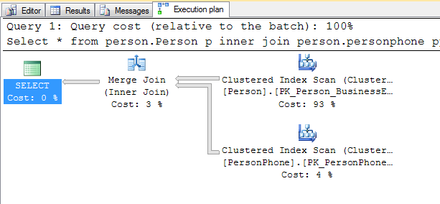
Understanding Execution Plans
Execution plan describes the data retrieval and storage methods used by the Query Optimizer to execute a specific query.
Understanding how it was executed will help you understand if you can make it faster.
To active CTRL+M or Menu
XML and Graphical
Reading Graphical
Use the zoom menu
Zoom around button +
Use the tool tips
Don’t trust the SSMS Missing Index suggestion… Verify.

Slide 26
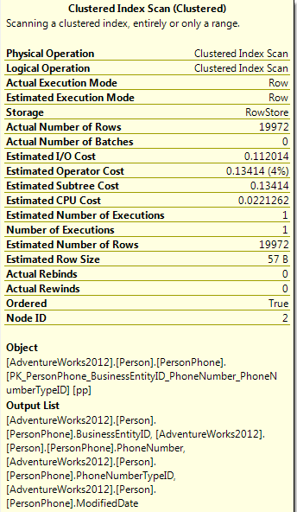
Actual vs. Estimated Execution Plans
Actual
Produced without running the query
Displays estimated data only
Can save time and resources
Can’t be used if the query creates objects it needs to use: i.e. temp table
Not always accurate, can be misleading
Estimated
Displayed after the query is run
Includes estimates and actual values

Slide 27
Execution Plans
Good = Fast
Bad = Slow
Key Lookup (clustered)
Clustered Index Seek
Index Seek
Clustered Index Scan
Index Scan
Many more…
Clustered Index Update
Table Scan (heap)
RID Lookup (heap)
Many more…

Slide 28
Execution Plans DEMO
Select *
from person.Person p
inner join person.personphone pp on p.BusinessEntityID = pp.BusinessEntityID;
SELECT FirstName, MiddleName, LastName, PhoneNumber
FROM person.Person p
INNER JOIN person.personphone pp ON p.BusinessEntityID = pp.BusinessEntityID;
SELECT FirstName, MiddleName, LastName, PhoneNumber
FROM person.Person p
INNER JOIN person.personphone pp on p.BusinessEntityID = pp.BusinessEntityID
WHERE FirstName = 'Alexandra'
AND MiddleName = 'E'
AND LastName = 'Washington‘;
Select FirstName, MiddleName, LastName, PhoneNumber
from person.Person p
inner join person.personphone pp on p.BusinessEntityID = pp.BusinessEntityID
where FirstName like 'Alexandra'
and MiddleName like 'E'
and LastName like 'Washington';
Select FirstName, MiddleName, LastName, PhoneNumber
from person.Person p
inner join person.personphone pp on p.BusinessEntityID = pp.BusinessEntityID
where FirstName like 'Alexa%'
and MiddleName like 'E'
and LastName like 'Wash%‘;
Select FirstName, MiddleName, LastName, PhoneNumber
from person.Person p
inner join person.personphone pp on p.BusinessEntityID = pp.BusinessEntityID
where FirstName like 'Alexandra'
and MiddleName like 'E'
and LastName like '%ington';

Slide 29
Up Next
STATISTICS IO
And
STATISTICS TIME

Slide 30
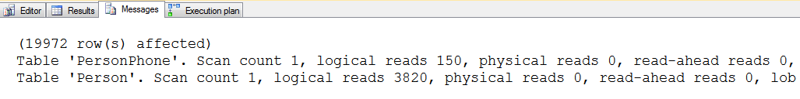
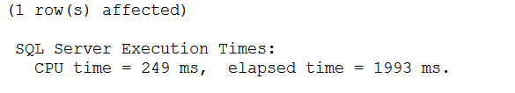
Statistics IO and TIME
SET STATISTICS IO ON
Scan Count
Logical Reads
Physical Reads
…
SET STATISTICS TIME ON
CPU time is time used by CPU resources to complete a task (parse, compile or execute)
Elapsed time is the total time took by a task from start to its end

Slide 31
Statistics IO and TIME Demo
SET STATISTICS IO ON;
SELECT FirstName, MiddleName, LastName, PhoneNumber
FROM person.Person p
INNER JOIN person.personphone pp on p.BusinessEntityID = pp.BusinessEntityID;
SET STATISTICS IO OFF;
SET STATISTICS TIME ON;
SELECT FirstName, MiddleName, LastName, PhoneNumber
FROM person.Person p
INNER JOIN person.personphone pp on p.BusinessEntityID = pp.BusinessEntityID;
SET STATISTICS TIME OFF;

Slide 32
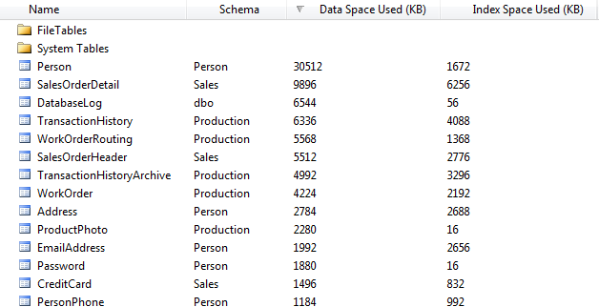
Understanding Table Size
How big is that table?
F7 to get the Object Explorer

Slide 33
Procedure Cache and Parameterization
The procedure cache caches more than just procedures, it also caches parsed queries.
Performance tuning the Procedure Cache reduces waste on the SQL Server.
You don’t have control over the size of the procedure cache, but you do have control over how it is used.
Reuse in the procedure cache allows queries and procedures to run faster.
Tuning is accomplished by a number of methods:
Using Parameterized Queries.
Removing temp tables from Procedures.
Implementing database Coding Standards.

Slide 34
Procedure Cache and Parameters Example

Slide 35
Seven Deadly Sins
Poor or No Database Design
Where to begin…
Index Design Issues
Too Many or Too Few, or just wrong
RBAR instead of Sets
Cursors in SQL Server are very different than Oracle
Not using explicit column lists
Avoid SELECT *
Calculations in the WHERE Clause
User Defined Functions and Inline Functions
Dirty Reads
WITH (NOLOCK), READ UNCOMMITTED
Believing Moore’s Law Will Save You
I don’t need to write fast queries, the hardware will catch up

Slide 36
Sin 1: Poor or No Database Design
No Primary Key
Not Foreign Keys
No Indexes
UniqueIdentifiers for Primary Keys
It might work fine in your development environment, but as soon as the database fills up with data, it’s a whole other story

Slide 37
Sin 2: Index Design Issues
Missing the right indexes or lots of the wrong indexes
Example, hospital system used by hundreds of doctors to look up patient info when seeing patients
5 minute wait every time the doctor clicked on the medication history for the patient, which accessed 5 tables
The tables had lots of indexes, just none of them worked for this query
As a consultant, I analyzed the query, recommended one index, added the index, tested and was done in 2 hours
After the index was added it took 3 seconds to display the medication history

Slide 38
Sin 3: RBAR instead of Sets
Cursors in SQL Server are very different than in Oracle
Looping is very expensive compared to set logic
SQL Server is very good at working with sets
RBAR Demo

Slide 39
Sin 4: Not using explicit column lists
Avoid SELECT *
Use explicit columns on inserts
SELECT * Demo

Slide 40
Sin 5: Calculations in the WHERE Clause
User Defined Functions
Inline Functions
Calculations Demo

Slide 41
Sin 6: Dirty Reads
WITH(NOLOCK)
There is a chance that if you are reading data out of the table while it is in the process of being updated
READ UNCOMMITTED
When a transaction is allowed to read data from a row that has been modified by another running transaction and not yet committed.
WITH(NOLOCK) demo

Slide 42
Sin 7: Believing Moore’s Law Will Save You
Transistors and computer power doubling every two years.
Really… Maybe true from 1958 to 1965.
Don't use Moore’s Law as an excuse to write bad code.
“Good hardware can never completely overcome bad code."

Slide 43
Tips for writing queries
Always SET STATISTICS IO ON and look at the results
Use the Actual Execution Plan
Understand indexes
Fill your tables up with data in your development environment, at least 10 times what you think you will have in production

Slide 44
Tools for finding problems
Database Health Reports
http://stevestedman.com/server-health/
Confio Ignite
Idera
SQL Sentry Plan Explorer (nice Free Product)

Slide 45
In Review
Is Tuning Necessary for the Developer
Understanding Tables and Indexes
Understanding Execution Plans
Statistics IO and TIME
Understanding Table Size
Procedure Cache and Parameterization
Seven Deadly Sins
DB Design, Index Design, Explicit Column Lists, RBAR, Calculations in the Where Clause, Dirty Reads, Moore’s Law
Tips For Writing Queries

Slide 46
More Information
Follow me on Twitter
@SqlEmt
Visit my website
http://stevestedman.com/
Send me an email:
Steve@SteveStedman.com
Download Slides and Sample TSQL
http://stevestedman.com/speaking/

