Slide 1

SQL Server Performance for Developers
Presented by Steve Stedman

Slide 2
Presenter: Steve Stedman
SQL Server Performance for Developers
Been using SQL Server since 1990
DBA/Consultant/Trainer/Speaker/Writer
Taught SQL Server classes at WWU
SQL Server consultant
Blog regularly on SQL Server topics at http://SteveStedman.com
Author of the only book on Common Table Expressions
Founder of Database Health Monitoring
http://DatabaseHealth.com
Working at Emergency Reporting
Volunteer Firefighter and EMT
http://SteveStedman.com for more information.

Slide 3
Outline
SQL Server Performance for Developers
Is Tuning Necessary for the Developer
Understanding Tables and Indexes
Understanding Execution Plans
Statistics IO and TIME
Understanding Table Size
Procedure Cache and Parameterization
Seven Deadly Sins
Tips For Writing Queries

Slide 4
Objectives
SQL Server Performance for Developers
To provide the tools and knowledge to developers so that they can create the best performing queries.
Everyone usually has the best intentions, but that’s not enough anymore.

Slide 5
Is Tuning Necessary for the Developer
SQL Server Performance for Developers
Remember your reputation will follow you.
YES if you want to write sustainable code.
You don’t want to be known as the developer that cost the company 3 years of development time to undo their mess.
YES even more so if you don’t have a DBA.

Slide 6
But that’s the job of the DBA
SQL Server Performance for Developers
True… part of the job of the DBA is to clean up the messes made by developers.
DBA’s also like to gripe and complain about those who cause the most trouble.
2 types of developer TSQL code from the DBA perspective:
The problem code
The code that they never have to deal with
Wouldn’t it be better to be the developer that the DBA never uses as the example or their excuse.
“Sorry, but I can’t do my job because Joe Developer messed up the database.”

Slide 7
Understanding Tables and Indexes
SQL Server Performance for Developers
Heap – table with no clustered index
Rows are organized as they are inserted
Non Clustered Indexes
Traditional indexing – a separate structure that contains pointers to the data. Can include extra data – included columns
Clustered Indexes
The base table structure on disk and in memory is based on the structure of the index
Covered Indexes
Returns the query result from an index without accessing the table

Slide 8
Other Indexing – Not Covered In This
SQL Server Performance for Developers
Indexed Views – Many restrictions.
Filtered Indexes – not covered in this presentation. Too many restrictions.
XML Indexes – not covered in this presentation.

Slide 9

Index Example - I need 4 volunteers
SQL Server Performance for Developers
Heap
Clustered Index
Non Clustered Index
Covering Index

Slide 10
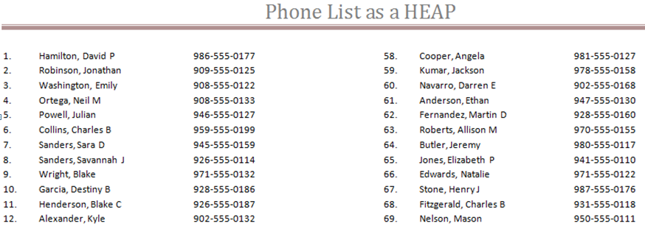
HEAP
SQL Server Performance for Developers
Find the phone number for David P Hamilton.
Find the phone number for all David P Hamilton’s.
Find the phone number for Haley L Butler.
Hint: Page 6 line 646

Slide 11
HEAP
SQL Server Performance for Developers
SELECT PhoneNumber FROM PhoneTable WHERE Name = ‘Hamilton, David P’
Search row by row, for every row on every page
Full Table Scan

Slide 12
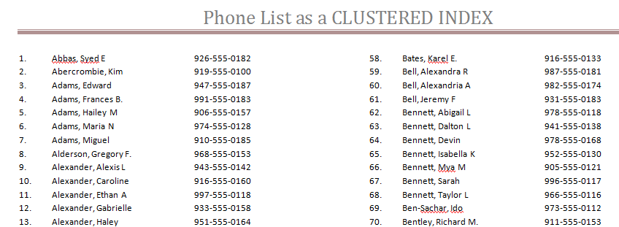
CLUSTERED INDEX
SQL Server Performance for Developers
Clustered by Name
Find the phone number for all people named David P Hamilton. Line 315

Slide 13
CLUSTERED INDEX
SQL Server Performance for Developers
SELECT PhoneNumber FROM PhoneTable WHERE Name = ‘Hamilton, David P’
Find Hamilton, alphabetically and get them all.
Clustered Index Seek - Much faster than the full table scan
How about this one:
SELECT PhoneNumber FROM PhoneTable WHERE Name = ‘%ton, David P’

Slide 14

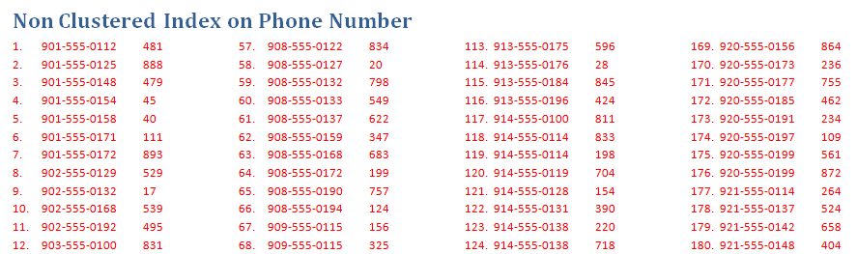
CLUSTERED w/ NONCLUSTERED INDEX
SQL Server Performance for Developers
Find all names with a phone number of 901-555-0112
First Find 901-555-0112 in the non clustered index
Look up row 481 in the clustered index

Slide 15
CLUSTERED w/ NONCLUSTERED INDEX
SQL Server Performance for Developers
SELECT Name FROM PhoneTable WHERE Phone = ‘901-555-0112’
Index Seek (NonClustered), Index Seek Clustered.
Row 1, top left of page 9, followed by row 481, left middle of page 5.

Slide 16
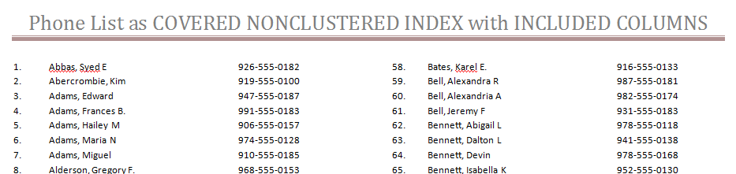
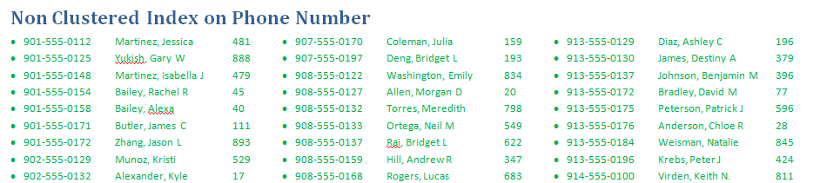
COVERING INDEX
SQL Server Performance for Developers
Find all names with a phone number of 901-555-0112
Find 901-555-0112 in the non clustered index, and you are done

Slide 17
COVERING INDEX
SQL Server Performance for Developers
SELECT Name FROM PhoneTable WHERE Phone = ‘901-555-0112’
Find 901-555-0112 in the non-clustered index, and notice that the name your are looking for is included.
Index Seek (NonClustered).
Row 1, top left of page 9.

Slide 18
Index Type Summary
SQL Server Performance for Developers
Heap
Clustered Index
Non Clustered Index
Covering Index

Slide 19
Index Waste
SQL Server Performance for Developers
Duplicate Indexes
Exact Duplicate vs Partial Duplicates
Excessive duplicate indexes slow down inserts and updates with no added value
May slow down the query optimizer
Unused Indexes
These are indexes that have never been used in a query
Why?
They are indexing on columns that aren't being queries?
There is a better index, or duplicate index that is being used instead
Slows down inserts and updates

Slide 20
Duplicate Indexes – Waste Example
SQL Server Performance for Developers
Sample of Duplicates
Table People
Index1: Column1 and Column2
Index2: Column1
Index3: Column1, Column2, Column3
See Database Health Monitor
Available at http://DatabaseHealth.com
Useful for developers and DBAs.

Slide 21
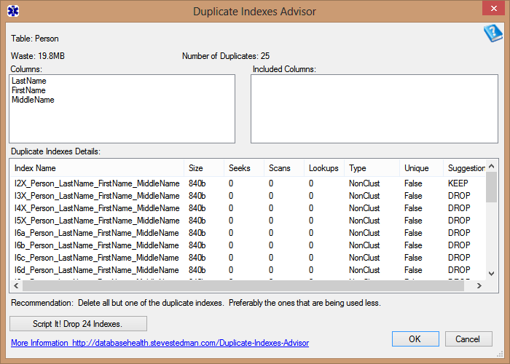
SQL Server Health Reports
SQL Server Performance for Developers

Slide 22
Unused Indexes - TSQL
SQL Server Performance for Developers
SELECT iv.table_name, i.name AS index_name, iv.seeks + iv.scans + iv.lookups AS total_accesses, iv.seeks, iv.scans, iv.lookups, t.IndexType, t.IndexSizeMB FROM (SELECT i.object_id, Object_name(i.object_id) AS table_name, i.index_id, SUM(i.user_seeks) AS seeks, SUM(i.user_scans) AS scans, SUM(i.user_lookups) AS lookups FROM sys.tables t INNER JOIN sys.dm_db_index_usage_stats i ON t.object_id = i.object_id GROUP BY i.object_id, i.index_id) AS iv INNER JOIN sys.indexes i ON iv.object_id = i.object_id AND iv.index_id = i.index_id INNER JOIN (SELECT sys_schemas.name AS SchemaName ,sys_objects.name AS TableName ,sys_indexes.name AS IndexName ,sys_indexes.type_desc AS IndexType ,CAST(partition_stats.used_page_count * 8 / 1024.00 AS Decimal(10,3))AS IndexSizeMB FROM sys.dm_db_partition_stats partition_stats INNER JOIN sys.indexes sys_indexes ON partition_stats.[object_id] = sys_indexes.[object_id] AND partition_stats.index_id = sys_indexes.index_id AND sys_indexes.type_desc <> 'HEAP' INNER JOIN sys.objects sys_objects ON sys_objects.[object_id] = partition_stats.[object_id] INNER JOIN sys.schemas sys_schemas ON sys_objects.[schema_id] = sys_schemas.[schema_id] AND sys_schemas.name <> 'SYS' ) AS t ON t.IndexName = i.name AND t.TableName = iv.table_name WHERE --t.IndexSizeMB > 200 and iv.seeks + iv.scans + iv.lookups = 0 ORDER BY total_accesses asc ;
Yes, its ugly, but it gets the job done. Just copy and paste.

Slide 23
Index Waste – Real World Example
SQL Server Performance for Developers
Developer learned just enough about indexes to be dangerous.
Developer created a script to create thousands of indexes. This impacted every table and every Foreign Key or likely column to be queried against.
Developer then wrote middle tier code to scan the database for tables and indexes to generate code to access the database based on the indexes.
This code generation process then locked the database structure so that new indexes couldn’t be easily added and bad indexes couldn’t be removed without breaking the middle tier code.
Result was many unused indexes, many duplicate indexes, and lots of wasted time, money and database resources.

Slide 24
Up Next
SQL Server Performance for Developers
Understanding Execution Plans

Slide 25
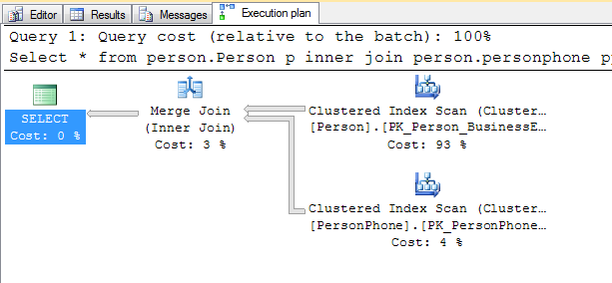
Understanding Execution Plans
SQL Server Performance for Developers
Execution plan describes the data retrieval and storage methods used by the Query Optimizer to execute a specific query.
Understanding how it was executed will help you understand if you can make it faster.
To active CTRL+M or Menu
XML and Graphical
Reading Graphical
Use the zoom menu
Zoom around button +
Use the tool tips
Don’t trust the SSMS Missing Index suggestion… Verify.

Slide 26
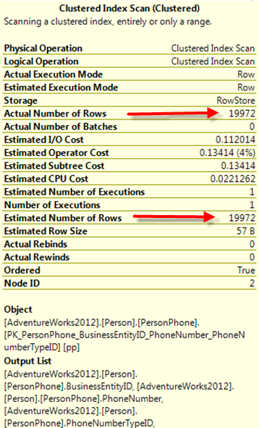
Actual vs. Estimated Execution Plans
SQL Server Performance for Developers
Estimated
Produced without running the query
Displays estimated data only
Can save time and resources
Can’t be used if the query creates objects it needs to use: i.e. temp table
Not always accurate, can be misleading
Actual
Displayed after the query is run
Includes estimates and actual values
Can sometimes be misleading

Slide 27
Execution Plans
SQL Server Performance for Developers
Good = Fast
Bad = Slow
Key Lookup (clustered)
Clustered Index Seek
Index Seek
Clustered Index Scan
Index Scan
Many more…
Clustered Index Update
Table Scan (heap)
RID Lookup (heap)
Many more…

Slide 28
Execution Plans DEMO
SQL Server Performance for Developers
Select * from person.Person p
inner join person.personphone pp on p.BusinessEntityID = pp.BusinessEntityID;
SELECT FirstName, MiddleName, LastName, PhoneNumber
FROM person.Person p
INNER JOIN person.personphone pp ON p.BusinessEntityID = pp.BusinessEntityID;
SELECT FirstName, MiddleName, LastName, PhoneNumber
FROM person.Person p
INNER JOIN person.personphone pp on p.BusinessEntityID = pp.BusinessEntityID
WHERE FirstName = 'Alexandra'
AND MiddleName = 'E'
AND LastName = 'Washington‘;
.
.
.

Slide 29
Functions in the Execution Plan
SQL Server Performance for Developers
Scalar Functions and Multi-Statement Table Valued Functions are hidden from the Execution Plan

Slide 30
Up Next
SQL Server Performance for Developers
STATISTICS IO
And
STATISTICS TIME

Slide 31
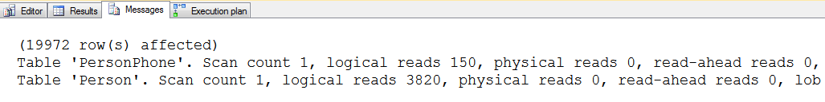
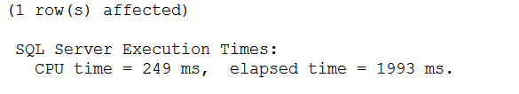
Statistics IO and TIME
SQL Server Performance for Developers
SET STATISTICS IO ON
Scan Count, Logical Reads, Physical Reads
SET STATISTICS TIME ON
CPU time is time used by CPU resources to complete a task (parse, compile or execute)
Elapsed time is the total time took by a task from start to its end
Sometimes CPU time can be greater than Elapsed Time

Slide 32
Statistics IO and TIME Demo
SQL Server Performance for Developers
SET STATISTICS IO ON;
SELECT FirstName, MiddleName, LastName, PhoneNumber
FROM person.Person p
INNER JOIN person.personphone ph on p.BusinessEntityID = ph.BusinessEntityID;
SET STATISTICS IO OFF;
SET STATISTICS TIME ON;
SELECT FirstName, MiddleName, LastName, PhoneNumber
FROM person.Person p
INNER JOIN person.personphone ph on p.BusinessEntityID = ph.BusinessEntityID;
SET STATISTICS TIME OFF;

Slide 33
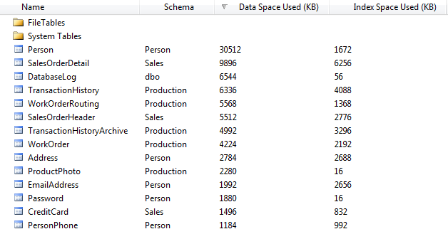
Understanding Table Size
SQL Server Performance for Developers
How big is that table?
F7 to get the Object Explorer

Slide 34
Plan Cache and Parameterization
SQL Server Performance for Developers
The plan cache caches more than just procedures, it also caches all parsed queries.
Performance tuning the Plan Cache reduces waste on the SQL Server.
You don’t have control over the size of the Plan Cache, but you do have control over how it is used.
Reuse in the Plan Cache allows queries and procedures to run faster.

Slide 35
Tuning the Plan Cache
SQL Server Performance for Developers
Tuning is accomplished by a number of methods:
Using Parameterized Queries.
Removing temp tables from Procedures.
Implementing database Coding Standards.

Slide 36
Procedure Cache and Parameters Demo
SQL Server Performance for Developers

Slide 37
Seven Deadly Sins
SQL Server Performance for Developers
Poor or No Database Design
Where to begin…
Index Design Issues
Too Many or Too Few, or just wrong
RBAR instead of Sets
Cursors in SQL Server are very different than Oracle
Not using explicit column lists
Avoid SELECT *
Calculations in the WHERE Clause
User Defined Functions and Inline Functions

Slide 38
Seven Deadly Sins Continued
SQL Server Performance for Developers
Dirty Reads
WITH (NOLOCK), READ UNCOMMITTED
The Run Faster switch or Turbo Button
Believing Moore’s Law Will Save You
I don’t need to write fast queries, the hardware will catch up

Slide 39
Sin 1: Poor or No Database Design
SQL Server Performance for Developers
No Primary Key
Not Foreign Keys
No Indexes
UniqueIdentifiers for Primary Keys or Clustered Indexes
It might work fine in your development environment, but as soon as the database fills up with data, it’s a whole other story

Slide 40
Sin 2: Index Design Issues
SQL Server Performance for Developers
Missing the right indexes or lots of the wrong indexes
Example, hospital system used by hundreds of doctors to look up patient info when seeing patients
5 minute wait every time the doctor clicked on the medication history for the patient, which accessed 5 tables
The tables had lots of indexes, just not the right index for this query
As a consultant, I analyzed the query, recommended one index, added the index, tested and was done in less than my 2 hour minimum bill
After the index was added it took 3 seconds to display the medication history

Slide 41
Sin 3: RBAR instead of Sets
SQL Server Performance for Developers
Row By Agonizing Row
Cursors in SQL Server are very different than in Oracle
Looping is very expensive compared to set logic
SQL Server is very good at working with sets
RBAR Demo

Slide 42
Sin 4: Not using explicit column lists
SQL Server Performance for Developers
Avoid SELECT *
Use explicit columns on inserts
SELECT * Demo

Slide 43
Sin 5: Calculations in the WHERE Clause
SQL Server Performance for Developers
User Defined Functions
Inline Functions
Calculations Demo

Slide 44
Sin 6: Dirty Reads
SQL Server Performance for Developers
WITH(NOLOCK)
There is a chance that if you are reading data out of the table while it is in the process of being updated.
When a transaction is allowed to read data from a row that has been modified by another running transaction and not yet committed.
READ UNCOMMITTED
Same as WITH (NOLOCK)
WITH(NOLOCK) demo

Slide 45
Sin 7: Believing Moore’s Law Will Save You
SQL Server Performance for Developers
Transistors and computer power doubling every two years.
Really… Maybe true from 1958 to 1965.
Don't use Moore’s Law as an excuse to write bad code.
“Good hardware can never completely overcome bad code."

Slide 46
Tips For Writing Queries
SQL Server Performance for Developers
SET STATISTICS IO ON and look at the results
Use the Actual Execution Plan
Understand indexes
Fill your tables up with data in your development environment, at least 10 times what you think you will have in production

Slide 47
Tools for finding problems
SQL Server Performance for Developers
Database Health Reports
http://DatabaseHealth.com
Confio Ignite
Idera
SQL Sentry Plan Explorer (nice Free Product)

Slide 48
In Review
SQL Server Performance for Developers
Is Tuning Necessary for the Developer
Understanding Tables and Indexes
Understanding Execution Plans
Statistics IO and TIME
Understanding Table Size
Procedure Cache and Parameterization
Seven Deadly Sins
DB Design, Index Design, Explicit Column Lists, RBAR, Calculations in the Where Clause, Dirty Reads, Moore’s Law
Tips For Writing Queries

Slide 49
Next Steps
SQL Server Performance for Developers
Take a look at execution plans for your queries
Be sure to SET STATISTICS IO ON when analyzing queries
Look for NOLOCK or READ UNCOMMITTED
See if you can find duplicate indexes on your database

Slide 50
Related Session(s)
Interpret Query Plans (John Huang) – 11:00 Today
Temporary T-SQL (Richard Baumet) – 4:30 Today

Slide 51
Resources for Attendees
SQL Server Performance for Developers
Follow me on Twitter
@SqlEmt
Visit my website
http://stevestedman.com/
Database Health Reports – Free Tool
http://DatabaseHealth.com
Send me an email:
Steve@SteveStedman.com

