Slide 1


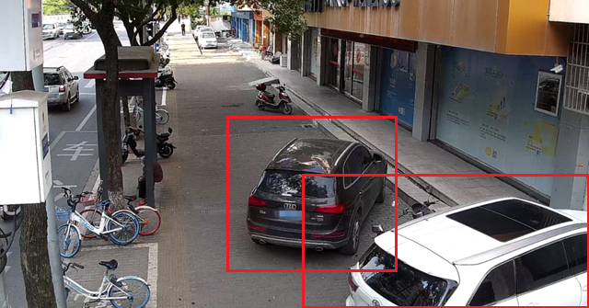

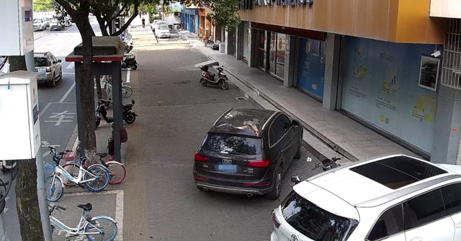

Fusing visual and textual knowledge
Search
Knowledge
related to urban comprehensive administrative management
RAG Module
O1:
O2:
...:
Relative docs
Output
“Identify illegal parking behaviors on the street in the image and tell me the corresponding administrative penalty decision”
Result
“Two instances of illegal parking behaviors were identified.
According to <Ordinance> , <penalty> should be imposed for each violation.”
Input
LMM
Final output
Input visual data and instruction
EVA-ViT
Multimodal Model

Slide 2
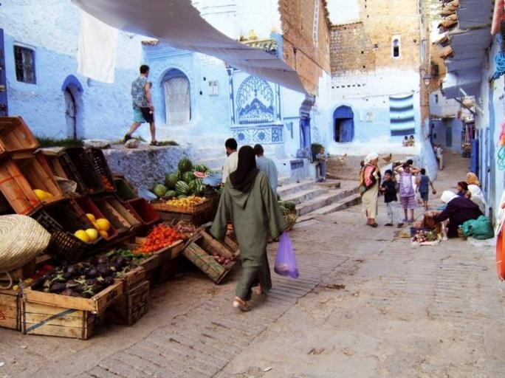


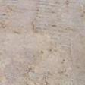


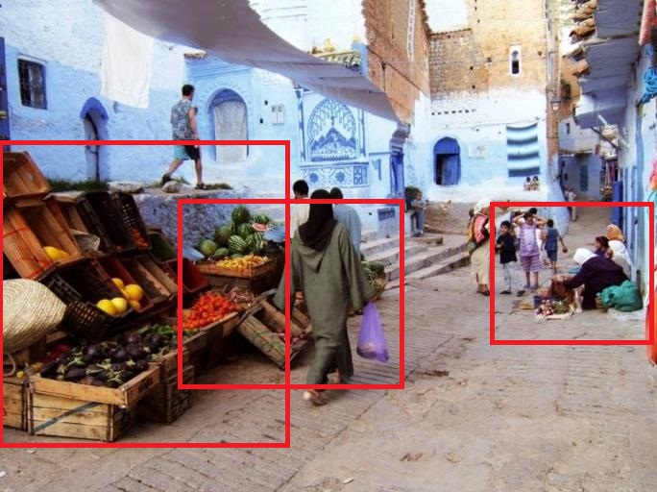
resize
Processed image
crop
Raw image
...
Patch Embedding
Frozen
ViT
Trainable
Linear
[INST] <Img>
New embedding
</Img> [detection] Illegal sales [/INST]
Detection result
Llama2

Slide 3
Material
<Query>
Loader
<Answer>
Embedding Model
Store
Similarity search
LLM
Index
Vector Store
Query
Template
Context
Relevant info

Slide 4
Chunk_1_1
Chunk_1
Chunk 1
Chunk_1_2
Splitter_1
Splitter_2
…
Chunk_2
Documents
Chunk 2
Chunk_1_k
…
…
Chunk_n
Chunk_n_k
Embedding
Documents Store
Vector Store

Slide 5
Chunk_1_1
Chunk_1
Urban governance textual regulations
Chunk 1
Chunk_1_2
Splitter_1
Splitter_2
…
Chunk_2
Chunk 2
Chunk_1_k
…
…
Chunk_n
Chunk_n_k
Embedding
Documents Store
Vector Store

Slide 6
{detection}
“Find {detection} in the image.”
Random selection
“Help me detect {} in the image.”
“Find {} in the image.”
“The image includes {}.”
…

Slide 7
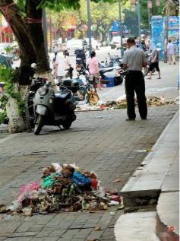

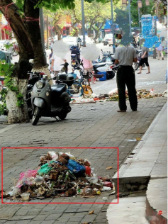
Is there any trash in the image?
Yes, there is trash scattered around the sidewalk area.
Help me find the trash.
How to deal with illegal dumping of trash according to regulations? *
Upon order to rectify by the Department of Household Waste Management, a fine of not less than five thousand yuan and not more than fifty thousand yuan may be imposed; for serious cases, a fine of not less than fifty thousand yuan and not more than five hundred thousand yuan shall be imposed. *

Slide 8
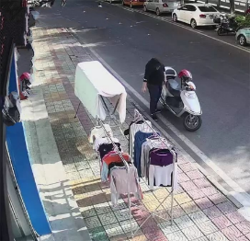
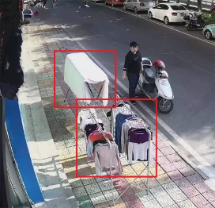
Is there any clothing hanging in the picture?
Yes, there is clothing hanging on a clothesline in the image.
Help me detect cloth hanging.
How to deal with illegal cloth hanging or drying according to regulations? *
In violation of the provisions stated in the first clause herein, failure to rectify shall result in a fine of no less than five hundred yuan and no more than three thousand yuan imposed on the establishment or managing entity. *

Slide 9
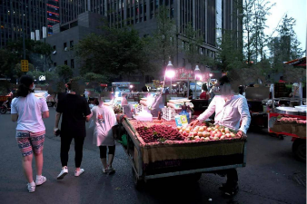

Is there any street vendors in the picture?
Yes, there are several street vendors in the image.
Help me find street vendors.
How to deal with street vendors according to regulations? *
If it is found that a vendor violates the provisions of Article 15, Paragraph 1, Item 1 of these regulations, operating outside of the designated locations, areas, places, or times, shall be punished by comprehensive administrative law enforcement and other relevant departments in accordance with relevant laws and regulations. If it is found that a vendor violates the provisions of Article 15, Paragraph 1, Items 2 to 8 of these regulations, it shall be handled by food safety supervision. *

