Slide 1
非功能需求研究
张璇
云南大学
2016年11月19日

Slide 2
研究方向
可信软件需求建模及可满足性
冲突非功能需求权衡
实现非功能需求策略的编织（软件过程）
非功能需求本体知识库
需求变更影响

Slide 3
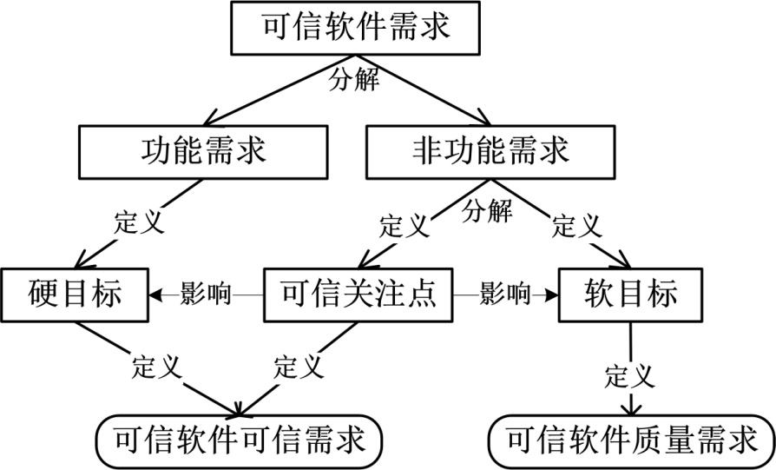
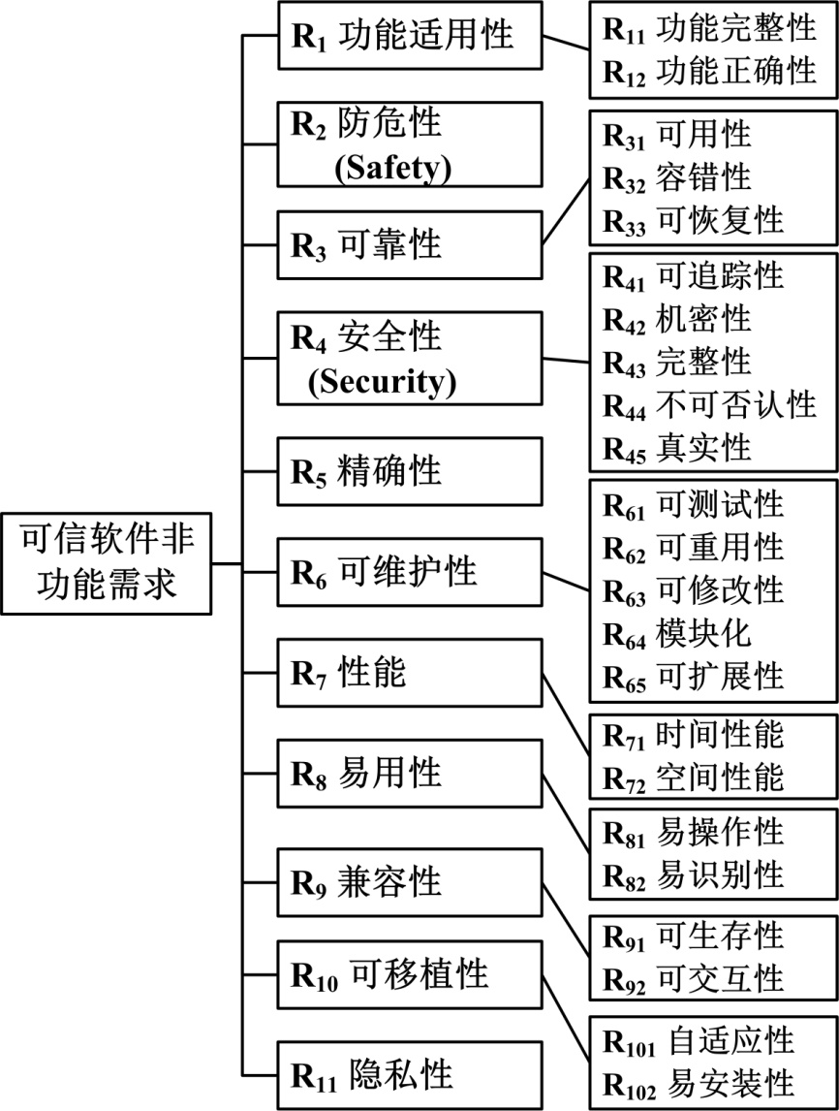
1. 可信软件需求
基于面向目标需求工程方法建模
非功能需求分解模型
ISO/IEC 25010
TCSEC（Trusted Computer System Evaluation Criteria）[DoD 85]
Dependability在IEC 60090-191中定义[IEC 90]
TSM（Trusted Software methodology）[Amoroso 94]
Microsoft [Howard 02, Howard 06]
TCG（Trustworthy Computing Group）[TCG 07]
Littlewood，Strigine，Schmidt [Littlewood 00，Schmidt 03]
DARPA’s CHATS (Defense Advanced Research Projects Agency’s Composable High-Assurance Trustworthy Systems) [Neumann 04]
NSS2（the second National Software Summit）[NSS2 05]
TrustSoft（TrustSoft Graduate School in University of Oldenburg）[Bernstein 05, Hasselbring 06]
COMPSAC（International Computer Software and Applications Conference）[Miller 06]
ICSP（International Conference on Software Process） [Yang 09]

Slide 4
可信软件非功能需求
来源 | 可信软件非功能需求 | 时间
TCSEC | Security (confidentiality, authenticity, accountability) | 1985-
Dependability | Reliability (availability), safety, security | 1990
TSM | Security, reliability (availability) | 1994
Microsoft | Reliability, security, privacy, business integrity | 2002
TCG | Security, maintainability | 2003
Littlewood, Schmidt | Reliability, safety, robustness, availability, security | 2003
DARPA’s CHATS | Security (integrity, confidentiality, authentication, authorization, accountability), reliability (fault tolerance), performance (Time-behavior, capacity), survivability | 2004
NSS2 | Security, safety, reliability, survivability, performance | 2005
TrustSoft | Correctness, safety, quality of service (performance, reliability, availability), security, privacy | 2005
COMPSAC | Availability, reliability, security, survivability, recoverability, confidentiality, integrity | 2006
ICSP | Functionality, reliability, safety, usability, security, portability, maintainability | 2009
ISO/IEC 25010标准定义
统一分解、定义
Conflicts & Synergies
There is nothing permanent except Change

Slide 5
The need for a System Qualities (SQs) ontology
Critical nature of SQs
Need for SQs ontology
Or non-functional requirements; ilities
Major source of project overruns, failures
Significant source of stakeholder value conflicts
Poorly defined, understood
Underemphasized in life cycle management
Oversimplified one-size-fits all definitions
Proliferation of definitions, as with Resilience
Weak understanding of inter-SQ relationships

Slide 6
Proliferation of Definitions: Resilience
Wikipedia Resilience variants: Climate, Ecology, Energy Development, Engineering and Construction, Network, Organizational, Psychological, Soil
Ecology and Society Organization Resilience variants: Original-ecological, Extended-ecological, Walker et al. list, Folke et al. list; Systemic-heuristic, Operational, Sociological, Ecological-economic, Social-ecological system, Metaphoric, Sustainability-related
Variants in resilience outcomes
Returning to original state; Restoring or improving original state; Maintaining same relationships among state variables; Maintaining desired services; Maintaining an acceptable level of service; Retaining essentially the same function, structure, and feedbacks; Absorbing disturbances; Coping with disturbances; Self-organizing; Learning and adaptation; Creating lasting value
Source of serious cross-discipline collaboration problems

Slide 7
Set-Based & SQs-Aware Life Cycle
Incremental SQ definition and evolution
Based on Incremental Commitment Spiral Model
Set-based SQ requirements ranges
Resulting from stakeholder negotiation
Decreasing with growth in feasibility evidence
SQ evidence development process

Slide 8
Set-Based SQs Convergence
Phase 1
Phase 1: rough
Phase 2: improved
Phase 3: good
Desired
Phase 2
Effective ness
Phase 3
Acceptable
Acceptable
Desired
Efficiency

Slide 9
SQs Ontology from Dr Boehm
Enable more effective collaboration across stakeholders from different disciplines
Non-functional Requirements as Qualities, with a Spice of Ontology——Jennifer Horkoff, John Mylopoulos (University of Trento)
Varibility for Qualities in Software Architecture——Azadeh Alebrahim, Germany
SQDS
Class
Individual
Referent
Relation
State
Process

Slide 10
SQs ontology (IDEF 5 ontology structure)
 | Elements | Explaination
1 | Class | Class hierarchies: SQ end objectives and means-ends relationships of child-class.
2 | Individual | Variation by Referents, States, Processes, and Relations.
3 | Referent | Sources of variation by context: Product Q.; Q. In Use e.g. Mean Time Between Failures (MBTF) for reliability...
4 | State | Internal (beta-test); External (rural, temperate, sunny) e.g. Liveness (live & not-live), message-delivery (full-delivery & partial-delivery), message-accuracy, response time (5-sec)...
5 | Process | Operational scenarios (normal vs. crisis; experts vs. novices) e.g. Maintainability: Detection, Preparation for Maintenance, Localization and Isolation, Disassembly, Repair or Removal and Replacement, Reassembly, Alignment and Adjustment, Condition Verification and Checkout.
6 | Relation | Impact of other SQs (Conflicts & Synergies)

Slide 11
Product Quality View of Changeability
Changeability (PQ): Ability to become different product
Swiss Army Knife, Brick Useful but not Changeable
Changeability (Q in Use): Ability to accommodate changes in use
Swiss Army Knife does not change as a product but is Changeable
Brick is Changeable in Use (Can help build a wall or break a window?)
Changeability
External
Adaptability
Internal
Maintainability
Defects
Modifiability
Changes
Repairability
Self-Diagnosability
Self-Modifiability
Self-Testability
Understandability
Modularity
Scalability
Portability
Testability
Diagnosability
Accessibility
Restorability
Subclass of
Means to End

Slide 12
2. 冲突非功能需求权衡
Conflicts

Slide 13
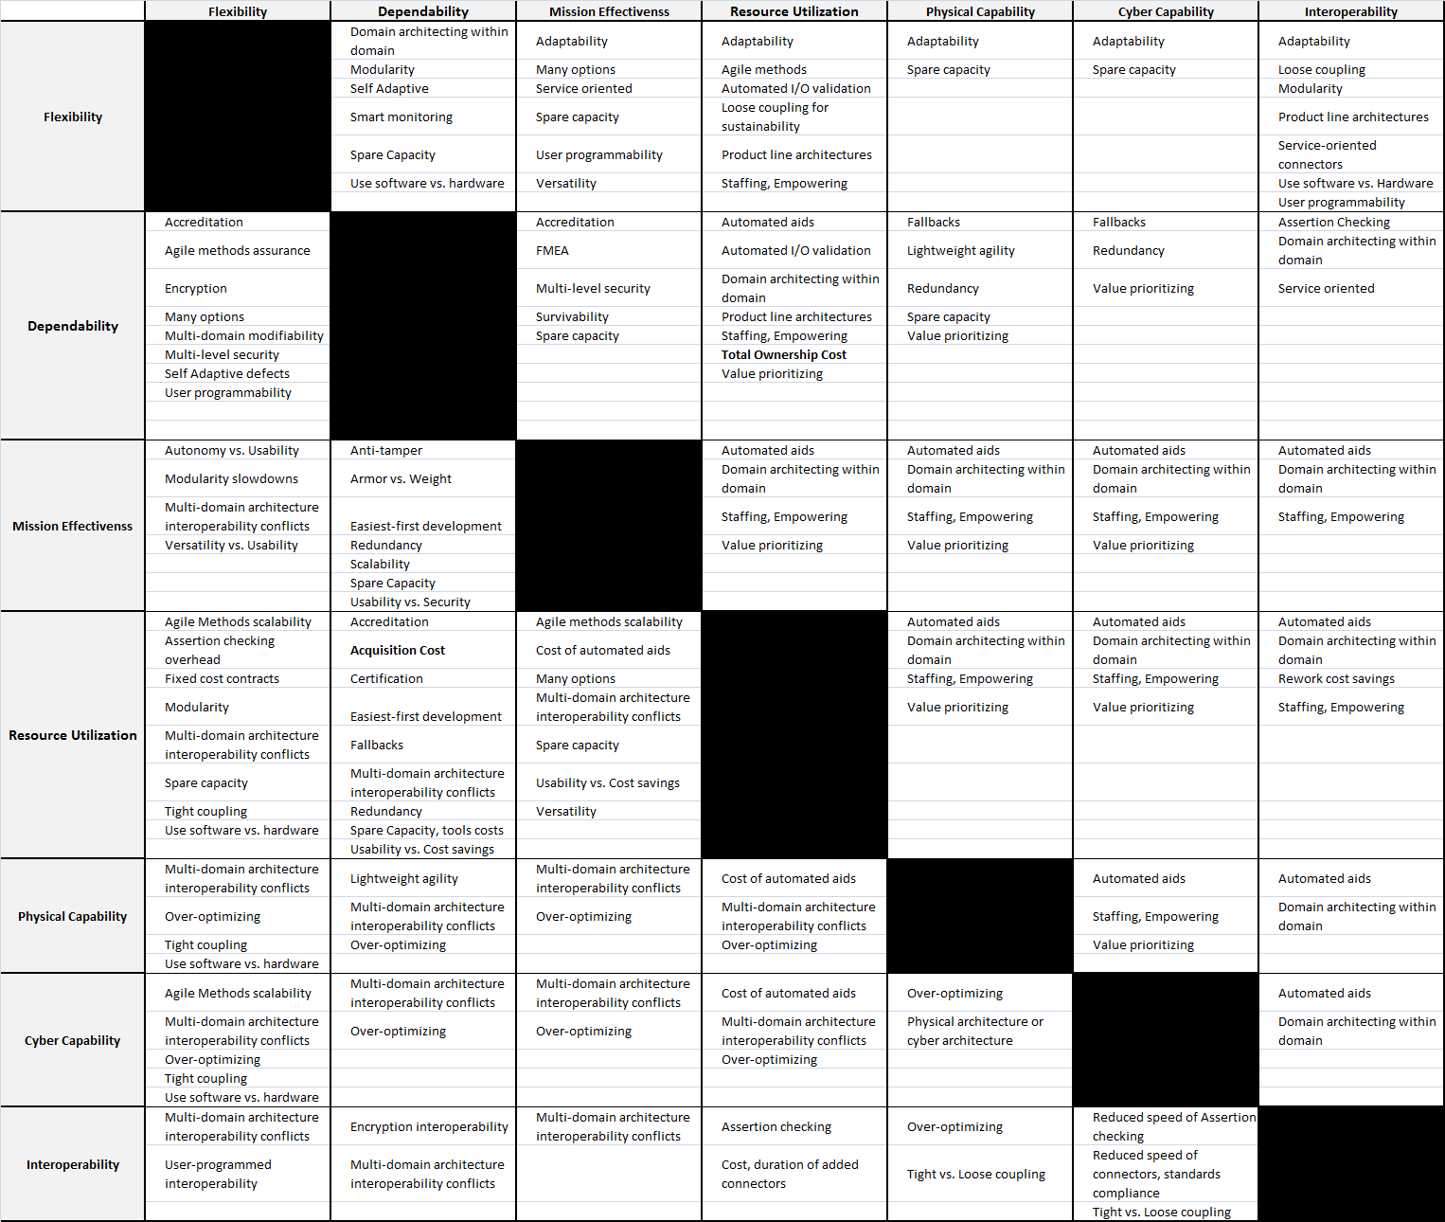
Conflicts
Come from Strategies.
Different projects.
7x7 Synergies and Conflicts Matrix.

Slide 14
Example of SQ Value Conflicts: Security IPT
Single-agent key distribution; single data copy
Reliability: single points of failure
Elaborate multilayer defense
Performance: 50% overhead; real-time deadline problems
Elaborate authentication
Usability: delays, delegation problems; GUI complexity
Everything at highest level
Modifiability: overly complex changes, recertification

Slide 15
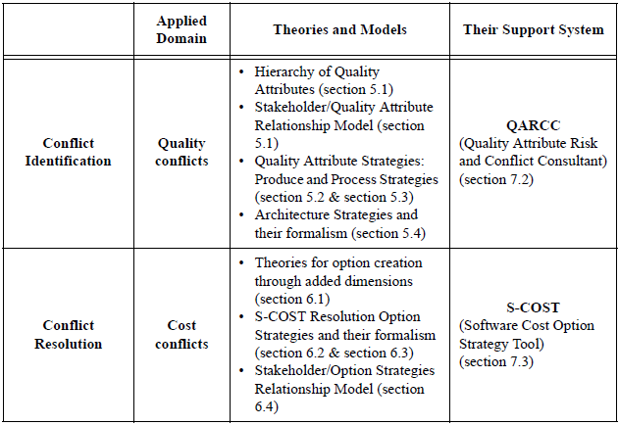
Conflict Identification and Resolution for Software Attribute Requirements —— Hoh In

Slide 16
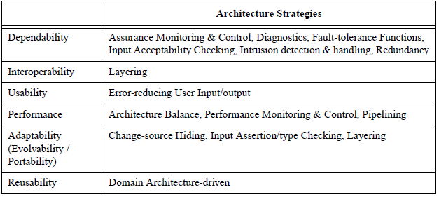
Strategies

Slide 17
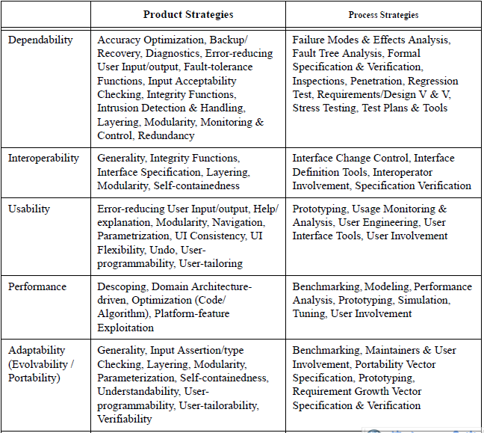

Slide 18
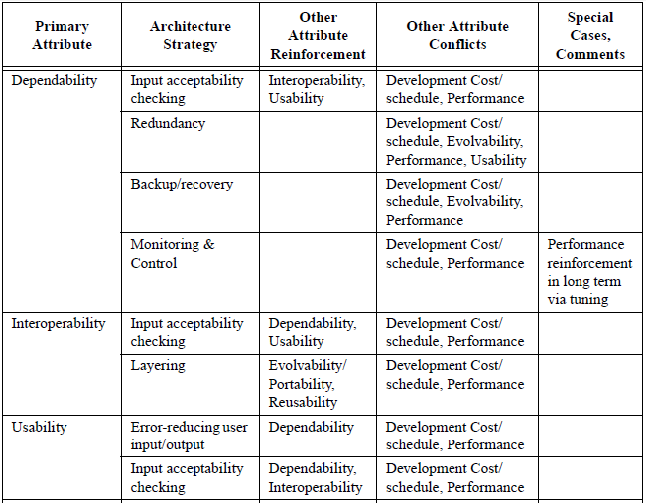
Quality Attribute Strategies and Relations

Slide 19
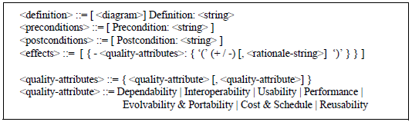
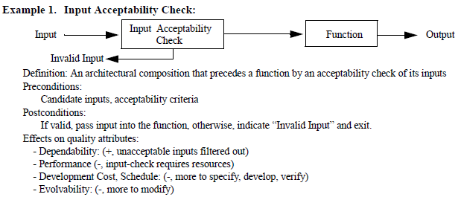
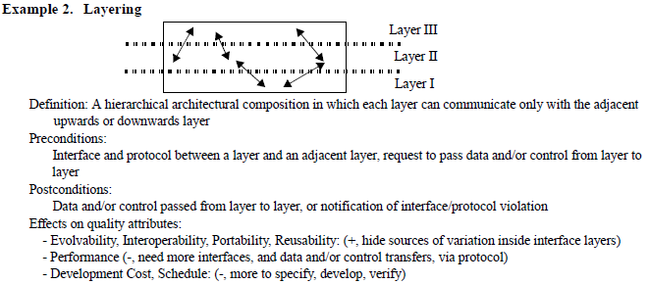
Formalization of Strategies

Slide 20
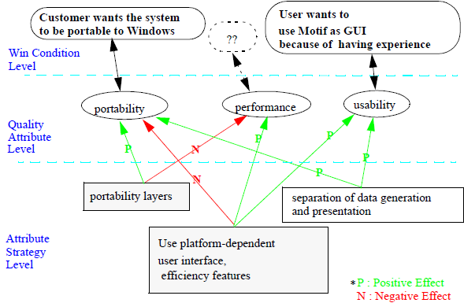
Tradeoff analysis

Slide 21
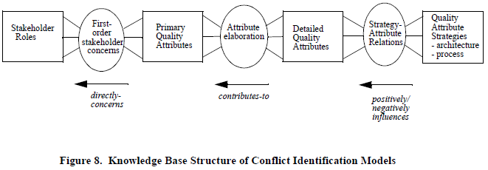
Knowledge Base

Slide 22
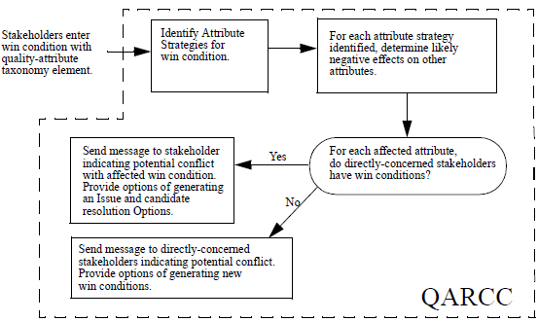
QARCC

Slide 23
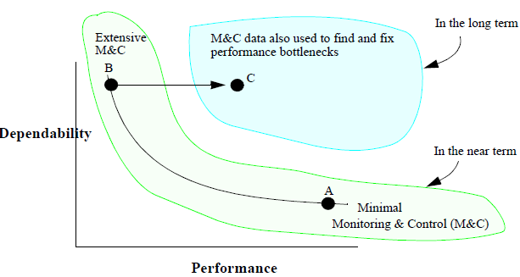
Performance/Dependability trades via Monitoring & Control strategy

Slide 24
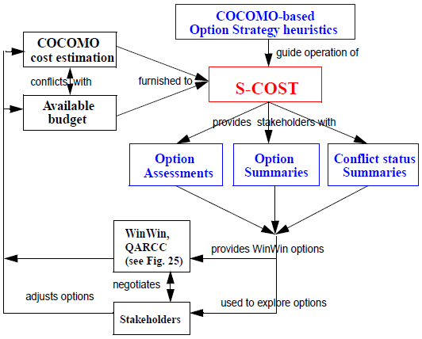
QARCC & S-COST

Slide 25
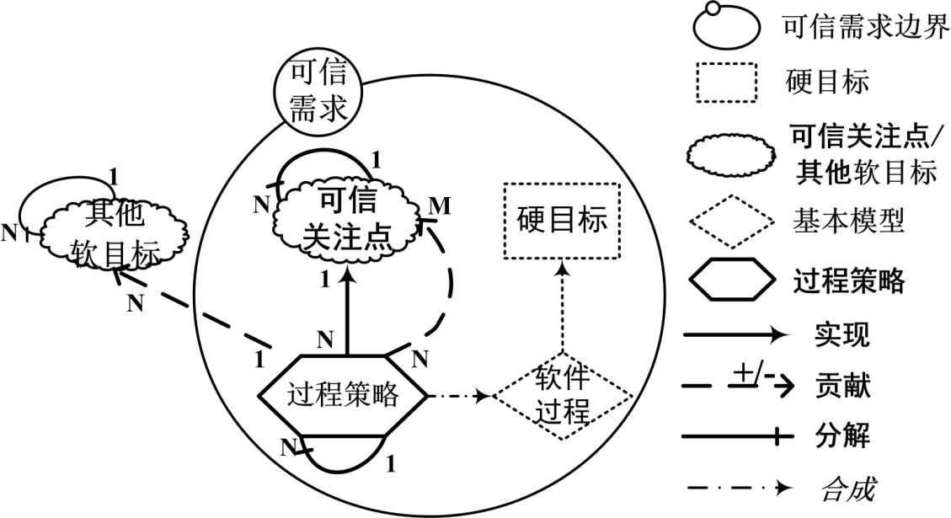
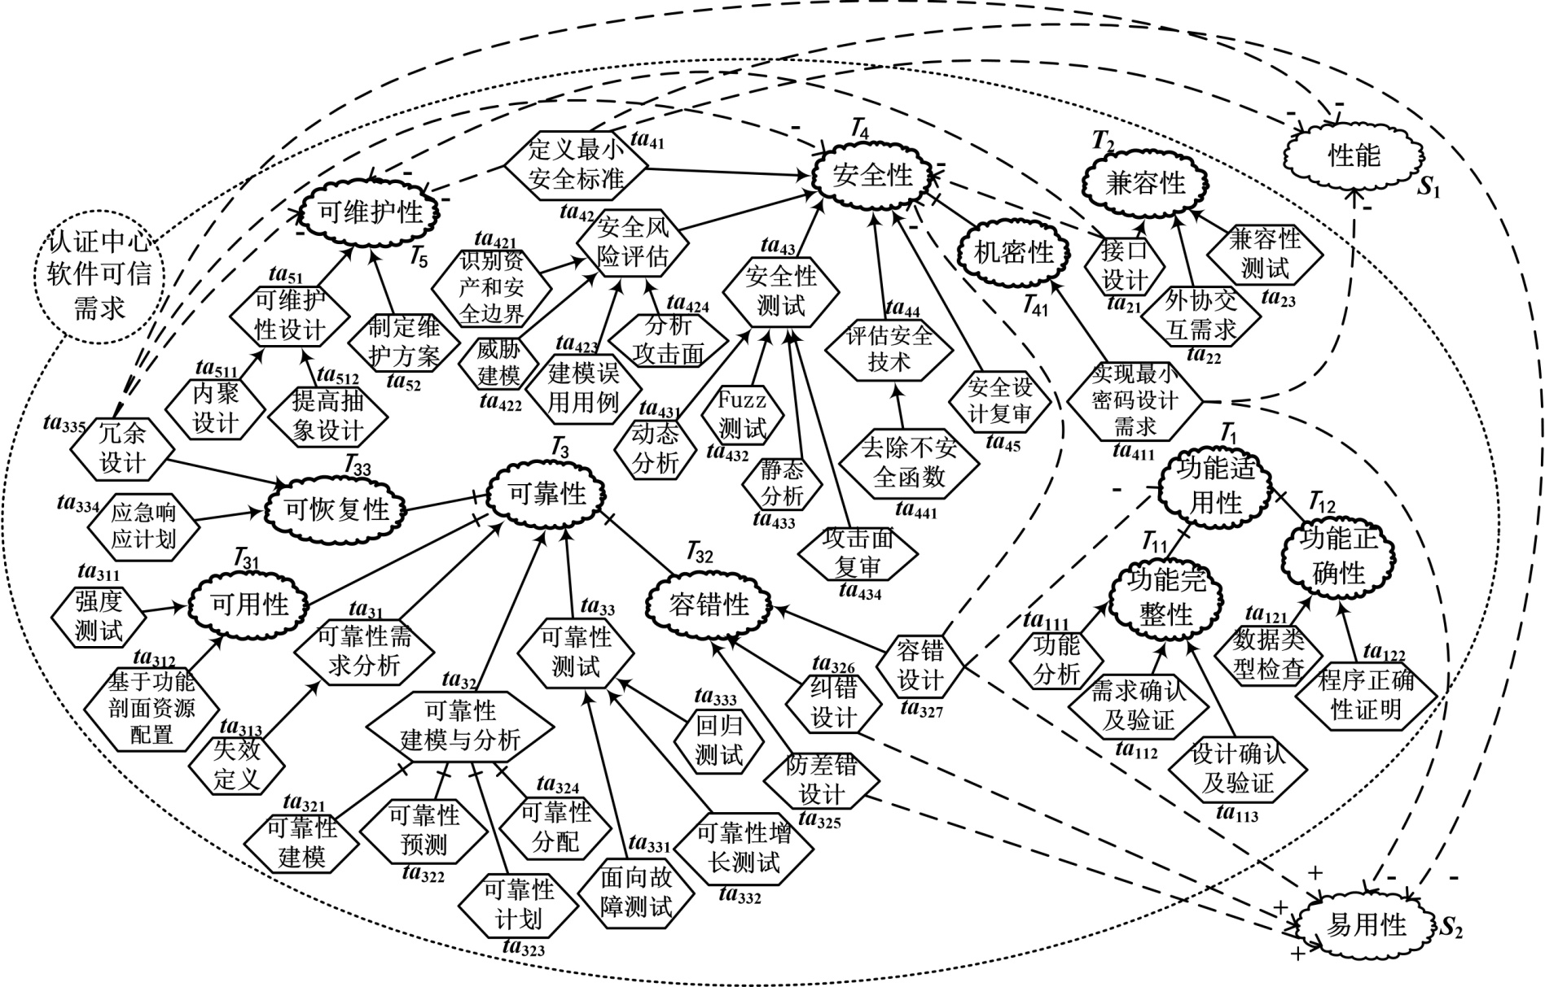
Global View

Slide 26
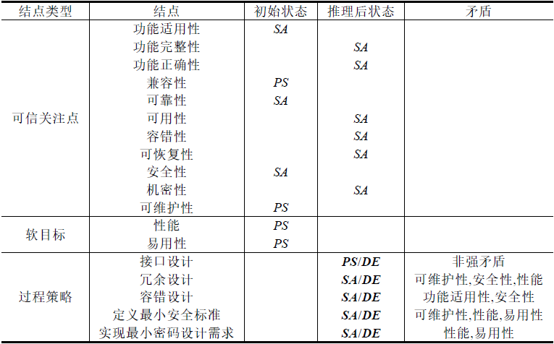
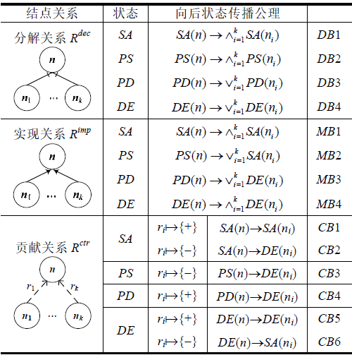
向后推理
Global View

Slide 27
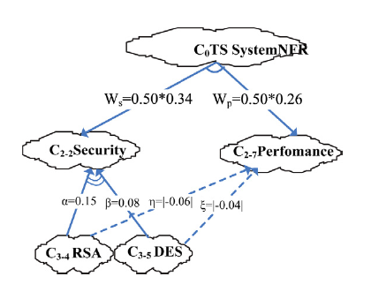
Tradeoff Analysis of Strategies for SQs
Zhu’s Tradeoff Analysis

Slide 28
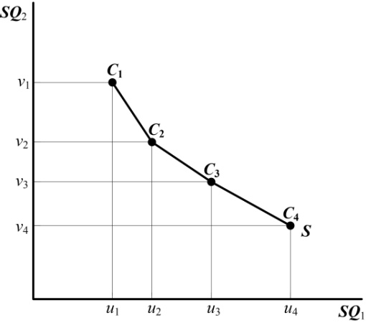
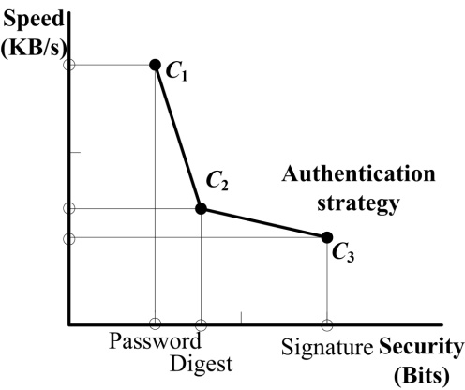
Our Tradeoff Analysis

Slide 29
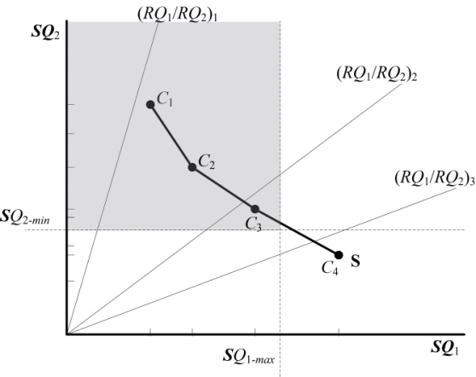
Optimize Tradeoff

Slide 30
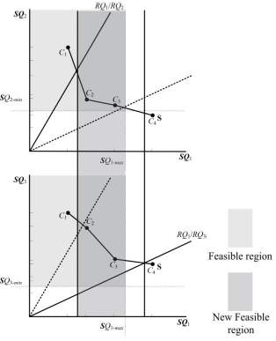
Optimize Tradeoff

Slide 31
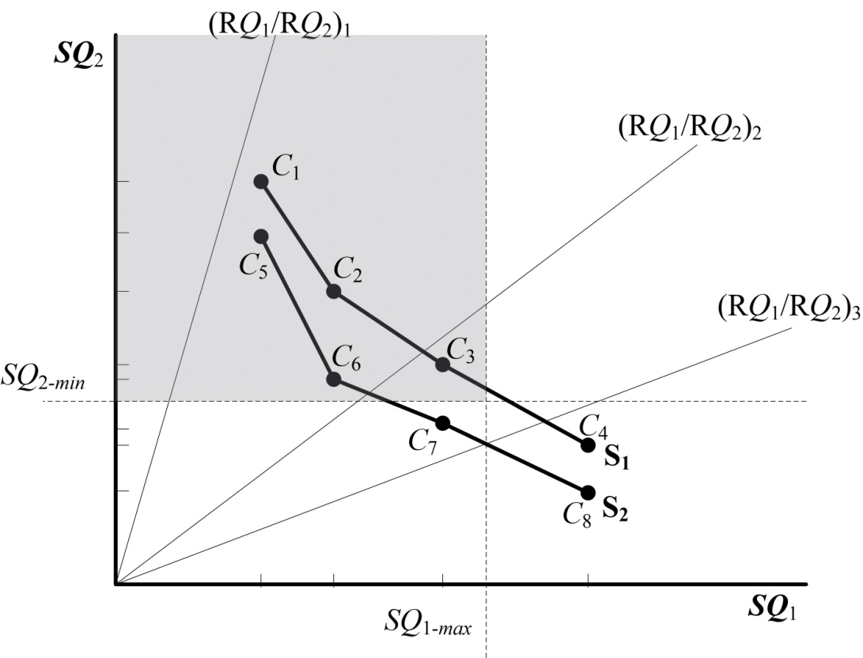
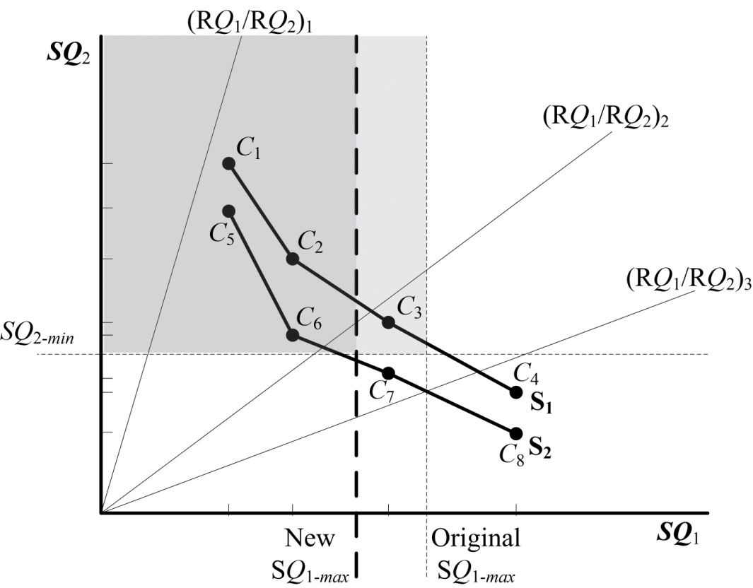
Impact of Changes

Slide 32
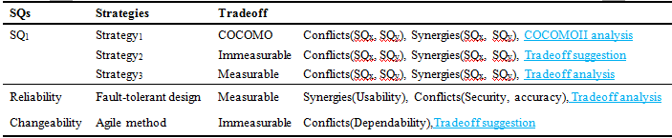
Categories of Strategies

Slide 33
Software Ownership Cost vs. Reliability——Boehm
1.4
VL = 2.55
L = 1.52
Operational-defect cost at Nominal dependability
= Software life cycle cost
1.3
1.26
Relative Cost to Develop, Maintain,
Own and
Operate
70% Maint.
1.2
1.23
1.20
1.10
1.10
1.1
1.11
Operational -
defect cost = 0
1.05
1.07
1.07
1.0
0.99
0.9
0.92
0.8
0.82
0.76
0.69
Very
Low
Low
Nominal
High
Very
High
COCOMO II RELY Rating
MTBF (hours) 1 10 300 10,000 300,000

Slide 34
“More access interfaces” strategy
 | Solutions | Attack surface | Normalization | Values in objective function
C₁₁ | One entry point and one exit point for root method with authenticated access right. Two entry point and one exit point for authenticated method with authenticated access right. Adding protocol SSL and socket. Three data items with root access right and three with authenticated access right. | 9.18 | 6 | 11.5941
C₁₂ | One entry point and one exit point for root method with authenticated access right. Four entry point and two exit point for authenticated method with authenticated access right. Adding protocol SSL and socket. Three data items with root access right and six with authenticated access right. | 13.18 | 4.77 | 5.9736
C₁₃ | Two entry point and one exit point for root method with authenticated access right. Four entry point and two exit point for authenticated method with authenticated access right. Adding protocol SSL and socket. Six data items with root access right and six with authenticated access right. | 15.45 | 4.07 | 1.615
C₁₄ | Three entry point and two exit point for root Method with authenticated access right. Six entry point and two exit point for authenticated method with authenticated access right. Adding protocol SSL and socket. Three data items with root access right and three with authenticated access right. | 20.18 | 1.62 | 6.91

Slide 35
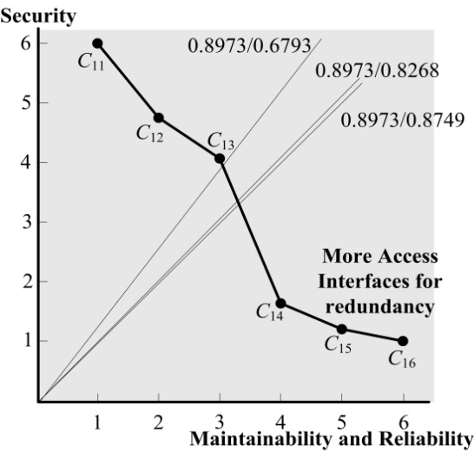
“More access interfaces” “Redundancy design”

Slide 36
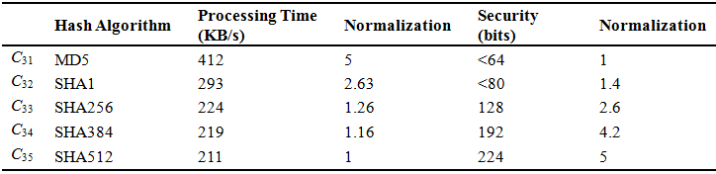
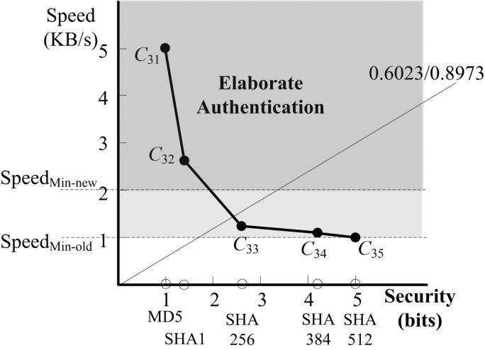
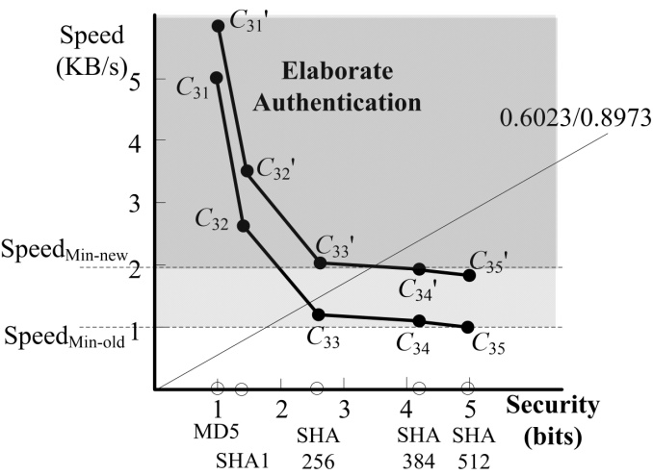

Slide 37
limitations
The tradeoff result relies on the metrics of strategies, but it is risky that the metrics may be difficult to acquire, or be subject to error or a degree of estimation.
Further validation should be conducted, including more appropriate metrics and more accurate measurements. Also, our framework should be used in more variety of realistic cases.

Slide 38
3. 过程方面编织——AOP（软件过程） 4. 非功能需求本体知识库Wiki tool 5. 需求变更影响

Slide 39
非常感谢！

