Slide 1

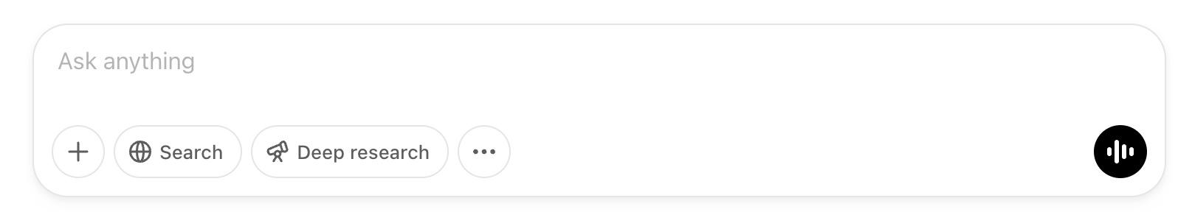
Hi, I'm DeepAnalytics, not DeepSeek
Team Member: Evelyn Liang, Huei-Sin Liu, Jim Cao, Jingwen Zhang, Qilian Wu, Shelly Wei, Corey Lin
1

Slide 2
1. Statement of Problem
2. Study Design & Method
3. Data Analysis
4. Discussion
5. Recommendation
6. Conclusion
Statement of Problem & Justification
Overview of the problem and data details
Deep Dive into the Case
Insights
Develop a dynamic month-by-month staffing plan for Google’s advertiser support agents in 2025. Balance:
Cost efficiency by minimizing idle agents.
Timely advertiser support by reducing waiting times and maximizing revenue uplift.
Scalability by adjusting agent number based on market fluctuations while adhering to hiring/firing constraints.
Issue of the data question:
Need of the data question:
Developed
Objective
The provided datasets don’t cover the available number of agents in Nov. and Dec. in 2024 and Jan. and Feb in 2026.
Advertiser Eligibility: An advertiser qualifies for Google’s agent support if their annual budget exceeds a country-specific thrCountryeshold. Advertisers that do not meet this criterion are excluded.
Agent Capacity: Each Google agent can concurrently manage up to 10 advertisers.
Queue Management: Advertisers unassigned after 60 days are automatically removed from the waiting pool.
Agent Assignment: If agent capacity is available, an agent is assigned.
Waiting Period: If no agent capacity is available, the advertiser waits up to 60 days in the pool.
Operational Time Lags:
New Hires: New hires take 1 month to become operational.
Fire: Fires require 1 month’s notice before taking effect, and firing an agent incurs a cost of 40% of the agent’s annual salary.
Let the optimization cannot cover the full period, leading to 0 assigned advertiser in jan 2025, potentially
Developed
Assumption
Need to predict or simulate the following data:
Sign_Up_Month
Advertiser_Count_Per_Month
Avg_Budget_Per_Advertiser
Advertiser Sign-ups 2023-2024 covers Advertiser_ID, Country, Sign_Up_Date, Projected_Annual_Budget
Agent Salary and Eligibility Threshold covers Country, Annual_Agent_Salary_USD, Advertiser_Eligibility_Threshold_USD
Existing Agent Staffing covers Country, Existing_Agent_Count
Data Structure
2

Slide 3
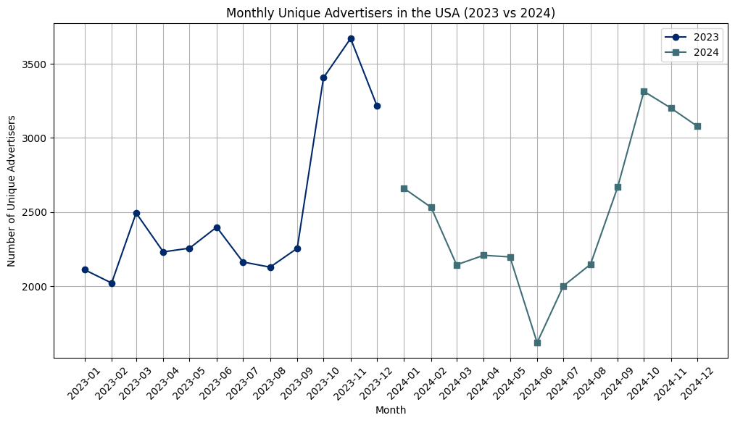
1. Statement of Problem
2. Study Design & Method
3. Data Analysis
4. Discussion
5. Recommendation
6. Conclusion
Statement of Problem
Exploratory Data Analysis
Seasonality
- Low number of Advertisers in Q1
- Gradual increase/recovery in Q3
- Surge in Q4
Trend
- Potential Downward Trend
xxx
Prediction
Optimization

Slide 4
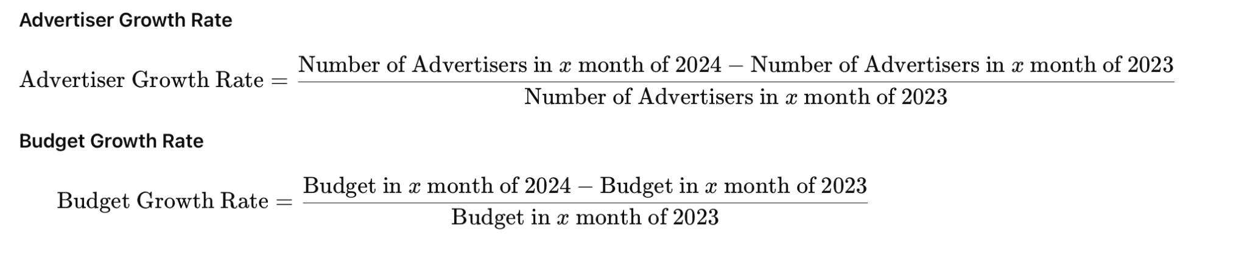
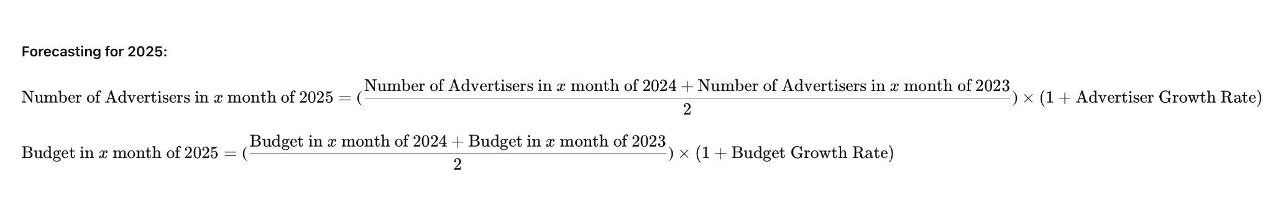
1. Statement of Problem
2. Study Design & Method
3. Data Analysis
4. Discussion
5. Recommendation
6. Conclusion
Study Design & Method
Prediction using simple prediction model instead of SARIMA and PROPHET
Data Validity Check & Growth Rate Analysis
 | SARIMA (1,1,1) (1,1,1,12) | PROPHET
R-Squared | -0.74 | -1.27
MSE | 92672.45 | 65446.16
RMSE | 304.42 | 255.82
Performance of Two Time-Series Models
Out-of-sample validation
Use Simple Prediction Model
4

Slide 5
1. Statement of Problem
2. Study Design & Method
3. Data Analysis
4. Discussion
5. Recommendation
6. Conclusion
Study Design & Method
Why LP not ILP or other heuristic algorithm, while balancing profit and waiting time?
4
1. Waiting Pool Dynamics (W[m])
2. Dropped Advertisers (D[m])
3. Graduated Advertisers (G[m])
4. Hiring/Firing Constraints (N[m], F[m]) Constraint
5. Required Agents Capacity (A[m]) Constraint
6. Agent Availability Dynamics (A[m+1])
7. Total Agent Count (T[m])
7 constraints:
See more math formulation in Appendix
3
7 decision variables:
Available Agents (A[m])
New Hires (N[m])
Fired Agents (F[m])
Assigned Advertisers (S[m])
Waiting Advertisers (W[m])
Dropped Advertisers (D[m])
Graduated Advertisers (G[m])
2
There are two more main additional assumptions:
1
Decision Variables
Trade-off between profit and reducing waiting time:
1. Revenue Uplift from Agent Support: 13.5% on average
Expected Uplift=∑(Uplift Percentage×Probability)
Constraints
Objective
Assumptions
Minimize:
Σ(A[m]×monthly salary
+F[m]×firing cost
−S[m]×revenue uplift
+W[m]×waiting cost penalty)
2. Waiting Cost Penalty:
the opportunity cost = potential revenue loss
Waiting Cost Penalty=W[m]×[(Average Budget/12)*Expected Uplift]
5

Slide 6
1. Statement of Problem
2. Study Design & Method
3. Data Analysis
4. Discussion
5. Recommendation
6. Conclusion
Data Analysis
Optimizing Staffing Costs: Key Insights & Implications
Deep Dive into the model building
Sensitivity to Initial Conditions
The model prioritizes cost minimization. Firing is a necessary adjustment when agents aren't needed.
The large initial firing cost impacts overall performance, even with later recovery.
Takeaway: Precise initial agent calibration is crucial for accurate and cost-effective modeling.
Demand-Driven Staffing Adjustments
Higher demand months = increased staffing (hiring or retention).
Lower demand months = potential firing.
Takeaway: The model ensures sufficient agent capacity to handle both current and past demand.
The Waiting Pool: A Cost Trade-off
If hiring is too expensive, the model tolerates a waiting pool.
This reflects the opportunity cost: the model weighs the penalty of delayed onboarding against the cost of immediate hiring.
Takeaway: The model demonstrates a sophisticated understanding of cost trade-offs.
6

Slide 7
1. Statement of Problem
2. Study Design & Method
3. Data Analysis
4. Discussion
5. Recommendation
6. Conclusion
Data Analysis- Limitations
Guiding us in interpreting results and planning for future refinements.
Temporal Granularity
Unbounded Hiring/Firing
Limited Historical Data
Linear Programming Constraints
The model assumes unrestricted hiring and firing, which is unrealistic.
Real-world constraints include financial limits, training periods, and employee well-being.
The model relies on only two years of data, which may not capture long-term trends, seasonality, or exceptional events (e.g., economic shifts, pandemics).
Real-world relationships (e.g., learning curves, economies of scale) are often non-linear, but the model uses a linear programming (LP) approach.
The model uses monthly intervals, which may miss daily fluctuations in advertiser demand and agent availability.
Aspect
Short-term variations crucial for operational efficiency might be overlooked.
Some recommendations may be impractical or unsustainable.
Predictions may be skewed if past data isn't fully representative of future conditions.
Some complexities of real-world scenarios may not be accurately represented.
Impact
7

Slide 8
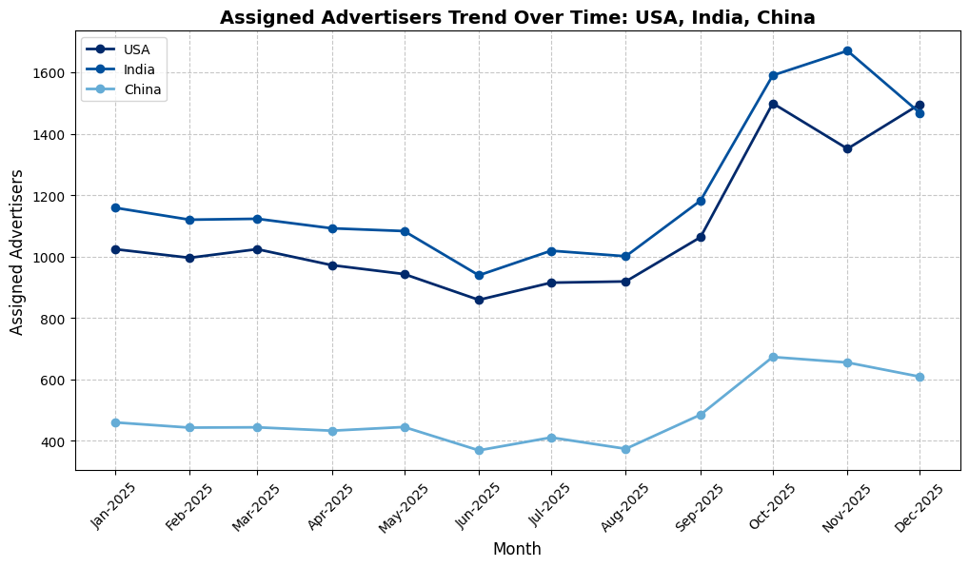
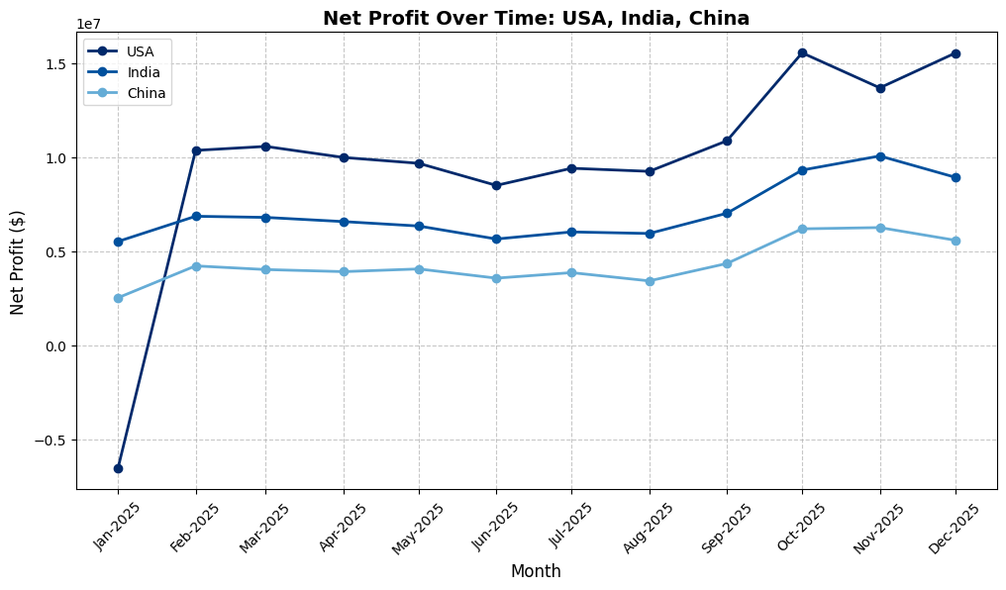
1. Statement of Problem
2. Study Design & Method
3. Data Analysis
4. Discussion
5. Recommendation
6. Conclusion
Data Analysis - Visualization
Model’s Seasonality and Sensitivity
Seasonality - Assigned Advertisers of Selected Countries
Sensitivity - Net Profit Trend of Selected Countries
8

Slide 9
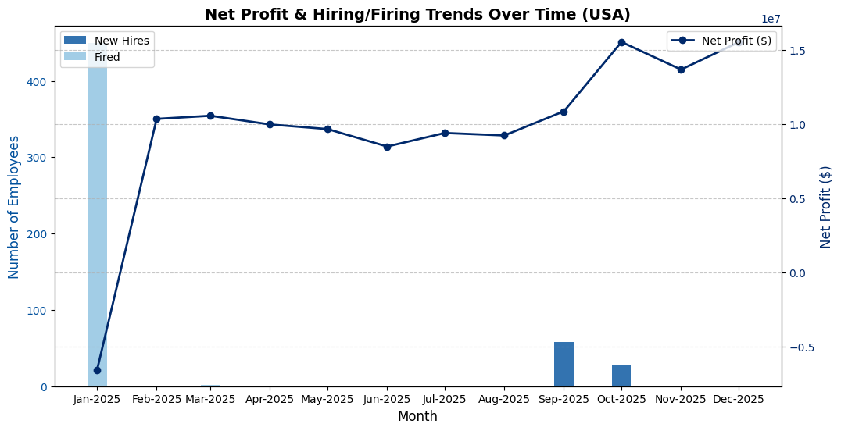
1. Statement of Problem
2. Study Design & Method
3. Data Analysis
4. Discussion
5. Recommendation
6. Conclusion
Data Analysis - Visualization
USA Focus Analysis
Net Profit Stability vs. Workforce Adjustments: Firing can be a strategy to sustain profitability
9

Slide 10
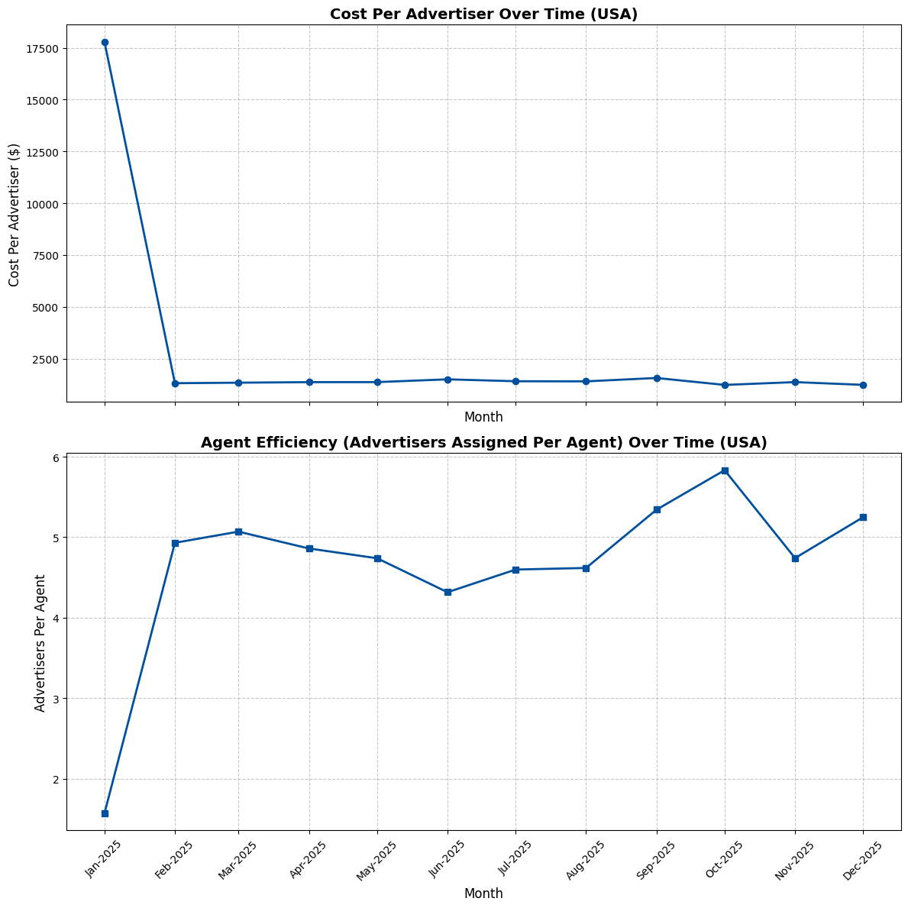
1. Statement of Problem
2. Study Design & Method
3. Data Analysis
4. Discussion
5. Recommendation
6. Conclusion
Data Analysis - Visualization
Personnel Efficiency Analysis
Cost and Agent Efficiency
1. Cost Per Advertiser:
Operational costs are well-aligned with advertiser volume, ensuring a balanced spend-to-revenue ratio.
2. Agent Efficiency:
The number of advertisers per agent remains within a consistent range, suggesting an optimized workload distribution. This consistency prevents overloading agents while ensuring that advertisers receive adequate support.
No major spikes or dips in cost per advertiser or agent efficiency, reinforcing the idea that the US market operates with strategic cost control and resource management.
10
Notes:
1. Cost Per Advertiser The cost per advertiser remains relatively stable, indicating that operational costs are well-aligned with the number of advertisers. No extreme fluctuations, meaning there is an efficient balance between spending and revenue generation. 2. Agent Efficiency (Advertisers Per Agent) The number of advertisers per agent remains within a consistent range, suggesting an optimized workload distribution. This consistency prevents overloading agents while ensuring that advertisers receive adequate support. => No major spikes or dips in cost per advertiser or agent efficiency, reinforcing the idea that the US market operates with strategic cost control and resource management.

Slide 11
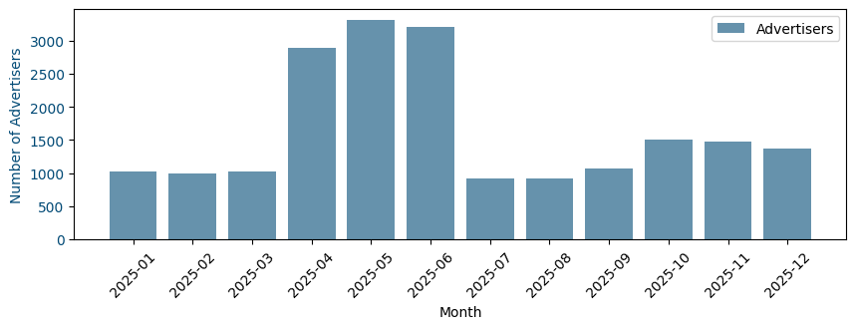
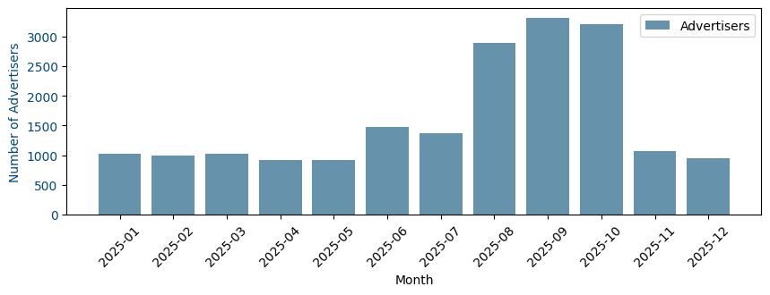
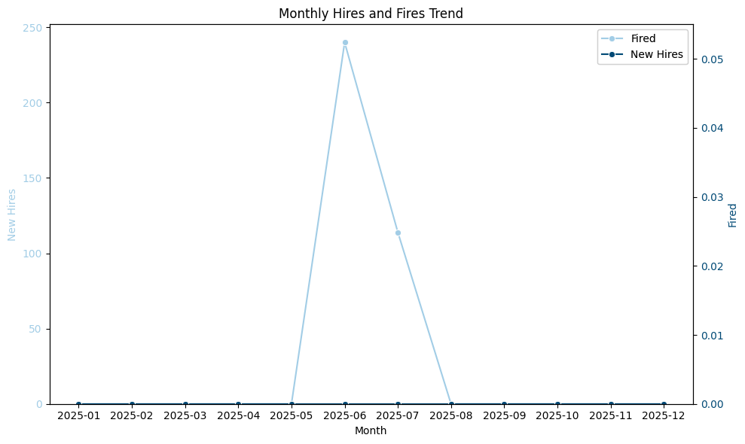
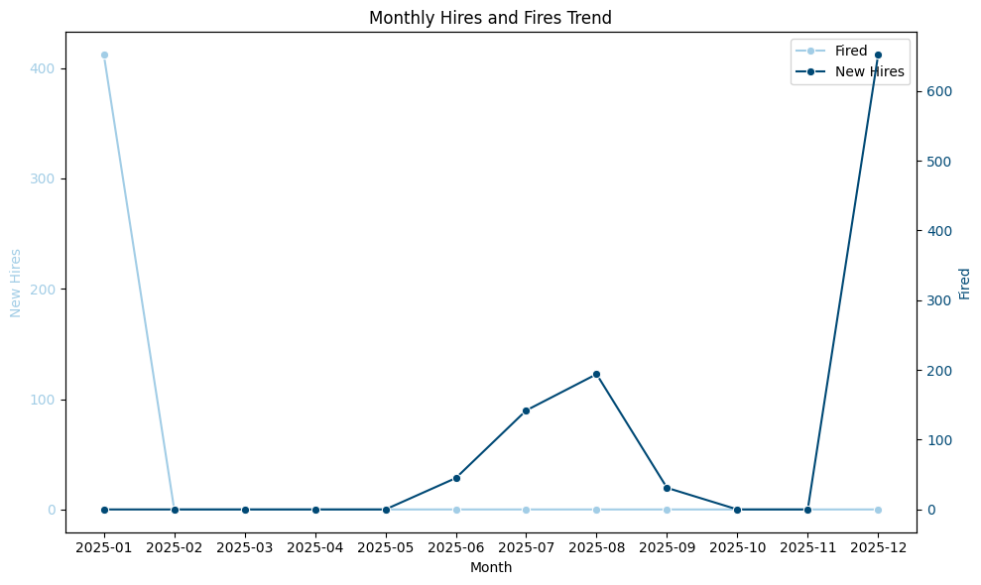
1. Statement of Problem
2. Study Design & Method
3. Data Analysis
4. Discussion
5. Recommendation
6. Conclusion
Discussion - Sensitivity Analysis
Same Annual Total, Different Monthly Distribution → Different Strategy
Scenario A - Mid-Year Peak
Scenario B - Late Year Peak
11

Slide 12
1. Statement of Problem
2. Study Design & Method
3. Data Analysis
4. Discussion
5. Recommendation
6. Conclusion
Discussion - Sensitivity Analysis
Trade-off Between Idle Cost and Re-Hiring Cost
Comparison
Action
Impact
Sensitive to demand changes, it will hire and fire agents frequently
Leading to higher costs and risks
Insights
High Sensitive Model
Our model avoids frequent hire/fire actions due to minor monthly changes.
It takes a low-sensitivity, comprehensive approach based on seasonality and long-term trends to minimize total costs.
Less sensitive to demand changes, it tends to keep a certain number of agents on standby
Ensuring service quality and avoiding waiting costs
Low Sensitive Model
12

Slide 13
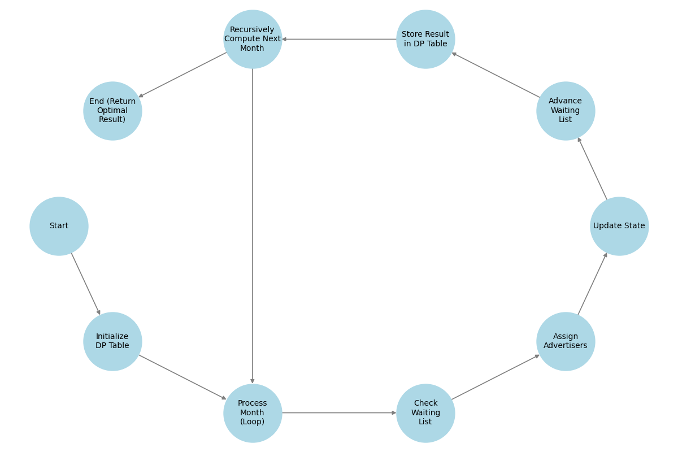
1. Statement of Problem
2. Study Design & Method
3. Data Analysis
4. Discussion
5. Recommendation
6. Conclusion
Recommendation
Dynamic Programming (DP) Algorithm
Validation of Previous LP Model
Introducing Hire/Fire Limits
Consistent Findings with Previous LP Model
State keeps track of:
Number of active agents
Advertisers waiting to be assigned
Advertisers currently being serviced
Decisions on each month:
How many agents to hire/fire
How many arriving or waiting advertisers to assign
State Transitions (Month t → t+1)
The training pipeline end for newly hired agents.
Advertisers in service progress one month further.
The waiting queue ages by one month.
Costs and revenues are realized.
13

Slide 14
1. Statement of Problem
2. Study Design & Method
3. Data Analysis
4. Discussion
5. Recommendation
6. Conclusion
Two-Stage Optimization can solve some limitations
An alternative way
Stage 1
Optimal yearly staffing plan
Maximize revenue
Stage 2
Decide advertisers to assign
minimize waiting time
Current
Data
Real advertiser sign-ups
observed each month
Motivation & Purpose
Limited data can cause inaccurate demand forecasts.
Decision made before knowing exact future demand. & Trade-off between short-term (waiting time) and long-term (revenue).
Approach
Stage 1 (Strategic Staffing): Plan monthly agent numbers over 12 months to maximize revenue under uncertainty.
Stage 2 (Adaptive Assignment): Assign actual incoming advertisers to minimize wait and maximize uplift (prioritize high-budget).
Increase forecast accuracy, more adaptive and responsive.
Maximizes returns by focusing on high-value advertisers.
Advantages
More complex: Requires real-time/near real-time data and computational resources.
Implementation demands accurate, up-to-date data management.
Challenges
14

Slide 15
1. Statement of Problem
2. Study Design & Method
3. Data Analysis
4. Discussion
5. Recommendation
6. Conclusion
Conclusion
A well-balanced approach is proposed to solve the limitations
1
Google’s dedicated advertising agents enhance advertiser success by offering personalized support, optimizing budget allocation, and improving campaign performance.
2
A flexible staffing strategy is implemented to adjust to advertiser demand fluctuations.
3
We aimed to minimize staffing costs while ensuring timely advertiser support.
4
The model is highly sensitive to initial agent staffing, impacting early-month firing costs.
5
We proposed a Two-Stage Optimization, A proposed enhancement involves separating strategic long-term staffing from real-time advertiser assignment,
6
An alternative DP model was developed to validate the LP results.
15

Slide 16
1. Statement of Problem
2. Study Design & Method
3. Data Analysis
4. Discussion
5. Recommendation
6. Conclusion
Appendix
Assumptions
We define that an advertiser qualifies for Google’s agent support if their annual budget exceeds a country-specific threshold. Advertisers that do not meet this criterion are excluded.
We define that each Google agent can concurrently manage up to 10 advertisers.
Advertisers unassigned after 60 days are automatically removed from the waiting pool.
If agent capacity is available, an agent is assigned.
If no agent capacity is available, the advertisers waits up to 60 days in the pool.
New hires need 1 month to become operational.
Terminations require 1 month’s notice before taking effect and firing an agent will incur a cost of 40% of the agent’s annual salary.
Additional Assumption for Our Model:
The first key assumption is the revenue uplift from providing agent support to eligible advertisers. We model this uplift using a probability distribution based on the varying levels of advertisers’ responses given in the problem set. We calculate the weighted average of the outcome using the formula below to get an expected revenue uplift of 13.5%. This represents that advertisers receiving support are expected to increase their annual advertising budget by 13.5%, on average.
Expected Uplift=∑(Uplift Percentage×Probability)
The second additional assumption is that advertisers graduate exactly 2 months after being assigned to an agent. According to the original information from the problem set, advertisers receive support for 60 days before graduating. We assume that all months have 30 days for simplicity and consistency with other time assumptions: such as the 1-month ramp-up time for new hires and the 1-month notice period for firing agents.
The third assumption is that Google only hires or fires agents on the first day of each month. In addition, Google can only choose to hire agents or only choose to hire on that day. Google can’t fire and hire agents simultaneously. This constraint ensures that staffing adjustments are mutually exclusive within a given month. The exclusivity of hiring and firing decisions also simplifies the model by preventing overlapping actions that could complicate the optimization process.
Our last additional assumption is to have a waiting cost penalty. The penalty represents the opportunity cost incurred when advertisers are left waiting in the pool for agent support. When advertisers are not assigned to an agent promptly, they may delay their advertising spend, leading to potential revenue loss for Google. This penalty quantifies the financial impact of delayed support and is a critical component of the optimization model. The waiting cost penalty is calculated based on the number of advertisers waiting in the pool (W[m]), their average monthly budget, and the expected revenue uplift from the third key assumption. Here is the formula we use:
Waiting Cost Penalty=W[m]×[(Average Budget/12)*Expected Uplift]
Where:
W[m]: Number of advertisers waiting in the pool in month m
Average Budget: The average annual advertising budget of eligible advertisers.
Average Budget/12: The average monthly budget of an advertiser
Expected Uplift: The expected revenue uplift (13.5% or 0.135)
16

Slide 17
1. Statement of Problem
2. Study Design & Method
3. Data Analysis
4. Discussion
5. Recommendation
6. Conclusion
Appendix
Objective and Decision Variables
The objective of the optimization model is to minimize the total cost associated with agent staffing while ensuring timely support for advertisers.
The total cost includes the following components:
Agent Salaries: The monthly cost of maintaining the available agents.
Firing Costs: The cost incurred when firing agents, which is 40% of their annual salary.
Revenue Uplift: The expected increase in advertising spend from advertisers who receive support.
Waiting Cost Penalty: The opportunity cost of advertisers waiting in the pool without support.
The objective function is formulated as follows:
Minimize: Σₘ(A[m]×monthly salary+F[m]×firing cost−S[m]×revenue uplift+W[m]×waiting cost penalty)
Our optimization model employs several decision variables to dynamically manage agent staffing and advertiser support over time. These variables are central to the model's ability to balance costs, agent capacity, and advertiser demand. These decision variables include:
Available Agents (A[m]): The number of agents available to support advertisers in month m
New Hires (N[m]): The number of agents hired at the beginning of the month m
Fired Agents (F[m]): The number of agents fired at the beginning of the month m
Assigned Advertisers (S[m]): The number of advertisers assigned to agents in month m
Waiting Advertisers (W[m]): The number of advertisers in the waiting pool in month m
Dropped Advertisers (D[m]): The number of advertisers removed from the waiting pool after 60 days without support
Graduated Advertisers (G[m]): The number of advertisers who complete their 60-day support period and free up agent capacity in month m
17

Slide 18
1. Statement of Problem
2. Study Design & Method
3. Data Analysis
4. Discussion
5. Recommendation
6. Conclusion
Appendix
Constraints
Waiting Pool Dynamics (W[m])
W[m] = W_prev + advertiser_data['Advertisers'][m] - S[m] - D[m]
W[m] represents the number of advertisers in the waiting pool at month m.
W_prev is the waiting pool from the previous month.
advertiser_data['Advertisers'][m] is the number of new advertisers arriving in month m.
S[m] is the number of advertisers assigned to agents in month m.
D[m] is the number of advertisers dropped from the waiting pool in month m
W[m] >= 0
Dropped Advertisers (D[m])
if m >= 2: prob += D[m] == W[m-2] else: prob += D[m] == 0
Graduated Advertisers (G[m])
if m >= 2: prob += G[m] == S[m-2] else: prob += G[m] == 0
Hiring/Firing Constraints (N[m], F[m])
prob += N[m] <= A[m]
N[m] represents the number of agents hired in month m.
A[m] represents the total number of agents available in month m.
*The number of agents hired cannot exceed the total number of agents available.
prob += F[m] <= A[m]
F[m] represents the number of agents fired in month m.
*The number of agents fired cannot exceed the total number of agents available.
Required Agents Capacity (A[m])
prob += A[m] * 10 >= S[m] + S_prev
Agent Availability Dynamics (A[m+1])
if m < n_months - 1: prob += A[m+1] == A[m] + N[m] - F[m]
Total Agent Count (T[m])
if m == 0: prob += T[m] == A[m] + N[m] else: prob += T[m] == T[m-1] + N[m] - F[m-1]
*T[m] represents the total number of agents either able to support clients or agents that are not able to support clients.
18

