Slide 1
How to Measure Robustness
A formal approach
Changjian (CJ) Zhang
Eunsuk Kang
David Garlan
Carnegie Mellon University

Slide 2
Agenda
Research Problem
Motivation Example & Overview
Approach In Details
Discussion

Slide 3
Research Problem

Slide 4
What is Robustness?

Slide 5
What is Robustness?
IEEE definition:
The degree to which a system or component can function correctly in the presence of invalid inputs or stressful environmental conditions.
Robust control:
In control theory, robust control is an approach to controller design that explicitly deals with uncertainty.
Other fields…

Slide 6
How to measure Robustness?
In other disciplines, there are widely accepted robustness measures and on-going research on it.
Robust control in control theory
Robust statistics in statistics
Robustness measures in computer networks
Robustness metrics in mechanical design
… (by simply Google it)
What about software?
Unlike other quality attributes (e.g., performance, availability), no widely used measures.
The context matters!

Slide 7
The Source and Goal
A robust system should function correctly with erroneous input or environment.
A robust ML algorithm should have similar performance on datasets other than the training set (i.e., not prone to overfitting).
A robust scheduling algorithm should generate suboptimal scheme which is not sensitive to stochastic disturbances.
…
Important to set up the CONTEXT!
Notes:
The source and goal concepts are similar to the six dimensions of quality attributes proposed by SEI. Here, we simplify it and only focus on the stimulus (source) and the expected reaction of the system.

Slide 8
Research Questions
How to measure the system capability to deal with uncertainty in environment to ensure correct function?
What’s the formal definition of “correct” function?
What’s the representation of uncertainty in the environment?
How to measure capability?
How to define such a measure?
How to compare the capability of two systems?
Notes:
In other domain, there are formal definitions of robustness

Slide 9
Motivation Example & Overview

Slide 10
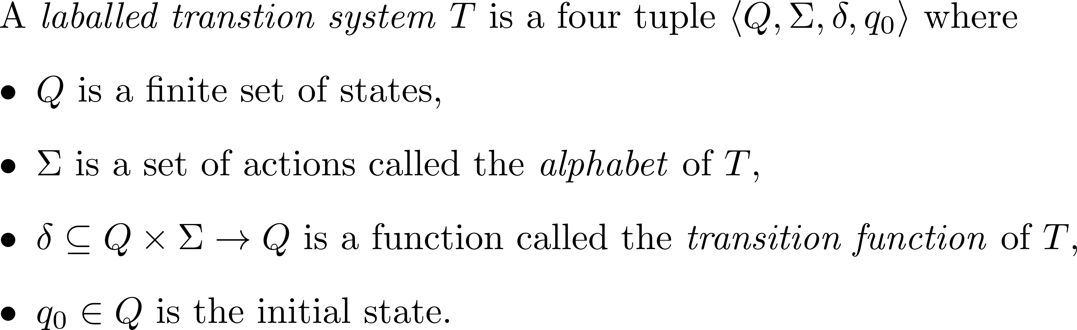
Background
We use labelled transition systems to model the behavior of systems and environments.

Slide 11
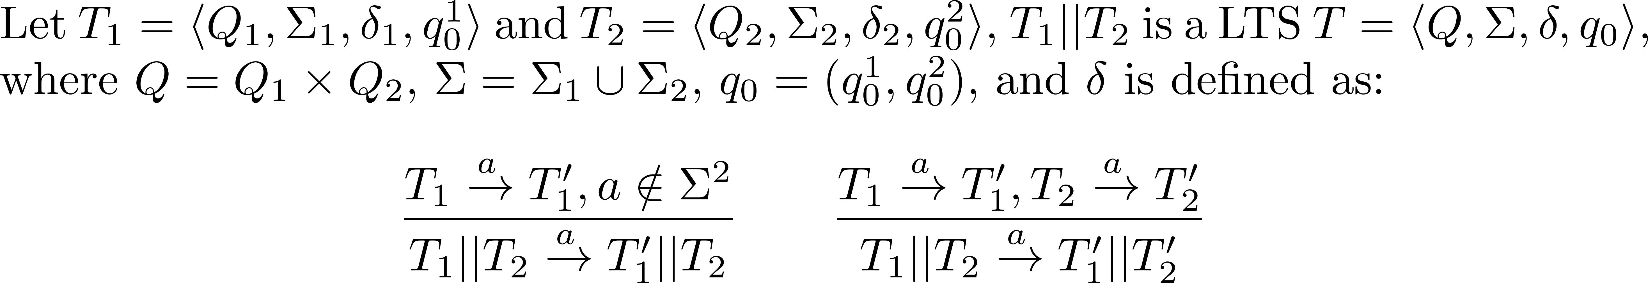
Background
We use parallel composition to model multiple concurrent LTSs.
Parallel composition “||” is an operator that combines behavior of two LTSs by synchronizing common actions and interleaving the remaining actions.

Slide 12
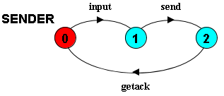
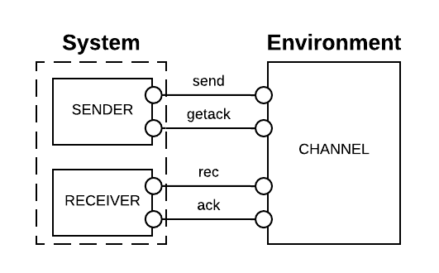
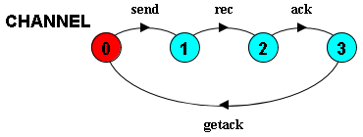
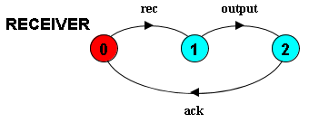
Motivation Example
Notes:
In the diagrams above, state 0 is always the initial state

Slide 13
The “correct” function
Informally, in a system
bad things should not happen, and
good things should eventually happen.
Formally, the correct function is a combination of safety and liveness properties.
Notes:
Limitations:
A safety property is restricted to the form of LTSA property.
We consider deadlock-free to be the weakest form of liveness, i.e., the system should not be stuck at some step.
I will use “correct” in this presentation for simplicity, but it means the system should satisfy the given safety properties and be deadlock-free.

Slide 14
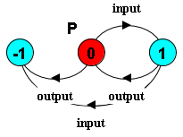

Safety Property
A safety property P is a deterministic LTS which defines the acceptable behavior over the alphabet of P.
E.g., assert that the input and output events should alternate, we have:
-1 is the error state. When the system reaches this state, the safety property is violated

Slide 15



Liveness Property - Deadlock
In LTS, a system is deadlock when it reaches a state where no outgoing transitions can occur.
The system is deadlock since no outgoing transitions can take
A wait-for cycle exists. Because A is waiting to do a; but to do a, B has to do b first.

Slide 16
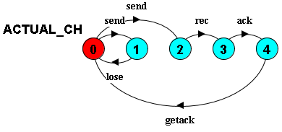
Uncertainty in environment - 1
Messages may be lost in the actual channel.

Slide 17
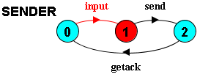
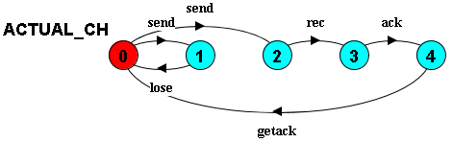
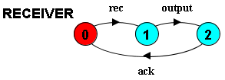
Trace to deadlock
<input>

Slide 18
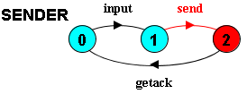
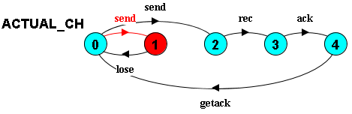
Trace to deadlock
<input, send>

Slide 19

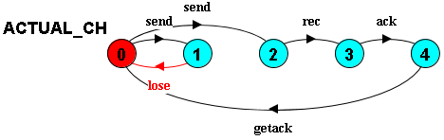
Trace to deadlock
<input, send, lose> DEADLOCK!

Slide 20
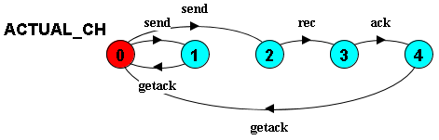
Uncertainty in environment - 2
Instead of lose, the channel acknowledges to the sender immediately after the send.

Slide 21
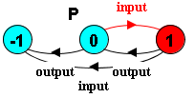
Trace to error state
<input>

Slide 22
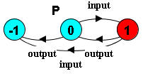
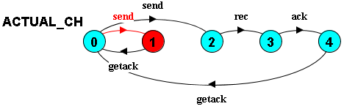
Trace to error state
<input, send>

Slide 23
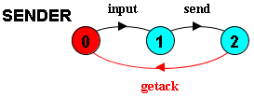

Trace to error state
<input, send, getack>

Slide 24
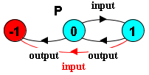
Trace to error state
<input, send, getack, input> ERROR STATE!

Slide 25
Representation of Uncertainty
A system makes assumptions about the environment to ensure “correct” function.
Uncertainty is the additional unexpected behavior in the actual environment in the form of nondeterminism.

Slide 26
Capability to deal with Uncertainty
If the additional behavior of the environment would not cause property violation, we say the system can deal with the uncertainty.
Capability of a system to deal with uncertainty is the additional behavior allowed by the system, that is not in the base environment.
Intuitively, Capability(S) = AllowedEnv(S) – Beh(Env_{base}).
How to generate the maximum allowed behavior of the environment?
How to define the LTS minus operator?

Slide 27
Approach In Details

Slide 28
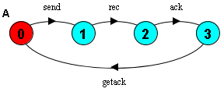
System Assumption
The assumption is the expected behavior of the environment, made by a system, in which the system can ensure the “correct” function.
E.g., to ensure the property, the example system assumes the environment to be:
Other environments would either cause safety property violations or deadlock.

Slide 29
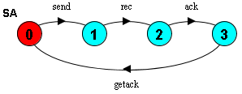
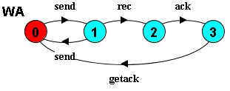
Stronger and Weaker Assumption
Stronger assumption => less allowed behavior of the environment;
Weaker assumption => more allowed behavior of the environment.

Slide 30
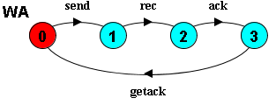
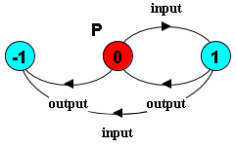
Generating the weakest assumption
Maximum allowed behavior = The weakest assumption
[Dimitra02] already presents an approach to generate the weakest assumption (a minor modification required).
[Dimitra02] D. Giannakopoulou, C. S. Pǎsǎreanu, and H. Barringer, “Assumption generation for software component verification,” in Proceedings - ASE 2002: 17th IEEE International Conference on Automated Software Engineering, 2002, pp. 3–12.

Slide 31
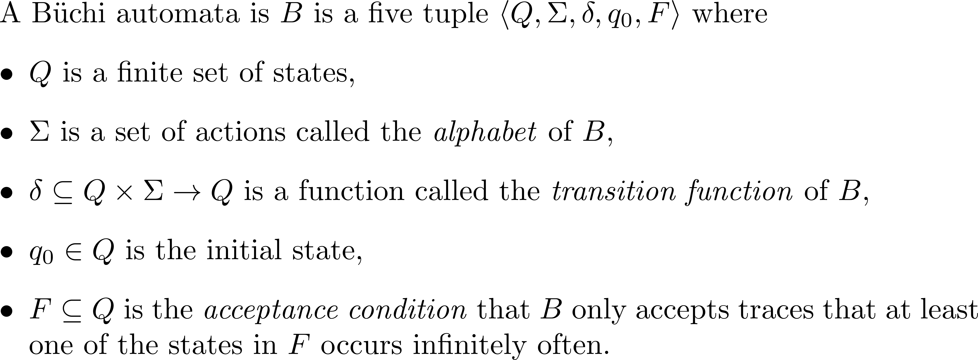
Büchi automata
Reminder: Capability(S) = WeakestAssumption(S) – Beh(Env_{base})
The LTS formalism is not enough, we introduce Büchi automata.

Slide 32
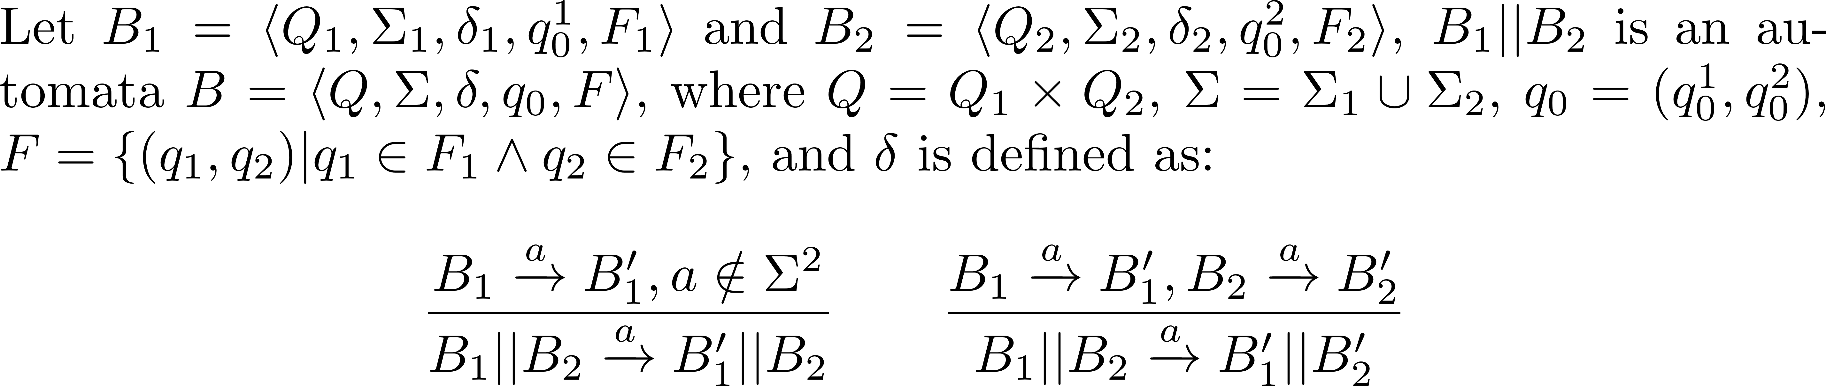
Parallel composition ||
Parallel composition “||” is an operator that combines behavior of two automaton by synchronizing common actions and interleaving the remaining actions.

Slide 33
Negation
Negation is an operator that reverts the acceptance condition of a Büchi automata.

Slide 34
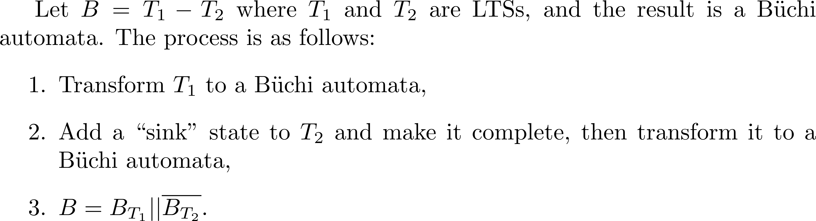
The Minus Operator

Slide 35
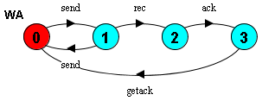
Example
The weakest assumption of a system
The baseline environment
?

Slide 36
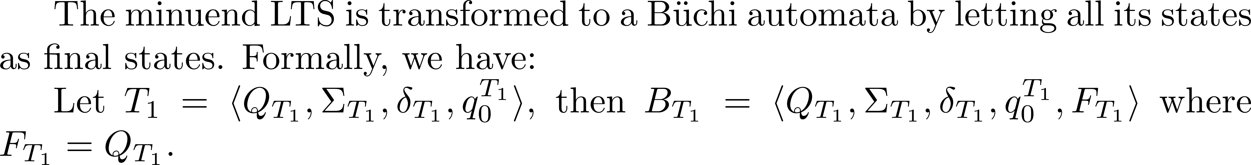
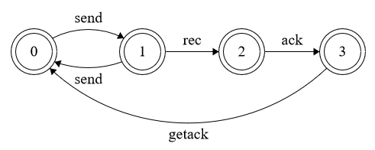
Step 1

Slide 37
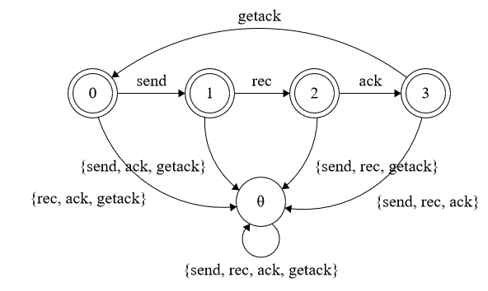
Step 2

Slide 38
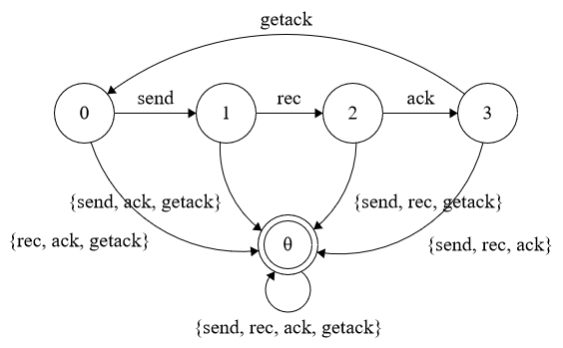
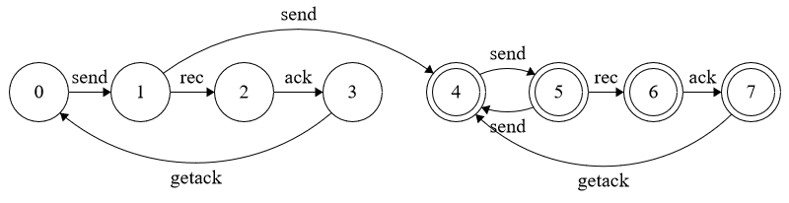
Step 3

Slide 39
Discussion

Slide 40
Potential Applications - 1
Robustness of a Security Protocol against Attacker Models
Robustness of a Human Computer Interface Model against Human Behavior Models
Robustness of a Distributed Protocol against Fault Models
…
Key Insights: How robust is a system when we only have limited information about the environment?

Slide 41
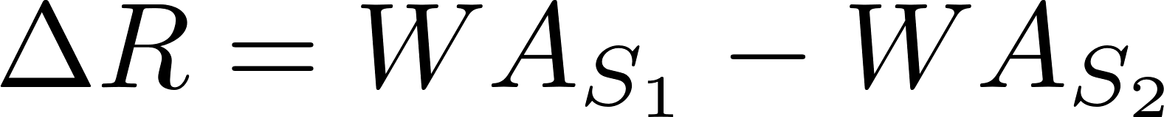
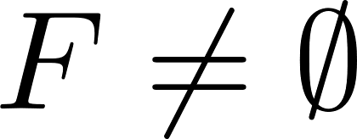
Potential Applications - 2
Compare the robustness of two systems, i.e.,
If the result Büchi automata contains final states, i.e., then S₁ contains additional behavior than S₂.
But, it doesn’t imply S₁ is more robust than S₂!
S₁
S₂
base

Slide 42
Limitations
Our approach is based on LTSA, thus the form of safety property is limited to it.
We only consider deadlock-free as the only liveness property.
The Büchi automata can capture the capability to deal with unceratinty, but it is not a good representation as a metric.

